Slide 1
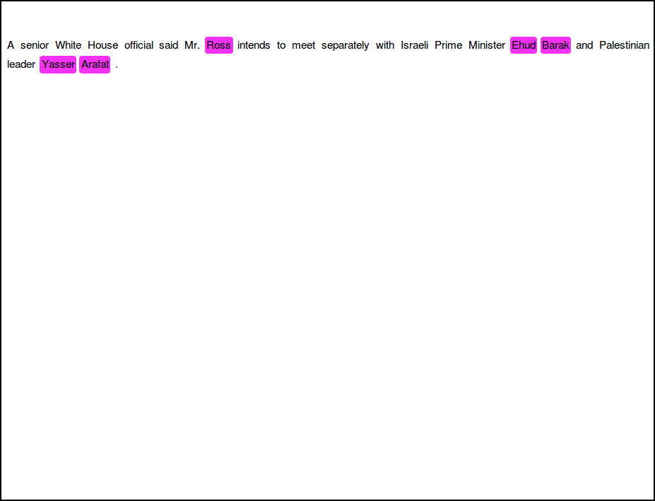
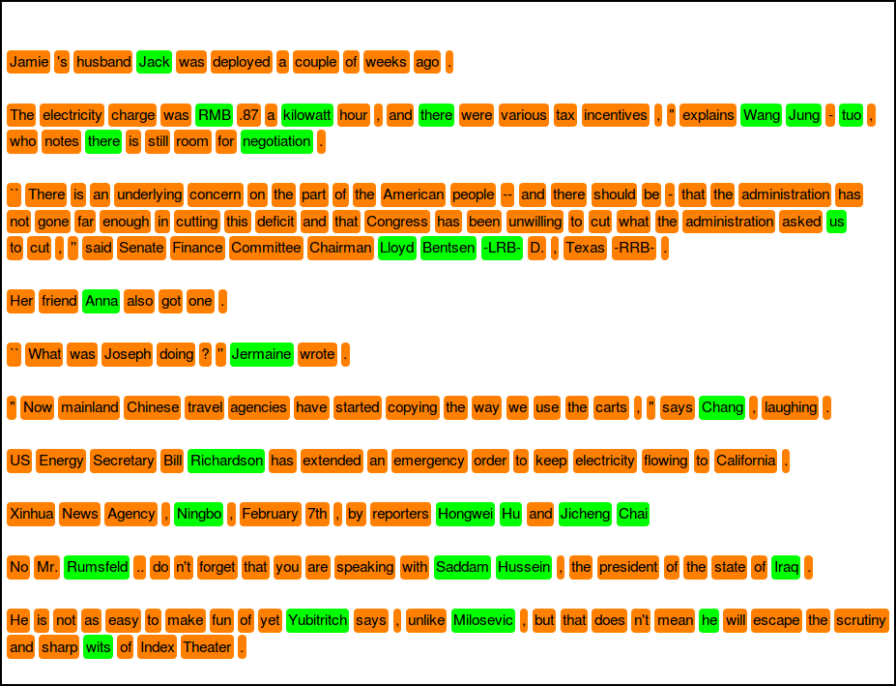
Online learning example
1 marked sentence
Support sentences
Query (test) sentences
Method used: kNN, F1 = 71.70

Slide 2
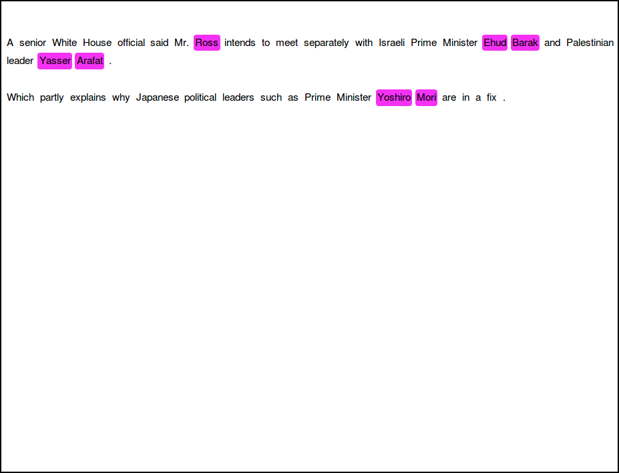

Online learning example
2 marked sentences
Support sentences
Query (test) sentences
Method used: kNN, F1 = 80.00

Slide 3
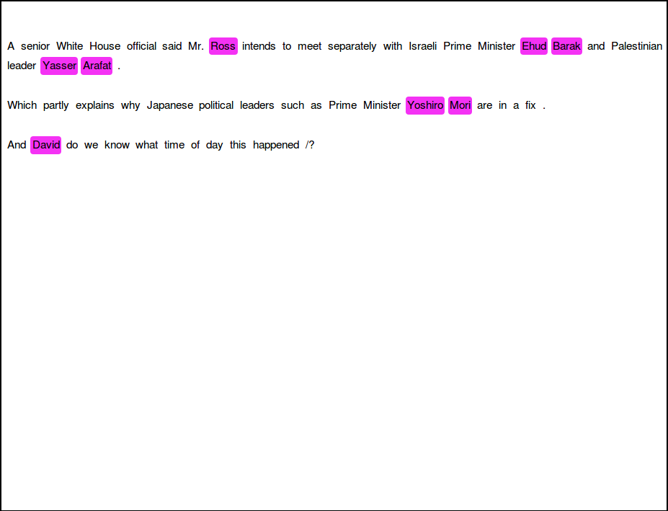
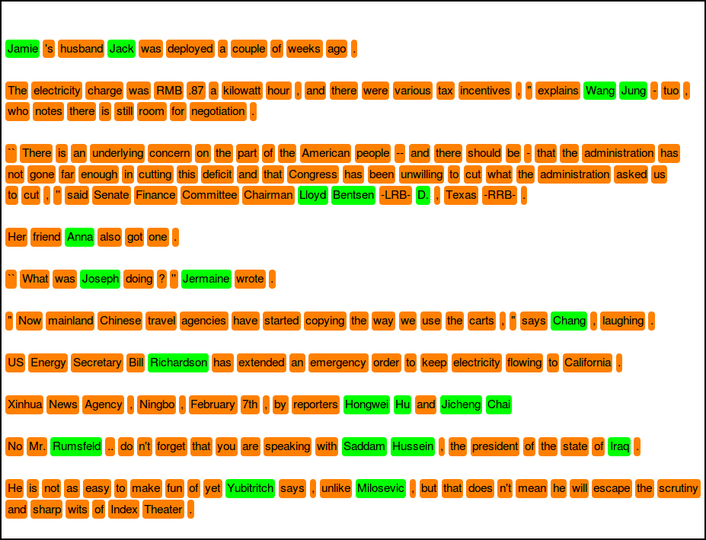
Online learning example
3 marked sentences
Support sentences
Query (test) sentences
Method used: kNN, F1 = 88.89

Slide 4
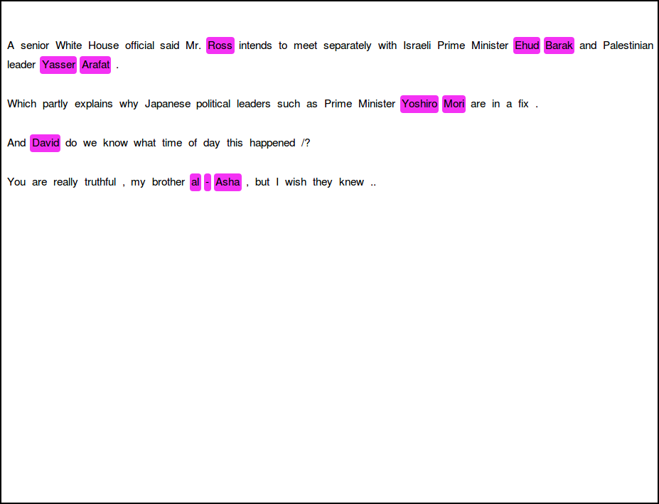

Online learning example
4 marked sentences
Support sentences
Query (test) sentences
Method used: kNN, F1 = 85.71

Slide 5
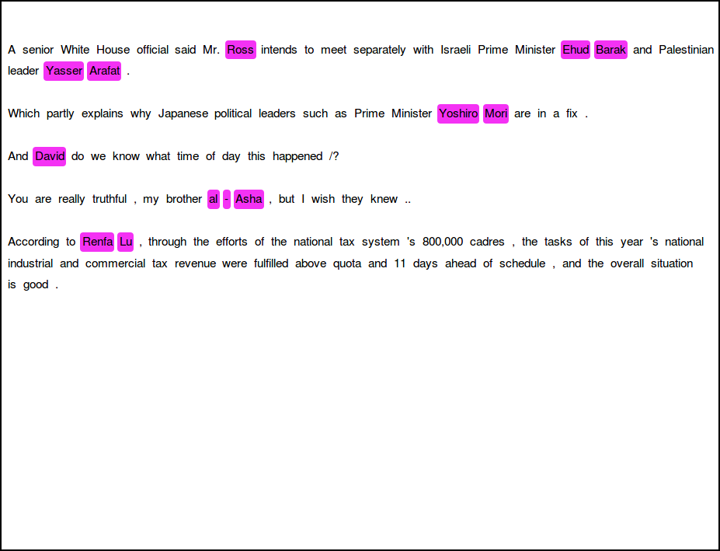
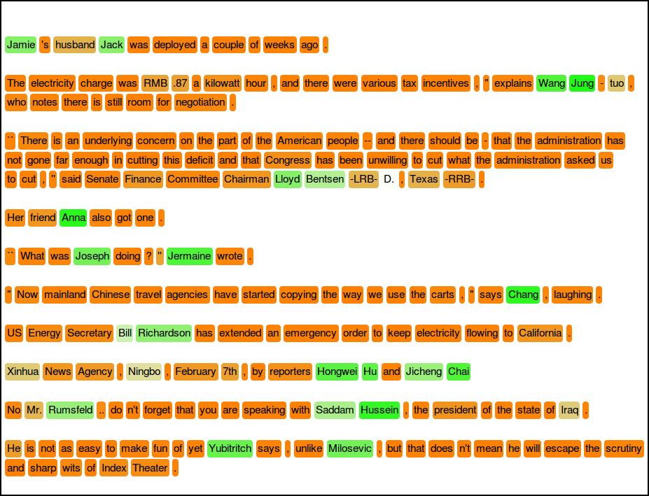
Online learning example
5 marked sentences
Support sentences
Query (test) sentences
Method used: SVM, F1 = 93.33

Slide 6
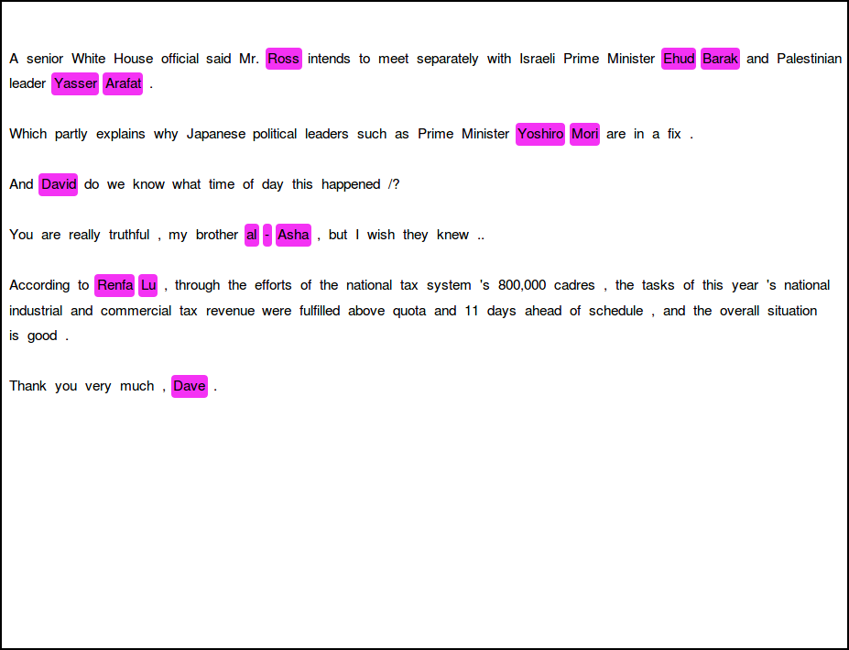

Online learning example
6 marked sentences
Support sentences
Query (test) sentences
Method used: SVM, F1 = 93.33

Slide 7
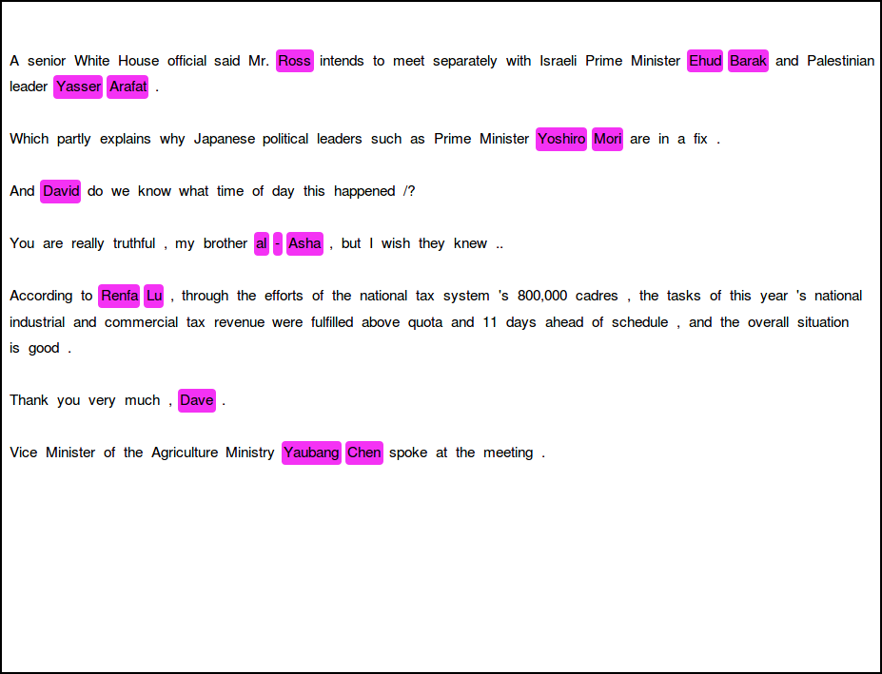
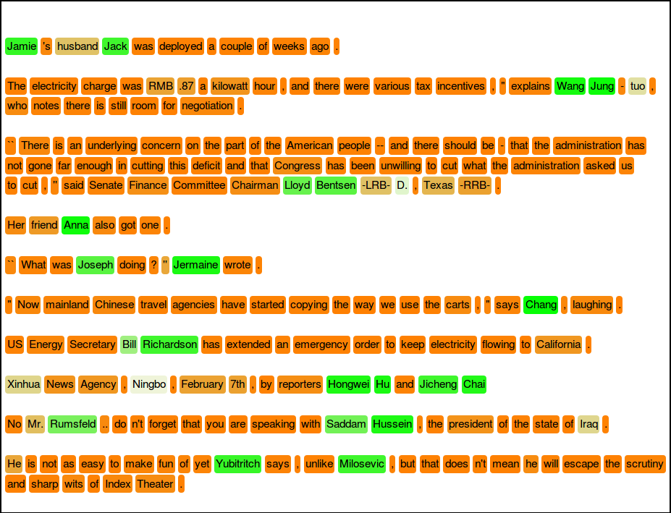
Online learning example
7 marked sentences
Support sentences
Query (test) sentences
Method used: SVM, F1 = 93.33

Slide 8
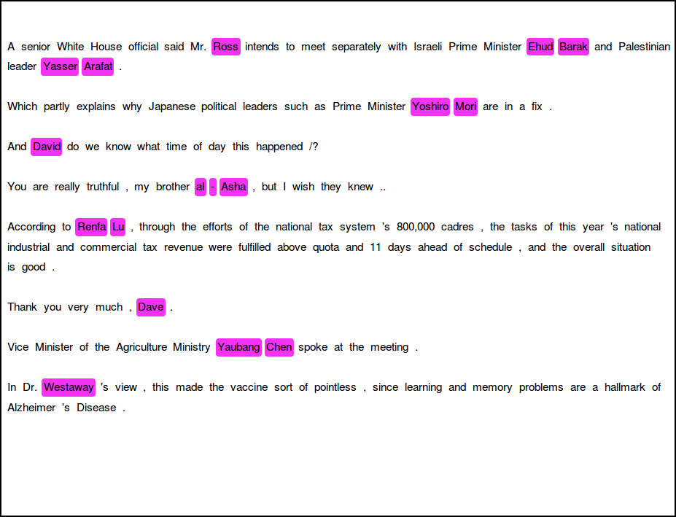
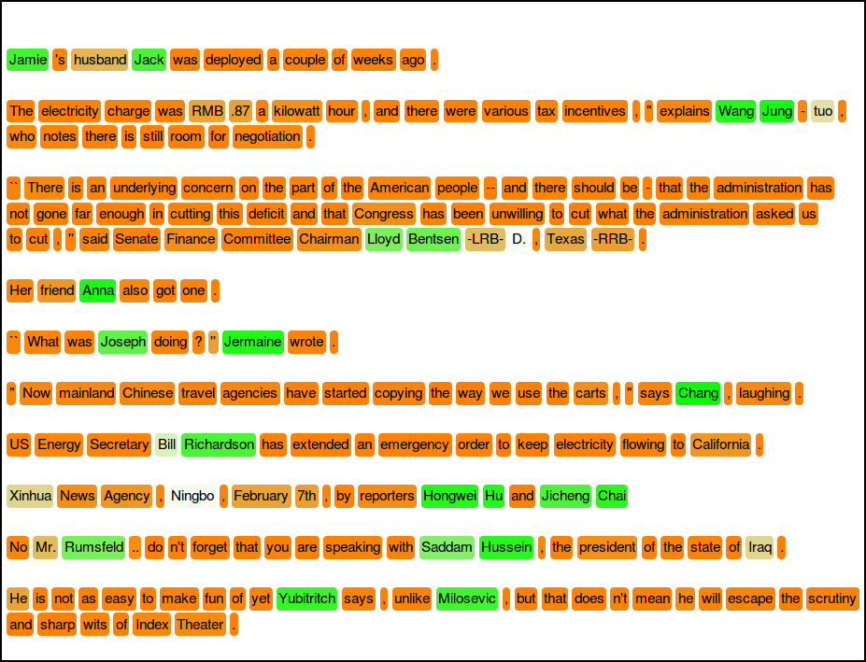
Online learning example
8 marked sentences
Support sentences
Query (test) sentences
Method used: SVM, F1 = 91.30

Slide 9
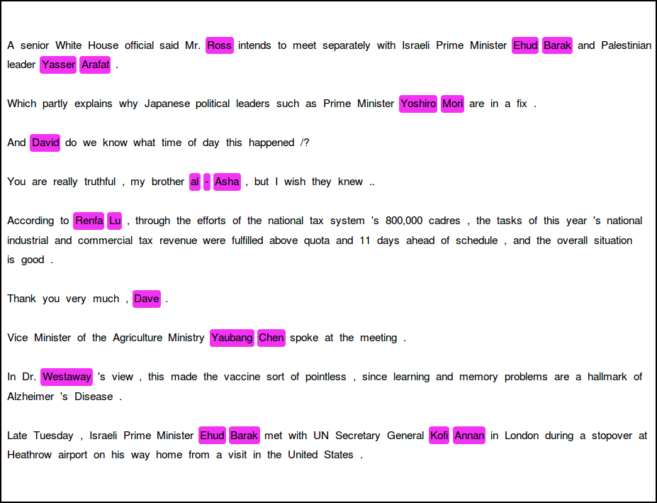
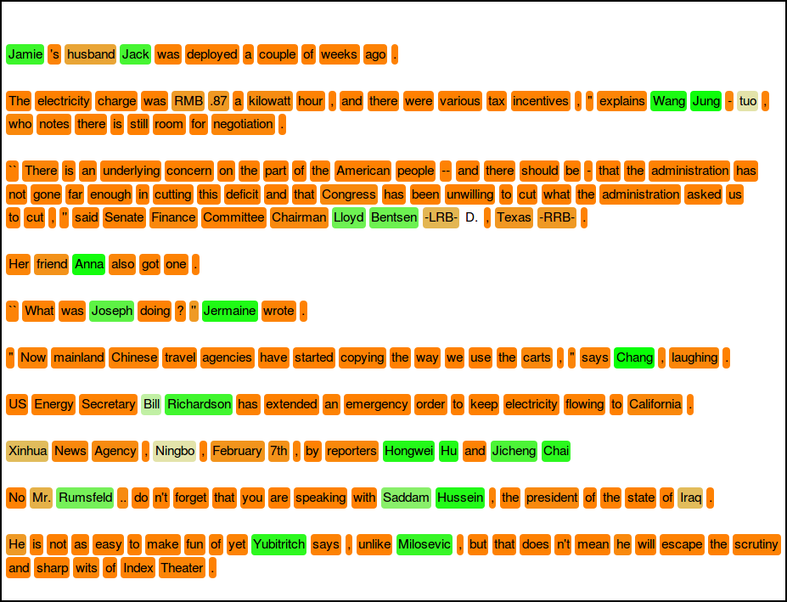
Online learning example
9 marked sentences
Support sentences
Query (test) sentences
Model used: SVM, F1 = 93.33
Number of support sentences: 9

Slide 10
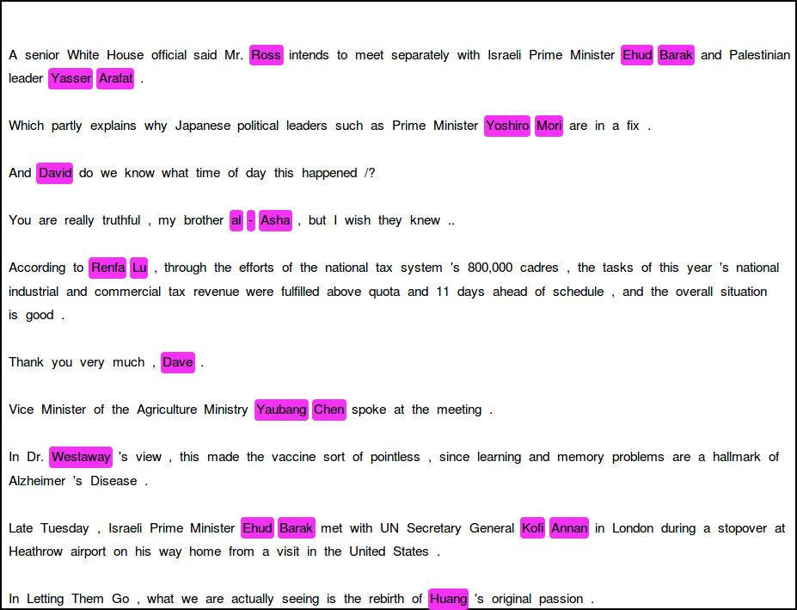

Online learning example
10 marked sentences
Support sentences
Query (test) sentences
Model used: SVM, F1 = 93.33

Slide 11
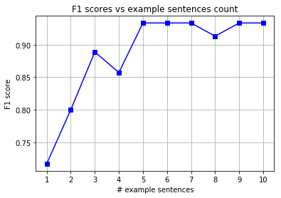
Online learning example

Slide 12
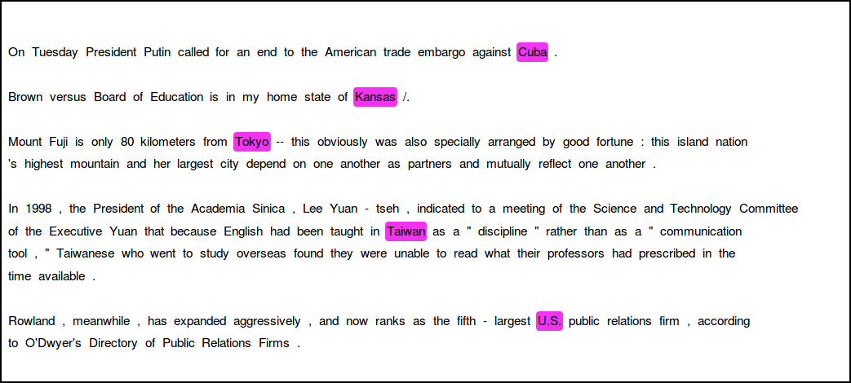
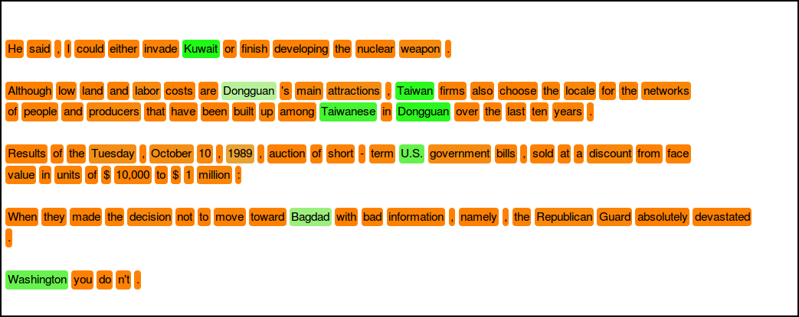
Examples for different entity types
Support sentences for GPE entity:
Query sentences:

Slide 13
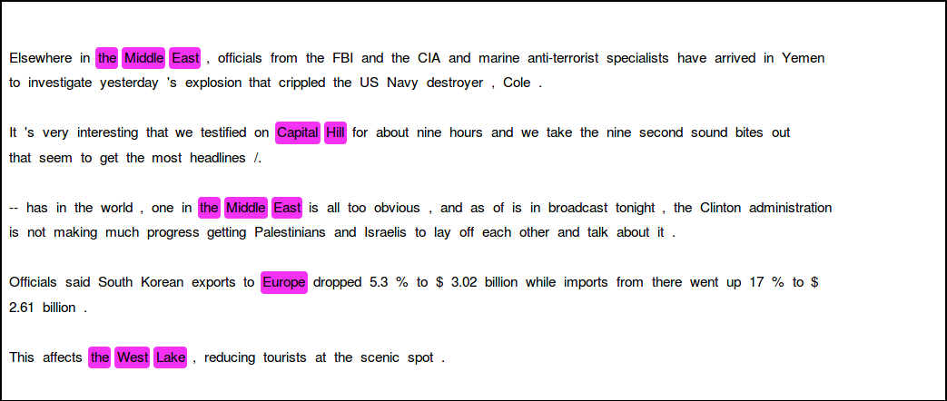
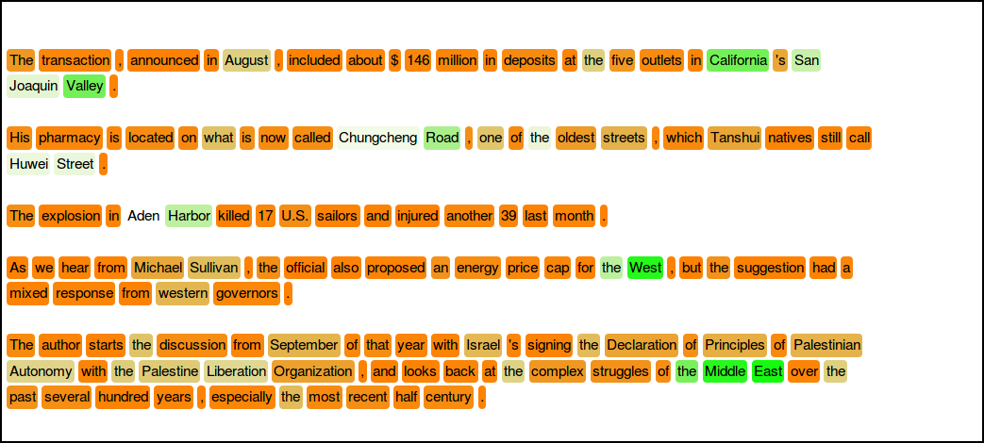
Examples for different entity types
Support sentences for LOC entity:
Query sentences:

Slide 14
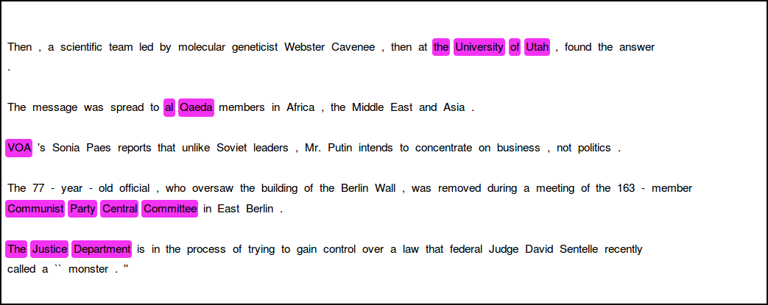
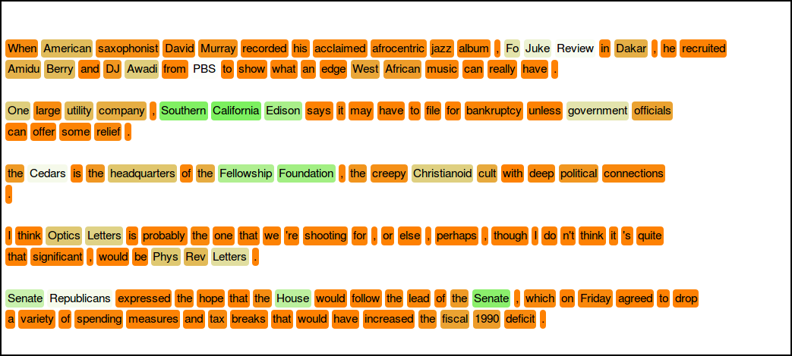
Examples for different entity types
Support sentences for ORG entity:
Query sentences:

Slide 15
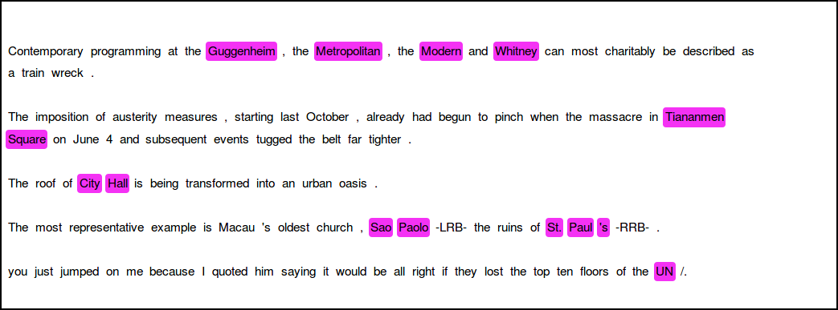
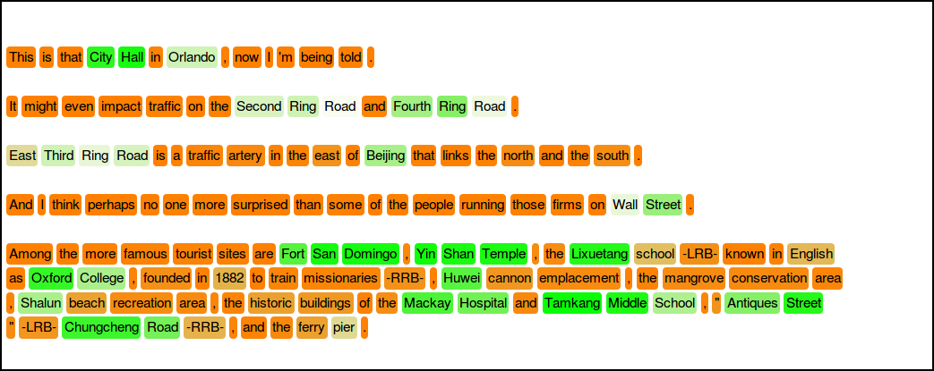
Examples for different entity types
Support sentences for FAC entity:
Query sentences:

Slide 16
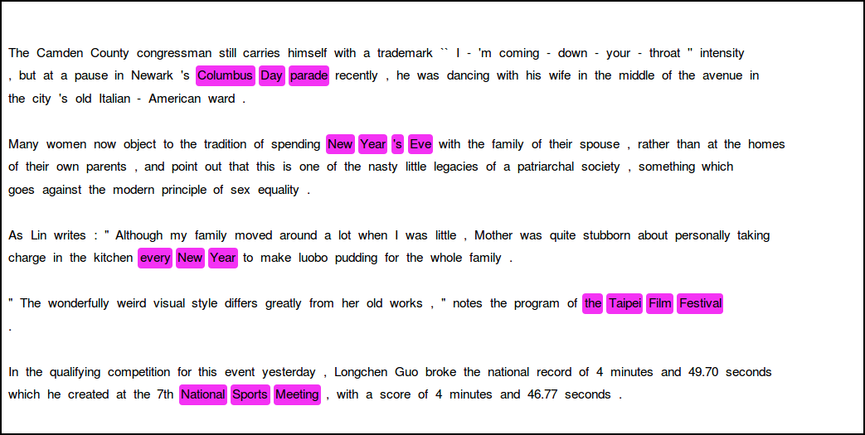
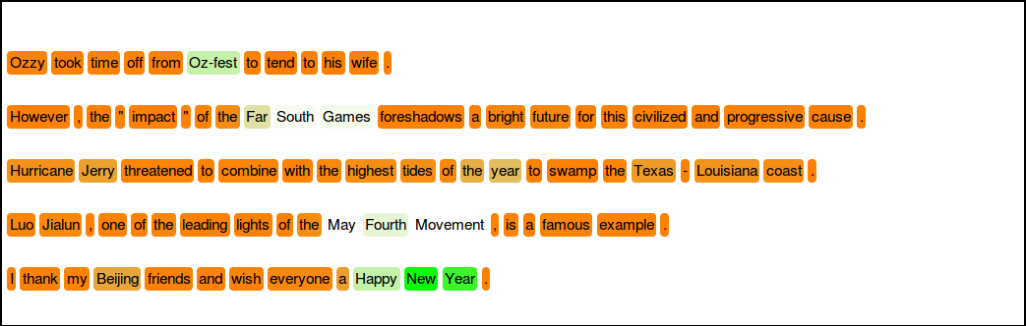
Examples for different entity types
Support sentences for EVENT entity:
Query sentences:

