Slide 1
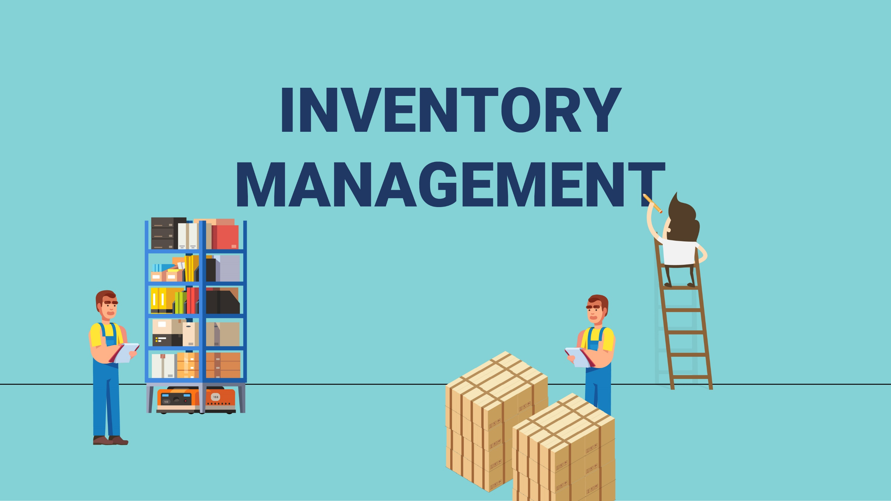

Slide 2
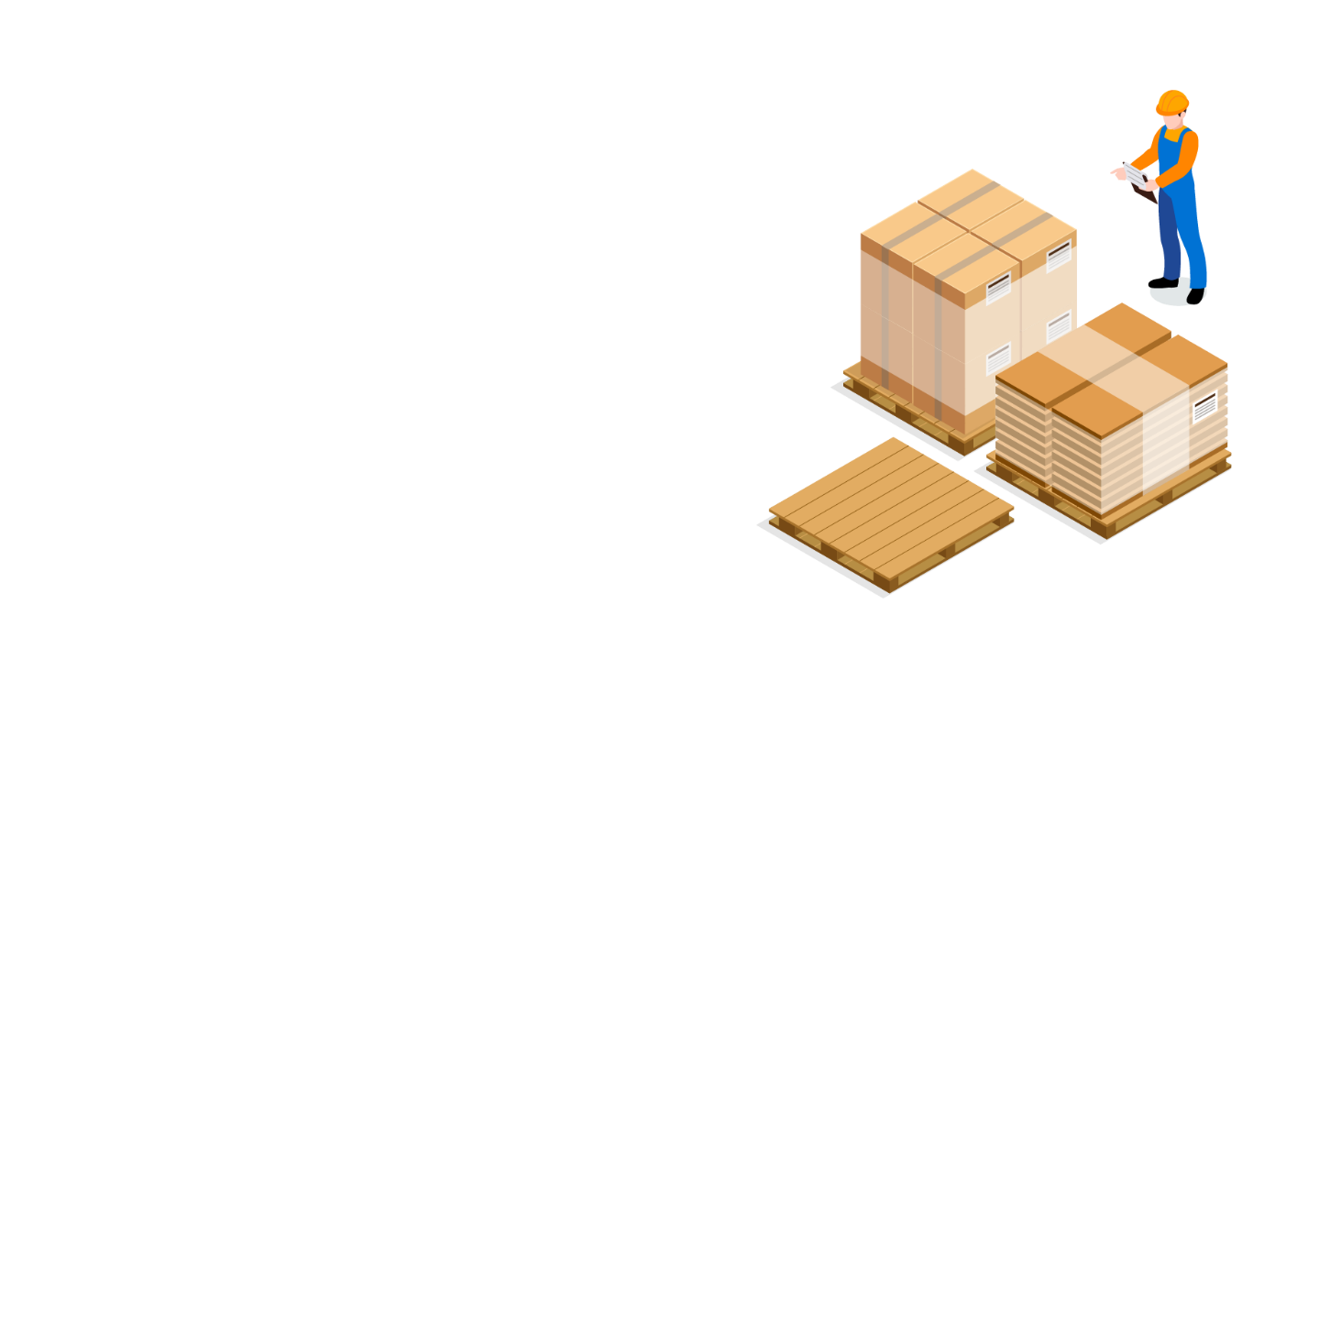
What is Inventory Management?
Inventory management is at the center of all your trading activities.
From buying, selling, and keeping the stock organized; inventory management plays a significant role.

Slide 3

Objective
Hand Held Inventory Management
Users
Shopkeeper
Superstore
Industry

Slide 4






FEATURES:
Stock Summary
Sumarrized all stock with the detail and recent number of stock of particular item.
Update Stock
Add or minus the
particular item quantity.
Sells History
Number of item sold , company name,product name,date & time , total amount.
Company Detail
How much product you sell to any company , for particular company how much profit you generate.
Employee Detail
Employee name,contact number,Email.
Analysis
Analyse profit/lose per month,per company,which product sell more.

Slide 5
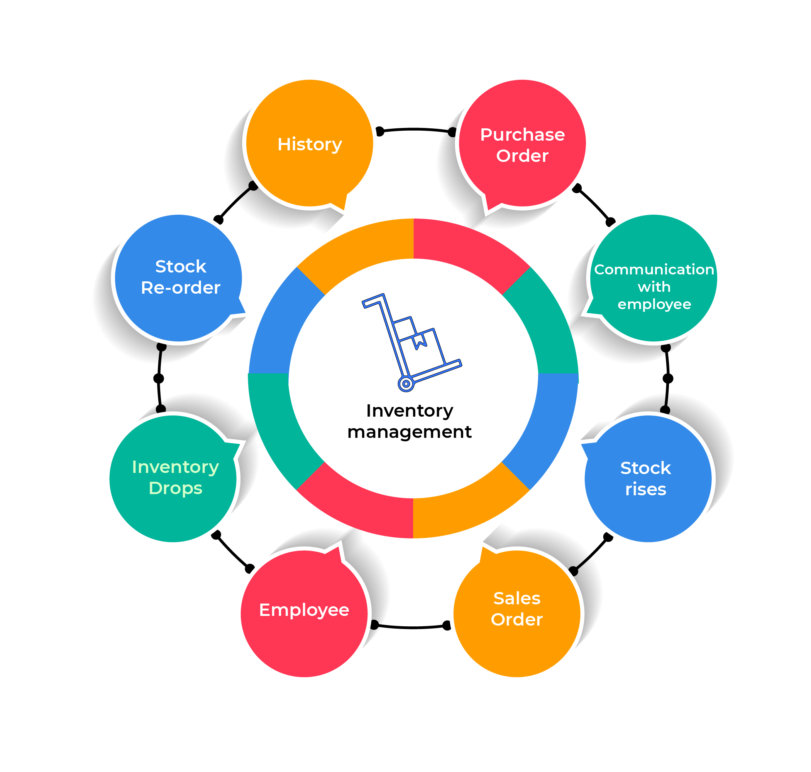

Slide 6
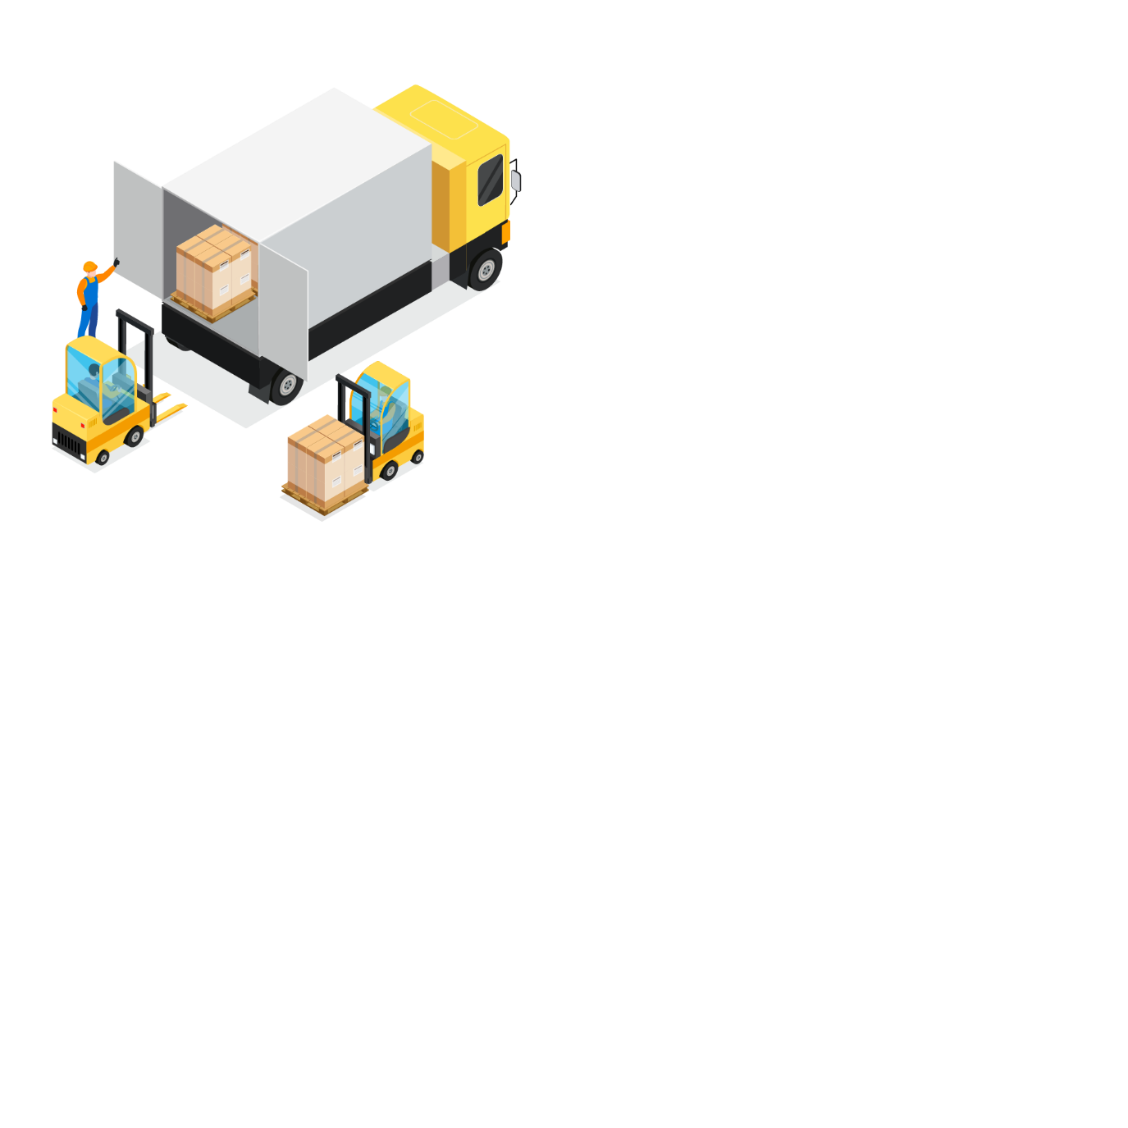
Purpose of Inventory
Enhancing cash flow
Preventing dead stock or perishability
Reducing purchase cost of goods
Maintaining sufficient stock
Optimizing storage cost

Slide 7


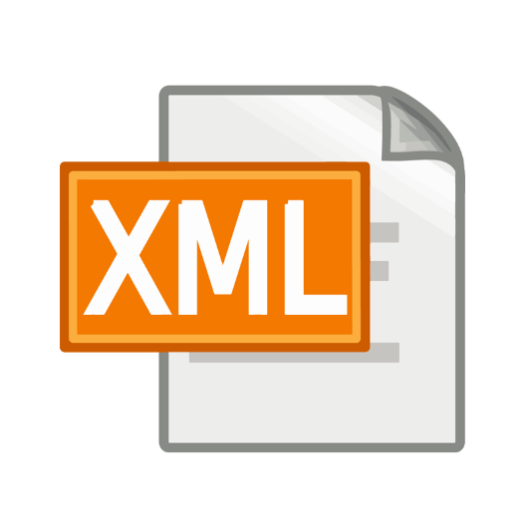

Tools
Languages

