Slide 1


Talex
Prepared by:
Deep Prajapati (18DCE099)
Jenil Savaliya (18DCE106)
Aashray Zaveri (18DCE142)

Slide 2
Index
Introduction
Problem Statement
Motivation
Hardware and Software Requirements
Future Aim
Implementation Screenshot
Resources

Slide 3
Introduction
From stock entries ,stock summaries to employee details and conversing with employee, our app has it all.
All the work that business man and stocks and data manager used to do in tally(except bill making) and in excel can be done by anyone without any prior knowledge of using it.

Slide 4
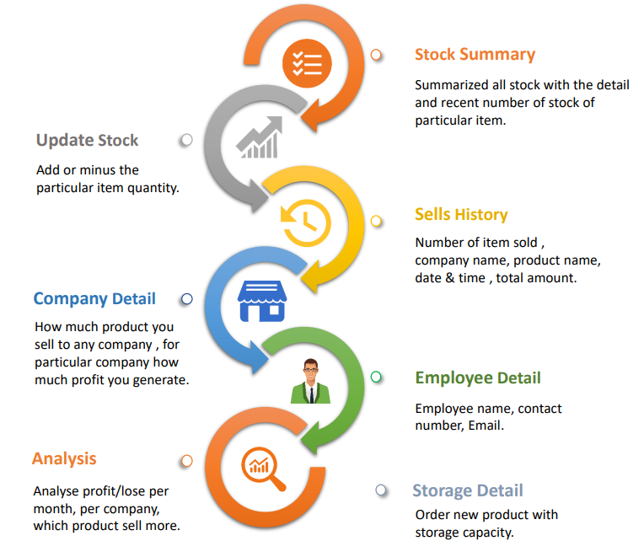
Features

Slide 5
Problem Statement
Faster: The model resides on the device and does not require internet connectivity. Thus, the inference is very fast and has an average latency of only a few milliseconds.
Resource efficient: The model has a small memory footprint on the device.
Privacy-friendly: The user data never leaves the device and this eliminates any privacy restrictions.

Slide 6
Motivation
Often times , if we are a newbies in excel and tally we are not equipped with better knowledge to do what we wish for.
So in order to eradicate the problems for the very new users , we came up with an idea of making an application that would be suitable for users of both.

Slide 7
Hardware and Software Requirements
Hardware Requirements-:
Microsoft Windows 7/8/10 (32-bit or 64-bit)
3 GB RAM minimum, 8 GB RAM recommended (plus 1 GB for the Android Emulator)
2 GB of available disk space minimum, 4 GB recommended (500 MB for IDE plus 1.5 GB for Android SDK and emulator system image)
Software Requirements-:
Android Studio
Firebase

Slide 8
Future Aim
The foremost thing now we will be concentrating upon would be to make this app capable of handling traffic.
payment gateway

Slide 9
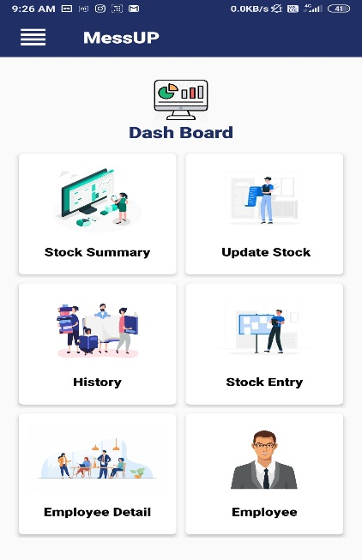
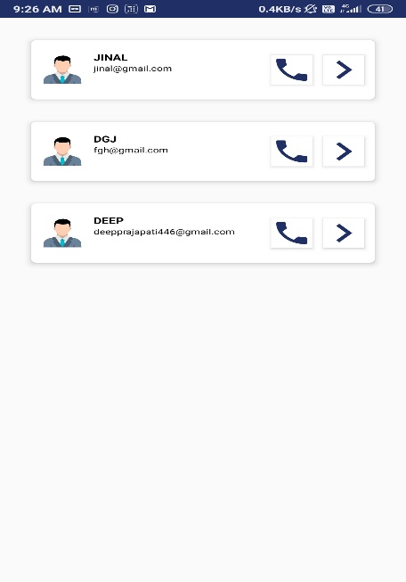
Implementation Screenshot
(Dash Board)
(Employee Details )

Slide 10
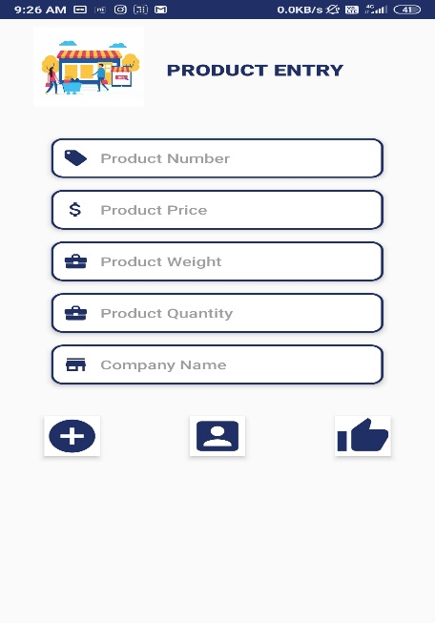
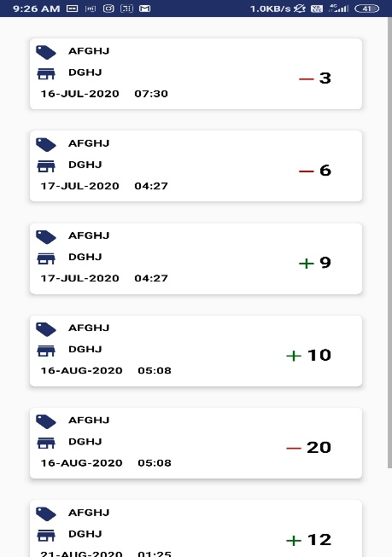
Implementation Screenshot
(Product Entry)
(Stock Summaries)

Slide 11
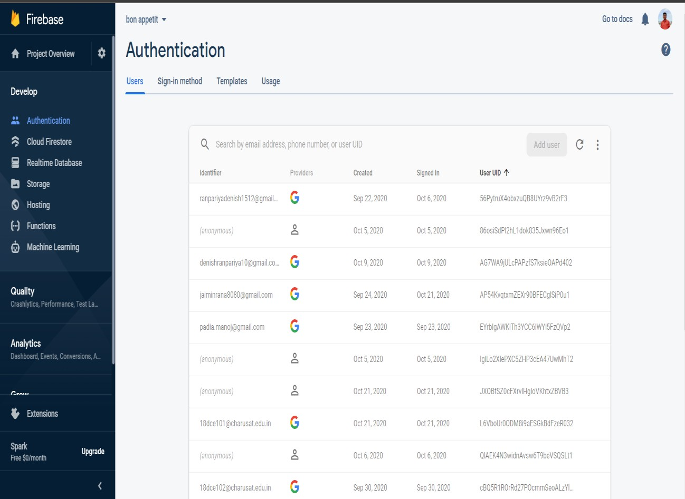
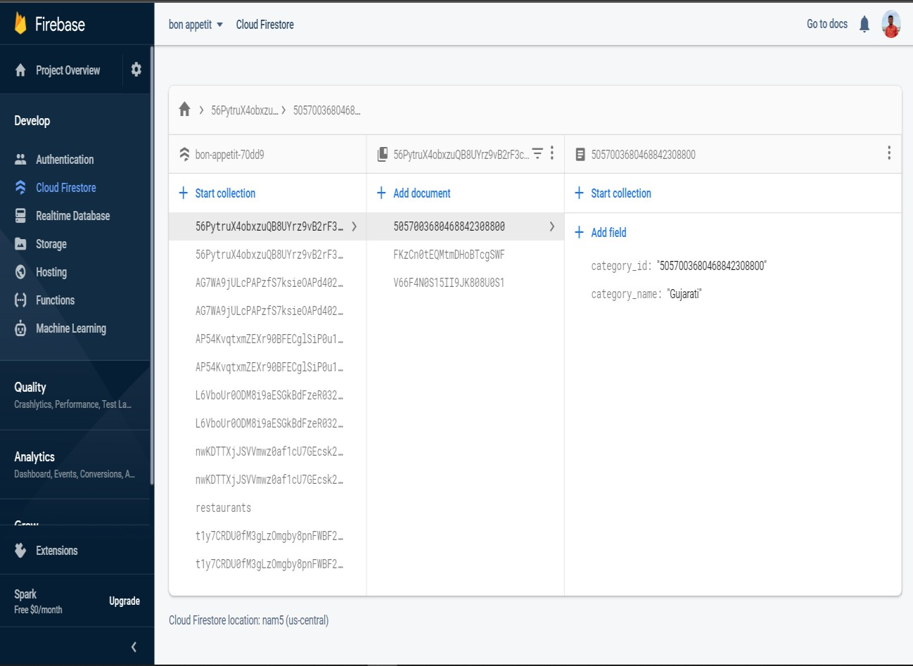
Database Screenshots
Signup/login data
Stocks entry data

Slide 12
Resources
https://www.youtube.com/watch?v=roDz8mMvbIg&list=PLknSwrodgQ72X4sKpzf5vT8kY80HKcUSe
(Android studio basic tutorial playlist)
https://youtu.be/9ch_rkRwk1M
(How to add product and employee details)
https://stackoverflow.com/questions/8716661/in-app-purchase-getting-product-details-programmatically
(how to converse with employees)

Slide 13
Thank You!

