Slide 1




Bhasha Bandhu Hackathon
Innovating for a Multilingual Judiciary
Innovating for a Multilingual Judiciary
Individual Name: Deepraj Bera Individual bio: Passionate about Solving Real-world Problems
Project Name: NyayVed Date: 17-07-2024
Supported by

Slide 2
Problem Statement
In many rural areas, people often struggle to understand the complex legal jargon used in court judgments. This lack of comprehension can create a significant barrier to justice, leaving individuals confused and unable to grasp the implications of legal decisions that affect their lives. Judges face the challenge of drafting judgments that are legally precise while also being understandable to the general public, especially those without a legal background.
Approach: To address this issue, we propose the development of a system designed to assist judges in drafting judgments that are both legally accurate and accessible to a wider audience. This system will focus on:
Simplifying Legal Jargon: Translating complex legal terms and language into layman's terms to ensure that the judgments are easily understood by individuals without legal expertise.
Multilingual Dissemination: Providing translations of judgments in multiple languages to cater to diverse linguistic needs, ensuring that non-native speakers and those in rural areas can access and understand the information.
Ensuring Clarity and Legal Integrity: Implementing mechanisms to maintain the legal accuracy and integrity of judgments while making them clear and comprehensible.
By integrating these features, our solution aims to bridge the communication gap in the legal system, making justice more accessible and understandable to everyone, regardless of their educational or linguistic background.
Notes:
Idea Submissions Form – Details of the form Topic
Thesis Abstract Concept Note What is the solution Build? Business use case (Less than 100 – 200 words) Judge and filter becomes easy

Slide 3
Solution
Interactive AI Chat Sessions: Users can engage in interactive chat sessions with an AI model, allowing them to ask questions about legal matters and receive clear, understandable responses. The AI is designed to only answer questions related to law and legal issues, ensuring relevance and accuracy.
Memory Update and Chat History: The system includes the ability to update the AI's memory, enhancing its responses over time. Additionally, it saves chat histories, enabling users to review past interactions and maintain continuity in their inquiries.
Translation to Local Languages: The web app provides translations of the AI responses into any local language of India, making legal information accessible to non-native speakers and those in rural areas.
By integrating these features, our solution aims to bridge the communication gap in the legal system, making justice more accessible and understandable to everyone, regardless of their educational or linguistic background. This approach ensures that legal information is both clear and legally accurate, facilitating better understanding and empowerment for individuals across diverse communities.
Notes:
Idea Submissions Form – Details of the form Topic
Thesis Abstract Concept Note What is the solution Build? Business use case (Less than 100 – 200 words) Judge and filter becomes easy

Slide 4
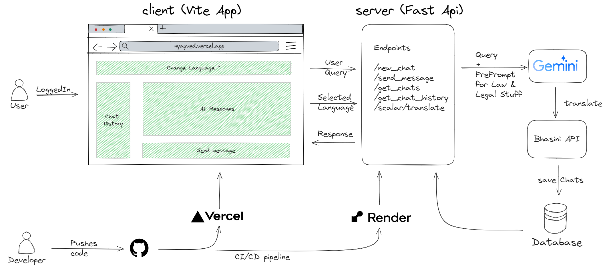
Architecture Diagram
Notes:
Idea Submissions Form – Details of the form Topic
Thesis Abstract Concept Note What is the solution Build? Business use case (Less than 100 – 200 words) Judge and filter becomes easy

Slide 5
Use of Bhashini API
The Bhashini API is a key component in our solution, enabling seamless translation of AI-generated responses into multiple local languages. Here's how we are using the Bhashini API:
Language Selection: When users engage with the web app, they have the option to select their preferred language from a list of available languages supported by the Bhashini API.
Requesting Translation: After the AI generates a response to a user's legal query, the response is sent to the Bhashini API along with the target language specified by the user.
Receiving Translated Response: The Bhashini API processes the request and returns the translated text in the selected language. This translated response is then displayed to the user within the chat interface.
Ensuring Accuracy: The Bhashini API's robust translation capabilities ensure that the legal information remains accurate and comprehensible, maintaining the integrity of the original message while making it accessible to a broader audience.
By integrating the Bhashini API, our web app ensures that legal information is not only clear and legally accurate but also accessible to individuals across diverse linguistic backgrounds, thus empowering them with a better understanding of legal matters.
Notes:
Idea Submissions Form – Details of the form Topic
Thesis Abstract Concept Note What is the solution Build? Business use case (Less than 100 – 200 words) Judge and filter becomes easy

Slide 6
Techstack/Technology Used
Frontend Vite + React
Backend
Python
FastAPI
Dev Tools Github Vercel render
APIs gemini Bhasini
Github Repo Link: https://github.com/deepraj21/bhashabandhu-hackathon
Deployed Link : https://nyayved.vercel.app/
Notes:
Idea Submissions Form – Details of the form Topic
Thesis Abstract Concept Note What is the solution Build? Business use case (Less than 100 – 200 words) Judge and filter becomes easy

Slide 7
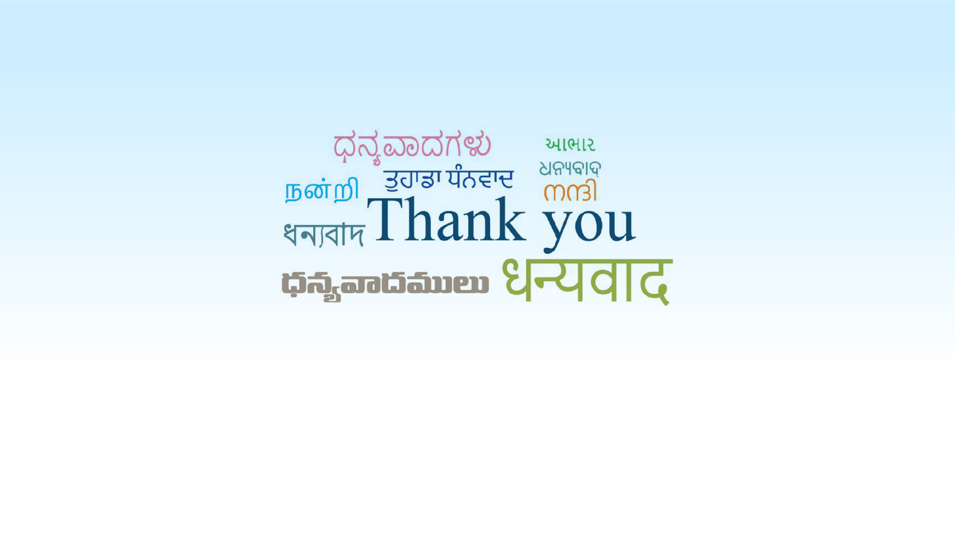
Innovating for a Multilingual Judiciary
Supported by

