Slide 1
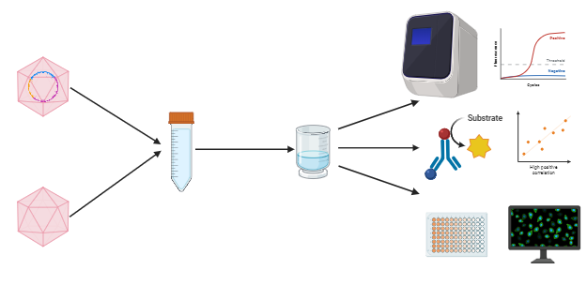
Sarmah et al., 2024. Figure 1
Graphical Abstract
Full capsids
qPCR
ELISA
Mixed and
diluted
Ultrafiltration
Infectivity Assay
Empty capsids
Illustration of Separation

Slide 2
Sarmah et al., 2024. Figure 2
a
b

Slide 3
Sarmah et al., 2024. Figure 3
a
b

Slide 4
Sarmah et al., 2024. Figure 4
a
b
c

Slide 5
Sarmah et al., 2024. Figure 5
a
b
c

