Slide 1
DeepGRN: transcription factor binding site prediction using attention-based deep neural networks – Review
Deepro Banerjee
09/21/2021
Notes:
Title Slide

Slide 2
Reasons for choosing this paper
Directly aligned to our research area
Supplements current state-of-the-art deep learning models with an attention mechanism and achieves comparable/superior performance
Claims that attention mechanism can improve model interpretation

Slide 3
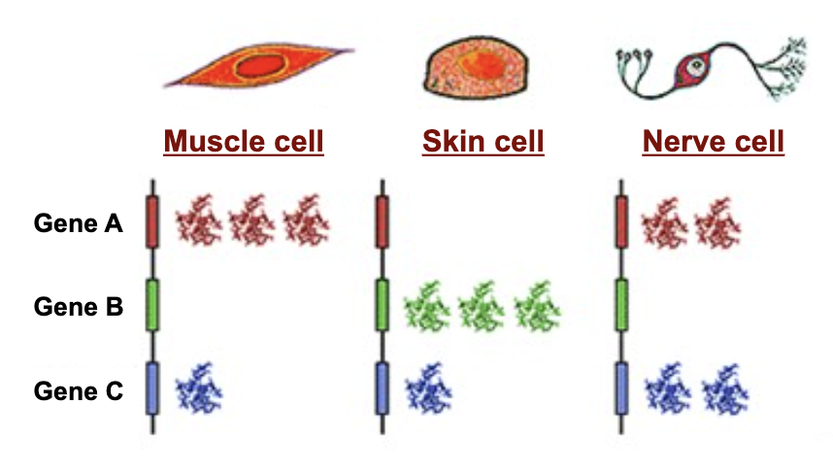
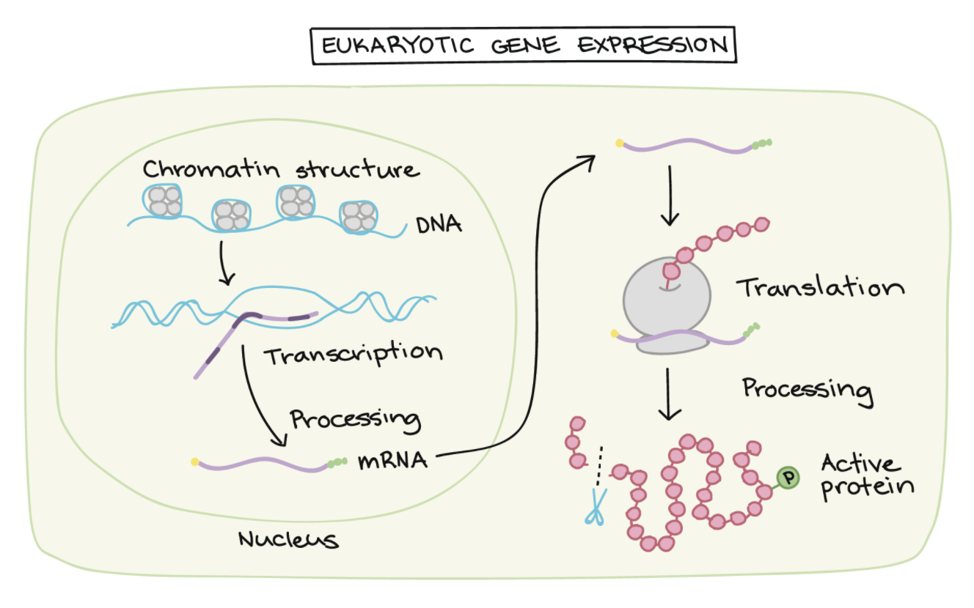
Cell types differ due to gene expression differences
Same DNA – Different functions
Various stages of Gene Regulation
Notes:
Figure1: https://slideplayer.com/slide/9089748/
Figure3: https://www.khanacademy.org/science/ap-biology/gene-expression-and-regulation/regulation-of-gene-expression-and-cell-specialization/a/overview-of-eukaryotic-gene-regulation
Same DNA different cell types
https://www.ncbi.nlm.nih.gov/Class/MLACourse/Original8Hour/Genetics/gene_expression.html
https://www.nature.com/scitable/topicpage/gene-expression-regulates-cell-differentiation-931/
https://www.nature.com/articles/hdy201054

Slide 4
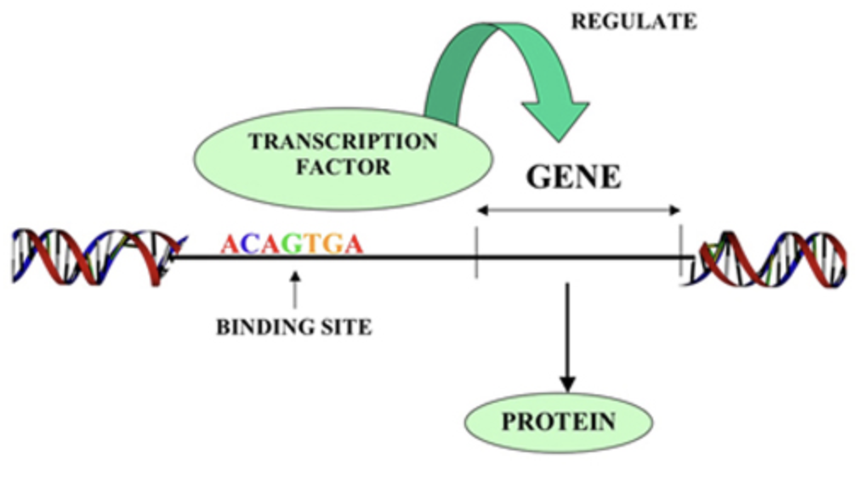
Transcription Factors regulate gene transcription
TFs are proteins that play a central role in regulating gene transcription
ChipSeq “golden standard”; however experimental determination of all possible cell types across all species is infeasible
Notes:
Figure2: http://2013.igem.org/wiki/index.php?title=Team:XMU_Software/Project/promoter&oldid=359507
TF Background
Khan Academy: https://www.khanacademy.org/science/biology/gene-regulation/gene-regulation-in-eukaryotes/a/eukaryotic-transcription-factors
http://2013.igem.org/wiki/index.php?title=Team:XMU_Software/Project/promoter&oldid=359507
https://www.nature.com/articles/nrg3207

Slide 5
Deep Learning models show superior performance
Conventional Models | Deep Learning Models
Handcrafted Features | Automatic high level feature learning
Not easily scalable | Can be trained in batches and in parallel
Worse performance | Better performance
Examples: Hidden Markov Models, Support Vector Machines, Random Forests | Examples: DeepBind/DeepSEA (CNNs), DanQ/DeeperBind/FactorNet (CNN + RNN)
Notes:
DeepBind: https://www.ncbi.nlm.nih.gov/pmc/articles/PMC4908339/
DeepSEA: https://www.ncbi.nlm.nih.gov/pmc/articles/PMC4768299/
DanQ: https://www.ncbi.nlm.nih.gov/pmc/articles/PMC4914104/
DeeperBind: https://www.ncbi.nlm.nih.gov/pmc/articles/PMC7302108/
FactorNet: https://pubmed.ncbi.nlm.nih.gov/30922998/

Slide 6
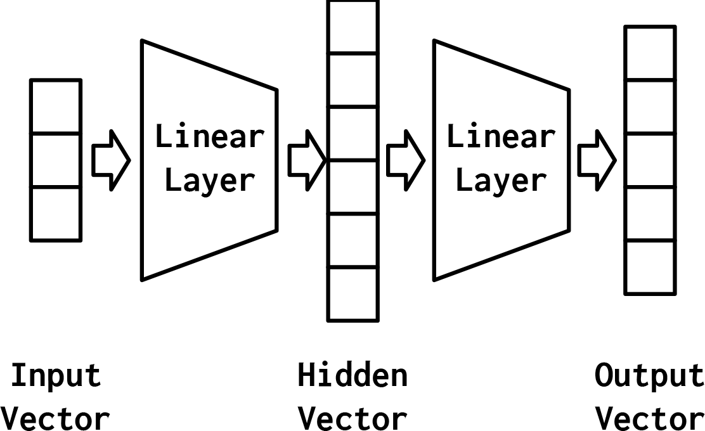
Multi-layer perceptron is good at summarizing tasks
W^{T} . x + b
𝛔 (W^{T} . x + b)
Also referred to as Feedforward networks/Dense layers/Fully connected layers
Notes:
Figure4: https://www.oreilly.com/library/view/natural-language-processing/9781491978221/ch04.html

Slide 7
Convolutional Neural Network can find patterns
A
T
T
A
A
C
A
C
A
A
G
A
A
C
A
0.8
0.7
0.5
0.2
CNNs are used to find sequence motifs where the Transcription Factor might bind
Notes:
CNN explanation:
https://machinelearningmastery.com/convolutional-layers-for-deep-learning-neural-networks/

Slide 8
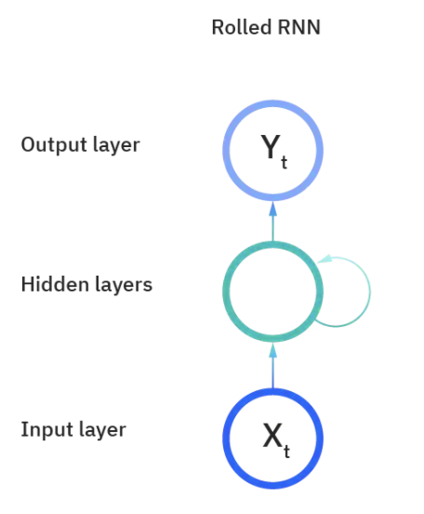
Recurrent Neural Network can learn context
Y₁
Y₂
Y_{t-1}
Y_{t}
Y_{n}
…
…
X₁
X₂
X_{t-1}
X_{t}
X_{n}
Notes:
Figure: https://www.ibm.com/cloud/learn/recurrent-neural-networks
RNN explanation:

Slide 9
Current CNN-RNN state-of-the-art architecture
MLP
CNN
RNN
ATTAACACAAGAACA
INPUT
CNN
RNN
MLP
OUTPUT
CNN will capture motif/motifs
RNN will capture context within and between motifs

Slide 10
Attention is all you need
Y
…
…
MLP
Y
…
…
X₁
X₂
X_{t-1}
X_{t}
X_{n}
Notes:
Original Attention Paper: https://arxiv.org/pdf/1409.0473.pdf
Transformer: https://arxiv.org/pdf/1706.03762.pdf
Attention Mechanism Explanation:
https://towardsdatascience.com/intuitive-understanding-of-attention-mechanism-in-deep-learning-6c9482aecf4f

Slide 11
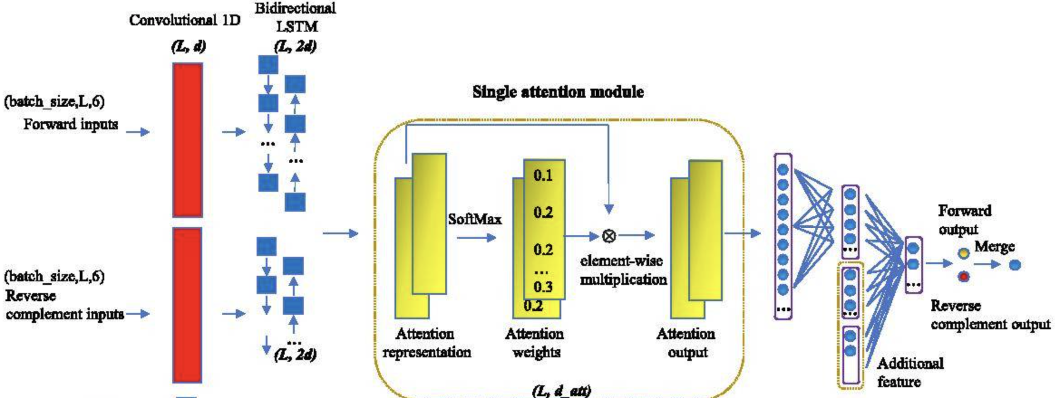
Model Architecture

Slide 12
Study Design under DREAM challenge restrictions
Problem Statement: Transcription Factor binding prediction across cell types
Features: DNA Sequence (S), DNase-Seq (S), RNA-Seq (NS)
Target: Bound/Unbound
Training
All Chrm except 1,8,11,21
Validation
Chrm 11
Test
Chrm 1, 8, 21
Cell type 1
Cell type 1
Cell type “test”
Cell type 2
Cell type 2
.
.
.
.
Cell type k
Cell type k

Slide 13
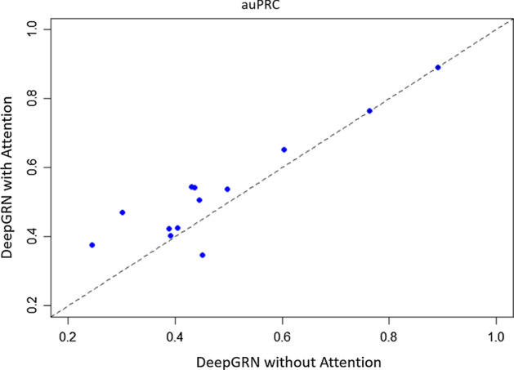
DeepGRN w and w/o attention

Slide 14
DeepGRN interpretation
Notes:
Saliency Maps:
https://towardsdatascience.com/saliency-map-using-pytorch-68270fe45e80

Slide 15
Thank you

Slide 16
Appendix – MLP Formulation

Slide 17
Appendix – CNN Formulation
Notes:
https://machinelearningmastery.com/convolutional-layers-for-deep-learning-neural-networks/

Slide 18
Appendix – RNN Formulation
Notes:
https://stanford.edu/~shervine/teaching/cs-230/cheatsheet-recurrent-neural-networks#attention

Slide 19
Appendix – LSTM formulation

Slide 20
Appendix – Attention formulation
Notes:
https://towardsdatascience.com/intuitive-understanding-of-attention-mechanism-in-deep-learning-6c9482aecf4f

Slide 21
Appendix – Saliency Features
Notes:
https://arxiv.org/pdf/1312.6034.pdf
https://www.nature.com/articles/s41576-019-0122-6#Sec11
https://glassboxmedicine.com/2019/06/21/cnn-heat-maps-saliency-backpropagation/
https://towardsdatascience.com/saliency-map-using-pytorch-68270fe45e80
Getting a linear approximation of the non-linear function at a point a, using a Taylor’s series expansion: https://en.wikipedia.org/wiki/Taylor%27s_theorem

Slide 22
References
DNaseSeq vs ATACSeq: https://genomebiology.biomedcentral.com/articles/10.1186/s13059-019-1654-y

