Slide 1

Hematopoiesis, RNA, Regulatory Landscape
Ross Hardison
Department of Biochemistry and Molecular Biology
Huck Institute for Genomics
Penn State University

Slide 2
Gene regulation and complex traits
Think about disease susceptibility in terms of gene regulation, not just protein sequence

Slide 3
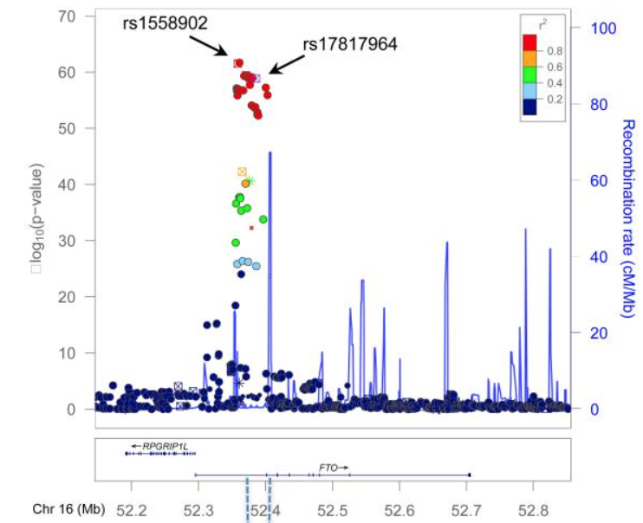
Common genetic variants associated with complex traits
Genome-wide association studies have identified tens of thousands of DNA variants associated with human complex traits
Most of these are not in protein coding regions
Hindorff et al. 2009. PNAS 106:9362
For example, some genetic variants associated with obesity map in the first intron of FTO
What are the causal variants?
What is the target gene?
What tissues are affected?
How does genotypic variation affect phenotype?
neg
Loos & Yeo. 2014. Nat Rev Endocrin

Slide 4
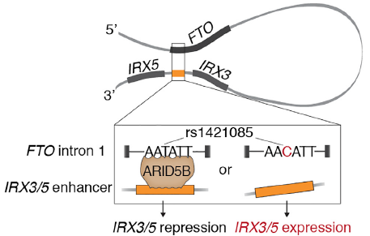
Variants affecting gene regulation play a prominent role in complex traits
Phenotype-associated, noncoding variants map to candidate regulatory regions.
Maurano et al. 2012. Science 337: 1190
ENCODE Consortium. 2012. Nature
Hardison. 2012. JBC 287:30932
Variants in FTO intron impact binding by ARID to regulate distal genes IRX3 and IRX5
Smemo et al. 2014. Nature 507: 371
Claussnitzer et al. 2015. N. Engl. J. Med. 373: 895.
Herman & Rosen. 2015. Cell Metabolism

Slide 5




Mouse hematopoietic cells and epigenetic features studied
RNHC
RNH
RNHC
RNHC
ER4
CFUE
ERY
G1E
RNH
RBC
NHC
MEP
HPC7
RN
RNH
H
CFUMk
iMk
MK_fl
RNHC
PLATELETS
CMP
EOS
RNHC
RNH
MAS
LSK
GMP
NEU
RNHC
MON
RNHC
R = RNA
N = nuclease accessibility
H = histone mods
C = CTCF
T
NHC
NH
B
NH
CLP
NK
NH

Slide 6
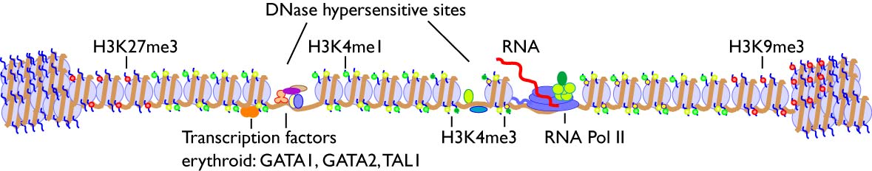
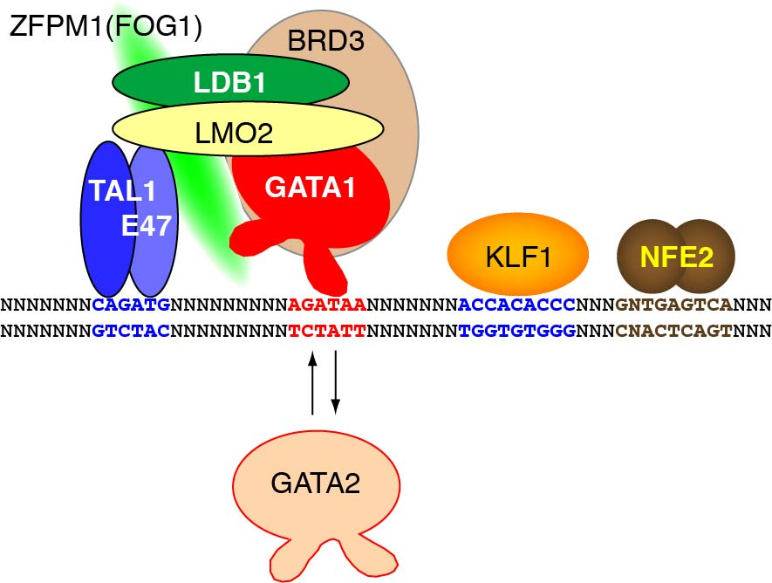
Epigenetic features associated with transcriptional regulation, assayed genome-wide
Repressed chromatin
Enhancer
Promoter
Repressed chromatin
H3K27ac

Slide 7
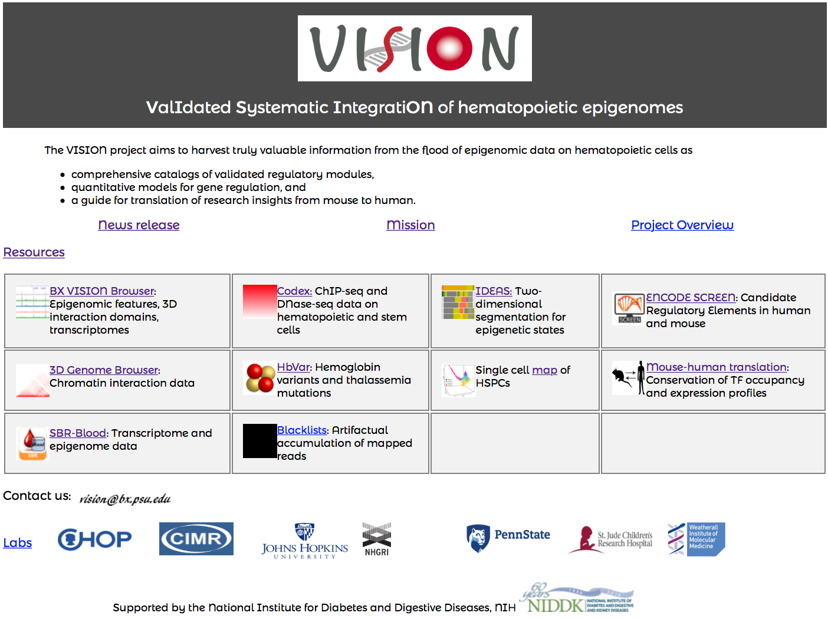
http://usevision.org

Slide 8
VISION Data
VISION = ValIdated Systematic IntegratiON of epigenomic data in hematopoiesis
Visualization
Website
http://usevision.org
BX Browser
http://main.genome-browser.bx.psu.edu/
Useful session
http://main.genome-browser.bx.psu.edu/cgi-bin/hgTracks?hgS_doOtherUser=submit&hgS_otherUserName=ross&hgS_otherUserSessionName=LSK_ERY_MEG_ATAC_HM_RNA_mm10
Data repositories:
ENCODE data portal
https://www.encodeproject.org
CODEX
http://codex.stemcells.cam.ac.uk
Course website

Slide 9
Mouse hematopoietic cells and epigenetic features studied in VISION
Bioinformatics
HSC: hematopoietic stem cell, aka LSK
CMP: common myeloid progenitor
CFUE: colony forming unit erythroid
ERY: erythroblast
RNHC
RNH
RNHC
RNHC
ER4
CFUE
ERY
G1E
RNH
RBC
NHC
MEP
HPC7
RN
RNH
H
CFUMk
iMk
MK_fl
RNHC
PLATELETS
CMP
EOS
RNHC
RNH
MAS
LSK
GMP
NEU
RNHC
MON
RNHC
R = RNA
N = nuclease accessibility
H = histone mods
C = CTCF
T
NHC
NH
B
NH
CLP
NK
NH

Slide 10
ScriptSeq RNA-seq at Zfpm1 and neighbors

Slide 11
Hierarchical clustering: Erythroid separates from others
Transcript levels of all genes (RNA-seq)
BG, July 22, 2016

Slide 12
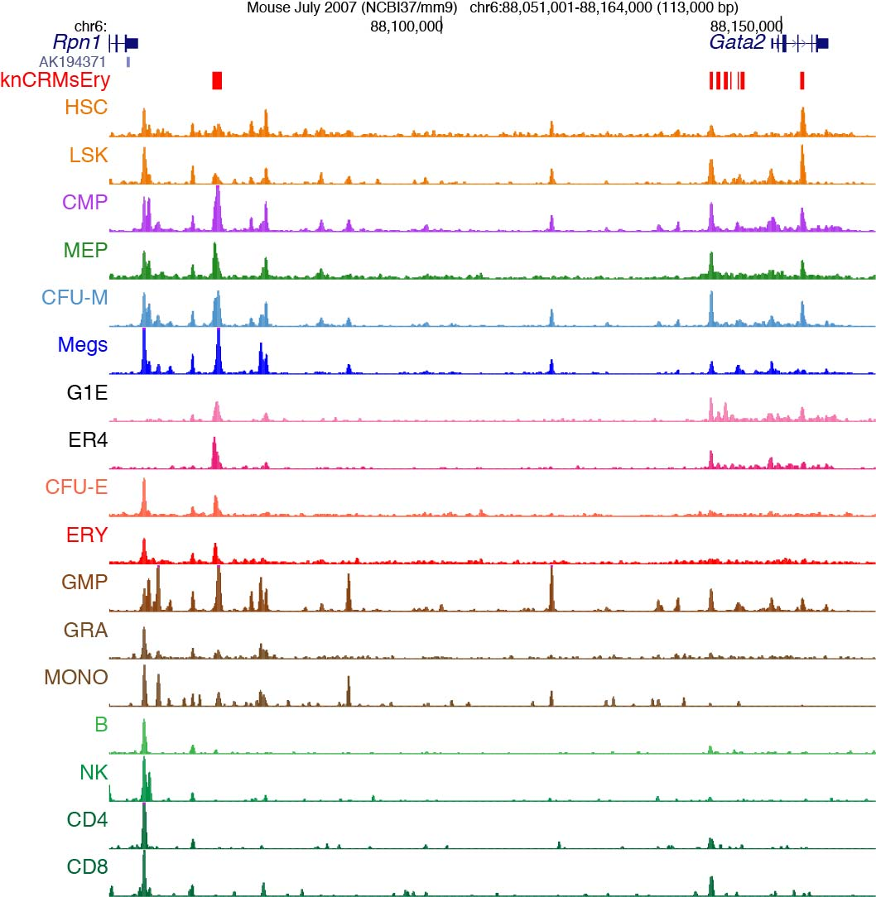
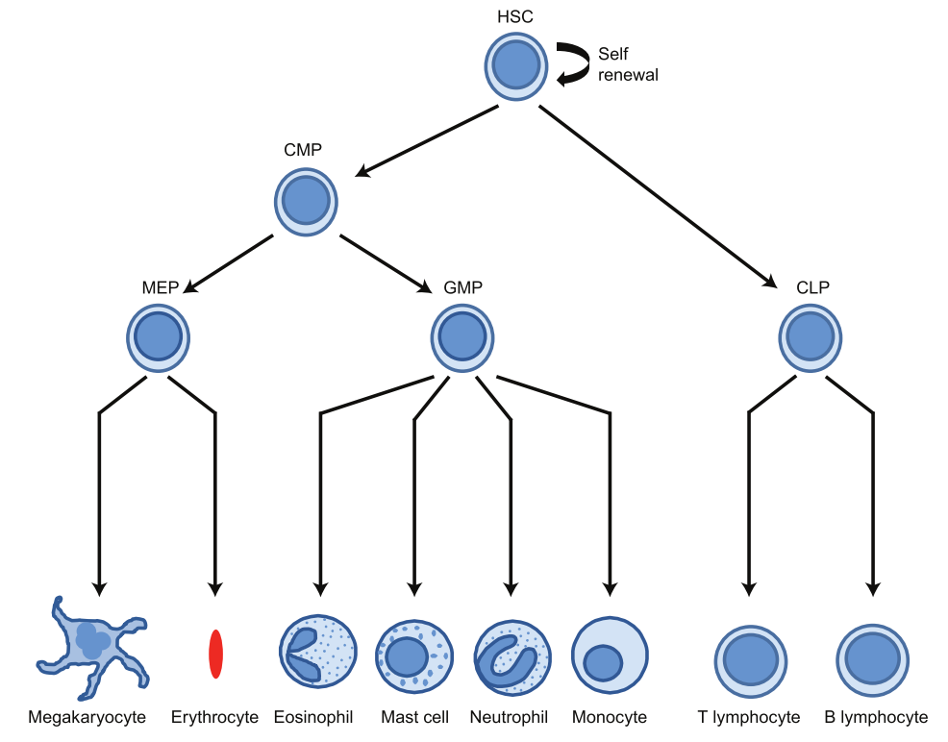
Sensitive, robust methods reveal regulatory landscape in rare cells
HSC
CMP
MEP
GMP
CLP
MEG
ERY
GRA
T
B
MONO
NK
ATAC-seq profiles of regulatory landscape. Data from Hardison and collaborators and from Friedman and Amit labs: Lara-Astiaso et al. (2014) Science Aug

Slide 13
ATAC-seq in Zfpm1 and neighbors

Slide 14
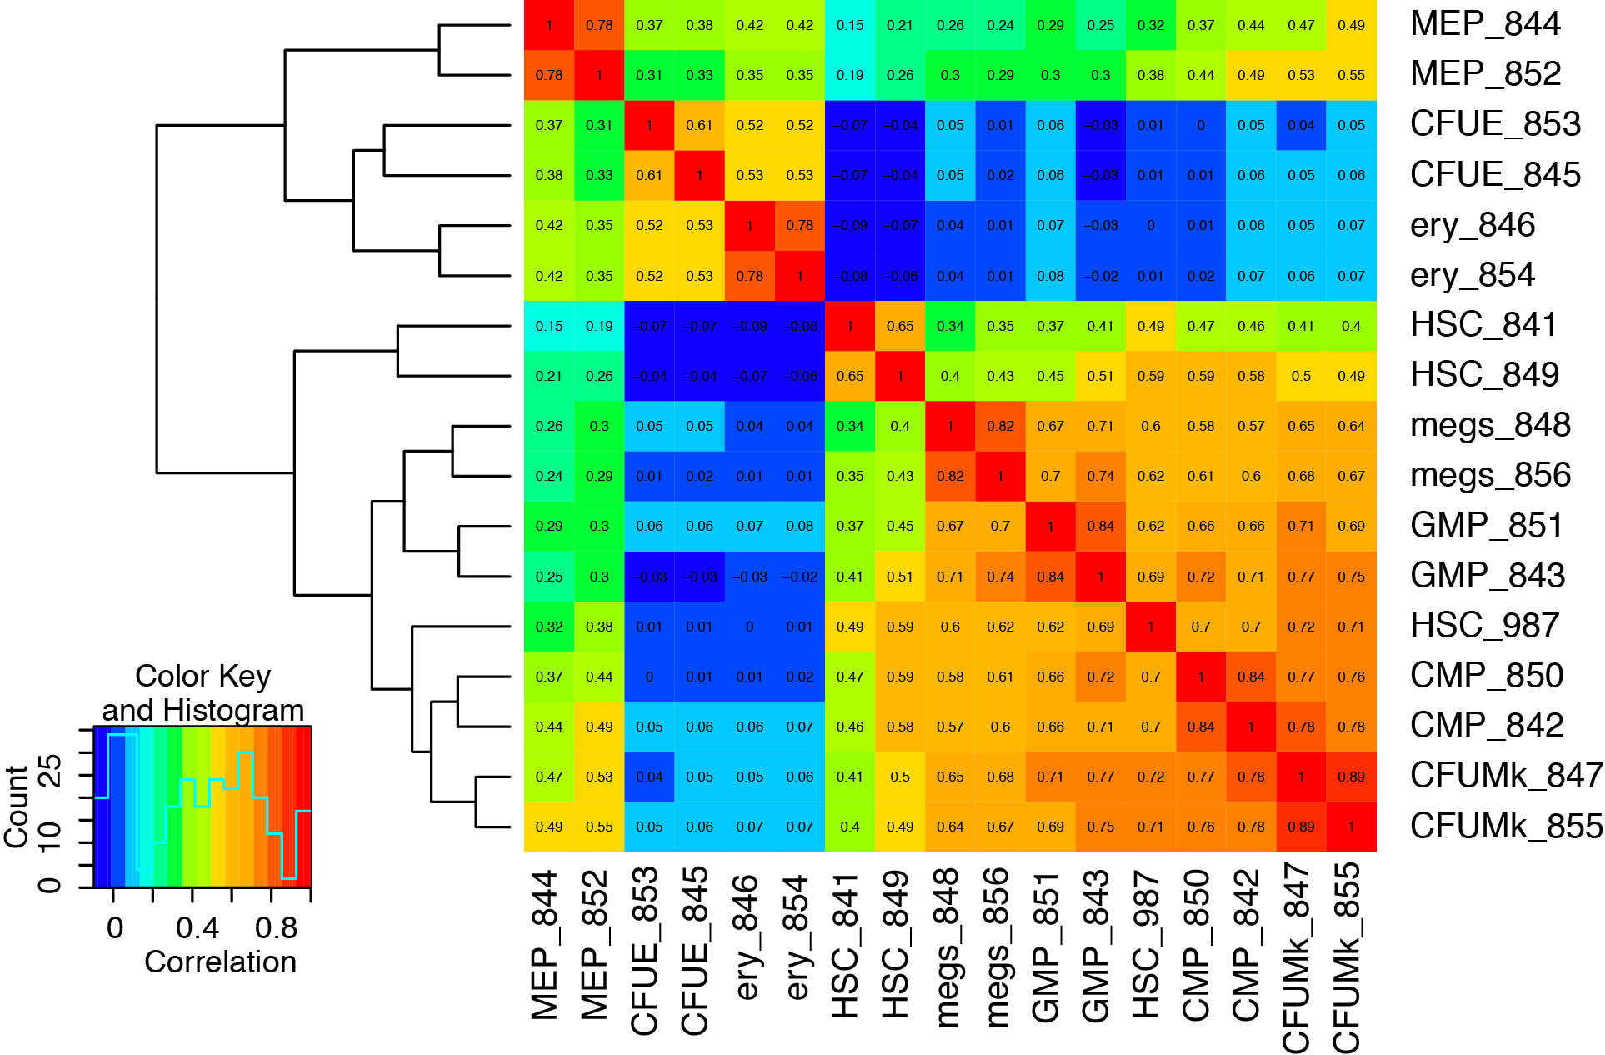
Hierarchical clustering: Erythroid separates from others
Nuclease accessibility (ATAC-seq)
BG, Aug 03, 2016

Slide 15
Prediction of candidate regulatory elements enhances the exploration of potential therapies

Slide 16
HbF ameliorates effects of HbS in sickle cell disease
HBE
HBG2
HBG1
HBD
HBB
RBC morphology at low O₂
S
HbS
S
S
HbS &
HbF
S
cis: HPFH
mutations
trans:
BCL11A
HBS1L-MYB
KLF1
none
low
med
high
Expression level

Slide 17
Strategies for genetic treatment of sickle cell disease
Gene addition: express HBG from viral integrant
Gene correction S to A allele
S
HbS &
HbF
S
cis: HPFH
mutations
Reactivate production of HbF in adult red cells.
Strategies target loci that act in cis or in trans
trans:
BCL11A
HBS1L-MYB
KLF1

Slide 18
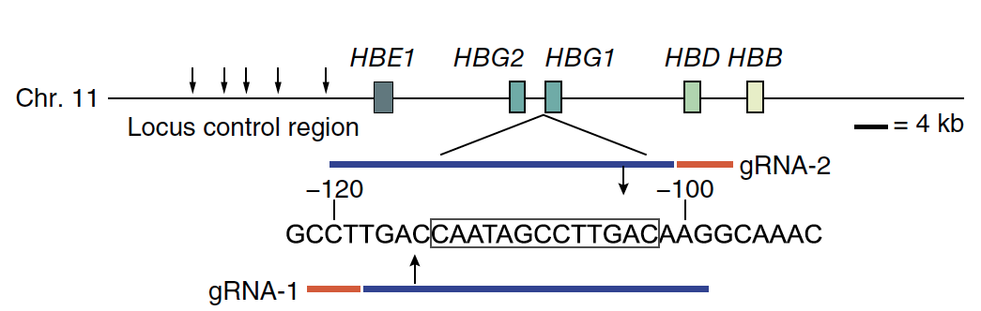
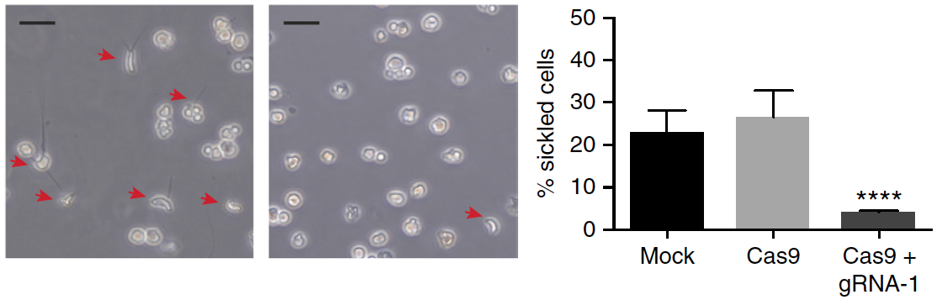
Genome editing strategy to treat sickle cell disease
CRISPR-Cas9 to recapitulate an HPFH mutation with high HbF
(Gilman et al. 1988. NAR)
Editing of CD34+ HSPCs from patients with sickle cell disease decreases rate of sickling
Cas9
Cas9 + gRNA-1
Traxler, Yao … M. Weiss. 2016. Nature Medicine 22: 987-990.

