Slide 1
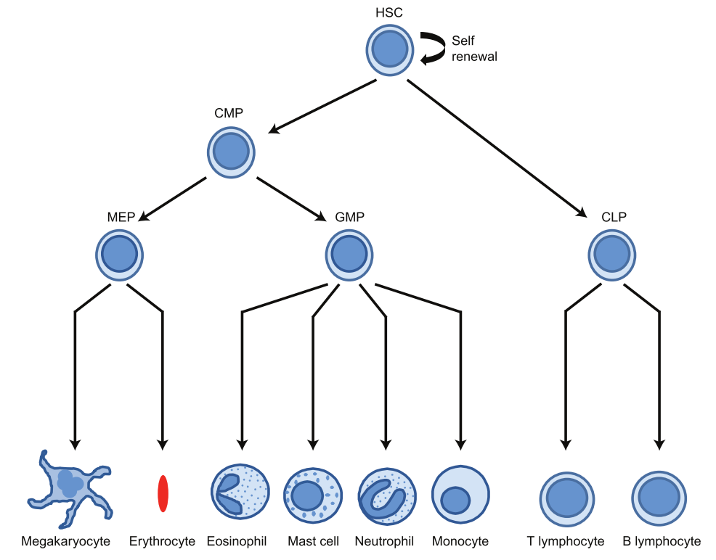


Relationship between cells in hematopoiesis for this project
HSC
HSC: hematopoietic stem cell, aka LSK
CMP: common myeloid progenitor
CFUE: colony forming unit erythroid
ERY: erythroblast
HPC7
CMP
MEP
GMP
CLP
G1E
ER4
CFU-Mk
CFU-E
ERY
MEG
Platelets
E’cyte
EOS
Mast
GRA
MONO
T
B
NK

