Slide 1
INFECTIOUS VIRUS MANAGEMENT SYSTEM
DATABASE PROJECT GROUP 10
DEEPRO BOSE
GOPI OGGU

Slide 2
INTRODUCTION
The Infectious Virus Management System is a comprehensive database designed to address the challenges posed by infectious viruses.
This project aims to provide a centralized platform for tracking and managing crucial information related to viruses, cases, deaths, vaccines, research, testing labs, and quarantine facilities.

Slide 3
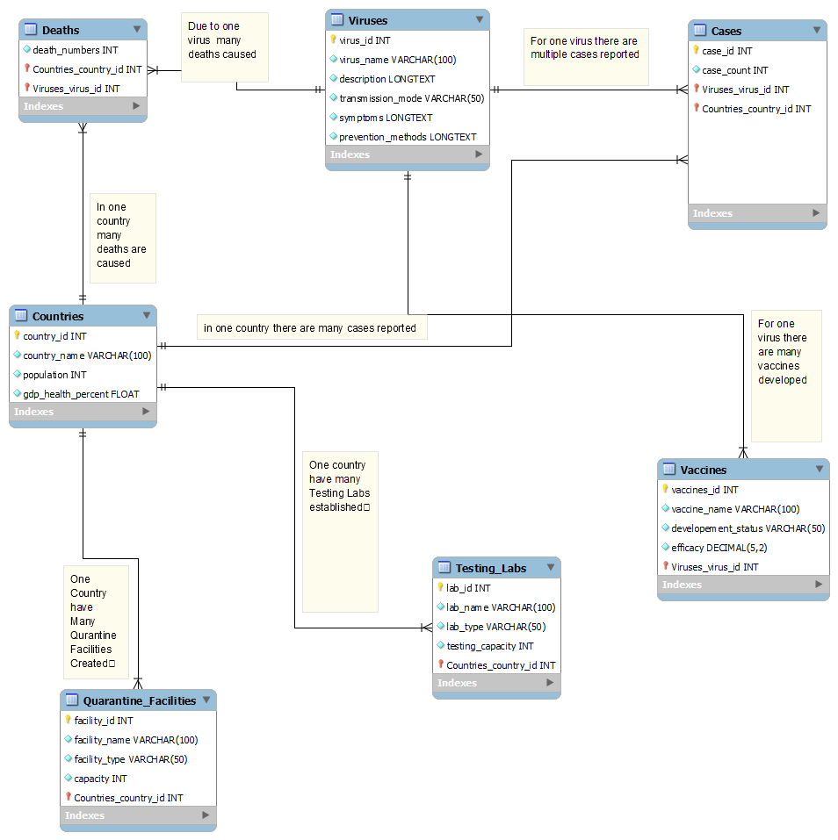
DATABASE DESIGN

Slide 4
QUERIES

Slide 5
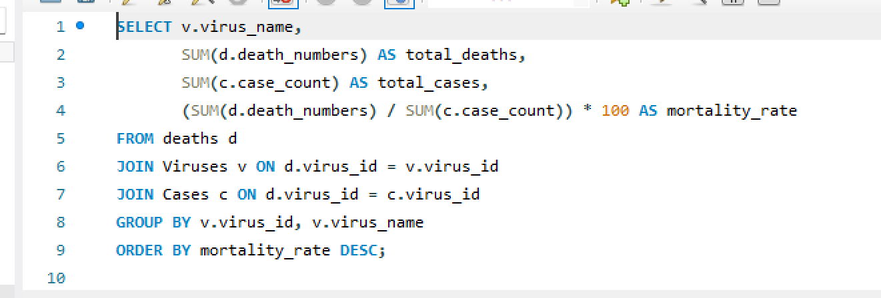
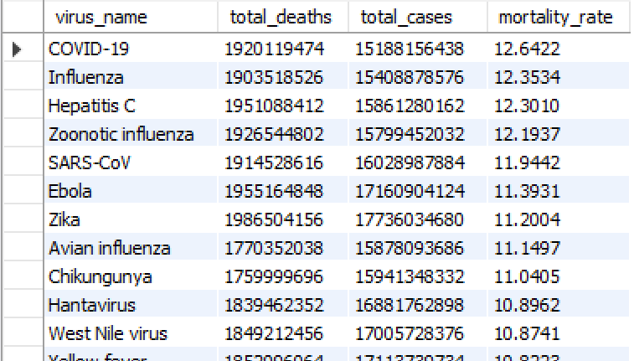
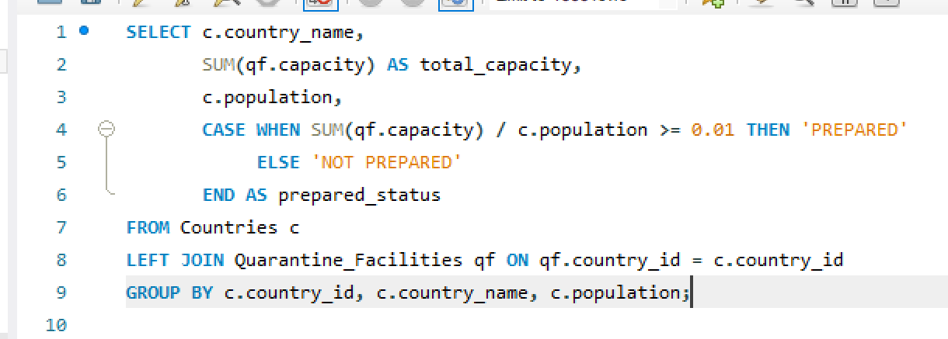
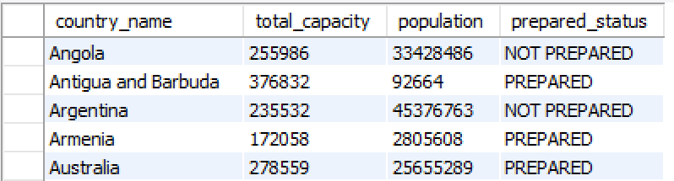
QUERIES

Slide 6
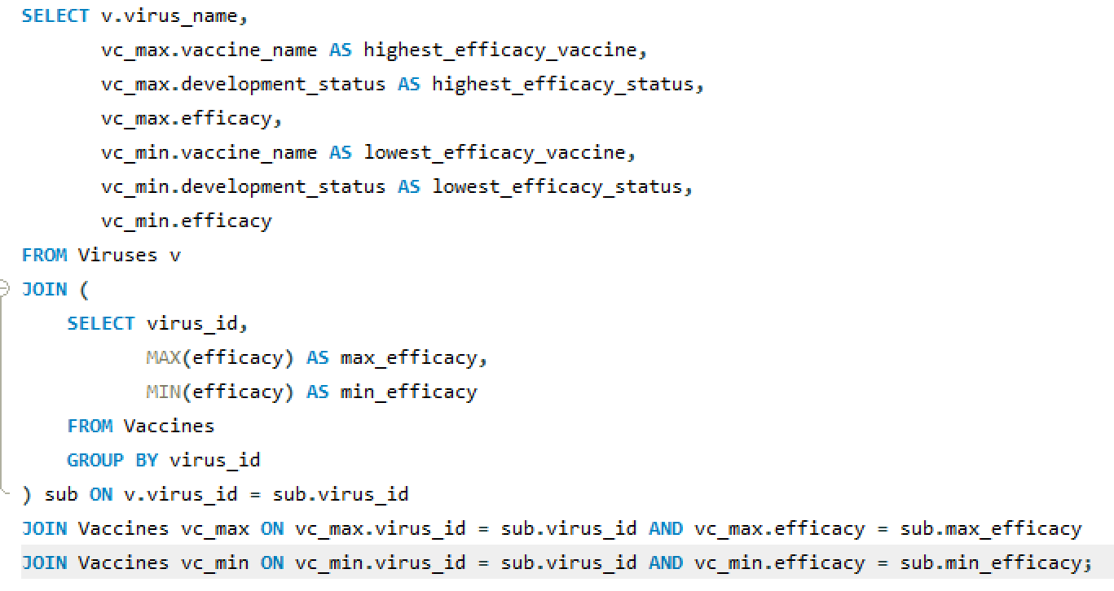
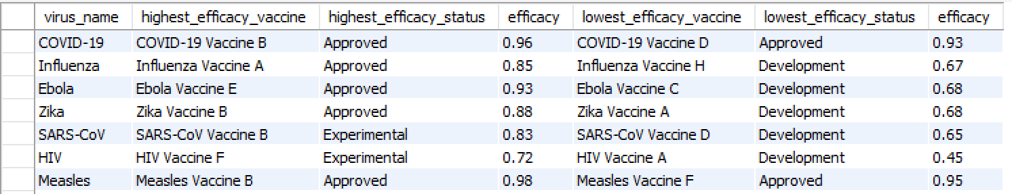
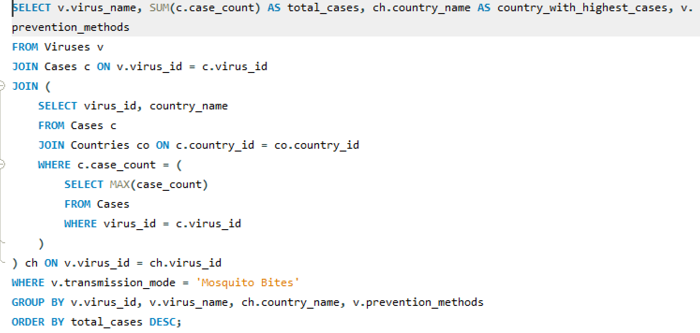
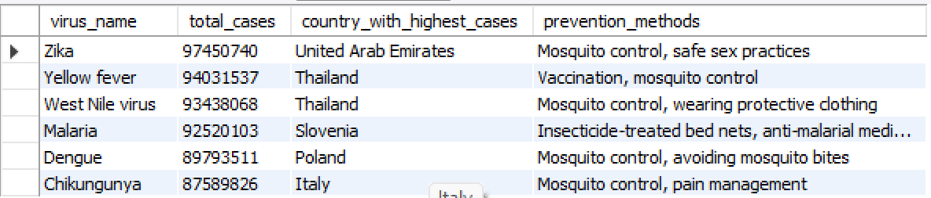

Slide 7
CONCLUSION
The project has provided us with valuable insights into the world of infectious diseases, even though the information used is entirely fictitious.
Through the development of a comprehensive database, we have been able to model and manage crucial aspects of virus outbreaks, including tracking cases, monitoring deaths, evaluating vaccines, and facilitating research collaboration.
This project highlights the significance of data-driven decision-making in healthcare and emphasizes the importance of effective database management in addressing public health challenges.

