Slide 1
Artificial Intelligence (MSCE-632-A01) - First Bi-term Summer- 2024 University of the Cumberlands
Satellite Tracking App
Submitted to: Dr. Archie Addo
Submitted by: Kamal Kumar

Slide 2

Project Objectives
Build a complex flow using Node-RED tools.
Integrate Watson Assistant chatbot with Node-RED.
Fetch live location of the International Space Station (ISS) using the final application.

Slide 3
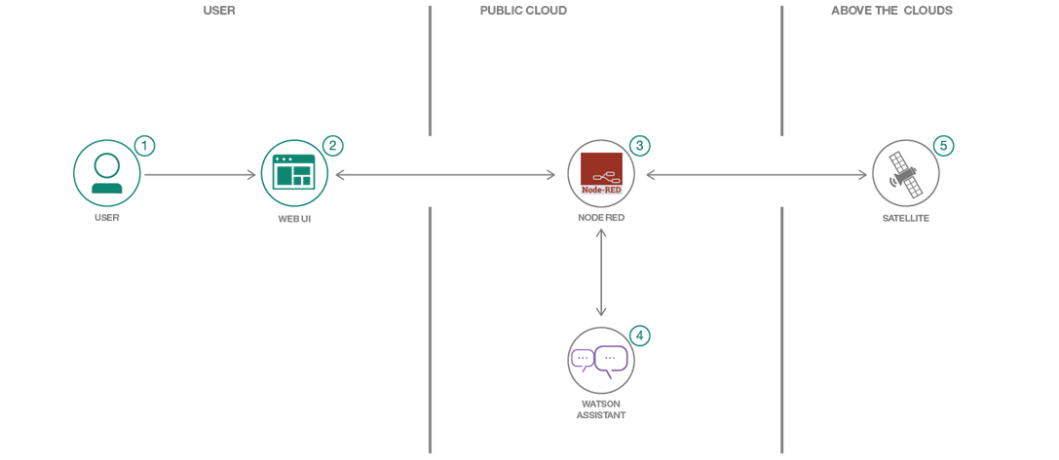
Design

Slide 4
Node-RED
Node-RED is a flow-based, low-code development tool for visual programming developed originally by IBM for wiring together hardware devices, APIs and online services as part of the Internet of things.
Node-RED provides a web browser-based flow editor, which can be used to create JavaScript functions.

Slide 5
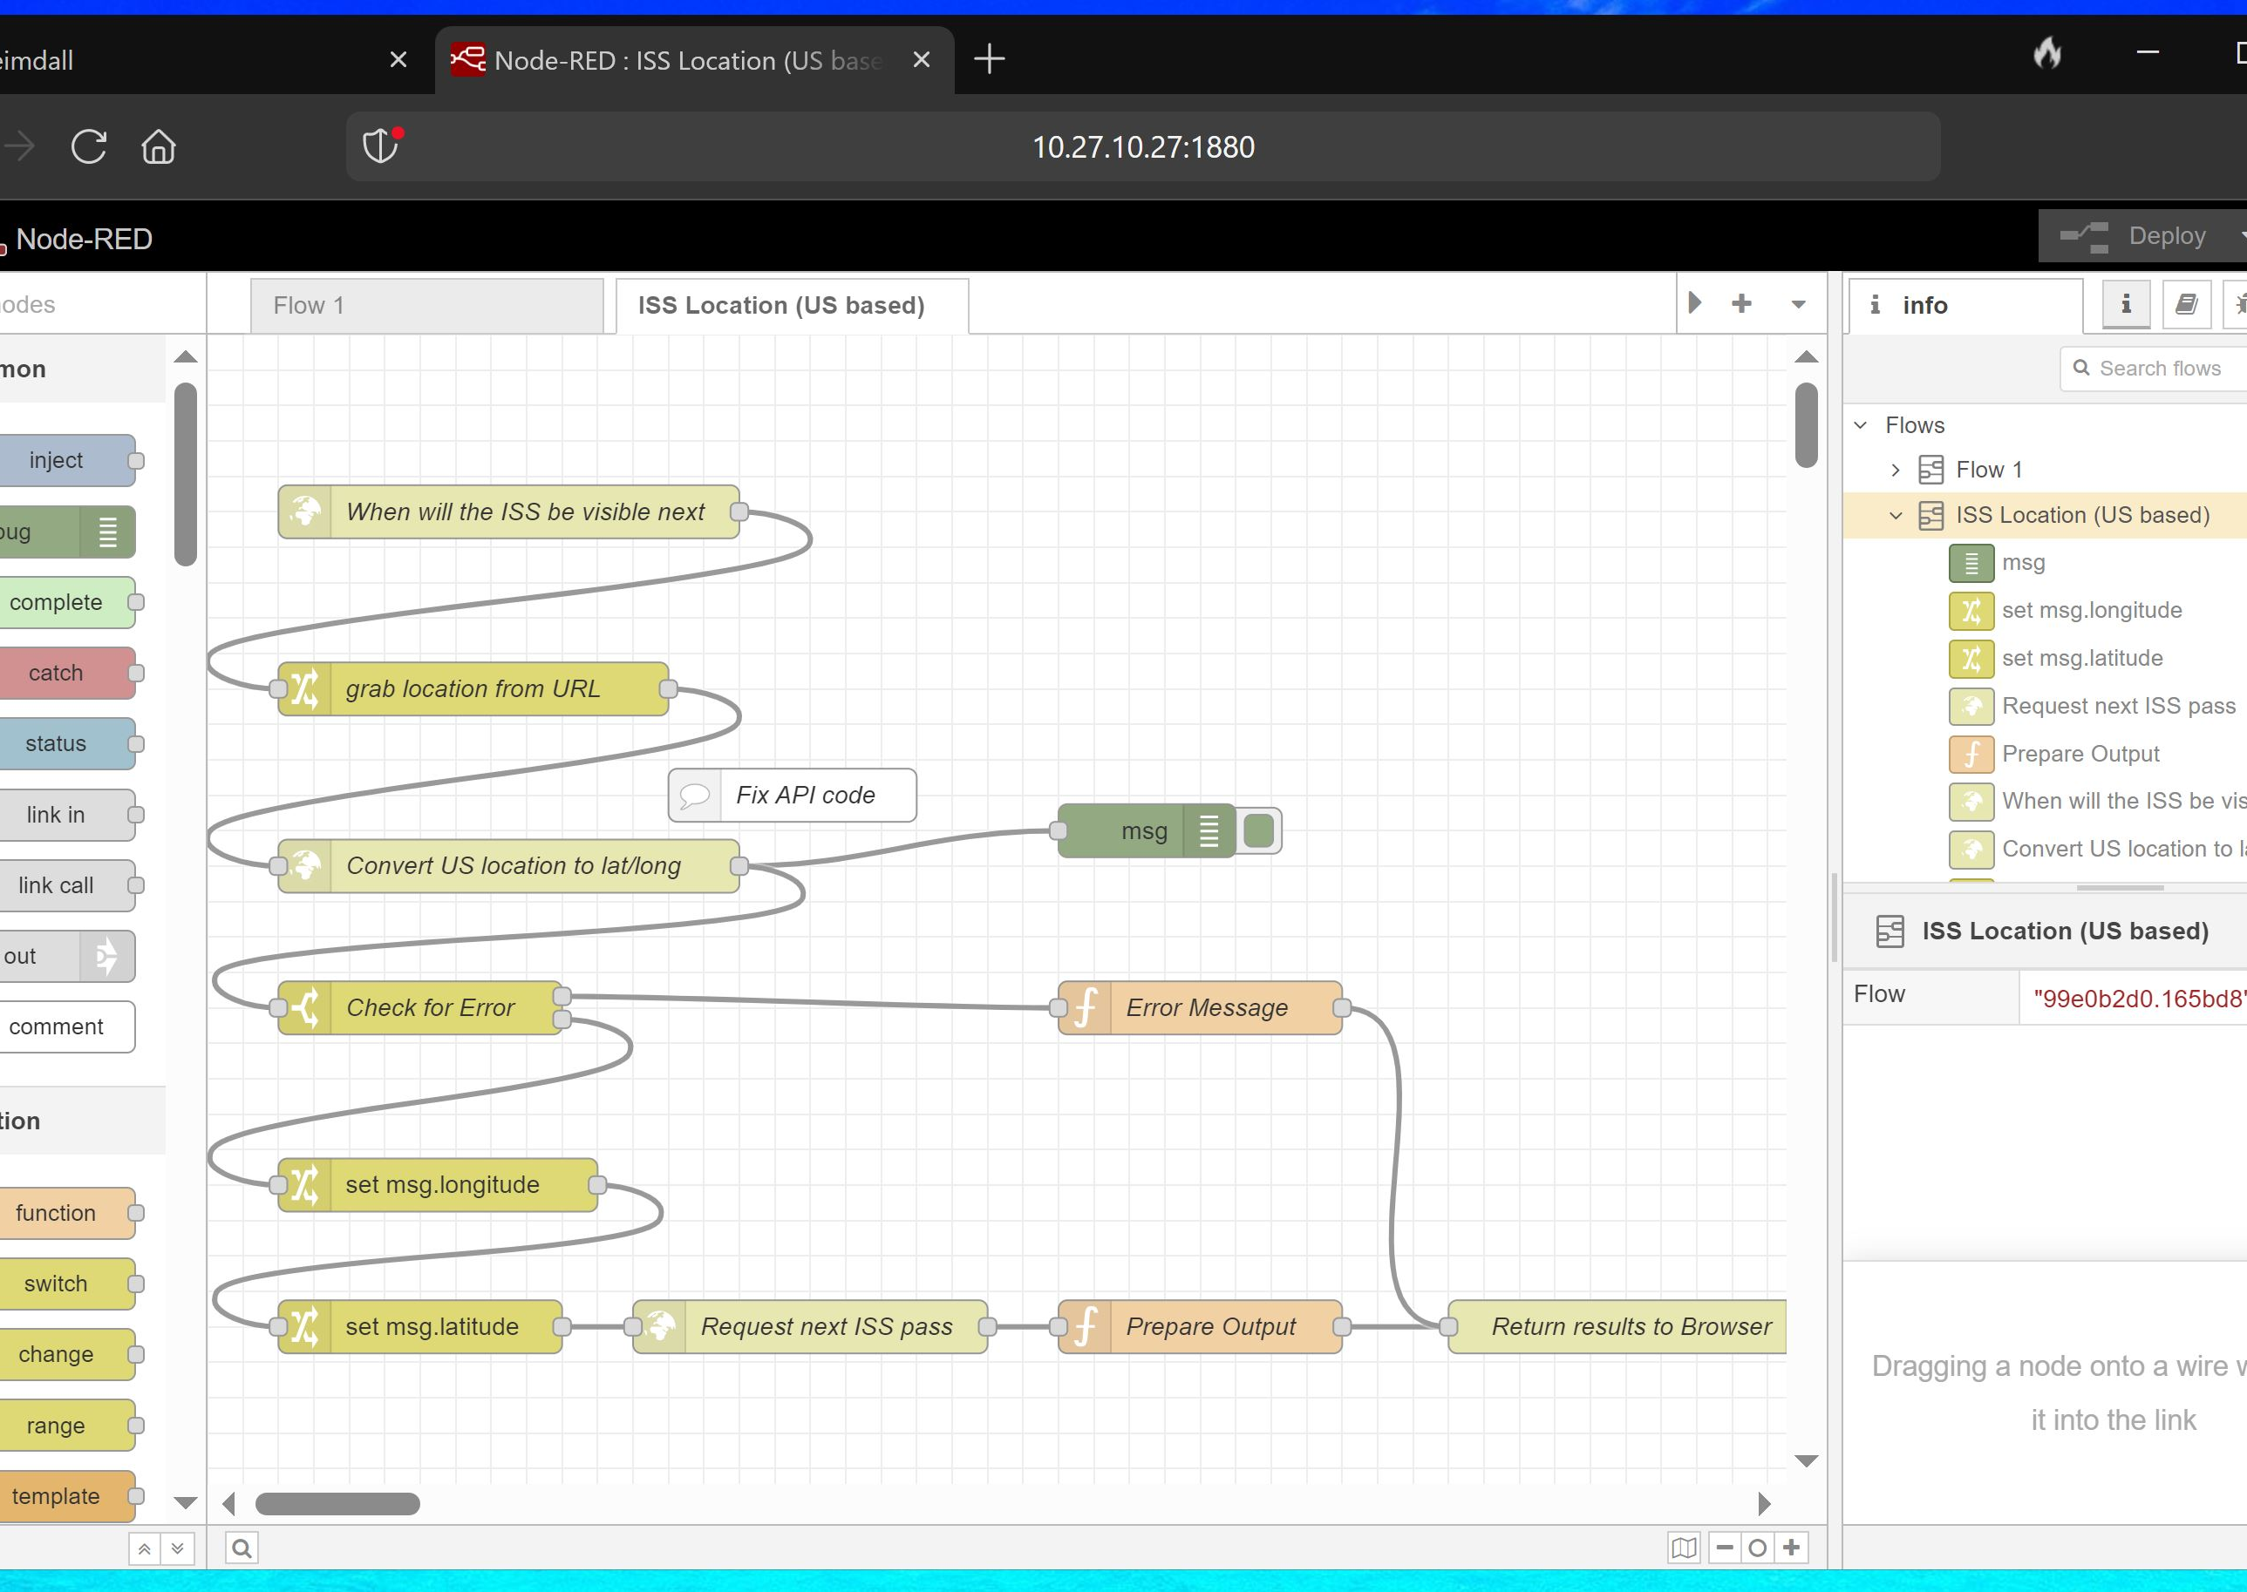
Node-RED editor can be accessed using IP address of the application host via specified port.
Each block shows the individual functional block connected with input-output blocks.
After flow is complete application is simply deployed and if no error output can be accessed using the specified function.

Slide 6
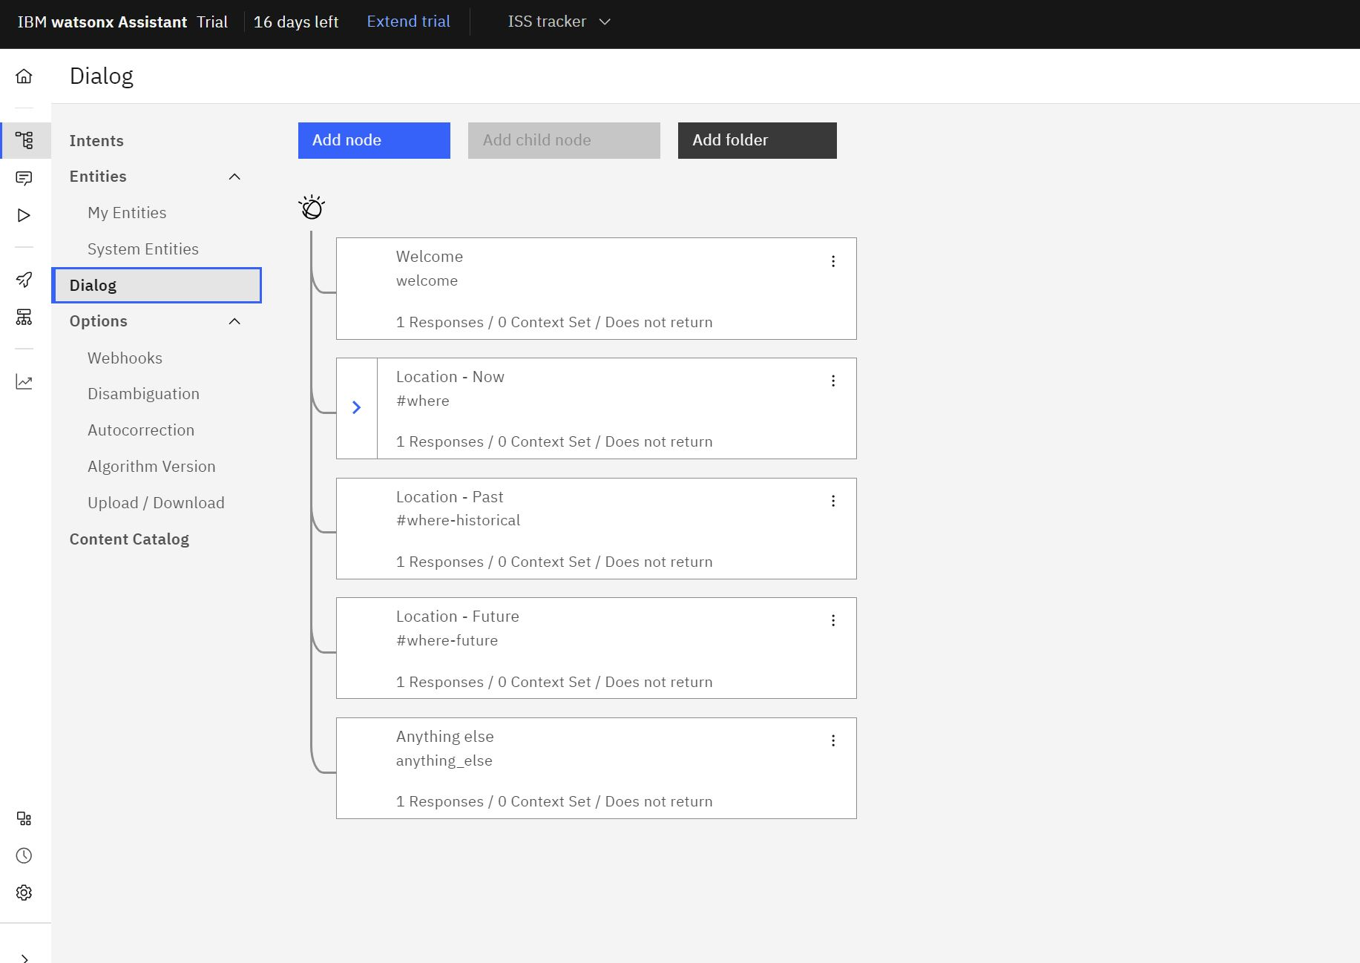
Watson Assistant Configuration
Add new dialog for enabling the human-AI conversation by importing predefined dialog.
Each node represent specified questions and conversation responses from Watson chatbot.
After Chatbot deployment, its credentials will be used to integrate with Node-RED.

Slide 7
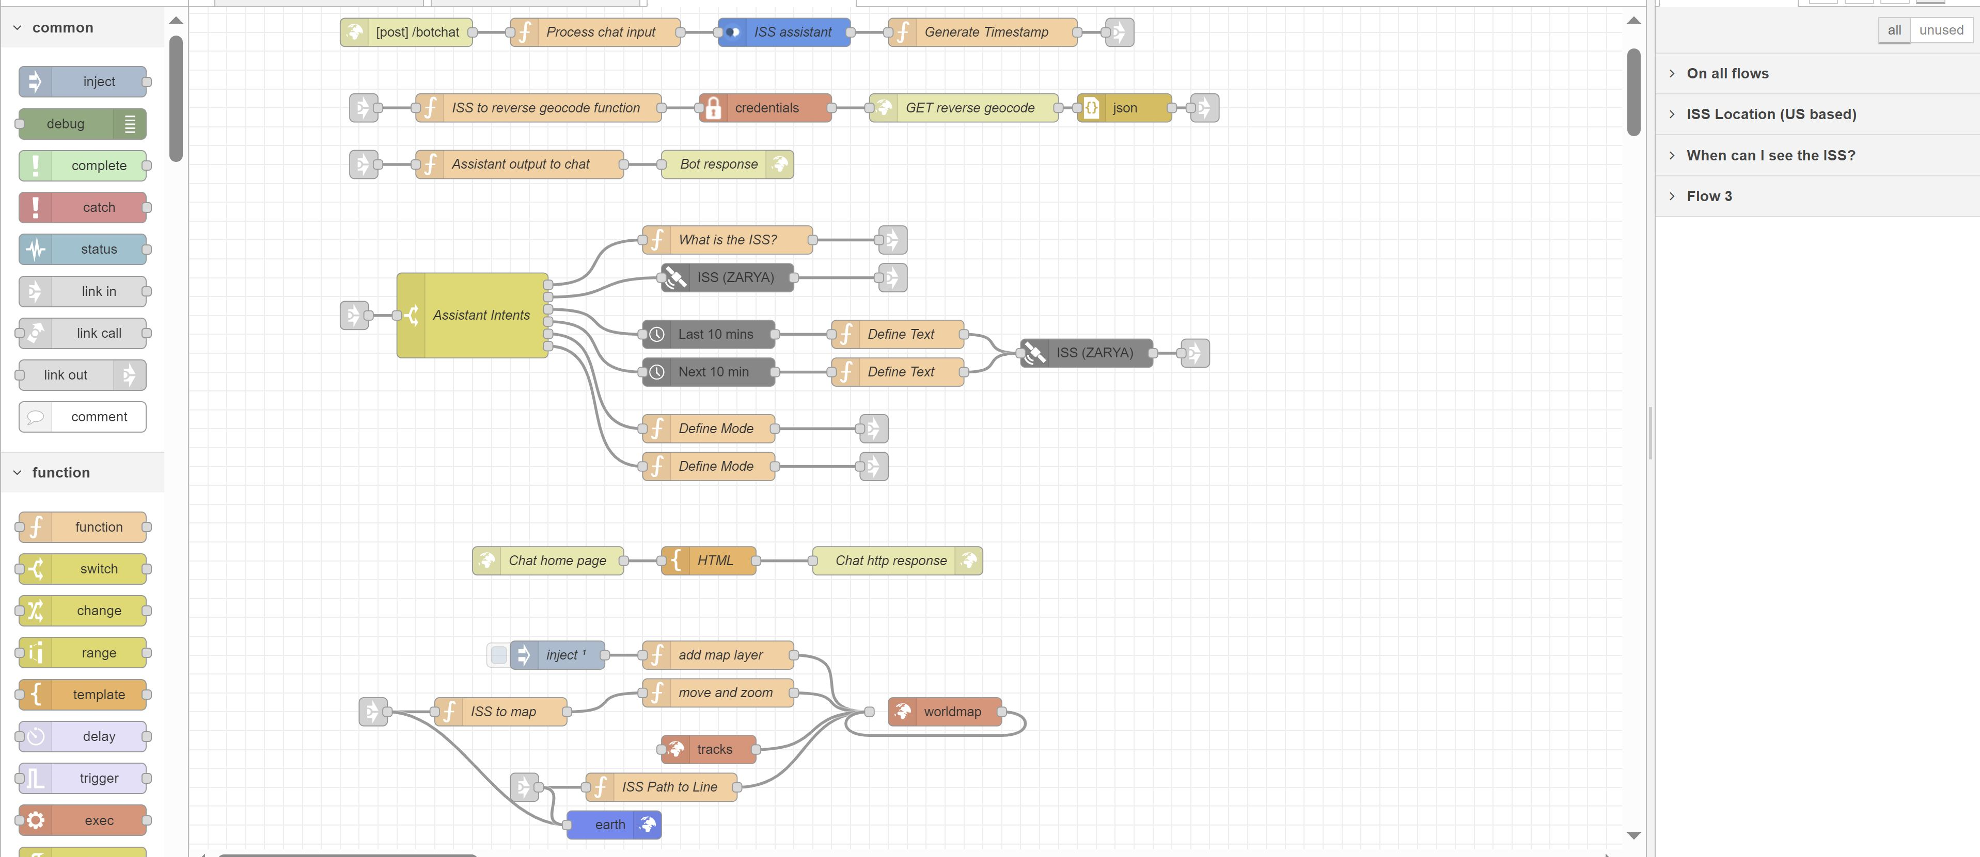
Build Flow in Node-RED

Slide 8

Integration
Populate the Assistant node with API credentials.
Configure LocationIQ API in Node-RED function.
Fill-in new chatbot workspace ID.

Slide 9
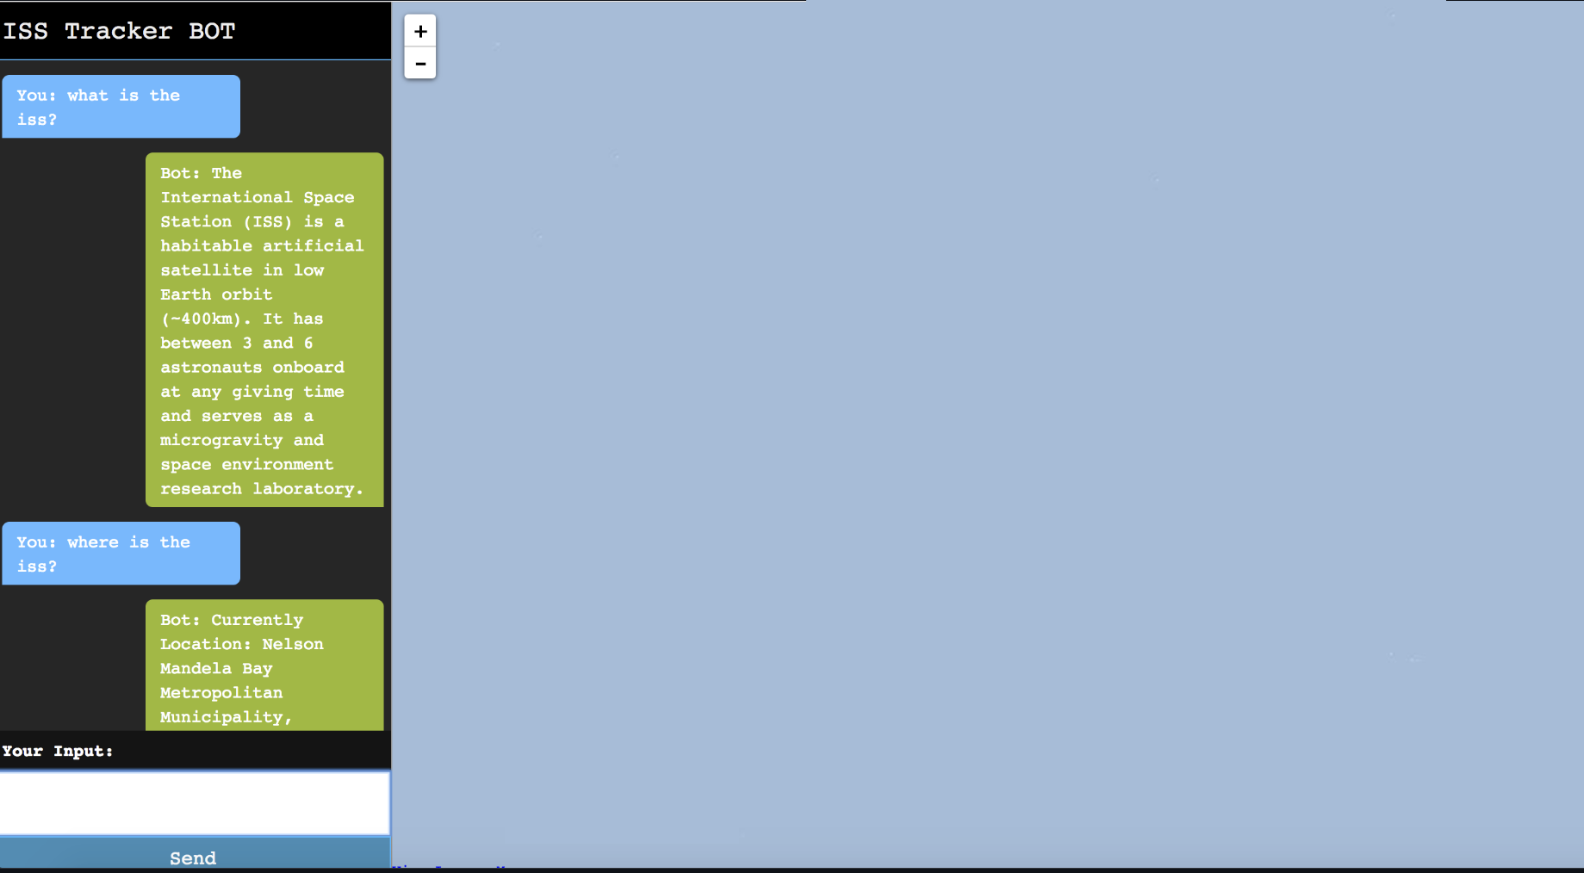
Application
Future Considerations
The map java-scrip update required to show moving map with ISS.
Watson Chatbot can be configured to send the location of ISS to the cellphone or email address.

