Slide 1
Determination of a person’s health
Data Analysis & Machine
Learning Using Python
Internship
DN Squad (6)
Neha Gupta and Deepanshu Rustagi

Slide 2
CONTENTS
Problem Statement
Objective
Motivation
Dataset Description
Process Cycle

Slide 3

Problem Statement
As Health is very sensitive issue that must be recognized and improved for better life so, determination of health status is necessary and this can be determined based on basic factors such as gender, height and weight.

Slide 4

OBJECTIVE
OBJECTIVE
The main aim of this project is to determine whether a
person is healthy or not based on basic factors by using
the concept of data analytics and machine learning.

Slide 5

It will help the doctors to categorise their patients with respect to their BMI.
It will also help the patients to check their height and weight.
This project will help for the betterment of the society.
People who have poor health, can be therefore helped by the concerned authorities.
We were motivated to make a safe and healthy society.

Slide 6
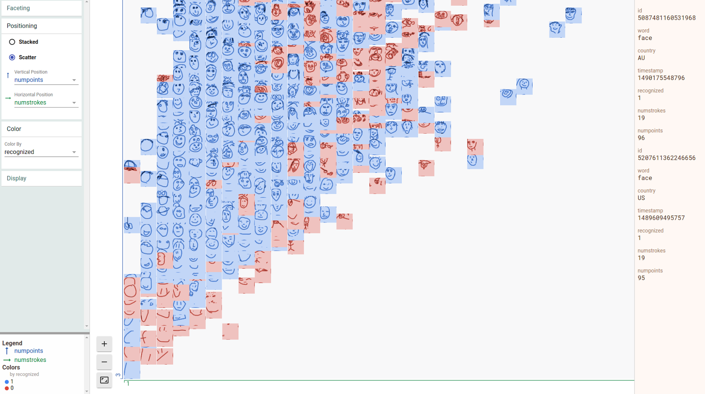
DATASET
DATASET AND VISUALIZATION

Slide 7
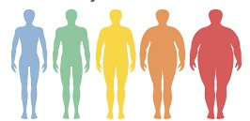
ATTRIBUTES AND FACTORS
The data set we’re using contains 4 attributes:
The machine will predict 2 factors:
If the weight is given then height will be predicted and vice-versa
Index
The index is categorised into 5 categories:
0 – Under weight
1 – Normal weight
2 – Healthy
3 – Over weight
4 – Obesity
Height
Weight
Index
Gender

Slide 8
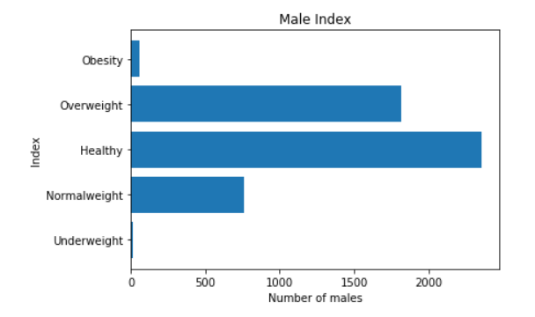
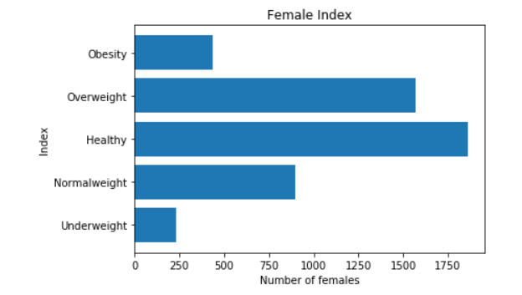
VISUALIZATION
The Dataset can be categorized based on health status for both (male and female).

Slide 9
PROCESS CYCLE
Loading Dataset
Analysing Data
Splitting the Data
Fitting Regression Model
Predicting test set Values
Model Accuracy
Predicting the Outcomes

Slide 10


