Slide 1

MemoryForge
Interactive learning with
fast-weight associative memory
DataForge 2026
Team BitWise
Deepshikha Rani and Ved Patel
DataForge 2026 / BitWise / 01
Notes:
DataForge 2026, Pathway track. Team BitWise: Deepshikha Rani and Ved Patel. Team names and optional contact details supplied by the user. Logo supplied by the user, used without modifying its original PNG bytes.

Slide 2
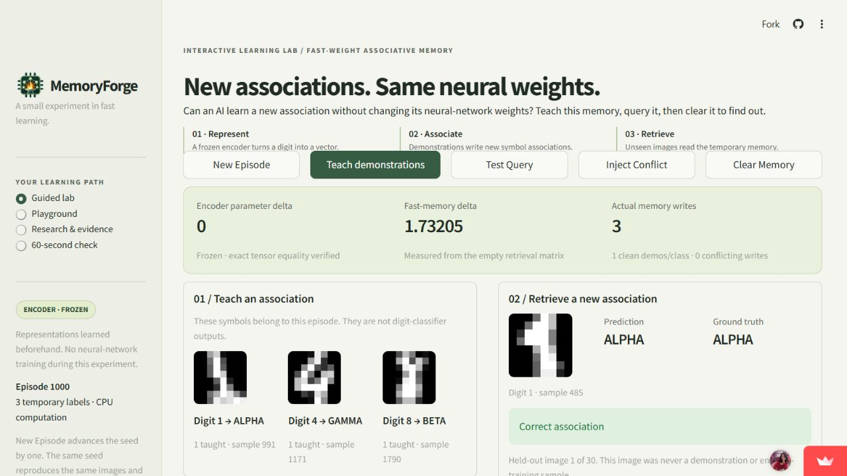
New associations with unchanged encoder weights
Public app capture, seed 1000: 3 writes, encoder delta 0, prediction beside truth.
DataForge 2026 / BitWise / 02
Notes:
Screenshot captured from https://memoryforge.streamlit.app/ on 2026-09-08. Original screenshot bytes included in assets/screenshots. Source: https://github.com/deeps2710/MemoryForge/blob/main/src/ui.py. The opening preset has 23/30 correct held-out queries.

Slide 3
DFD: offline model preparation
E3
Bundled digit images
and original labels
Features and labels
P1
Normalize /16
and stratify IDs
Training partition
D1
Training split
1,347 original IDs
Held-out partition
Optimizer inputs
D3
encoder.pt + metadata
weights, split, fingerprint
D2
Held-out split
450 original IDs
Sanity evaluation
(no updates)
P2
Train encoder + head
100 fixed epochs
Saved weights and training report
Training rows update weights. Held-out rows evaluate them. Application startup never invokes this path.
DataForge 2026 / BitWise / 03
Notes:
Sources: https://github.com/deeps2710/MemoryForge/blob/main/src/data.py, https://github.com/deeps2710/MemoryForge/blob/main/src/training.py, https://github.com/deeps2710/MemoryForge/blob/main/scripts/train_encoder.py, https://github.com/deeps2710/MemoryForge/blob/main/artifacts/encoder.training.json. All 1797 original row IDs are stratified once with seed 42. Encoder and training-only head learn from 1347 rows. 450 held-out rows provide sanity evaluation and later episode pools, never optimizer updates.

Slide 4
DFD: session memory, retrieval and audit
Write: S += v kᵀ, c += v. M[i] = S[i]/c[i] if c[i]>0, else 0. Read: scores = Mq.
D5
Episode support/query
keys and true labels
P5
Validate action
and select support writes
Teach / conflict
reset / set shots
D6
Session fast memory
S, c and derived M
k, one-hot v
Query q and
ground truth
Current M
P7
Audit exact weights
and render feedback
P6
Read Mq, choose label
compare with true label
Scores and
predictions
D7
Before/after snapshots
and query outcomes
Live result
Snapshots, deltas, predictions, truth
D6 is volatile session state. Reset zeros sums/counts. Next Query changes the cursor without a memory write.
DataForge 2026 / BitWise / 04
Notes:
Detailed session path: https://github.com/deeps2710/MemoryForge/blob/main/src/ui.py dispatch, https://github.com/deeps2710/MemoryForge/blob/main/src/lab.py _begin/_write_rows/_finish/state_view, https://github.com/deeps2710/MemoryForge/blob/main/src/fast_memory.py. Teach appends one support per class. Set shots rebuilds nested clean prefixes. Conflict appends support[0] under its next cyclic label while truth remains unchanged. Before/after actions audit exact frozen weights and query all 30 images. D6 stores S (3x16) and c (3); M is derived. D7 captures before/after snapshots, scores and measurements. Rendering cannot backpropagate into encoder weights.

Slide 5
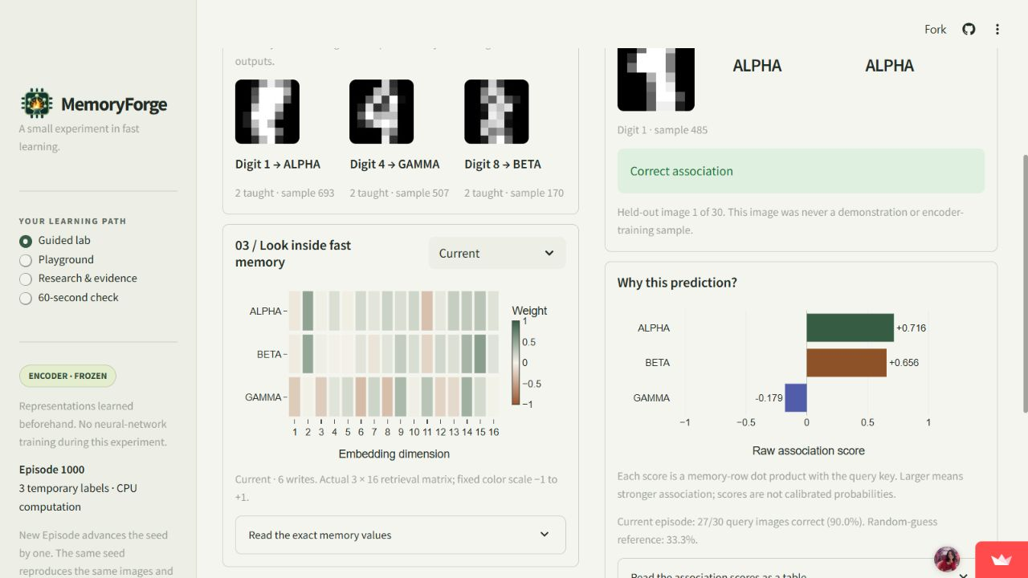
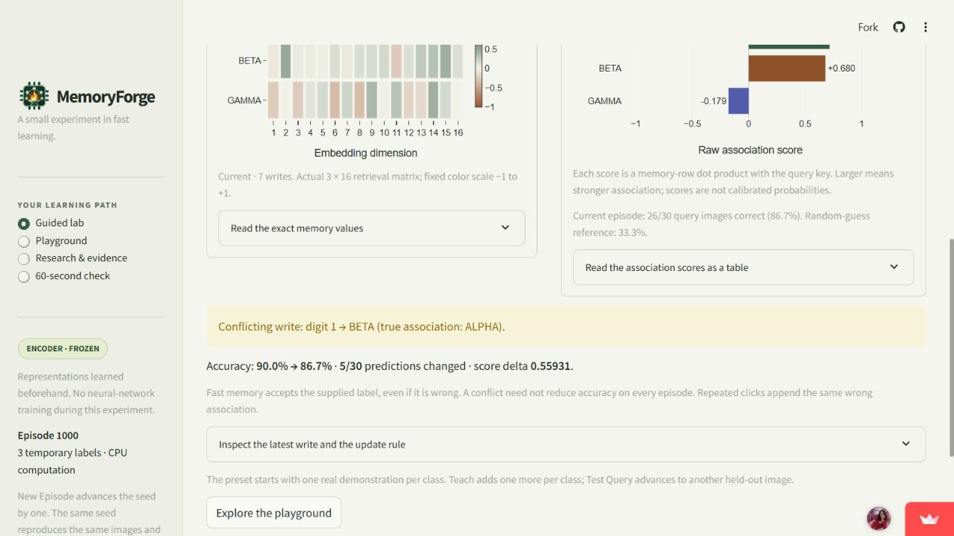
Memory changes, and a wrong label has a cost
6 writes / 27 of 30 correct
7 writes / 26 of 30 correct
The heatmap contains the actual matrix.
Retrieval scores equal memory-row dot products.
Five predictions change after one wrong label.
Reset clears memory and restores abstention.
Actual public app captures, seed 1000. The query set stays fixed. Original screenshots are included in the ZIP.
DataForge 2026 / BitWise / 05
Notes:
Source: https://github.com/deeps2710/MemoryForge/blob/main/artifacts/phase4_deployment.json and https://github.com/deeps2710/MemoryForge/blob/main/src/lab.py. Left: after two support examples per class, 6 writes, 27/30 correct. Right: Inject Conflict writes digit 1 as BETA while true association remains ALPHA. The same 30 queries give 26/30 correct and five predictions change. Encoder delta remains zero. Reset clears S and c and abstains. Screenshot files: assets/screenshots/memory-and-retrieval.png and conflict-outcome.png.

Slide 6
Measured evidence and the research connection
Mean query accuracy (%)
BDH [2025]
Fixed connections, dynamic Hebbian state.
The lab isolates that state distinction.
BDH-CQ [2026]
Context memory plus iterative workspace.
Workspace details remain proprietary.
DeltaNet [2024] / Titans [2024–25]
DeltaNet uses retrieval-and-correction.
Titans optimizes neural memory at test time.
650 conditions / 19,500 query outcomes
Encoder delta = 0 throughout
Shared images limit statistical inference.
MemoryForge uses supervised class means.
It implements neither BDH nor CQ reasoning.
Local developer evaluation, 50 fixed seeds. Papers: BDH 2509.26507v1; CQ 2608.09888v1; DeltaNet 2406.06484v3; Titans 2501.00663v1.
DataForge 2026 / BitWise / 06
Notes:
Source: https://github.com/deeps2710/MemoryForge/blob/main/artifacts/phase3_evidence.json. Native chart uses rounded mean accuracy percentages at 1,2,5,10 shots, conflicts 0 or 3. Query sets are paired within each seed. 650 total conditions and 19,500 outcomes share images; no independent evaluation claim. Primary citations adjacent to slide claims: BDH https://arxiv.org/html/2509.26507v1 §§1.2–1.3,2.2,3; CQ https://arxiv.org/html/2608.09888v1 §§3.1–3.3; DeltaNet https://arxiv.org/html/2406.06484v3 §§2.1–2.2,3; Titans https://arxiv.org/html/2501.00663v1 §§3.1–3.3. CQ exact updates/dimensions remain proprietary. This toy implements neither BDH nor CQ. No architecture accuracy ranking or external reproduction.

Slide 7
Deployment, reproducibility and limits
124 tests pass
Exact checkpoint regeneration and numerical core replay support reproducibility.
Public CPU application
Python 3.12.14. Observed actions: 952–1,017 ms. Fresh rebuild: within 130 seconds.
The claim stays narrow
Pretrained digit identities, temporary symbols, simple memory and overlapping episodes.
Team ownership
Codex assisted code and writing. BitWise must explain and defend the implementation.
Live: memoryforge.streamlit.app Source: github.com/deeps2710/MemoryForge
DataForge 2026 / BitWise / 07
Notes:
Sources: https://github.com/deeps2710/MemoryForge/blob/main/artifacts/phase4_final_robustness.json, https://github.com/deeps2710/MemoryForge/blob/main/artifacts/phase4_deployment.json, https://github.com/deeps2710/MemoryForge/blob/main/docs/LIMITATIONS.md. 124 tests passed on final Windows Python 3.12 configuration. Independent fresh retraining matches checkpoint tensors and full numerical Phase 1 report. Cloud Linux received install/browser verification. One measurement/action includes automation and network overhead. 130 seconds is an upper bound covering fresh provisioning and dependencies. No learner study or concurrent load study. User-provided team names/contacts do not establish role division or completed technical defense.

Slide 8
THANK YOU
DataForge 2026 / Team BitWise
Deepshikha Rani
Ved Patel
deepshikharani297@gmail.com
ved2032patel@gmail.com
Questions and live demonstration
DataForge 2026 / BitWise / 08
Notes:
DataForge 2026, Team BitWise. Deepshikha Rani and Ved Patel. The user supplied both names and email addresses and authorized optional inclusion in this presentation and its submission ZIP. Scoped MIT applies to original project code/docs/weights; logo and third-party notices remain separate. See docs/AI_ASSISTANCE.md and docs/PROVENANCE.md.

