Slide 1

DataForge 2026
MemoryForge
Associative Memory & Fast Weights
PS-1 — Pathway Track
Team BitWise
MEMBER
ASSIGNED RESPONSIBILITIES
Ved Patel
ML engineering, application development,
evaluation
Deepshikha Rani
Research, technical writing, presentation
MemoryForge / DataForge 2026 01
Notes:
Team names and contacts supplied by the user. The user authorized role allocation for this submission on 2026-09-08. See docs/TEAM.md. Assigned roles do not certify completed contribution history. Original supplied logo retained.

Slide 2
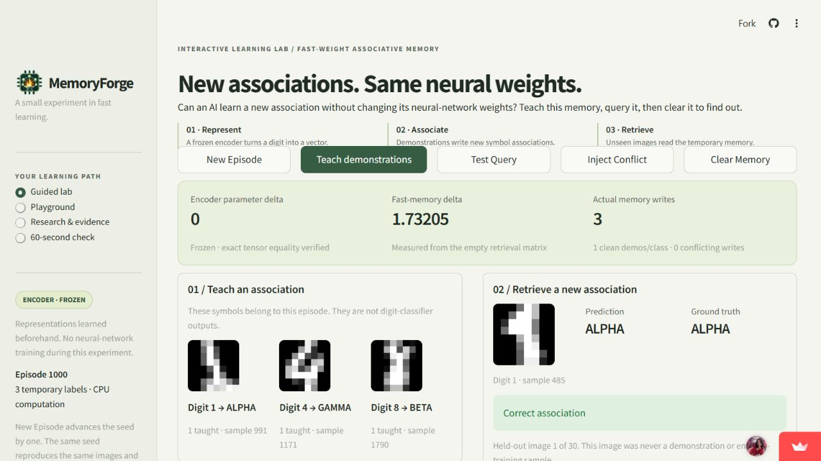
Learning an association without retraining
The problem
A changed prediction does not
show what the model learned.
MemoryForge exposes the
state that changed.
Encoder parameter delta
0
Fast-memory delta
1.73205 > 0
Working CPU prototype. Seed 1000 preset: 3 writes and 23/30 fixed queries correct.
MemoryForge / DataForge 2026 02
Notes:
Sources: https://github.com/deeps2710/MemoryForge/blob/3751264ac4eef1c5561692e67999c1d639ec658f/src/encoder.py, https://github.com/deeps2710/MemoryForge/blob/3751264ac4eef1c5561692e67999c1d639ec658f/src/lab.py, https://github.com/deeps2710/MemoryForge/blob/3751264ac4eef1c5561692e67999c1d639ec658f/artifacts/phase4_deployment.json. Public app inspected again on 2026-09-08 and shows the same preset. Screenshot captured earlier that date. Memory delta is Frobenius distance from the empty retrieval matrix. No claim of novel visual categories or learner outcomes.

Slide 3
The write rule and the retrieval rule
WRITE A DEMONSTRATION
What the symbols mean
S ← S + v kᵀ
k and q: unit 16-D embeddings
v: one-hot temporary label
S: key sums, c: write counts
c ← c + v
M[i] = S[i] / c[i]
What changes
Zero row when c[i] = 0
S and c change when taught.
M holds one mean per label.
Encoder tensors remain fixed.
READ A QUERY
scores = Mq
Empty memory abstains. Scores are similarities, not calibrated probabilities.
MemoryForge / DataForge 2026 03
Notes:
Source of truth: https://github.com/deeps2710/MemoryForge/blob/3751264ac4eef1c5561692e67999c1d639ec658f/src/fast_memory.py (_sums, _counts, _matrix, query). The toy uses class-wise averages of additive Hebbian sums, not direct additive updates to its displayed M. M rows are not renormalized. query computes row-major Q @ M.T. Only written labels can win. Exact ties use first index, flagged.

Slide 4
Architecture of the working prototype
Offline preparation
1,347 training images
Train 64–32–16 encoder
Save checkpoint + freeze
Runtime on CPU: 450 held-out images
Disjoint supports
and queries
Frozen encoder
unit embeddings
Session memory
S, c and Mq
Streamlit UI
audit + feedback
Python 3.12 / PyTorch / scikit-learn / NumPy / Streamlit / Plotly
No model API or database. Session reload clears memory. Detailed DFD: docs/DATA_FLOW.md.
MemoryForge / DataForge 2026 04
Notes:
Sources: https://github.com/deeps2710/MemoryForge/blob/3751264ac4eef1c5561692e67999c1d639ec658f/app.py, https://github.com/deeps2710/MemoryForge/blob/3751264ac4eef1c5561692e67999c1d639ec658f/src/data.py, https://github.com/deeps2710/MemoryForge/blob/3751264ac4eef1c5561692e67999c1d639ec658f/src/training.py, https://github.com/deeps2710/MemoryForge/blob/3751264ac4eef1c5561692e67999c1d639ec658f/src/lab.py. 1797 rows split 1347/450 using seed42. Encoder64-32-16 + 10-class head, trained100epochs. Classifier head is training/sanity only. Cache stores frozen encoder, heldout keys and original tensor snapshots. Each browser has its own LabSession. All image data are bundled scikit-learn digits.

Slide 5
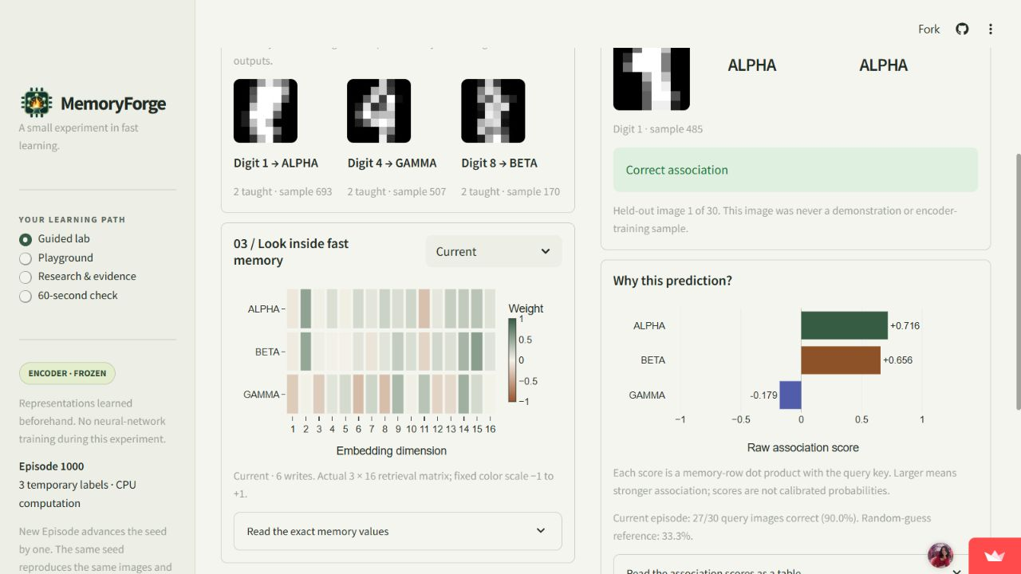
A learner can inspect each state change
1 Teach
Add one support per class.
S, c and M update.
2 Test Query
Read Mq on a held-out image.
Memory stays unchanged.
3 Clear Memory
Zero the memory.
The predictor abstains.
Guided lab, Playground, sourced research, and a 60-second concept check are implemented.
MemoryForge / DataForge 2026 05
Notes:
Sources: https://github.com/deeps2710/MemoryForge/blob/3751264ac4eef1c5561692e67999c1d639ec658f/src/ui.py and https://github.com/deeps2710/MemoryForge/blob/3751264ac4eef1c5561692e67999c1d639ec658f/src/lab.py. Actual screenshot after Teach to2shots/class,6writes27/30. Query advances through fixed30images without write. Clear zeros memory and abstains. Features also include0-10shot slider, saved research/evidence and3-question60-second check. No user learning study has been run.

Slide 6
More support reduces average conflict damage
Mean query accuracy (%)
50 fixed seeds
650 conditions
19,500 query outcomes
Encoder delta = 0 throughout
A limit worth testing
More shots can hurt one seed.
No novel-category or
concurrent-load evaluation.
Developer evaluation. Shared images and unequal corruption fractions limit the comparison.
MemoryForge / DataForge 2026 06
Notes:
Source: https://github.com/deeps2710/MemoryForge/blob/3751264ac4eef1c5561692e67999c1d639ec658f/artifacts/phase3_evidence.json. Developer-produced paired suite:50seeds1000-1049,0/1/2/5/10shots;0/1/3wrongwrites atnonzero shots.650conditions19500outcomes. Bar values rounded0.01percentage point, labels0.1. Clean means94.07,95.67,96.93,98.07. Corrupt3means84.47,86.87,94.20,97.27. Clean-minus-corrupt gaps9.60,8.80,2.73,0.80pp. Fixed corruption count means different noise fractions. No independent replication.

Slide 7
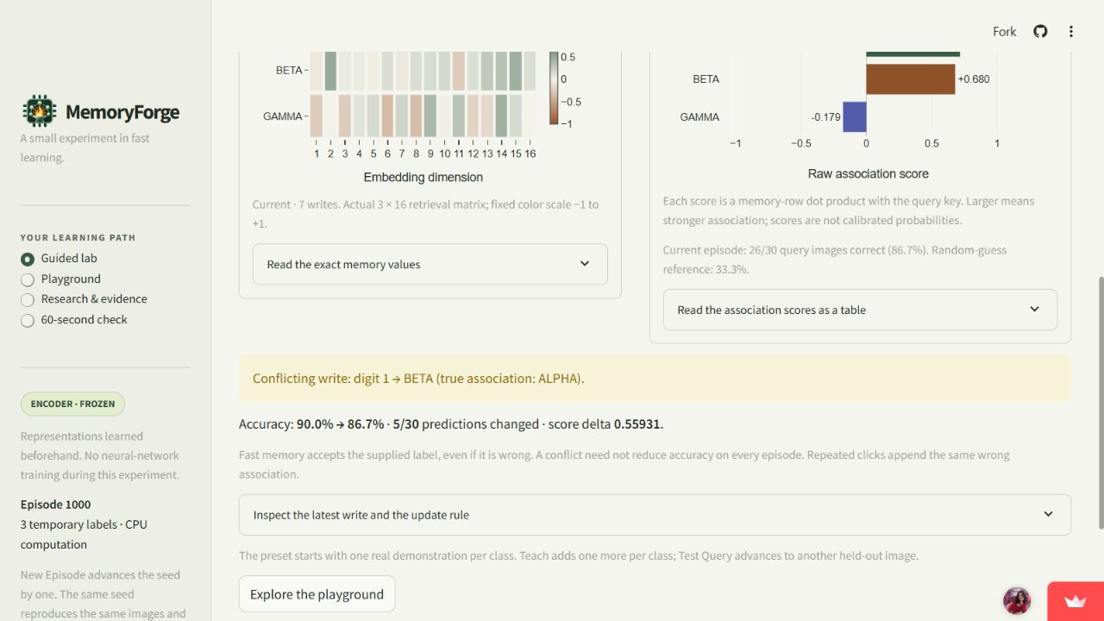
A wrong label changes the answer
27/30 → 26/30
correct after the conflict
5 predictions change
The mean for BETA now
includes an ALPHA key.
The lesson
A writable memory also
accepts contradictory input.
Seed 1000, the same 30 queries. One mislabeled write; the original ground truth is preserved.
MemoryForge / DataForge 2026 07
Notes:
Sources: https://github.com/deeps2710/MemoryForge/blob/3751264ac4eef1c5561692e67999c1d639ec658f/artifacts/phase2_demo.json, https://github.com/deeps2710/MemoryForge/blob/3751264ac4eef1c5561692e67999c1d639ec658f/artifacts/phase4_deployment.json, https://github.com/deeps2710/MemoryForge/blob/3751264ac4eef1c5561692e67999c1d639ec658f/src/lab.py. Conflict appends first taught digit1key toBETA, whiletrueALPHAunchanged. At2shots/class6writes27/30; conflict7writes26/30. Five predictions change, netonefewer correct. It can improve or worsen a different seed. Reset actually zeros S,c. Screenshot is the actual UI warning and measured outcomes.

Slide 8
The research connection is about changing state
BDH [1]
BDH-CQ [2]
Fixed connections coexist with
Hebbian synaptic state.
This motivates the teaching distinction.
Context memory feeds an iterative
query workspace. Exact updates
and dimensions remain proprietary.
Alternative update rules
MemoryForge’s boundary
DeltaNet [3]: retrieval-error correction.
Titans [4]: neural memory optimized
at test time.
Class-mean label memory only.
No BDH graph or CQ workspace.
No claim of general reasoning.
[1] 2509.26507v1 [2] 2608.09888v1 [3] 2406.06484v3 [4] 2501.00663v1
PS-1 / Pathway: a real state-changing experiment, inspectable evidence, and sourced BDH explanation.
MemoryForge / DataForge 2026 08
Notes:
Primary sources, rechecked2026-09-08: BDH https://arxiv.org/html/2509.26507v1 §§1.2,2.2; CQ https://arxiv.org/html/2608.09888v1 §§3.2-3.3; DeltaNet https://arxiv.org/html/2406.06484v3 §§2.1-2.2; Titans https://arxiv.org/html/2501.00663v1 §3. Published mechanisms only. MemoryForge implements none of these architectures. User-specified PS-1/Pathway; organizer audited docs/SUBMISSION_INSTRUCTIONS_AUDIT.md.

Slide 9
What it can support, and what needs validation
Reuse and scale
Next experiments
Sustainability option
An inspectable CPU teaching lab.
Core S+c state: 408 bytes.
Dense reads grow with labels
and embedding width.
Total app memory is larger.
Hold the noise fraction fixed.
Compare memory update rules.
Test unfamiliar categories.
Measure learner understanding
and concurrent-session behavior.
Keep the teaching core open.
Explore paid workshops or
managed classroom hosting.
Validate demand and support
costs before offering a service.
Functional prototype today
Public CPU app, 124 tests passed, reproducible evidence.
Learner outcomes and production capacity remain unmeasured.
Proposals only. No current revenue, paying users, learning-outcome study, or production-readiness claim.
MemoryForge / DataForge 2026 09
Notes:
Current core-state arithmetic is derived from src/fast_memory.py:3*16+3=51float64values=408bytes, excludingencoder,derivedM,snapshots,history,keysandPythonoverhead. Dense updates/readO(Cd) forC labels,d features. No capacity orconcurrentloadstudy. Future work and sustainability are proposals requested for this presentation, not implementation commitments or current revenue. See docs/FUTURE_SCOPE.md. No pricing, customer orpartner claim.

Slide 10
DataForge 2026
THANK YOU
MemoryForge / Team BitWise
Ved Patel
Deepshikha Rani
ved2032patel@gmail.com
deepshikharani297@gmail.com
Live demonstration: memoryforge.streamlit.app
MemoryForge / DataForge 2026 10
Notes:
Team names/contacts supplied by the user. Roles newly allocated on user authorization. MIT covers original code/docs/weights, with separate logo, dataset and dependency terms. Codex assistance disclosed. Public preset read again2026-09-08. Prototype verified, competition upload not performed.

