Slide 1

The MITRE Embed Project
Founder:
Brennan Lodge

Slide 2

MITRE Embed
An open source project enabling MITRE mapping of events, detection logic and alerts
MITREembed is an open-source platform designed to revolutionize security monitoring by mapping security log events and detection rules to MITRE ATT&CK techniques using machine learning and multimodal testing.
This project targets cybersecurity professionals aiming to enhance their monitoring capabilities, providing them with a tool that translates complex data into actionable intelligence.

Slide 3
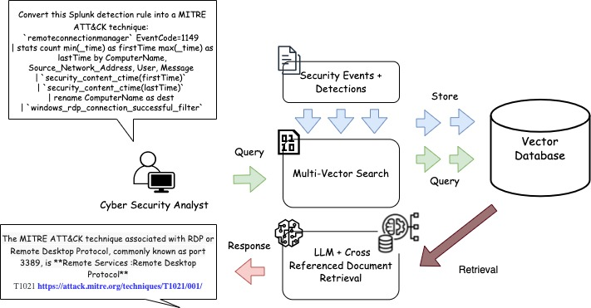
Security Events + Detections:
The process begins with the collection of security events and detections, such as log entries, alerts, and other relevant security data.
Multi-Vector Search:
These events are queried using a multi-vector search that analyzes various attributes like source, destination, user behavior, and network patterns, identifying potential matches with known attack techniques.
Vector Database:
The results of these queries are stored in a vector database, which acts as a high-performance storage solution that supports fast retrieval and scalable querying. This database is continuously updated with the latest security intelligence to ensure accurate mapping.
LLM + Cross-Referenced Document Retrieval:
The framework leverages a Large Language Model (LLM) to cross-reference the detected events with documentation, best practices, and known attack vectors. This process ensures that the security analyst receives contextually rich information, enhancing their ability to respond effectively to threats.
Response:
The final output is a response that provides the cybersecurity analyst with a precise MITRE ATT&CK technique associated with the detected event, including references to relevant documentation and potential remediation steps.

Slide 4
