Slide 1
BUSINESS CONTEXT
B2B & distributor portal
Unique Distribution ID for customer /distributor identification and order processing
Product Catalog (salonary products)
Order Management & inventory Billing
Securable (AWS WAF enabled + shield (DDOS protection)
High Availability and Fault tolerance–Multi Az deployment across availability Zones

Slide 2
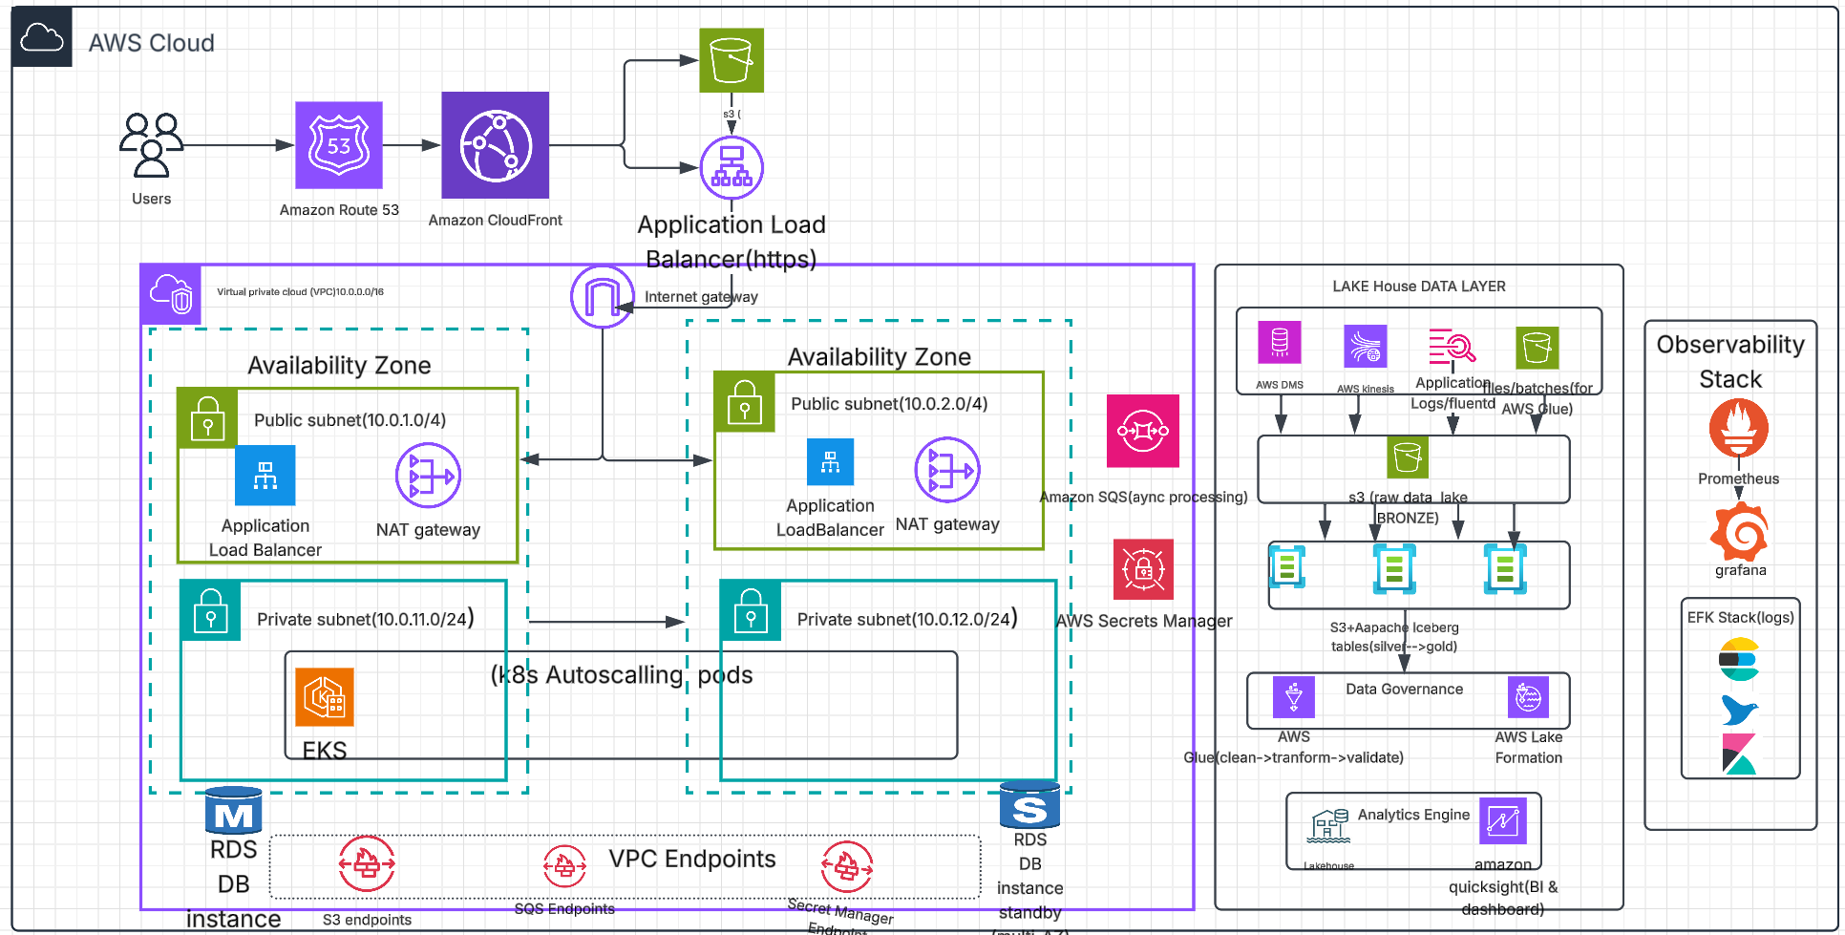
E-Commerce Platform(Salonary Products) on AWS Platform
[due to limitation of tools not able to show case security components like SNS, shield and WAF enabled in diagram .In another components are mentioned)

Slide 3
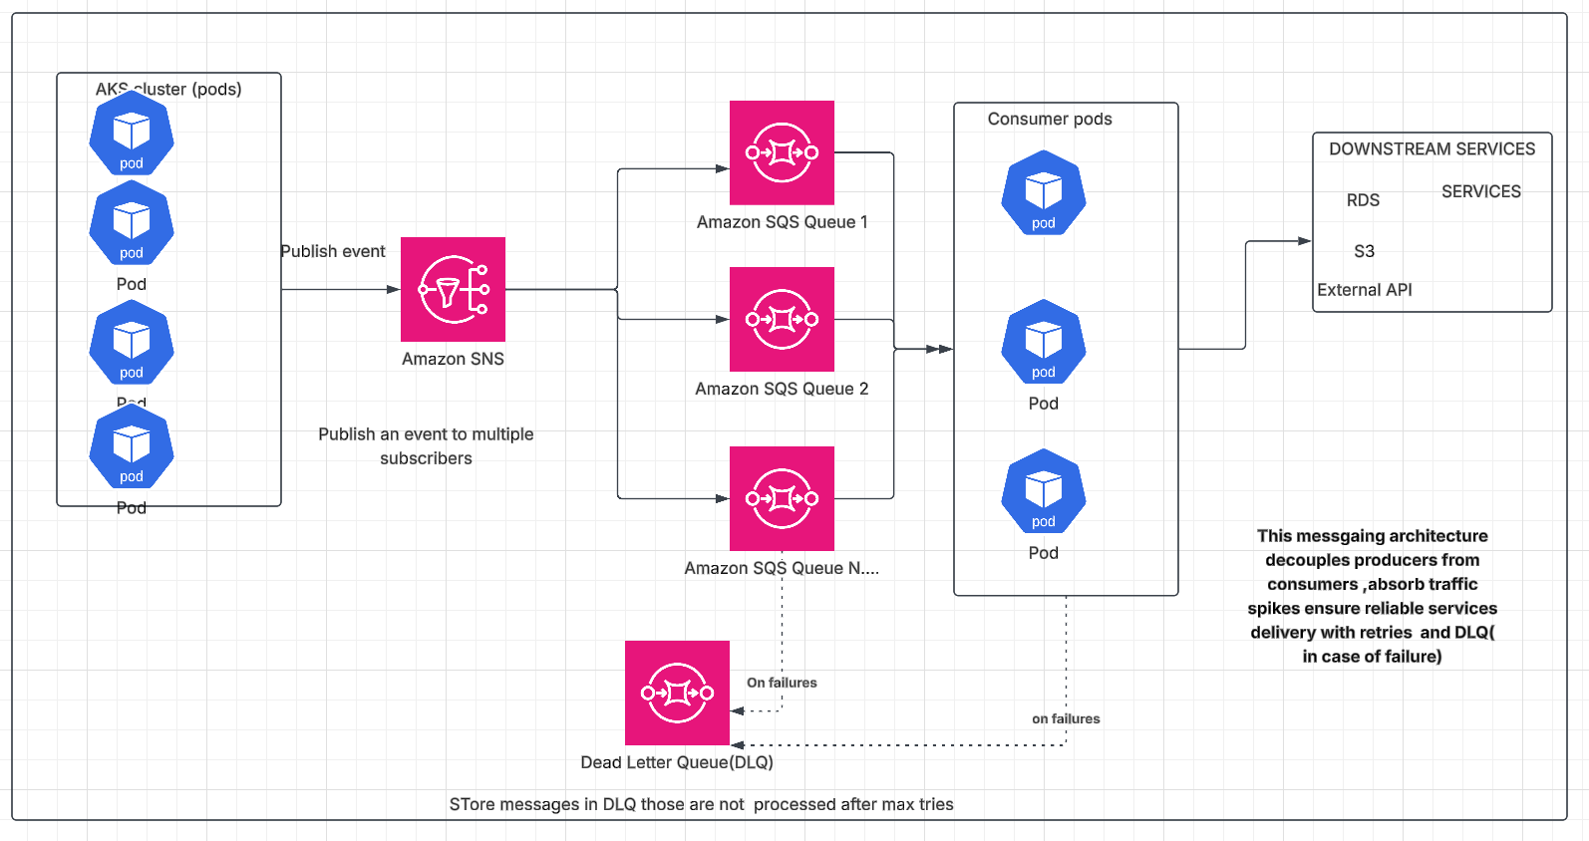
Messaging Architecture(Closure Look)

Slide 4
Amazon Services:
S3: Chosen for product images, distributor documents, invoices, reports, frontend static files and data-lake objects. These are primary objects storage workload .It can be handled better rather EFS .EBS , inside EKS as a pod ( need to attach volume and managed it). It also decouples application compute storage.
Lakehouse(S3 based):The data is coming from multiple sources (RDS DB , application events , clickstream, logs and batch files. Instead of maintaining separate storage placeholder , we can bring the data in S3 and organize it in raw, silver and gold(business ready operations).Since we are already using S3 for our front end , product images and reports, it also keeps the overall structure consistent and simple.
AWS Glue: The data coming from different streams, we need to clean .transform and prepare that data before putting into our curated layers .It is serverless and no require to manage EC2 infrastructure for the same and also integrate well with S3.

Slide 5
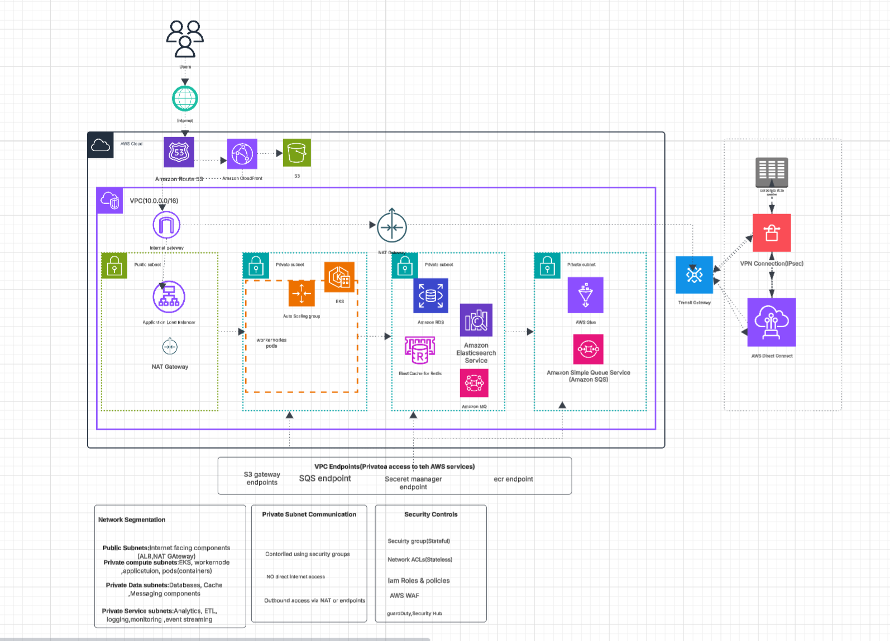
Network Segementation

Slide 6
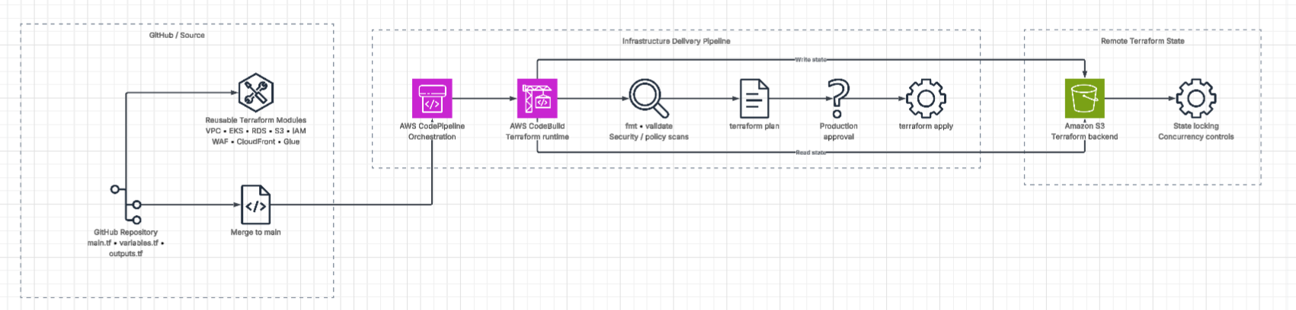
Architecture Diagram-Terraform +AWS code pipeline

Slide 7
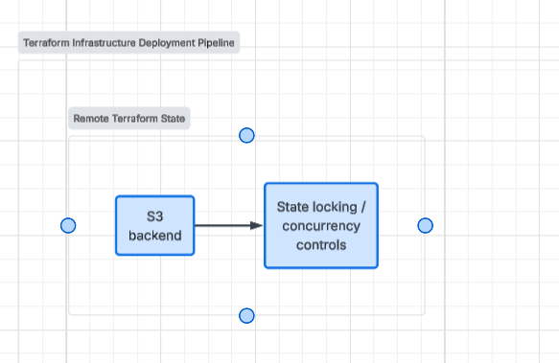
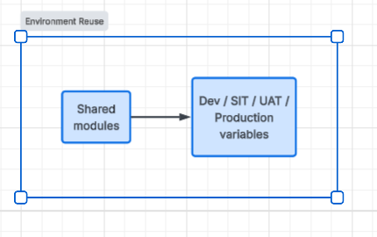
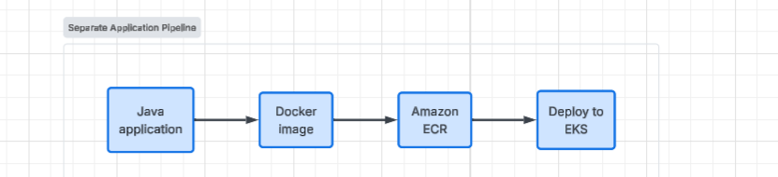
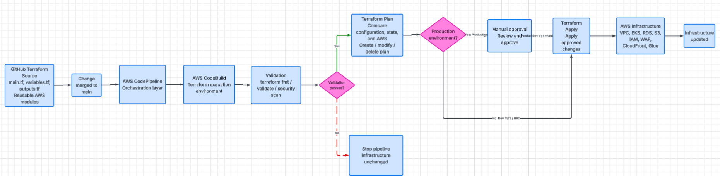
CI/CD Flow Diagram:
Create remote Terraform state file
Reduce Redundancy Code-Sharing modules
Overview of application Deployment
Full deployment process

Slide 8
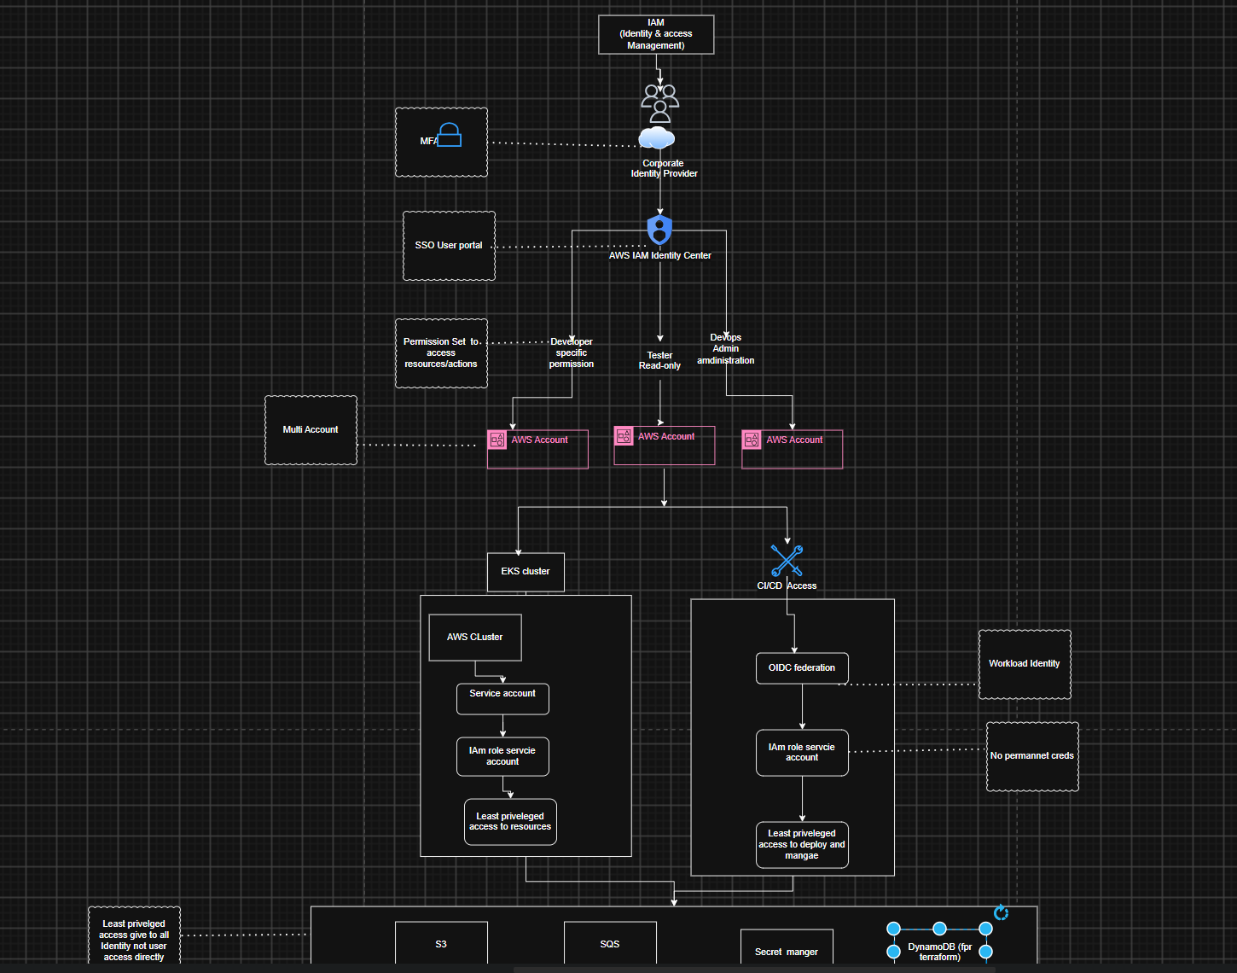
IAM Strategy

Slide 9
Multi-Level Cloud Cost Optimization Strategy
Cost optimization is not limited to infrastructure. In this architecture, I would approach cost optimization at multiple levels:
Application-level
Compute-level
Database-level
Data/storage-level
Network-level
Observability-level

Slide 10
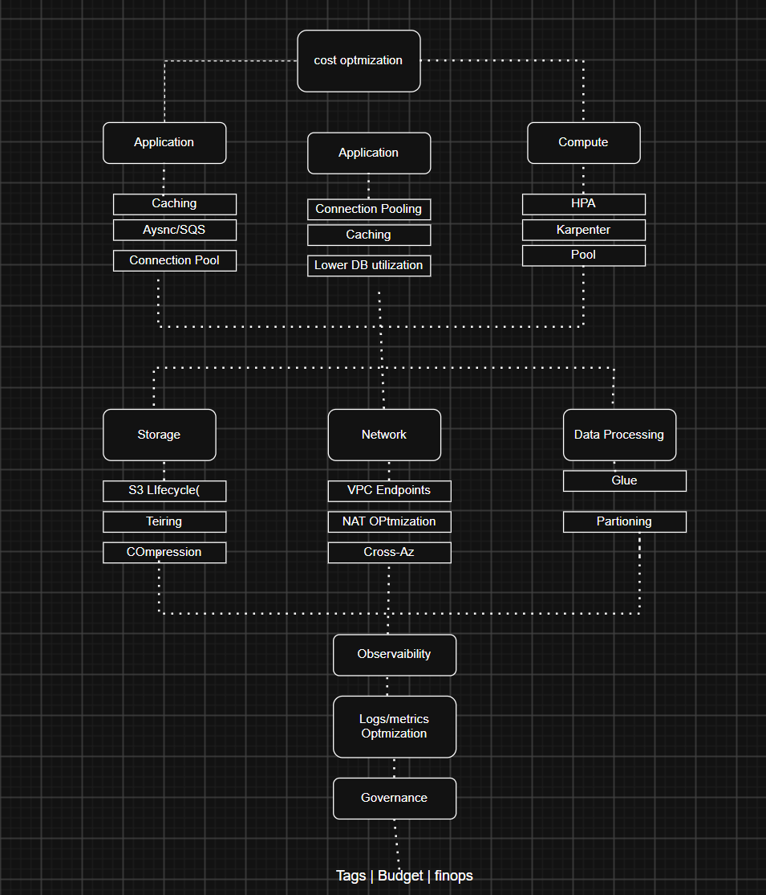
Multi-Level Cloud Cost Optimization Structure

Slide 11
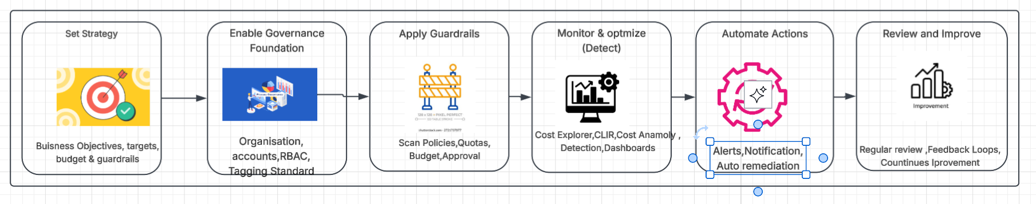
AWS Governance

Slide 12
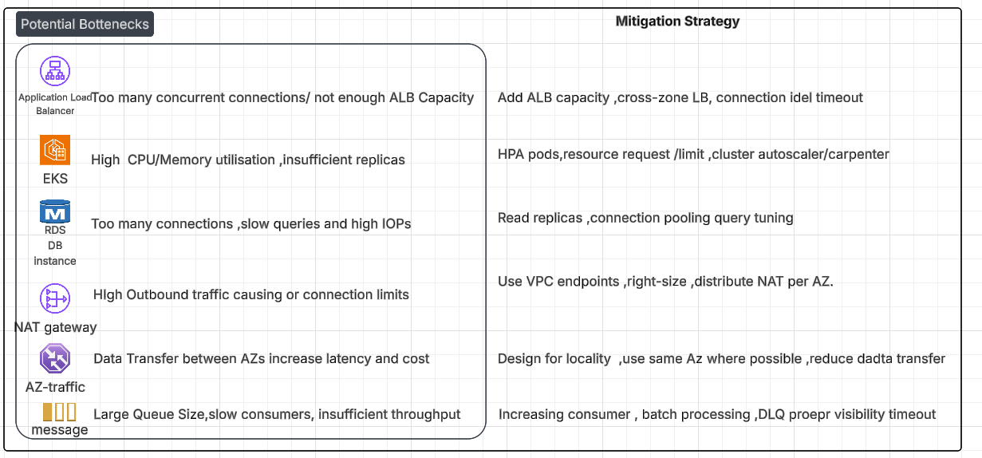
Potential Bottlenecks & Mitigation

