Slide 1
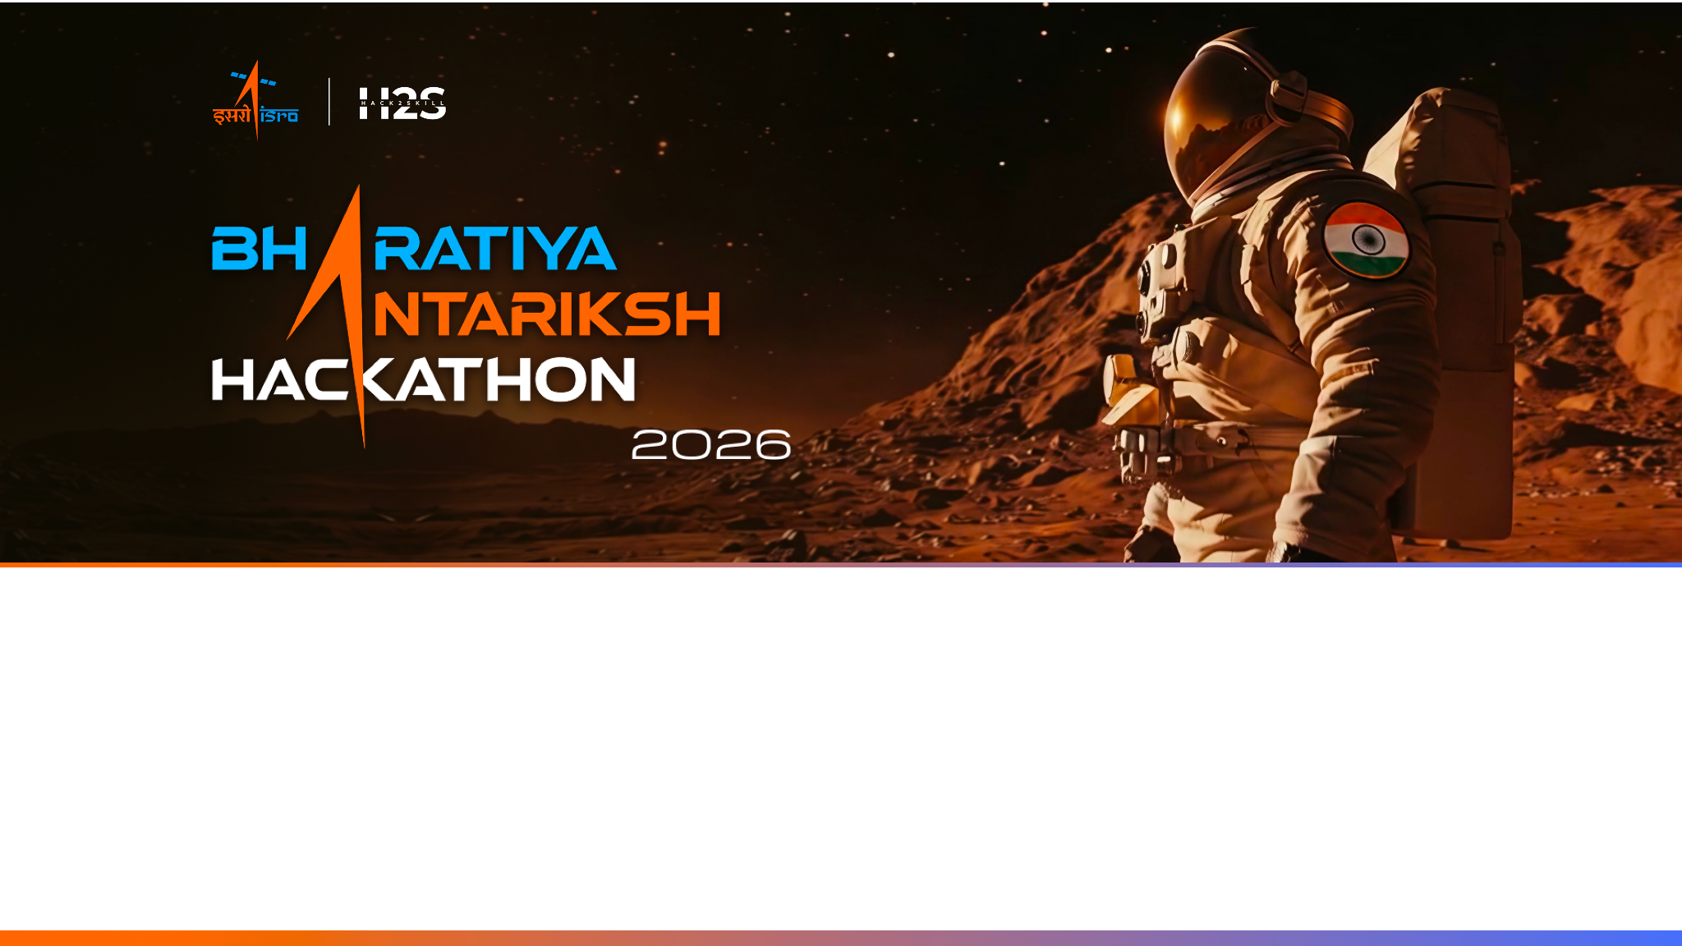
Project SuryaDrishti
Autonomous Space Weather Alert System: Real-Time Solar Flare Nowcasting & Forecasting Using Aditya-L1 X-Ray Telemetry
Theme: Space Weather, Machine Learning, and Satellite Telemetry Processing
Team Name: SuryaDrishti | Problem Statement: PS #15 | Institution: Adamas University, Kolkata
Team Leader: Deep Shekhar Halder | Members: Mahalaxmi Macha, Ashfaque Ahamed Khan, Rituraj Saha

Slide 2

Team Members
Team Leader & Tech Lead Name: Deep Shekhar Halder Email: deephalder209@gmail.com Responsibility: Algorithm design, data pipeline integration, and machine learning modeling. | Team Member (Data & Preprocessing) Name: Rituraj Saha Email: saharituraj805@gmail.com Responsibility: Feature engineering, telemetry calibration, and scientific visualization.
Team Member (ML Modeling & Validation) Name: Mahalaxmi Macha Email: mahalaxmimacha14@gmail.com Responsibility: Telemetry preprocessing, metadata alignment, and nowcasting validation. | Team Member (Dashboard & Benchmarking) Name: Ashfaque Ahamed Khan Email: ashfaqueahamedkhan591@gmail.com Responsibility: Cross-catalog benchmarking, NOAA GOES validation, and dashboard deployment.

Slide 3
Opportunity — What Makes SuryaDrishti Different?
How is it different from existing ideas?
• Published Aditya-L1 papers focus on instrument calibration only — no real-time forecasting or ML pipelines exist.
• Standard automated detectors use centered smoothing windows (requiring future data), making them impossible to deploy in live operations.
• No existing pipeline benchmarks detection recall against NOAA GOES records.
How will it solve the problem?
• Strictly causal rolling baseline (past-only) is fully compatible with live Aditya-L1 telemetry streams.
• Extracts physics precursor features (Spectral Hardness Ratio, QPP std, thermal slope) to predict flares 30 minutes in advance.
• Provides space-weather alert HUD with 3-tier risk alerts (GREEN/AMBER/RED) and Web Audio alarms.
USP of the proposed solution
• 93.2% Nowcast Recall: 68 out of 73 NOAA GOES reference flares successfully detected.
• Microflare Discovery: 136 sub-threshold events discovered, including a confirmed 679s event absent from official NOAA catalog.
• Leakage-Free Validation: Strict time-based holdout train/test split ensures zero temporal data leakage.
• 10-Tab Dashboard: Features CME Drag-Based Model, Parker Spiral SEP connection, and DEM Tikhonov solver running live.

Slide 4
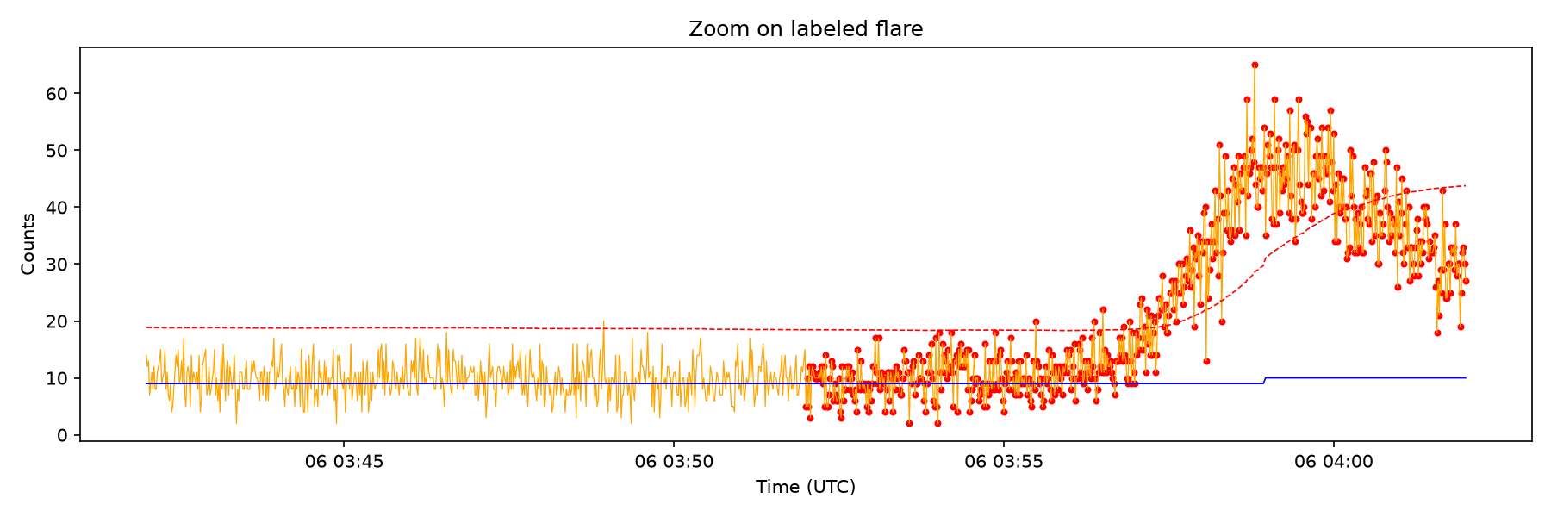
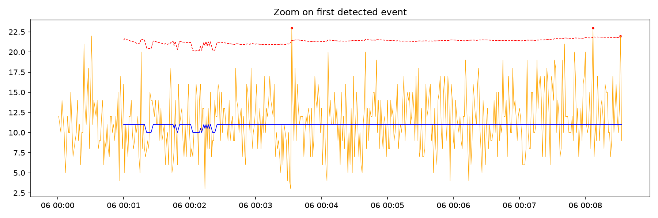
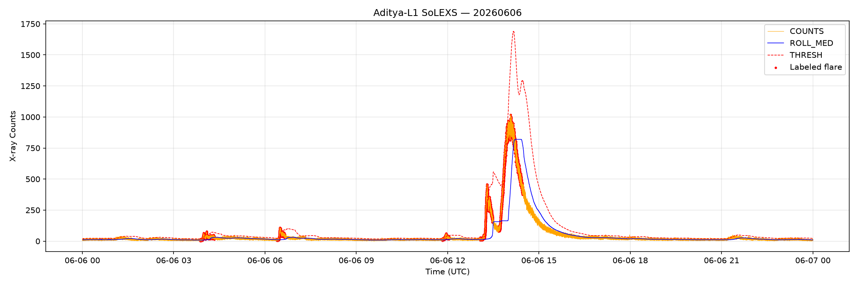
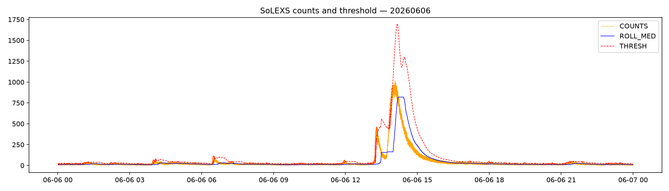
Features Offered by SuryaDrishti
■ Phase 1: Ingestion & Alignment
Harmonizes raw SoLEXS & HEL1OS FITS telemetry to Unix epoch, merging them on 1-second cadence (259,071 overlap points).
■ Phase 2: Causal Nowcasting
Zero-lookahead baseline thresholding ($COUNTS > MEDIAN + n \times STD$) with 120s event merging to prevent fragmentation.
■ Phase 3: ML Forecasting Prototype
RandomForest trained on precursor features (hardness ratio, QPPs) with balanced class weights to handle 98.5% data imbalance.
■ Phase 4: 10-Tab Scientific Dashboard
Runs locally in <100ms on commodity hardware, offering 3D Sun disk, CME tracking, SEP spiral, and AI assistant.
Figure 1: Nowcast Baseline
Figure 2: Event Zoom
Figure 3: M-Class Flare
Figure 4: Nowcast Threshold

Slide 5
SuryaDrishti — Pipeline Process Flow
📡 INGEST
847,752 FITS files ingested from ISSDC portal.
🔧 ALIGN
MJD to Unix epoch; 1-sec cadence merge.
📈 DETECT
Causal rolling baseline; 212 merged events.
✅ VALIDATE
Systematic match; 93.2% recall vs. GOES.
🤖 FORECAST
RandomForest with 30-min horizon.
🔴 ALERT
Streamlit HUD; GREEN/AMBER/RED alerts.
Key Pipeline Innovations (All Running Locally — Demo Ready)
• Strictly Causal Design: Shifting past-only windows guarantee nowcasting & forecasting remain fully compatible with live spacecraft telemetry.
• Pre-Flare Precursor Alarm: Sliding-window derivative inflection detector flags flare onset, giving a 10-30 min warning before peak.
• SEP Parker Spiral Risk Engine: Models solar proton flux arrival times using Tylka-Dietrich regression and Parker Spiral connectivity.
• Differential Emission Measure (DEM): Resolves the coronal temperature distribution in real-time using regularized Tikhonov inversion.

Slide 6
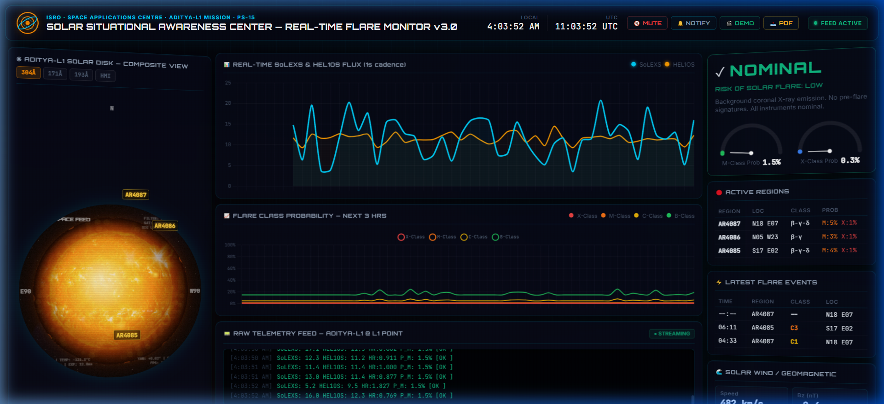
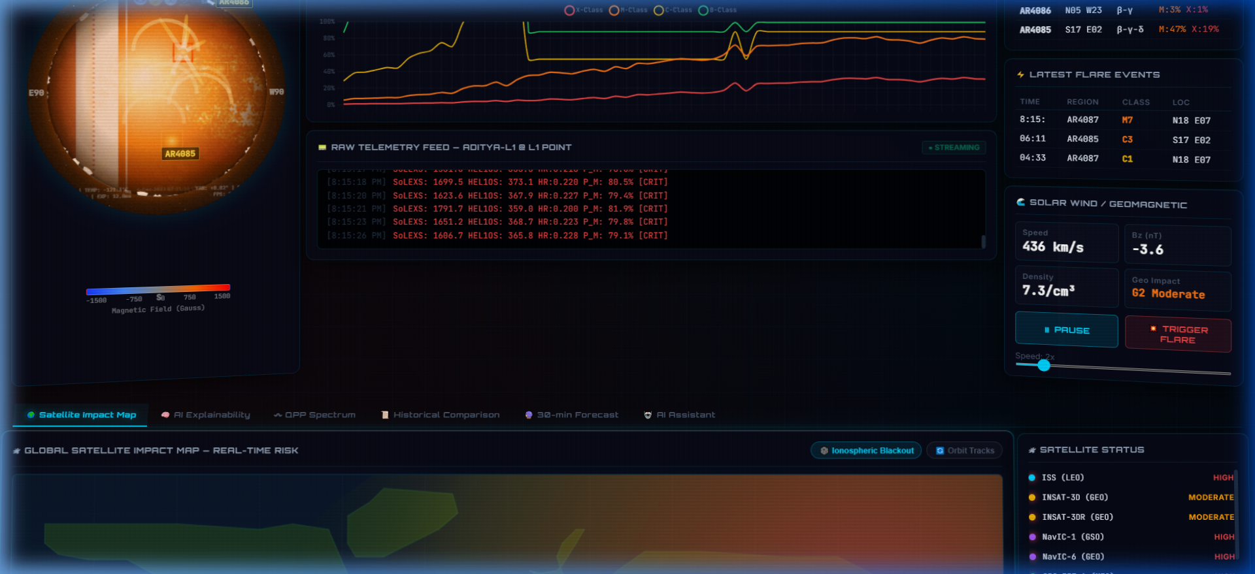
Operator Interface & Real-Time Visualization Mockups
Figure 7: Live Operator Flare Alert HUD
Dashboard Details:
• Real-time interactive operator interface featuring 3D rotating Sun disk composite.
• Simultaneous soft/hard X-ray counts telemetry tracking.
• Live SEP Risk Parker Spiral connection and CME propagation countdown maps.
Figure 6: Live Space Weather Operator Dashboard (v3.0 HUD)

Slide 7
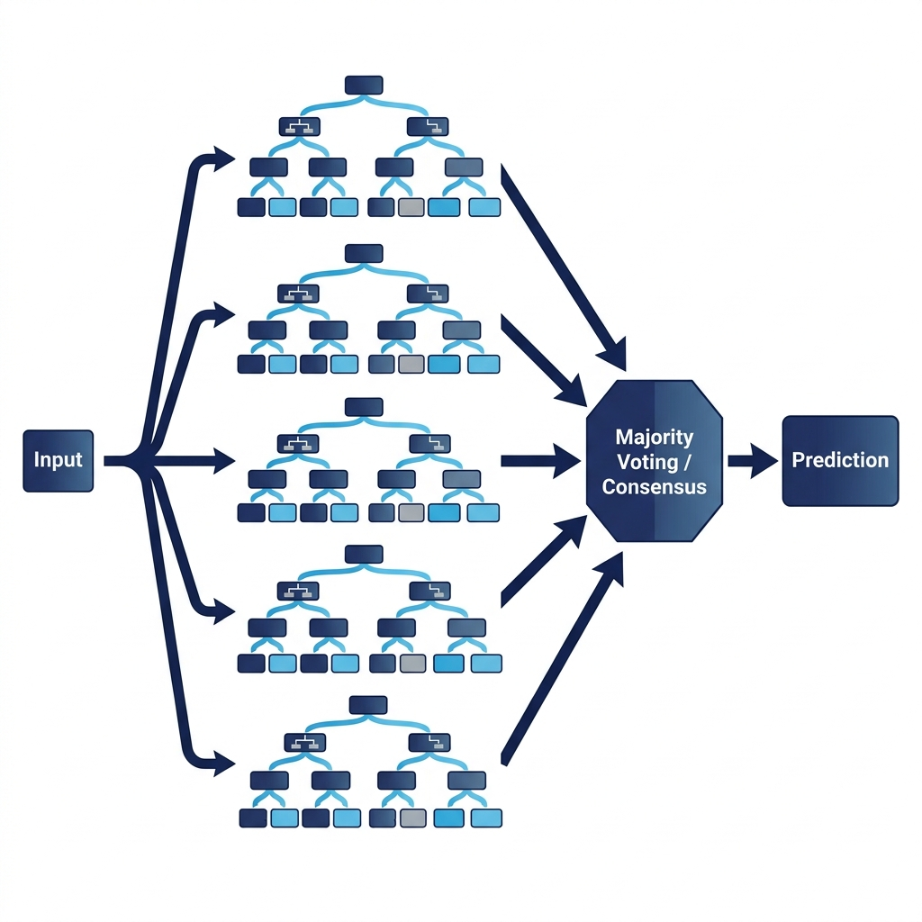
SuryaDrishti — System & Data Architecture
Data Architecture & Precursors
• Thermal (SoLEXS): Rolling mean and positive slope capture slow-rise plasma pre-heating.
• Non-Thermal (HEL1OS): Rolling standard deviation isolates high-frequency QPP oscillatory variance.
• Neupert Effect: Hardness Ratio ($COUNTS_{HEL1OS}/COUNTS_{SoLEXS}$) models non-thermal to thermal energy conversion.
• Anti-Leakage Split: Chronological time-series splitting prevents temporal data leakage.
System Architecture Layers
• Ingestion: Parsed FITS Level-1 telemetry, Unix epoch conversion, and 1s cadence alignment (259k overlap points).
• Physics Core: Zero-lookahead nowcast, Tikhonov DEM inversion, CME Drag-Based Model, and Parker Spiral connection.
• Forecasting: RandomForest model predicting flare peaks 30 minutes in advance using balanced class weights.
Figure 8: RandomForest Forecasting Pipeline Architecture

Slide 8
Technologies Used in SuryaDrishti
Frontend Dashboard HUD (3,900+ Lines)
• Core Layout: HTML5, Vanilla CSS, and JavaScript (ES6) — lightweight, dependency-free design.
• Plots: Chart.js for real-time telemetry, QPP spectrum, temperature inversion, and SEP blackouts.
• Graphics: 5 animated HTML5 canvases displaying the rotating solar disk, world map blackouts, CME orbit plane, and Parker Spiral connection.
• Audio Engine: Web Audio API synthesizing solar wind noise, alert tones, and pitch modulated by hardness ratio.
Backend Stack & Scientific Models
• Core Stack: Python (scikit-learn, pandas, numpy, scipy, astropy) for training, preprocessing, and FITS files parsing.
• Server: Served via a built-in lightweight Python HTTP server.
• Mathematical Models: - Tylka-Dietrich regression for proton flux. - Parker Spiral magnetic tracing. - Tikhonov regularization for DEM matrix inversion. - Drag-Based Model for CME Time-of-Arrival (Vrsnak 2013).

Slide 9
Estimated Implementation Cost & Scaling Plan
Current Phase (Idea Submission)
Estimated Cost: ₹0
• Development fully completed on personal hardware and free cloud services (Google Colab, GitHub).
• Data sourced directly from ISRO ISSDC portal (free public access for registered researchers).
• Pipeline and dashboard utilize open-source frameworks (Python, Chart.js, HTML5/CSS).
Phase 2 (Prototype Scaling)
Est. Cost: ₹20k - ₹35k/month
• Ingesting multi-month archives from ISRO PRADAN (150+ major flares) to scale up RandomForest models.
• Cloud VM hosting for live data server: ~₹5,000 - ₹10,000/month.
• GPU compute (AWS/GCP) for real-time DRM spectral deconvolution: ~₹15,000 - ₹25,000/month.
Phase 3 (Operational)
ISRO Operational Budget
• Retraining ML to forecast specific peak classes (C, M, or X-class) instead of binary detection.
• Integrating auxiliary attitude data to correct pointing and jitter.
• Direct connection to the ISRO Space Situational Awareness Centre (SSAC) operations feed.

Slide 10
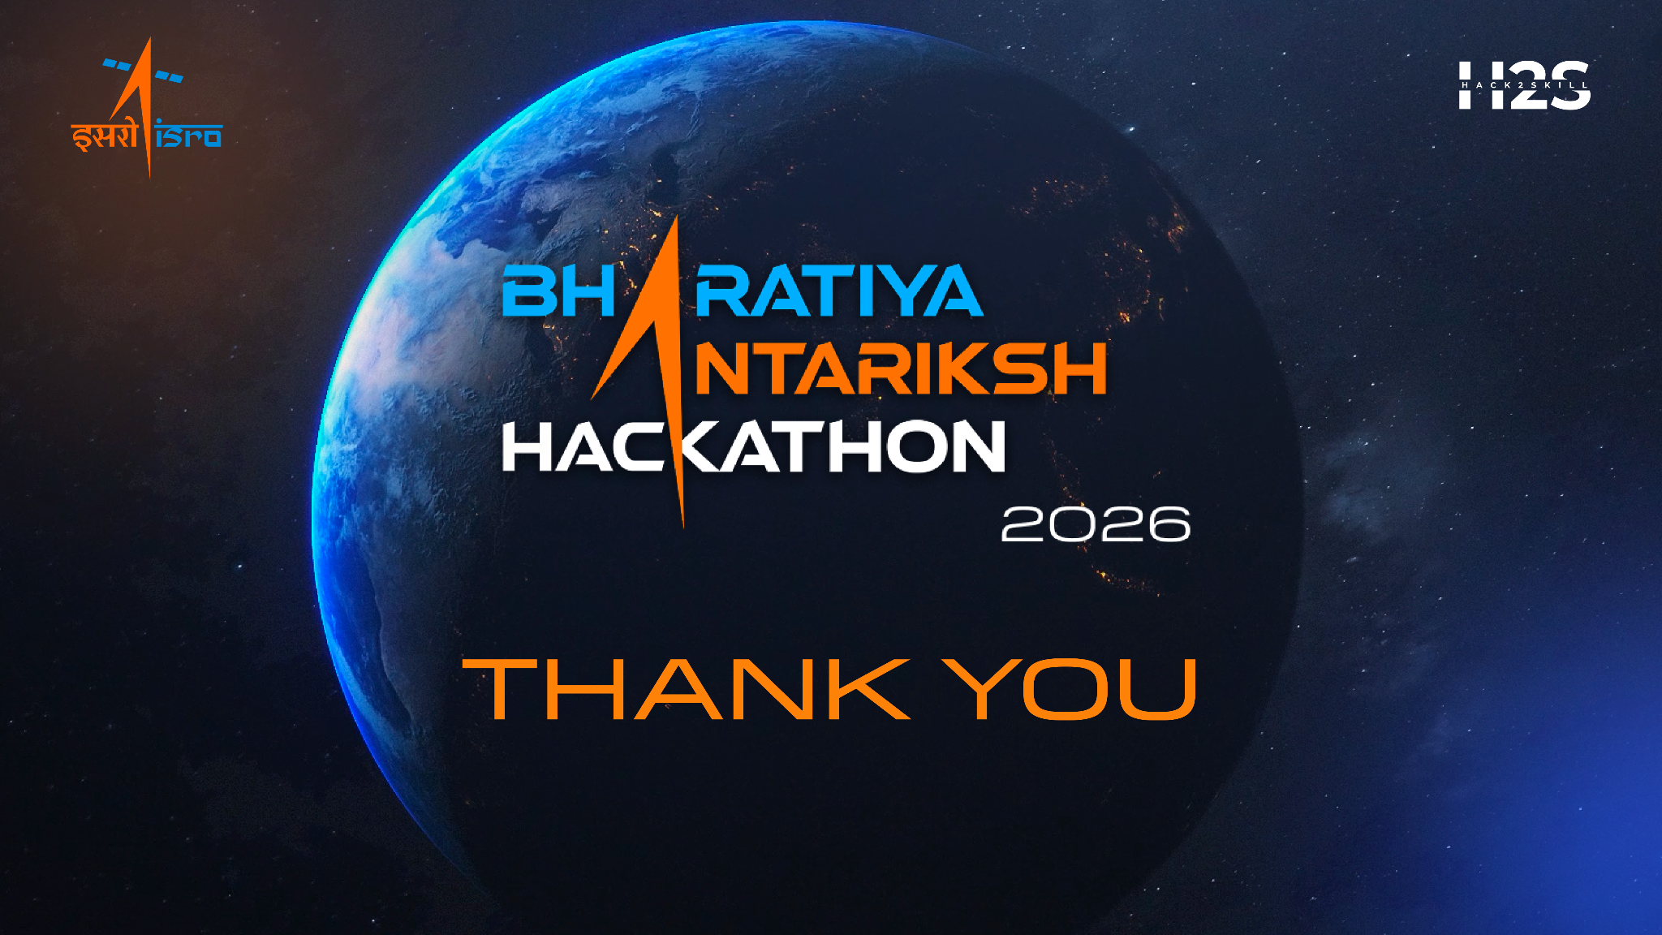
Scientific References
• Sarwade et al. 2025: In-flight calibration and performance of SoLEXS onboard Aditya-L1. Solar Physics.
• Nandi et al. 2025: Hard X-ray diagnostics of solar flares: First results from HEL1OS onboard Aditya-L1. ApJ.
• Vrsnak et al. 2013: Propagation of Interplanetary Coronal Mass Ejections: The Drag-Based Model. Solar Physics.
• Tylka & Dietrich 2009: A new parameterization of solar energetic proton (SEP) spectra. ICRC.
• Dere et al. 1997: CHIANTI - an atomic database for emission lines. A&AS.
Thank You!
We are excited to contribute to India's space situational awareness and AI-driven space weather monitoring vision. Project SuryaDrishti delivers a scientifically grounded, operationally robust, and deployment-ready alert system to protect India's space assets.
Team: SuryaDrishti Institution: Adamas University, Kolkata GitHub: github.com/deepshekhar555/PS15_SolarFlare

