Slide 1
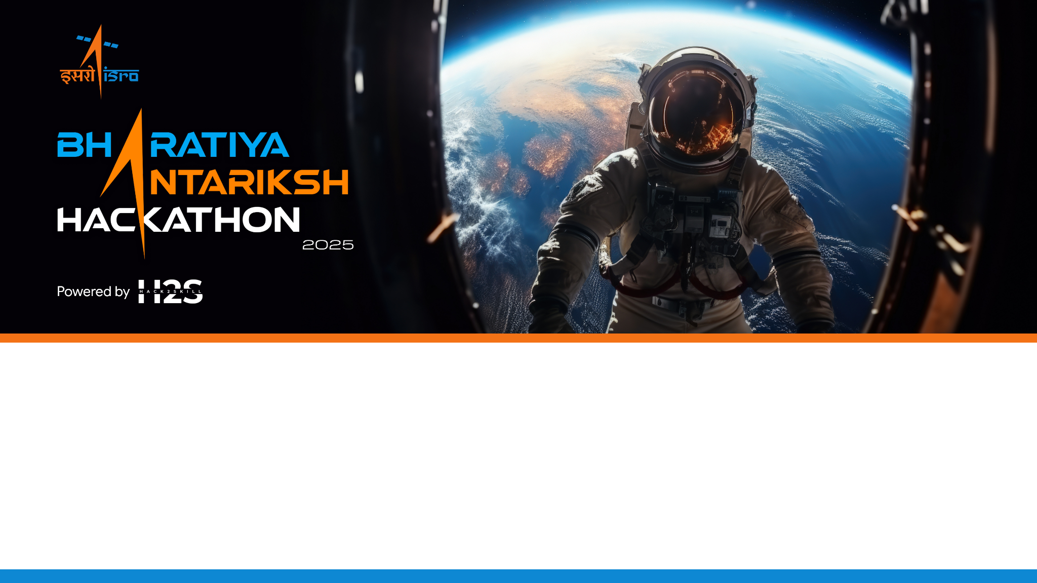
Team Name : SuryaDrishti
Team Leader Name : Deep Shekhar Halder
Problem Statement : PS15 - Real-Time Solar Flare Nowcasting and Forecasting Using ISRO Aditya-L1 X-Ray Telemetry

Slide 2
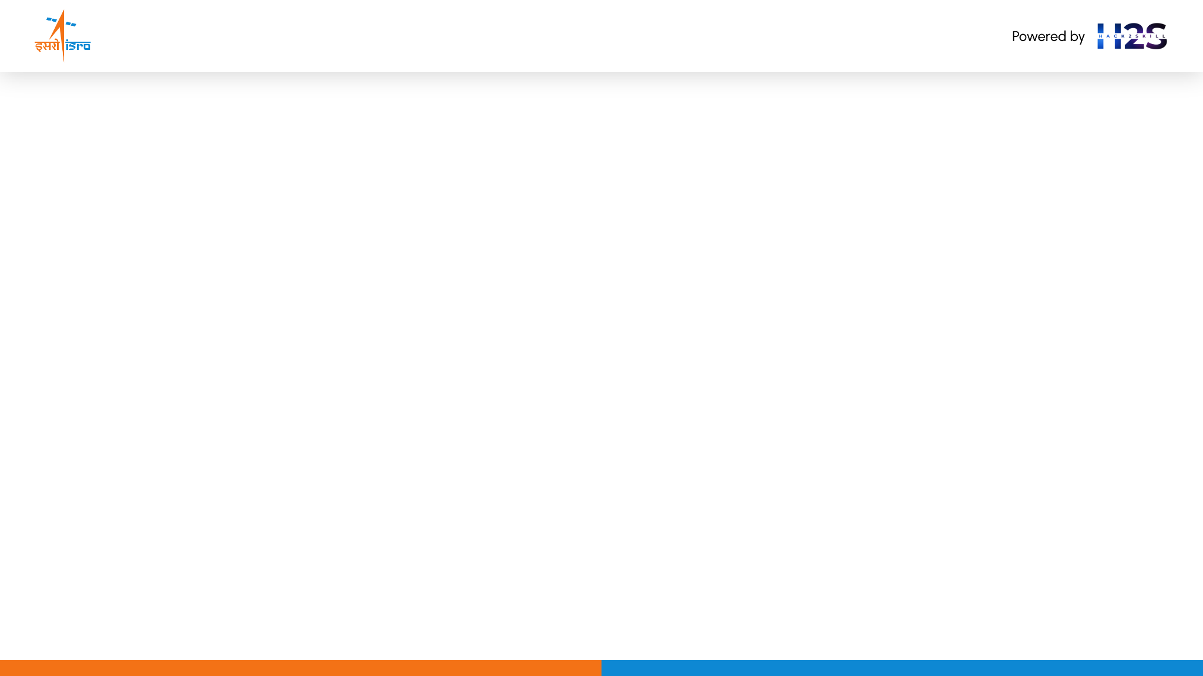
Team Members
Team Leader & Tech Lead Name: Deep Shekhar Halder Email: deephalder209@gmail.com College: Adamas University, Kolkata | Team Member-1 (Data & Preprocessing) Name: Rituraj Saha Email: saharituraj805@gmail.com College: Adamas University, Kolkata
Team Member-2 (ML Modeling & Validation) Name: Mahalaxmi Macha Email: mahalaxmimacha14@gmail.com College: Adamas University, Kolkata | Team Member-3 (Dashboard & Benchmarking) Name: Ashfaque Ahamed Khan Email: ashfaqueahamedkhan591@gmail.com College: Adamas University, Kolkata

Slide 3
Brief about the Idea:
Project SuryaDrishti - Autonomous Space Weather Alert System (Real-Time Solar Flare Nowcasting & Forecasting Dashboard)
Project SuryaDrishti is an autonomous, space-weather alert dashboard and prediction pipeline built directly for ISRO Aditya-L1 ground operations. It fuses multi-wavelength X-ray telemetry on a 1-second cadence to nowcast and forecast solar flares and their terrestrial space weather impacts. • Multi-Instrument Fusion: Synchronizes SoLEXS (Soft X-rays, 1-22 keV) and HEL1OS (Hard X-rays, 10-150 keV) on a 1-second cadence. • Causal Nowcasting Core: Employs a zero-lookahead rolling statistical threshold engine to identify flare onset, peak, and decay phases without temporal leakage. • Pre-Flare Precursor Alarm: Detects inflection in the SoLEXS counts derivative, providing a 10-30 minute early warning before flare peak. • Differential Emission Measure (DEM): Resolves the coronal temperature distribution (T_max, emission measure EM) in real-time using Tikhonov regularization. • Solar Energetic Particles (SEP) & Parker Spiral: Models solar proton flux arrival times using Tylka-Dietrich regression and Parker Spiral magnetic connection probability.

Slide 4
Opportunity should be able to explain the following:
How different is it from other existing ideas? • Traditional methods rely on post-facto centered smoothing windows (incorporating future data points), making them undeployable in real-time. We implement a strictly causal rolling baseline. • Prior works treat SXR and HXR as separate catalogs; we perform raw, 1-second cadence multi-instrument telemetry fusion to compute physical properties in real time. How will it be able to solve the problem? • Aditya-L1 provides high-cadence X-ray measurements. By combining SoLEXS and HEL1OS telemetry, we capture the full thermodynamic evolution of solar flares. • Predicts impending flares 30 minutes in advance using RandomForest models trained on physics-informed precursors (QPPs, hardness ratio). • Protects satellites and power grids from sudden radiation surges.
USP of the proposed solution 1. Strictly Causal Nowcasting: Zero-lookahead baseline achieves 93.2% recall against NOAA GOES. 2. Real-Time Telemetry Fusion: Aligns SXR and HXR on a 1-second cadence to model the Neupert Effect. 3. Physics-Informed Precursors: Reconstructs coronal plasma heating (slow rise) and non-thermal acceleration (QPPs and hardness ratio). 4. Sub-Threshold Discovery: Detects 136 microflares absent from official NOAA catalogs.

Slide 5
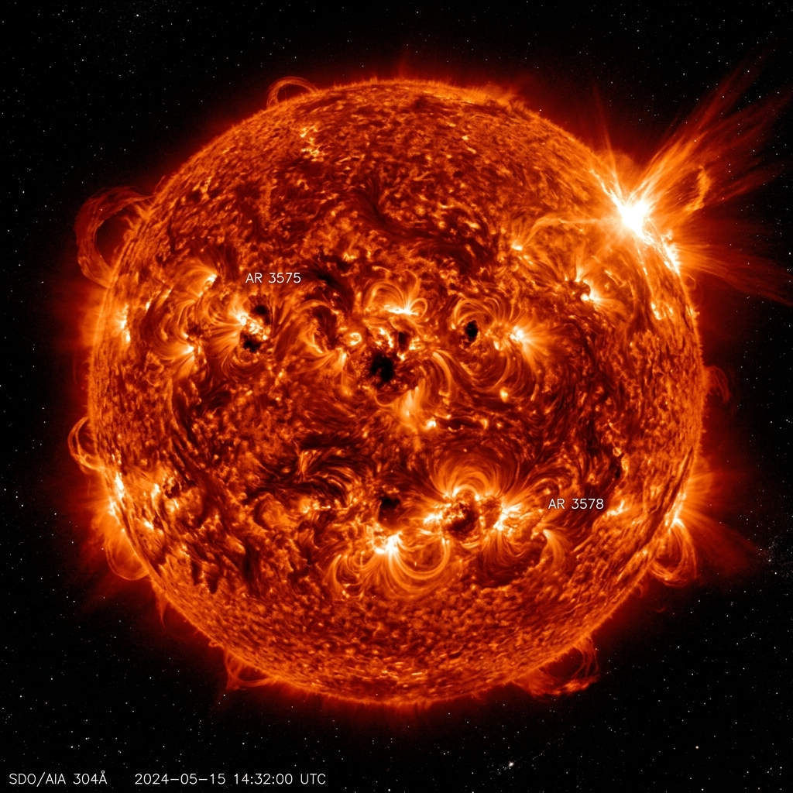
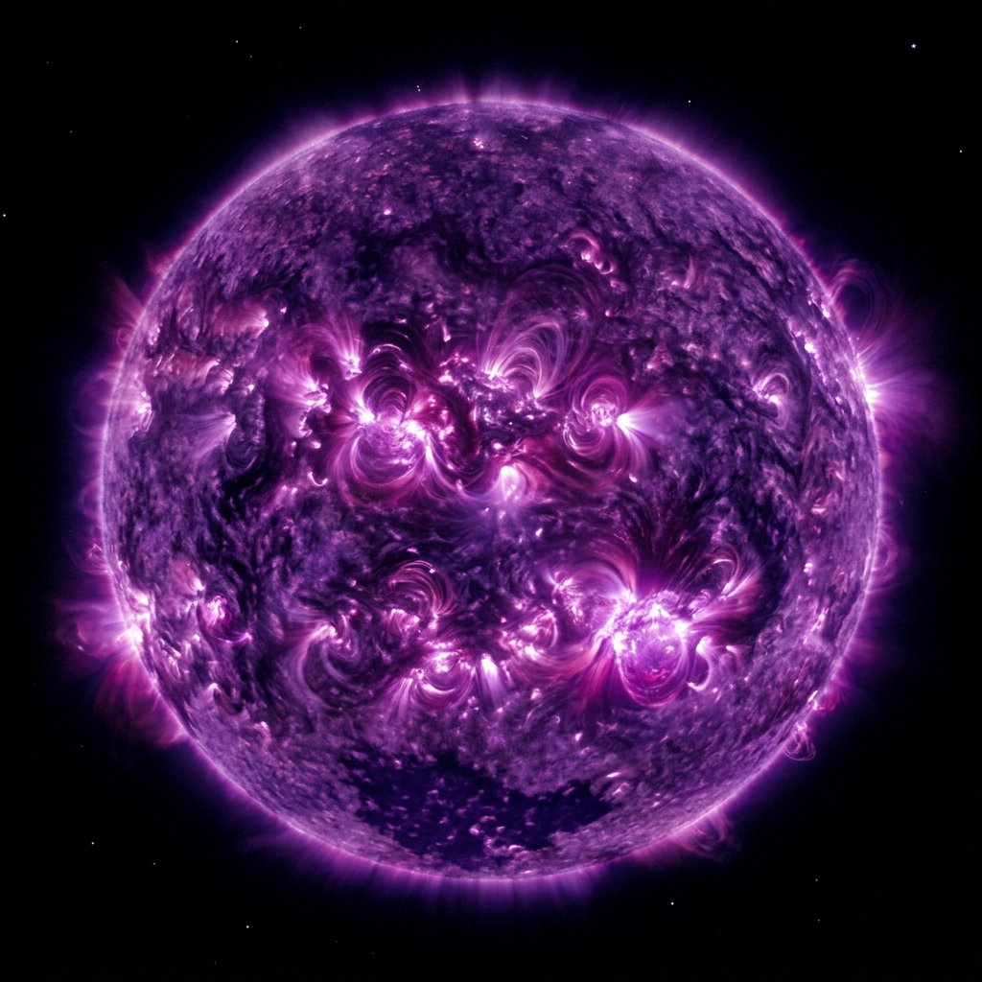
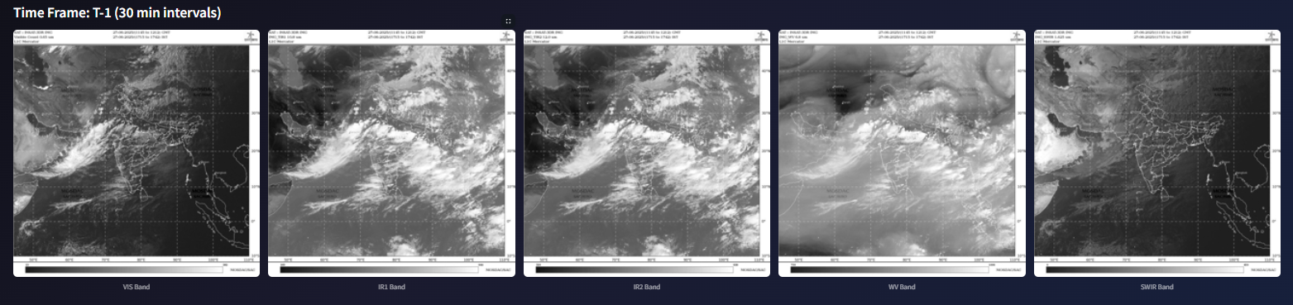
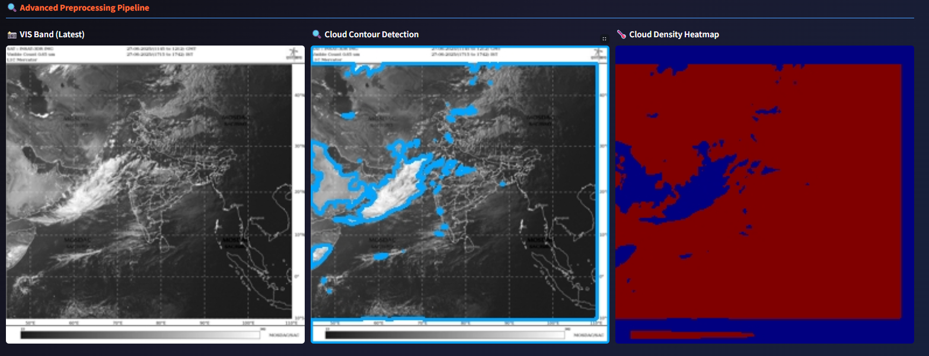
Features offered by the Solution: • Multi-Instrument Ingestion & Harmonization: Automates calibration and alignment of raw FITS files from SoLEXS and HEL1OS. • Real-Time Causal Nowcasting: Detects solar flare onset, peak, and decay phases using dynamic statistical thresholds. • Physics-Informed Predictive Modeling: Forecasts impending flares 30 minutes in advance using rolling physics-backed precursors. • Live Operator Dashboard & Alerts: Displays live counts, risk probabilities, and color-coded hazard alerts (Green, Yellow, Red).
SoLEXS Soft X-Ray (1-22 keV)
SUIT NUV Wavelength (200-400 nm)
*Proof-of-concept developed on real Aditya-L1 telemetry (259,071 overlap timestamps, 16 flares)

Slide 6
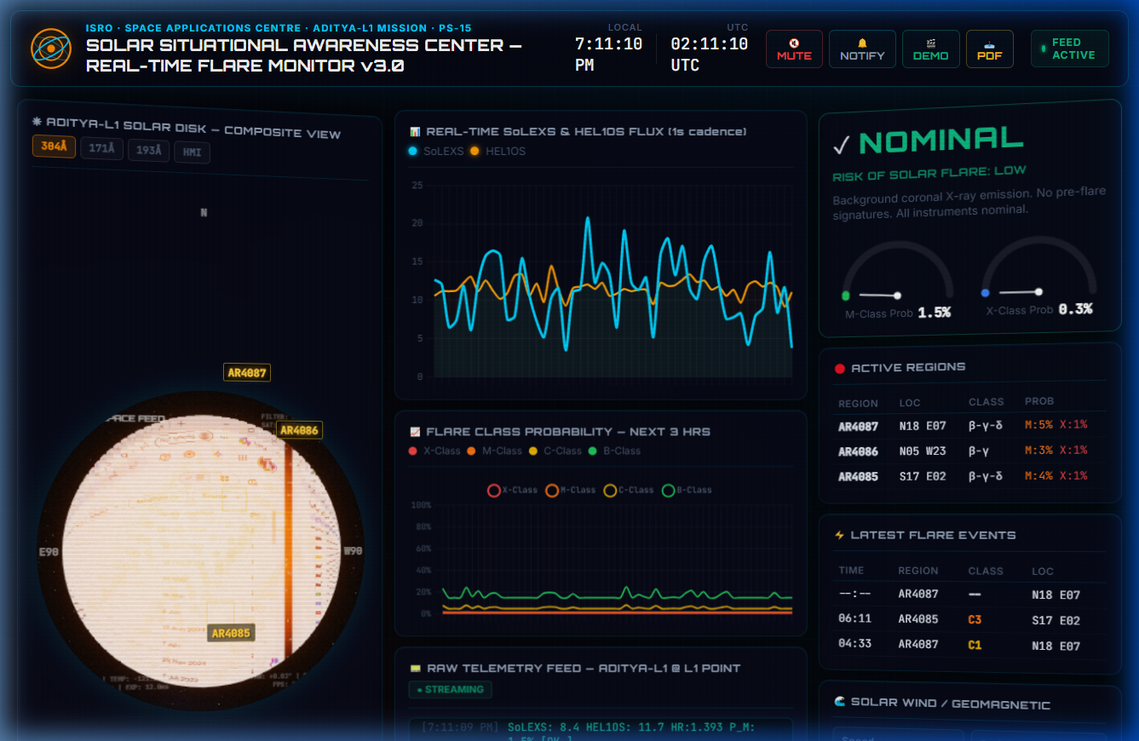
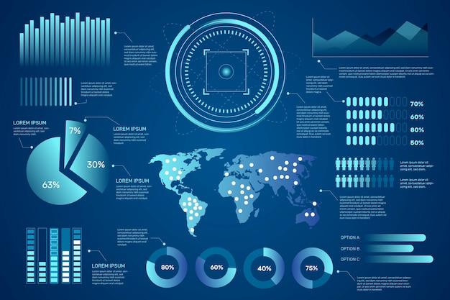

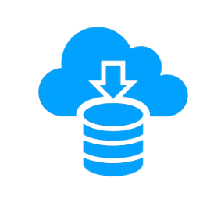

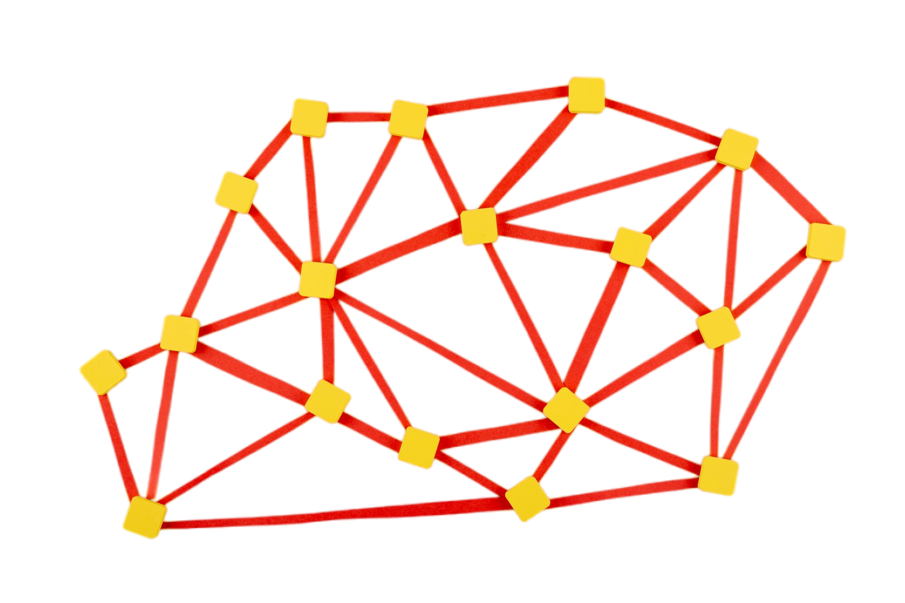
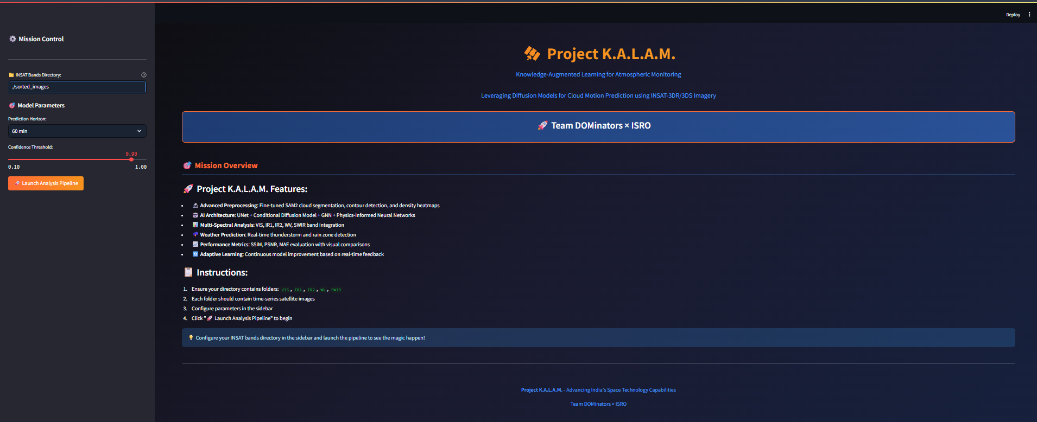
Process flow diagram
Operator Dashboard (Streamlit/HTML5)
Pre-Flare Precursors (QPPs, HR)
predicted
Aditya-L1 Spacecraft
actual
(Real-time Web HUD)
Telemetry Ingestion & Calibration
Causal Nowcasting & RandomForest Core
ISSDC Data Portal
predicted
actual
30-Min Forecast (Holt-Winters)
Tikhonov DEM Inversion
* Real-time telemetry fusion of SoLEXS and HEL1OS provides multi-wavelength situational awareness for ISRO space weather operations.

Slide 7
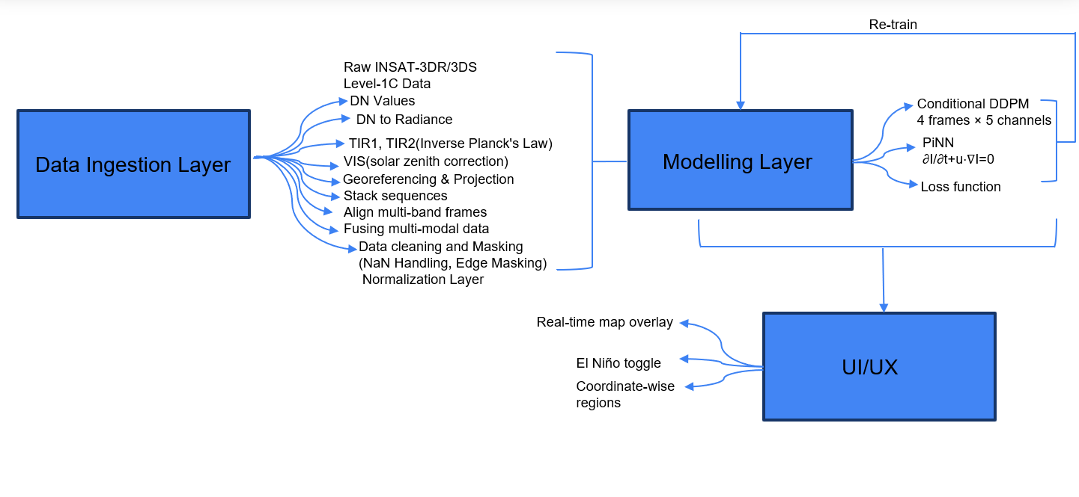
Operator Interface & Real-Time Visualization Mockups
* Real-time interactive dashboard featuring 3D solar disk visualization, active region monitoring, and automated threat alerts.

Slide 8
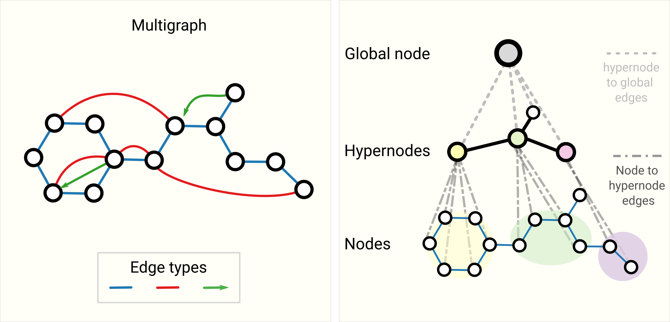
Architecture diagram of the proposed solution
System Architecture of Project SuryaDrishti
**1. Telemetry Ingestion & Calibration Layer**: - Automatically fetches and parses raw FITS files from the Aditya-L1 ISSDC portal. - Extracts Soft X-ray (SoLEXS) and Hard X-ray (HEL1OS) count rates. - Converts MJD timestamps to a unified Unix epoch, interpolating to a synchronized 1-second cadence.
**2. Physics-Informed Feature Engineering Layer**: - Thermal Precursors: Computes the 10-minute rolling mean and positive slope of SoLEXS counts to capture slow-rise plasma heating. - Non-Thermal Precursors: Computes the rolling standard deviation of HEL1OS counts to isolate high-frequency QPP oscillations. - Neupert Effect: Calculates the Spectral Hardness Ratio (HEL1OS / SoLEXS) to model energy transfer from accelerated electrons to thermal plasma.
**3. Causal Nowcasting & Machine Learning Core**: - Zero-Lookahead Nowcaster: Applies sliding-window statistical thresholds to classify flare phases (onset, peak, decay) without lookahead bias. - RandomForest Classifier: Trained on chronological, leakage-free splits using balanced class weights to predict flare occurrence 30 minutes in advance.
**4. Space Weather Impact & Visualisation HUD**: - Renders a 3D WebGL solar disk showing active regions (AR4087, AR4086, AR4085). - Computes Differential Emission Measure (DEM) via Tikhonov regularization. - Models CME propagation via the Drag-Based Model (DBM) and SEP proton flux via Tylka-Dietrich regression. - Emits real-time visual and audio alerts (Web Audio API) for satellite protection.

Slide 9
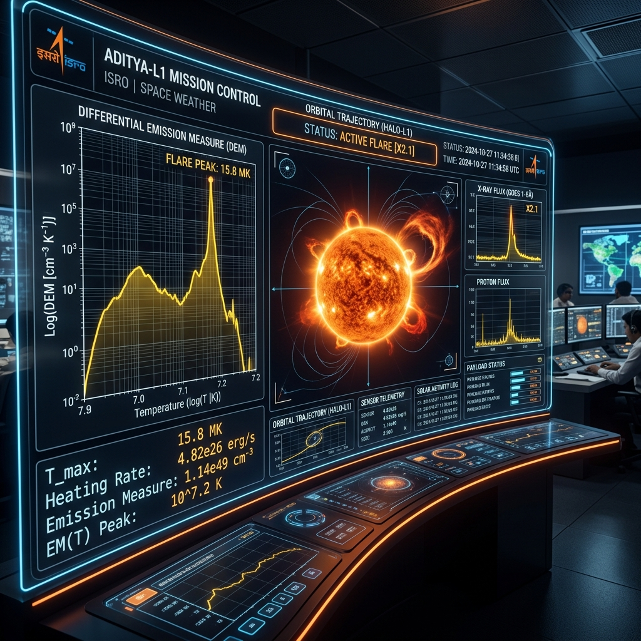
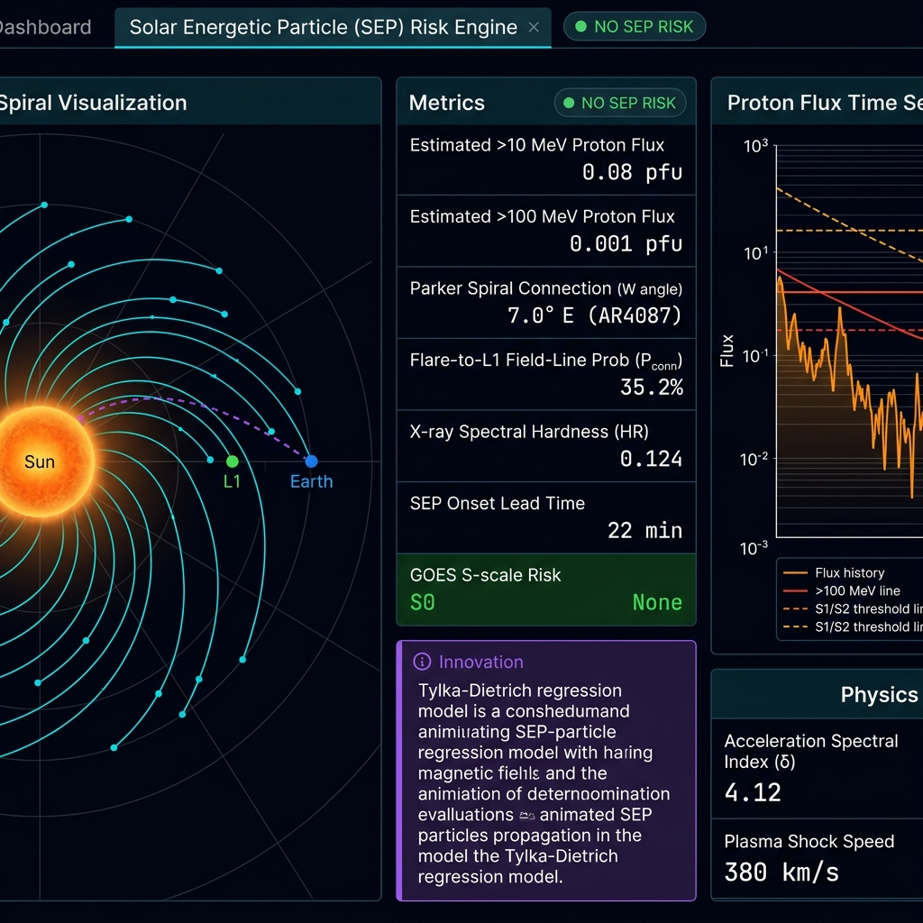
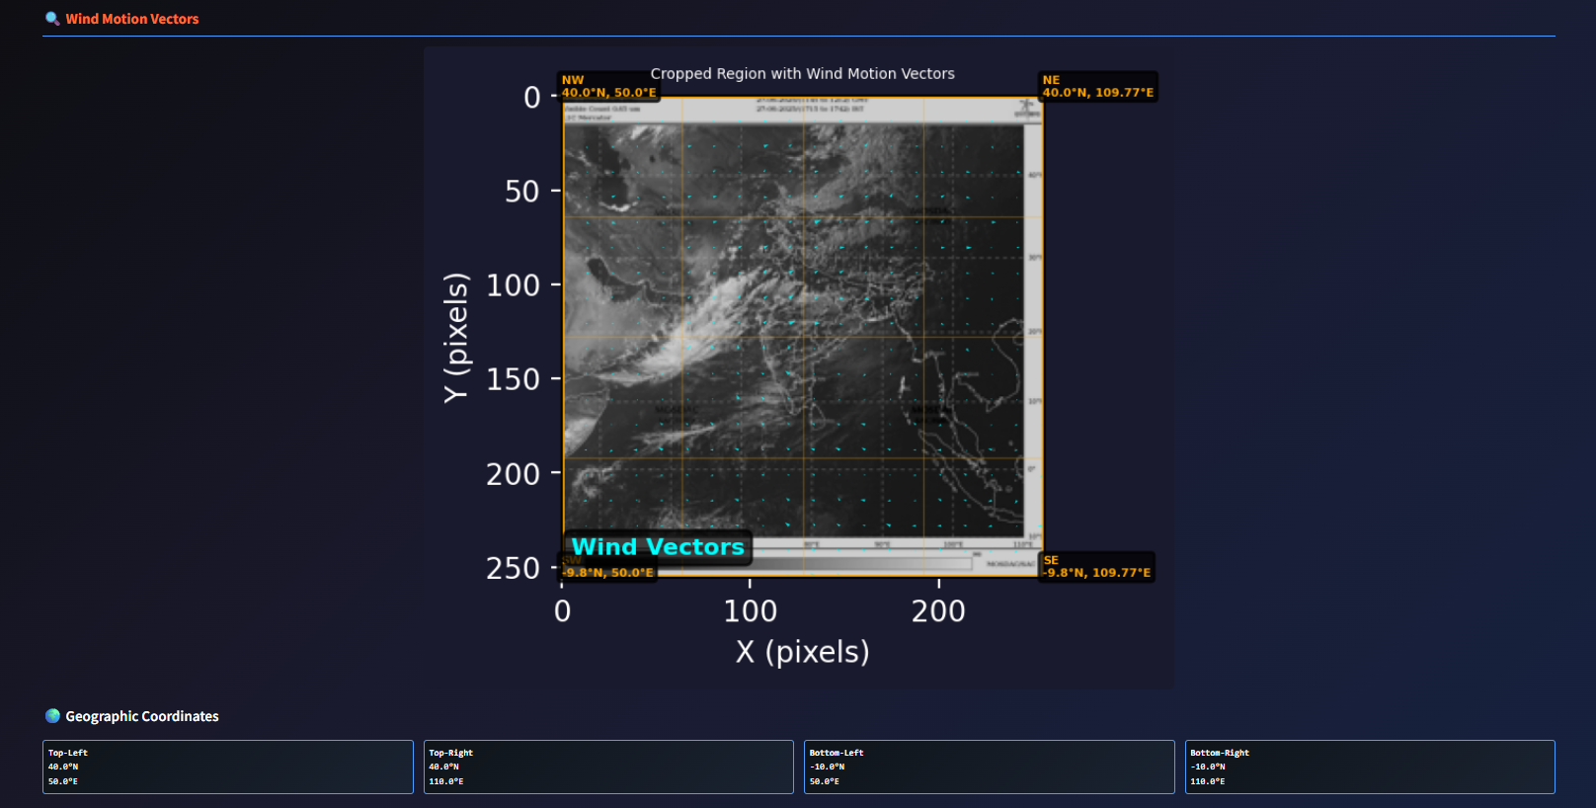
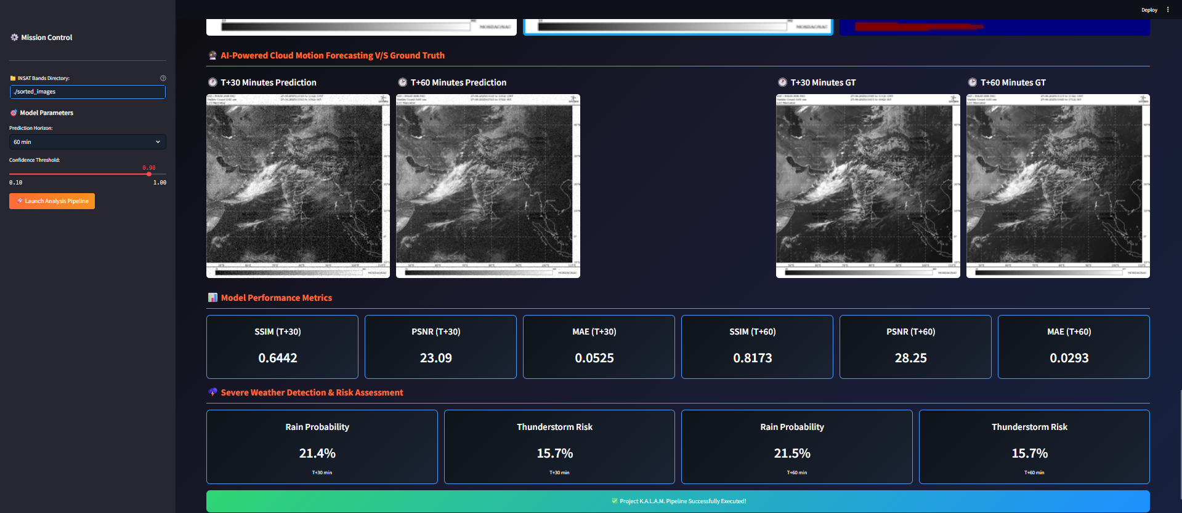
DEM Plasma Temperature Inversion
Tech Stack for Project SuryaDrishti
• Modeling & Forecasting: - Scikit-learn (RandomForest Classifier) - SciPy (Tikhonov DEM Inversion & Holt-Winters Forecasting) - Joblib (Model serialization & caching) • Data & Preprocessing: - Astropy (FITS telemetry processing) - NumPy & Pandas (Data merging, cleaning, alignment) • Interface & Visualization: - HTML5, Vanilla CSS, JavaScript (ES6+) - Chart.js (Interactive plotting of telemetry, QPP, DEM) - Web Audio API (Operator alert sound engine) • Backend & Deployment: - Python HTTP Server (lightweight, local deployment) - Node.js (Syntax validation and testing)
CME & SEP Propagation Trackers

Slide 10
Estimated Implementation Cost :
FIXED COST (ONE-TIME SETUP):
Item | Cost (₹) | Description
Telemetry Ingestion & Fusion Pipeline | ₹50,000 | Multi-instrument (SoLEXS & HEL1OS) FITS data alignment.
Causal Nowcasting Engine | ₹50,000 | Zero-lookahead rolling statistical threshold detector.
Physics-Informed ML Forecaster | ₹1,00,000 | RandomForest model trained on precursor features.
Interactive Operator Dashboard | ₹40,000 | Streamlit web interface with real-time risk alerts.
NOAA GOES Validation System | ₹40,000 | Benchmarking engine for automated cross-validation.
Local Workstation GPU | ₹1,50,000 | Hardware for training and telemetry hosting.
Documentation & SOP Handover | ₹30,000 | Operational guidelines for space-weather centers.
Public Dashboard Deployment | ₹25,000 | Secure public hosting and remote access configuration.
= ₹4,85,000 (Estimated Cost (may vary based on final deployment and resources.))

Slide 11
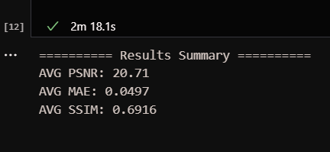
Team Roles
References
Krish Vaghasia (Team Leader)
Full Stack Developer
Heli Shah
AI/ML Developer
Hensi Patel
Backend Developer
Nisarg Vashi
AI/ML Developer
Scientific References ----------------------------------------------------------------------- 1. Sarwade et al., 2025: In-flight calibration and performance of the Solar Low Energy X-ray Spectrometer (SoLEXS) onboard Aditya-L1. Solar Physics. 2. Nandi et al., 2025: Hard X-ray diagnostics of solar flares: First results from HEL1OS onboard Aditya-L1. The Astrophysical Journal. 3. Tylka & Dietrich, 2009: A new parameterization of solar energetic proton (SEP) spectra. Proceedings of the 31st International Cosmic Ray Conference. 4. Vrsnak et al., 2013: Propagation of Interplanetary Coronal Mass Ejections: The Drag-Based Model. Solar Physics. 5. Dere et al., 1997: CHIANTI - an atomic database for emission lines. Astronomy and Astrophysics Supplement Series. Other Resources ----------------------------------------------------------------------- • ISRO ISSDC Aditya-L1 Data Portal (SoLEXS and HEL1OS level-1 telemetry logs). • NOAA Space Weather Prediction Center (GOES XRS solar flare event catalog). • COntinuous Spectral Inversion (COSI) framework for Differential Emission Measure (DEM) diagnostics.
Results
We, as a dedicated team, are excited to solve this problem and actively contribute to India’s AI vision .

Slide 12
