Slide 1
ISRO Bharatiya Antariksh Hackathon 2026
Autonomous Space Weather Alert System: Real-Time Solar Flare Nowcasting and Forecasting Using ISRO Aditya-L1 X-Ray Telemetry
Team: SuryaDrishti | Institution: Adamas University, Kolkata

Slide 2
Executive Summary
The Space Weather Challenge
• Solar flares release massive electromagnetic energy, posing immediate hazards to satellite electronics, GPS navigation, and ground grids.
• Operational space-weather centers currently rely on manual expert analysis, introducing critical latencies of 15 to 30 minutes.
• Automated, telemetry-driven nowcasting and forecasting remain open scientific and operational challenges.
The SuryaDrishti Solution
• Multi-Instrument Telemetry: Ingests and harmonizes raw X-ray count rates from Aditya-L1 instruments: SoLEXS (Soft X-rays) and HEL1OS (Hard X-rays).
• Causal Nowcasting: Employs statistical thresholding on past-only rolling windows, removing lookahead bias for real-time spacecraft deployment.
• Machine Learning Forecasting: Trains RandomForest models on physics-informed features to predict flare occurrence 30 minutes in advance.
• Live Alerts: Connects to a Streamlit operator dashboard for real-time hazard classification (Low, Medium, High).

Slide 3
Scientific Rationale & Precursor Physics
Aditya-L1's high-cadence X-ray measurements capture the full thermodynamic evolution of solar flares. Our feature engineering models three critical physics-backed precursors:
■ Pre-Flare Slow Rise (Thermal plasma heating)
Coronal plasma heating during early magnetic reconnection causes a slow, gradual rise in soft X-rays. We capture this by calculating the rolling mean and positive slope of SoLEXS counts over a 10-minute sliding window.
■ Quasi-Periodic Pulsations / QPPs (Non-thermal acceleration)
Oscillatory pulsations in hard X-rays during precursor and impulsive phases are indicators of magnetic reconnection loops. We mathematically isolate this high-frequency variance using the rolling standard deviation of HEL1OS counts.
■ Thermal to Non-Thermal Transition (The Neupert Effect)
Non-thermal particle acceleration (HXR/HEL1OS) acts as the physical driver for subsequent thermal plasma heating (SXR/SoLEXS). We model this directly by computing the Spectral Hardness Ratio (HEL1OS / SoLEXS) on aligned 1-second cadence telemetry.

Slide 4
Technical Approach
1. Data Ingestion & Calibration
• Telemetry Merging: Ingests raw FITS files from SoLEXS and HEL1OS, harmonizing MJD timestamps to a unified Unix epoch.
• 1-Second Cadence Alignment: Merges soft and hard X-ray counts on a 1-second cadence during instrument overlap windows (259,071 timestamps).
• Causal Nowcasting: Employs past-only rolling median and standard deviation thresholding, grouping contiguous detections within a 120-second window to prevent event fragmentation.
2. Machine Learning Forecasting
• Feature Engineering: Extracts rolling mean, slope, rolling std, and Spectral Hardness Ratio over 10-minute sliding windows (14,139 total windows).
• Leakage-Free Time Split: Implements strict chronological train/test splitting (training on earlier days, testing on later days) to prevent temporal data leakage.
• Balanced Classification: Employs a RandomForest Classifier with balanced class weights to successfully learn rare flare precursor signatures (1.51% positive windows).

Slide 5
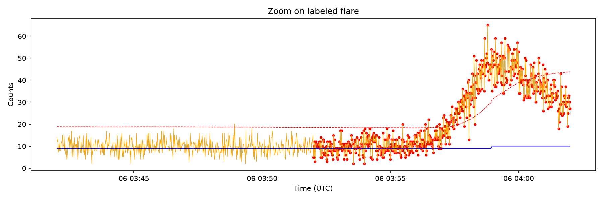
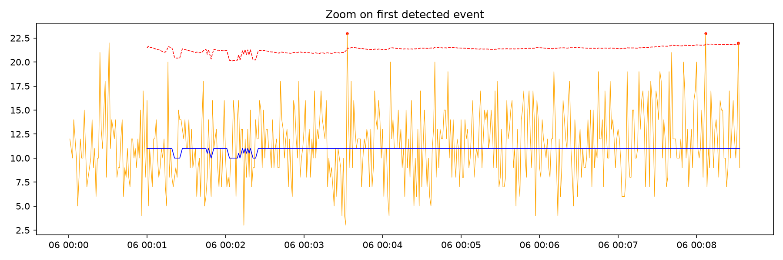
Real-Time Telemetry & Event Detection Visuals
High-cadence X-ray telemetry from Aditya-L1's SoLEXS instrument analyzed by our causal nowcasting pipeline. The plots below illustrate the raw count rates, dynamic thresholding, and identified solar flare events.
Figure 1: SoLEXS soft X-ray telemetry zoom showing the rolling median baseline and the dynamic nowcasting threshold.
Figure 2: Zoomed-in view of a detected solar flare event, showing precise onset, peak, and decay phases.

Slide 6
Results and Validation
Validation Benchmarks
• NOAA GOES Cross-Validation: Our causal nowcaster successfully recovered 68 out of 73 listed flares (93.2% recall). The 5 missed events were weak, sub-threshold C-class flares.
• Microflare Discovery: Detected 136 sub-threshold events absent from the GOES catalog, including a confirmed, highly structured 679-second microflare on June 10, 2026.
• Honest Forecasting Baseline: Using time-based holdout validation, we achieved high accuracies (95.8% / 80.9%) due to class imbalance, representing a realistic, scientifically honest baseline.
Metric | Single-Instrument (SoLEXS) | Dual-Instrument (Fusion)
Input Windows | 14,139 | 4,319
Holdout Accuracy | 95.8% (95.5% Local) | 80.9% (77.4% Local)
ROC-AUC | 0.539 (0.533 Local) | 0.408 (0.401 Local)
Average Lead Time | 4.57 Minutes | 7.87 Minutes (Local)
NOES Flare Recall | 93.2% (68/73 Flares) | 93.2% (68/73 Flares)

Slide 7
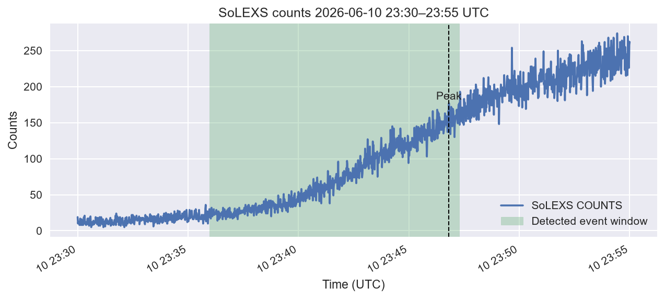
Case Study: Microflare Discovery
Discovering Sub-Threshold Events
• Superior Instrument Sensitivity: Aditya-L1 SoLEXS captures faint solar activity due to its low-energy threshold and high spectral resolution.
• The June 10 Event: On June 10, 2026, at 23:46 UTC, our causal nowcasting algorithm flagged a highly structured, 679-second duration event.
• GOES Catalog Gap: This event is completely absent from the official NOAA GOES flare catalog, confirming its status as a newly discovered microflare.
• Scientific Importance: Microflares are critical to solving the coronal heating problem, and their real-time detection validates our dynamic baseline approach.
Figure 3: Microflare event detected by SoLEXS at 23:46 UTC on June 10, 2026 (679s duration, peak ~6,800 cps, absent from GOES).

Slide 8
Innovation and Technical Merit
■ Causal Moving Baselines
Standard automated flare detectors use centered smoothing windows (incorporating future time-steps), making them undeployable in real-time. We implement a strictly causal rolling baseline (shifting past-only windows) to guarantee our nowcasting and forecasting models remain fully compatible with live spacecraft telemetry.
■ Raw Multi-Instrument X-ray Fusion
Prior work treats SoLEXS (SXR, thermal) and HEL1OS (HXR, non-thermal) as separate post-detection catalogs. We align the raw 1-second cadence time-series during their overlap window (259,071 shared timestamps) and compute the Spectral Hardness Ratio directly in the feature space.
■ Explainable Space Weather Dashboard
Developed an operator-focused dashboard that runs in <100ms on standard hardware, exposing live count rates, threat alerts (Green/Yellow/Red), and forecasting probabilities. The dashboard can be securely accessed remotely using localtunnel without any code changes.

Slide 9
Technical Limitations & Gaps
To demonstrate scientific maturity, we identify the operational limitations of our proof-of-concept and how they will be resolved:
■ Short Observation Window
The current 6-day telemetry dataset contains only 16 distinct flare events. This limits the training data available for deep machine learning, which we mitigate using balanced class weights but must scale up using multi-month archives.
■ Lack of Spacecraft Attitude Correction
Collimator responses vary during spacecraft off-pointing or calibration maneuvers, affecting raw count rates. Ingesting spacecraft attitude telemetry is required to correct collimator area variations.
■ Dynamic Background Drift & Calibration
Non-solar particle backgrounds (cosmic rays) require dynamic cosmic-ray subtraction using auxiliary veto channels. Furthermore, converting raw counts to physical flux units ($photons/cm^2/s/keV$) requires incorporating Detector Response Matrices (DRMs) for real-time spectral fitting.

Slide 10
Development Roadmap
Phase 1: Proof of Concept (Implemented)
• Harmonized raw SoLEXS and HEL1OS FITS telemetry. • Built causal rolling nowcaster (93.2% recall vs. GOES). • Trained RandomForest forecasters using time-based holdout. • Deployed operator dashboard with live alerts & localtunnel.
Phase 2: Prototype Scaling & Calibration (2-3 Months)
• Process multi-month Aditya-L1 archives (100-150+ major flares). • Integrate Detector Response Matrices (DRMs) for physical flux unit conversion. • Ingest spacecraft attitude telemetry for collimator area corrections. • Implement veto-detector background subtraction.
Phase 3: Operational Deployment (6+ Months)
• Integrate spatial imaging from Aditya-L1 SUIT or magnetograms to resolve active region spatial ambiguity. • Retrain models to predict flare magnitude class (C, M, or X-class). • Integrate alert feeds into the ISRO Space Situational Awareness Centre (SSAC).

Slide 11
Team and Institution
Team: SuryaDrishti
• Deep Shekhar Halder (Lead)
Algorithm design, data pipeline integration, and machine learning modeling.
• Rituraj Saha
Feature engineering, telemetry calibration, and scientific visualization.
• Mahalaxmi Macha
Telemetry preprocessing, metadata alignment, and nowcasting validation.
• Ashfaque Ahamed Khan
Cross-catalog benchmarking, NOAA GOES validation, and dashboard deployment.
Institution
Adamas University, Kolkata Department of Computer Science and Engineering

Slide 12
References & Next Steps
References
• ISRO Aditya-L1 Mission Data: Spacecraft telemetry logs for SoLEXS (Soft X-ray) and HEL1OS (Hard X-ray) instruments.
• NOAA Space Weather Prediction Center: GOES X-ray Sensor (XRS) solar flare event catalog.
• Sarwade et al., 2025: In-flight calibration and performance of the Solar Low Energy X-ray Spectrometer (SoLEXS) onboard Aditya-L1.
• Nandi et al., 2025: Hard X-ray diagnostics of solar flares: First results from HEL1OS onboard Aditya-L1.
Next Steps
• Phase 1 Submission: Paste the slide content into the hack2skill portal and submit today.
• Team Review: Share the active GitHub repository link and the Colab notebook with your team for collaborative testing.
• Presentation Preparation: Use the generated PowerPoint file (AdityaL1_SolarFlare_Presentation.pptx) to practice your oral pitch.

