Slide 1

Hate Speech Detection Using Machine Learning
Submitted in partial fulfillment of the requirement for the award of the degree of
BACHELOR OF TECHNOLOGY
IN
COMPUTER SCIENCE & ENGINEERING
Submitted By: Deepshi Jindal
2016723
Under the Mentorship of
Ms. Vishu Tyagi
Assistant Professor
Department of Computer Science and Engineering
Graphic Era (Deemed to be University)
Dehradun, Uttarakhand
January 2023

Slide 2





01
Introduction
02
Problem Statement
03
Methodology
04
Experiment & Result
05
Conclusion

Slide 3
01
Introduction
With the widespread use of social networks over the past few decades, people have become more involved. In-person and online hate speech has become more prevalent. The development and dissemination of hateful content, which eventually results in hate crimes, is greatly aided by social media and other internet platforms.
People may now communicate freely, which has enabled them to share a wide range of ideas, feelings, and information. Cyberspace is not always secure, and it sometimes serves as a venue for the distribution of offensive and dangerous material
"Content that advocates violence against individuals or groups based on race or ethnic origin, religion, handicap, gender, age, veteran status, and sexual orientation/gender identity”.
The suggested approaches used ML algorithms and various feature engineering techniques to categorize information as hate speech.
Due to differences over various definitions of hate speech, detecting hate speech can be difficult.

Slide 4
01
Problem Statement
A lot of money has been invested recently by governments, businesses, and researchers as a result of the rising prevalence of hate speech on social media and the urgent need for efficient defenses. Automated hate speech detection techniques have been developed in a variety of ways. This tries to classify textual information into non-hate or hate speech, in which case the approach may additionally identify the targeting features (i.e., categories of hatred, such as race, and religion) in the hate speech. But we see a big difference between the two in terms of performance (i.e., non-hate vs. hate).
In this work, we make the case for a practical focus on the latter issue. Our research of the language in the common datasets demonstrates that it is a considerably more difficult process since hate speech lacks distinctive, discriminative traits and is thus present in the dataset's "long tail" where it is more difficult to find. Our main task is to find the text given is hate speech or not.

Slide 5
Clustering model for classifying hate speech based on probabilistic
a better performance improvement in the detection process using Decision Tree Classifier
algorithm and NLTK.
Classification result for hate speech
This section describes the suggested system we used to categorize tweets into three
groups: “hate speech, offensive speech, and no hate and offensive.
02
Methodology
Errors and methods to classify hate speech.
Errors in the classification process are still very likely to occur
by existing algorithms, so a method that has high accuracy is needed
in the classification process.
Techniques and methods to find hate speech in tweet.
The whole technique is given as: Data collecting, data preprocessing, feature
engineering, data splitting, classification model development, and classification
model evaluation
Build a web interface for analyzing hate speech
Using Decision Tree Classifier algorithm to detect hate speech and using streamlit to
Build a web page.

Slide 6
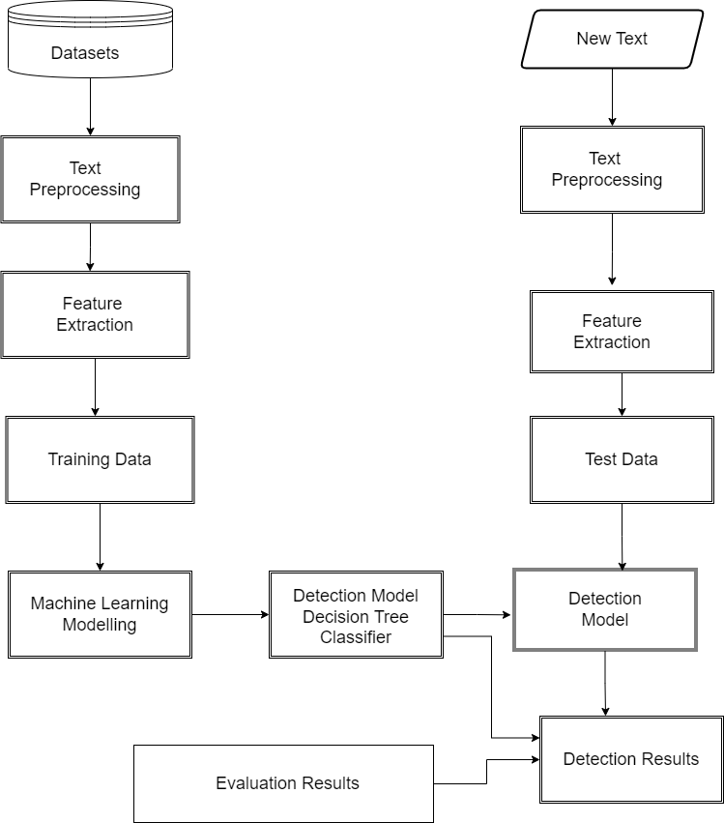
03
Methodology
Hate Speech Detection Architecture

Slide 7

Method
Building a Dataset
Data Sources
Data Annotation
1
2
Dataset using Twitter data, it was used to research hate-speech detection. The text is classified as: hate-speech, offensive language, and neither. Due to the nature of the study, it’s important to note that this dataset contains text that can be considered racist, sexist, homophobic, or generally offensive.
Consists of total 24786 data values in dataset.
The final data that can be labelled are tweets.
Labelling: Consists of six columns in table, namely
Count, hate speech, offensive speech, neither, class
and tweet
In the dataset: There are three values in class column that classify the type of speech.
0: indicates hate speech
1: offensive speech
2: no hate and offensive

Slide 8
Methodology
2. Hate Speech Language Detection
Data Pre-processing
Libraries used
Classification and Evaluation
1
2
3
1) removal username, hashtag, link;
2) remove punctuations and numbers;
3) remove stop word;
4) remove repeated characters;
5) and normalization.
We use classification algorithms to see the best performance, namely Decision Tree Classifier.
Training data, evaluate and predict hate speech using Python Programming and VS Code.
Processing using the Python 3.
Evaluation using Decision Tree Classifier
Pandas
NumPy
NLTK: Natural Language Toolkit.
Count Vectorizer: provided by scikit-learn library.

Slide 9
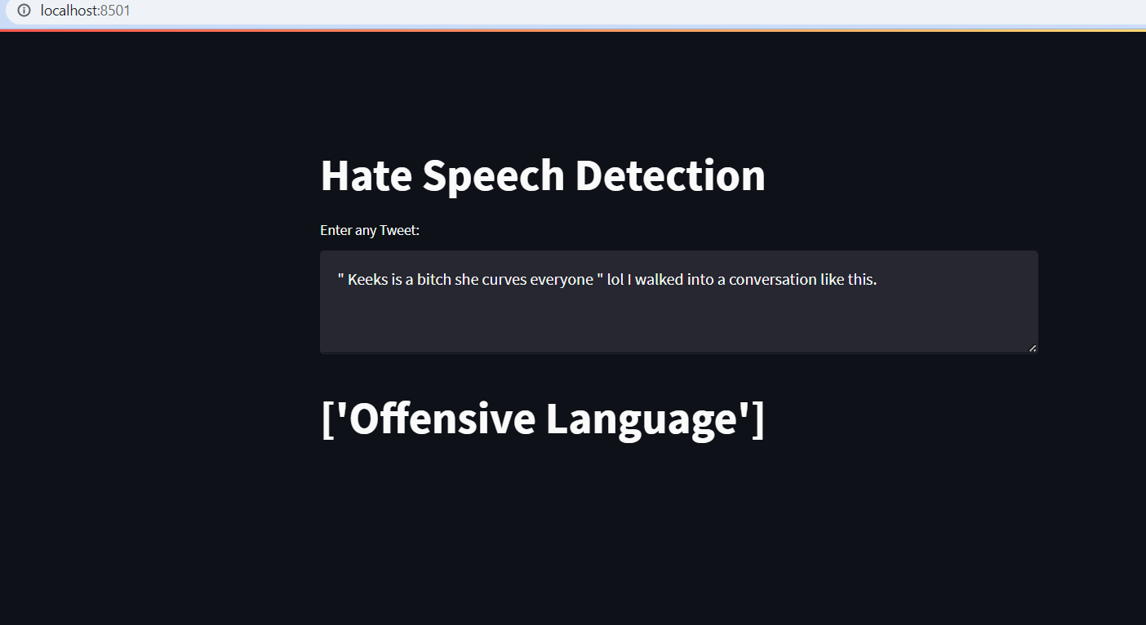
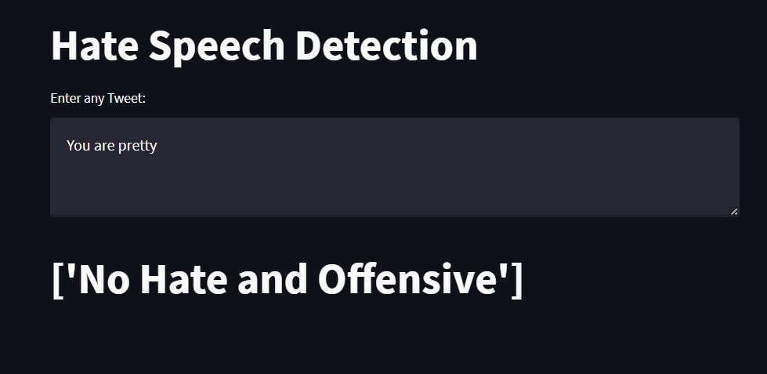
1. Experiment Results
Above are the snapshots of the result obtained.
04
Experiment & Result

Slide 10
This study presents a dataset that can help detect hateful and abusive speech on Twitter social media.
The result obtained an accuracy rate of 80-85% (Decision Tree Classifier)
We will be experimenting with an updated dataset with twitter data for hate speech and abusive dictionaries for future work.
We will also experiment with a SVM ,Deep Learning and Neural Network-based algorithm on the given and updated data.
We will also experiment to find the hate speech in videos and audios.
05
Conclusion & Future Work

Slide 11
THANK YOU
Any Suggestions

