Slide 1
INVOICE → VOUCHER
AI-Powered Voucher Automation
for Institute of Chartered Accountants of India
Client uploads an invoice • AI reads it • Staff reviews and posts the voucher

Slide 2
The Problem
Why voucher creation is still a bottleneck for CA practices
✎
Manual Data Entry
⏱
Time-Consuming Workflow
Every invoice is retyped by hand into ledgers — slow, repetitive, and error-prone.
Hours are spent each month on the same voucher creation steps, across every client.
⇄
Client–Team Friction
☰
No Audit Trail
No structured way for clients to hand off invoices directly to the accounting team.
Hard to trace who created or edited a voucher, or what changed and when.
Invoice-to-Voucher AI Automation
2

Slide 3
Our Solution
An AI-powered web app that reads client invoices and prepares ready-to-review accounting vouchers — automatically.
1
Upload Invoice
2
AI Extraction
AI reads uploaded invoices instantly — vendor, amounts, tax, dates
3
Ledger Match
Ledger accounts are auto-suggested from the Chart of Accounts
Staff verifies every entry with a simple Debit/Credit toggle before saving
4
Dr / Cr Review
5
Save Voucher
Invoice-to-Voucher AI Automation
3

Slide 4
System Workflow
From client upload to a saved, balanced voucher
1
2
3
4
5
Client Uploads
→
AI Extracts Data
→
Ledger Suggested
→
Staff Reviews
→
Voucher Saved
Invoice PDF/photo sent via a simple, public upload link
Gemini reads vendor, GSTIN, amounts, tax, dates
System matches or lets staff create the right ledger
Dr/Cr toggle, narration, and amounts confirmed
Stored permanently, balance-checked before saving
Planned next: automatic export as a Tally-importable voucher file (covered separately)
Invoice-to-Voucher AI Automation
4

Slide 5
Tech Stack & AI Tools Used
Built entirely on free-tier tools — genuinely no-cost for an educational build
▣
Next.js + Vercel
⛁
Supabase
Website framework and free hosting — auto-deploys on every code change
Free Postgres database, file storage, and access policies
✦
Google Gemini API
◐
GitHub
Reads invoice images/PDFs and extracts structured data as JSON
Version control — every change tracked, edited, and deployed from the browser
Invoice-to-Voucher AI Automation
5

Slide 6
Key Features Built
⇧
✦
☷
Smart Invoice Upload
AI Data Extraction
Auto Ledger Mapping
Auto-cleaned filenames, safe storage
Vendor, GSTIN, amounts, tax read automatically
Suggests ledgers; staff can add new ones inline
⇄
✓
⚿
Debit / Credit Toggle
Live Balance Check
Passcode-Protected Access
Every line switchable, per-line control
Won't save until Dr equals Cr
Staff-only screen, separate from client upload
Invoice-to-Voucher AI Automation
6

Slide 7
Database Design
Two simple tables power the whole workflow
ledgers
vouchers
Chart of Accounts for the dropdown
Every saved voucher entry
id
auto-numbered
id
auto-numbered
name
ledger name, e.g. "CGST"
voucher_number
text
created_at
timestamp
voucher_date
date
narration
editable free text
lines
JSON — ledger, Dr/Cr, amount
created_by
for future audit log
Invoice-to-Voucher AI Automation
7

Slide 8
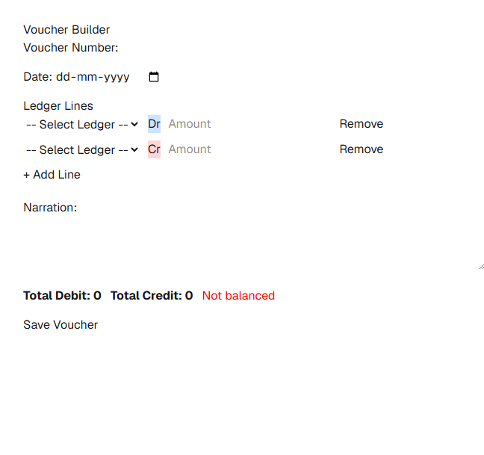
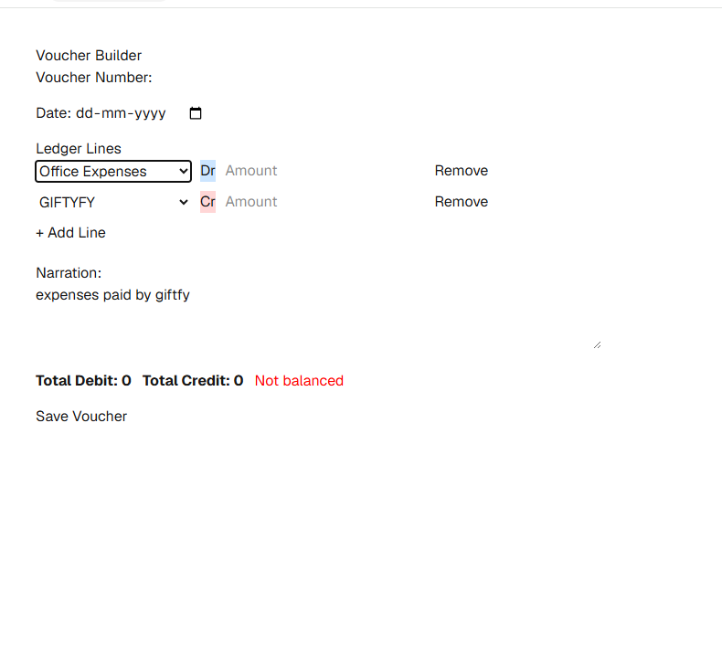
The App, Live
Screens captured from the actual working deployment
Voucher Builder — ready for entry
AI-Extracted Data — auto-filled ledgers
Invoice-to-Voucher AI Automation
8

Slide 9
Security & Access Control
Clients and staff see two very different screens
Client Access — /upload
Staff Access — /voucher
✓
Simple, public upload link — no login needed
⚿
Protected behind a team passcode
✕
No ledgers, amounts, or accounting data visible
✓
Full ledger, Dr/Cr, and narration control
✕
Cannot view, edit, or create vouchers
✓
Sees a live queue of pending client invoices
Invoice-to-Voucher AI Automation
9

Slide 10
Future Scope
What comes after this submission
⇩
Tally XML Voucher Export
⚿
Full Multi-User Login
One-click download of a Tally-importable voucher file — covered as a separate module
Individual staff accounts replacing the shared passcode, with a per-person audit log
⚡
Production-Tier AI
#
GSTIN-Based Auto Matching
Paid AI tier removes free-tier rate limits and occasional "high demand" delays
Vendors matched by GSTIN so returning invoices need zero manual ledger selection
Invoice-to-Voucher AI Automation
10

Slide 11
Live Demo — Links to Use
Open both during the recording to show the full client-to-staff flow
STEP 1 — CLIENT
ivapp.vercel.app/upload
Client Upload Link
Open this yourself to show a client uploading an invoice — no login needed
STEP 2 — CA STAFF
ivapp.vercel.app/voucher
Staff Processing Link
Enter the team passcode, see the invoice waiting, and process it into a voucher live
Tip: upload on the Client link first, switch tabs to the Staff link, and click "Process this invoice" to show the AI auto-fill live
Invoice-to-Voucher AI Automation
11

Slide 12
Thank You
Created by CA Deepa Gupta
Membership Number:-511382
Built with Claude AI

