Slide 1
ConfigMaps und Secrets
DEEPTALK
2020

Slide 2
Agenda
Grundlagen
Fallbeispiel
Kubernetes-Ressourcen
Zusammenfassung

Slide 3
ConfigMaps
Speichern von nicht vertraulichen Konfigurationsdaten
Trennung von Konfiguration und Anwendungscode
Key-Value-Paare
Umgebungsvariablen, CLI-Argumente, Konfigurationsdateien

Slide 4
Secrets
Speichern von vertrauenswürdigen Daten
Passwörter, Oauth-Tokens, SSH-Keys
Key-Value-Paare (Value: base64-encoded)

Slide 5
Setup 1: env
postgres-server- Service
postgres-client-Deployment
env
postgres-server-Deployment
POSTGRES_USER POSTGRES_PASSWORD POSTGRES_HOST PGPASSWORD
env
POSTGRES_USER POSTGRES_PASSWORD POSTGRES_DB
postgres-server- Pod
Postgres-client- Pod
Database: deeptalk
psql –h $POSTGRES_HOST …
connect

Slide 6
Setup 2: ConfigMap
postgres-server- Service
postgres- ConfigMap
POSTGRES_HOST
POSTGRES_DB
POSTGRES_USER POSTGRES_PASSWORD
PGPASSWORD
postgres-server-Deployment
postgres-client-Deployment
postgres-server- Pod
Postgres-client- Pod
Database: deeptalk
psql –h $POSTGRES_HOST …
connect

Slide 7
Setup 3: ConfigMap + Secret
postgres-server- Service
postgres- ConfigMap
POSTGRES_HOST
POSTGRES_DB
postgres-server-Deployment
postgres-client-Deployment
postgres- Secret
POSTGRES_USER POSTGRES_PASSWORD
PGPASSWORD
postgres-server- Pod
Postgres-client- Pod
Database: deeptalk
psql –h $POSTGRES_HOST …
connect

Slide 8
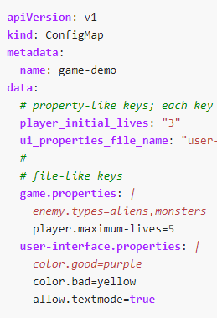
ConfigMaps und Secrets
ConfigMaps
„decouple environment-specific configuration from your container images“
Key-Value-Paare
Umgebungsvariablen, CLI-Argumente, Konfigurationsdateien
Secrets
„store and manage sensitive information“
Key-Value-Paare (Value: base64-encoded)
Passwörter, Oauth-Tokens, SSH-Keys
Notes:
https://www.docker.com/resources/what-container

Slide 9
Misc
Materialien zum Talk
https://github.com/grothesk/deeptalk
Weiterführendes
Postgres → https://www.postgresql.org/
Grafana → https://grafana.com/
Feedback , Anregungen, Themenvorschläge
florian.boldt@deepshore.de
malte.groth@deepshore.de
frederic.born@deepshore.de
Notes:
https://www.docker.com/resources/what-container

Slide 10
Vielen Dank.

