Slide 1
A Legacy of Exceptional Craftsmanship and Timeless Indulgence
23 July, 2023

Slide 3







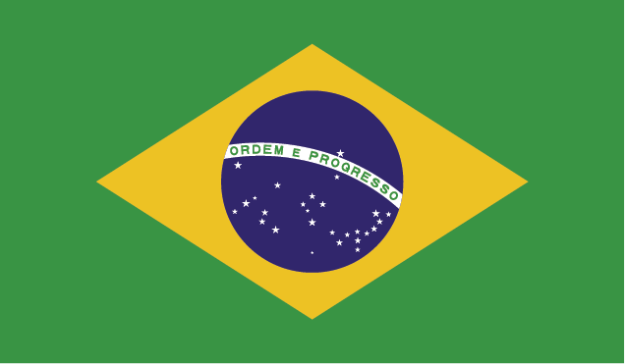
The US market is the most significant accounting for over 30% of total revenue in 2022
Top 6 Countries by Revenue in $ millions
Key Highlights
The United States sparkling chocolate market has seen 12% growth YoY from 2012-2022
Chocolates in the European Union slashed EU growth expectations to less than 1.5% in 2022
“The chocolate market has seen the massive regulatory hurdles in Europe”
- Sam Smith, Bloomberg Europe
“Cadbury has solidified it’s position as market leader in the United States despite intense competition”
- Martha Warren, CNBC Americas

Slide 4
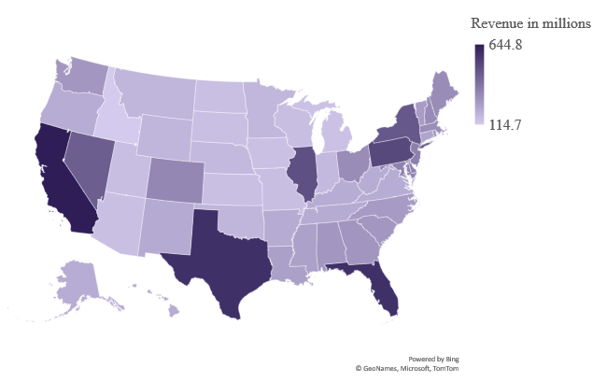
Cadbury is diversified across all 50 states
Revenue heatmap by state in 2022
Top performing states
State | Population (millions) | Revenue (millions) | Profit Margin (%)
CA | 39.4M | $2,500 | 25.6%
TX | 28.6M | $1,850 | 26.8%
FL | 21.2M | $1,785 | 24.4%
PA | 12.79M | $1,105 | 26.2%
IL | 12.72M | $1,103 | 24.2%
NV | 3.03M | $848 | 32.5%
NJ | 8.89M | $841 | 29.4%
NY | 8.38M | $796 | 28.0%

Slide 5
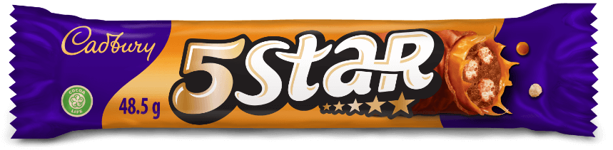

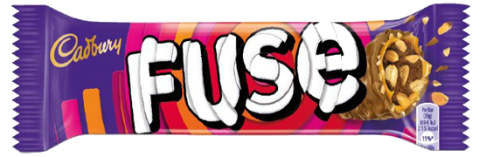
The Confectionery Harmony—Cadbury, 5 Star and Fuse
5 Star
An Exquisite Confection
Cadbury
A Legacy of Excellence
Fuse
A Symphony of Flavors
Delight in the exquisite Cadbury chocolate bar, 5 Star. Revel in the perfect harmony of chewy caramel, crunchy nougat, and velvety milk chocolate. An unforgettable taste experience, ideal for satisfying sweet cravings and creating moments of pure indulgence.
Embrace the legacy of Cadbury, a distinguished confectionery brand with over two centuries of craftsmanship. Discover an extensive range of premium chocolates, including Dairy Milk, Creme Egg, Silk, and Bournville. Committed to innovation, sustainability, and enriching lives through delectable treats.
Unleash your senses with Fuse, a harmonious blend of caramel, peanuts, and crispy cereal. A symphony of taste and texture awaits, creating a gratifying snacking experience for moments on-the-go or pure enjoyment.

Slide 6
People’s Choice
5 Star
30%
“Indulge in the decadent and heavenly experience of our 5 Star chocolate, a luxurious and exquisite delight that’s simple irresistible”.
Cadbury
50%
“Savor the rich and velvety taste of Cadbury, an opulent and mouthwatering chocolate that promises a delightful and unforgettable experience”.
Fuse
20%
“Discover the sensational fusion of flavors in Fuse, an extravagant and delectable chocolate bar that’s truly sublime”.

Slide 7
All Cadbury brands in the US show revenue growth of over 15% from 2021-2022
Boosted by the inflationary trends, the top three brands by revenue are Cadbury, 5 Star, and Fuse, with the latter recording an all-time high $3.9B in revenue in 2022
5 Star Revenue in the US
Cadbury Revenue in the US
Fuse Revenue in the US
1.5x
1.2x
1.3x
$3.0B
$6.0B
$3.0B
2021
2021
2021
$4.5B
$7.2B
$3.9B
2022
2022
2022

Slide 8
Why Cadbury Stands Out: A Recipe for Success
Rich legacy and long-standing presence in the market
Premium quality chocolates and confectionery products
Iconic chocolates like Dairy Milk and Creme Egg
Commitment to sustainability through the “Cocoa Life” program
Philanthropic initiatives and community engagement
Emotional marketing campaigns that create a strong connection with consumers
Extensive global reach in over 160 countries
Diverse product range catering to different tastes and preferences
Trust and loyalty fostered through consistent quality and ethical practices
Innovative offerings that cater to changing consumer preferences

Slide 9
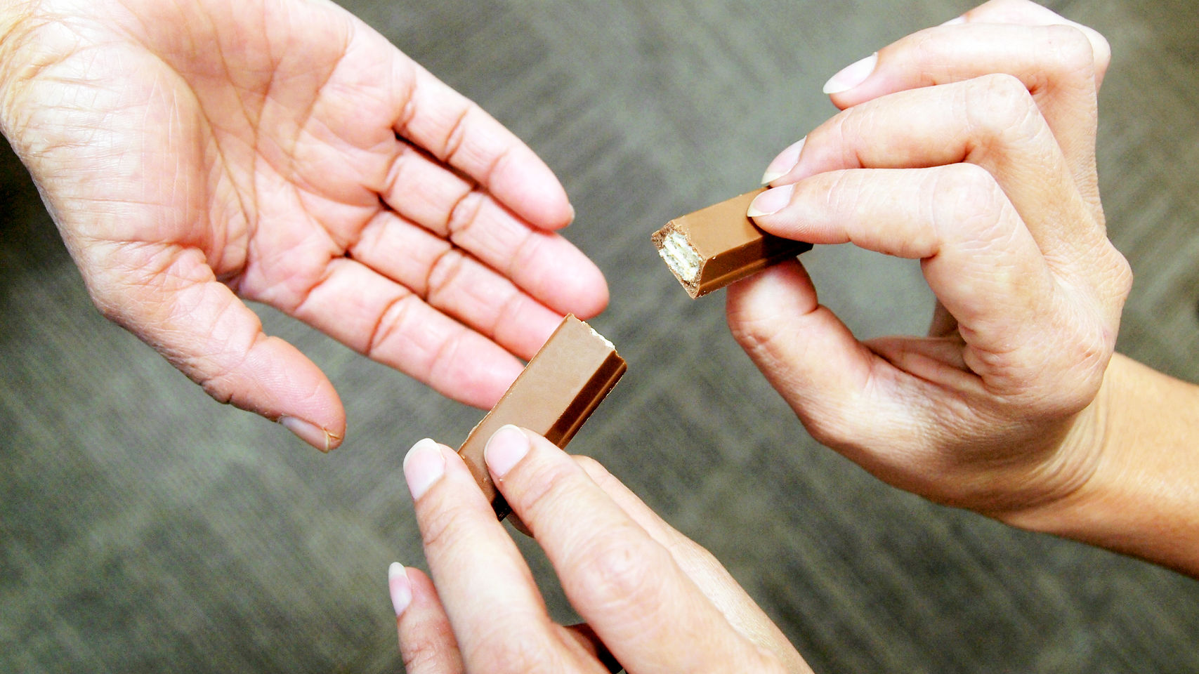

A PICTURE IS WORTH A THOUSAND WORDS

