Slide 1
ENGI 301 2- Player Pattern Memory Game Proposal
13th February 2023
Deepak Narayan

Slide 2
Background Information: My Story
One player sets a pattern using a keypad; the other is briefly shown the pattern and then attempts to replicate it correctly
Turning the standard memory pattern game into a 2-player game seemed like a good project to get started in learning to make a game
I am also interested in learning about multiplexing and Charlieplexing. I hope to learn a lot about how LED matrices work through this project.

Slide 3
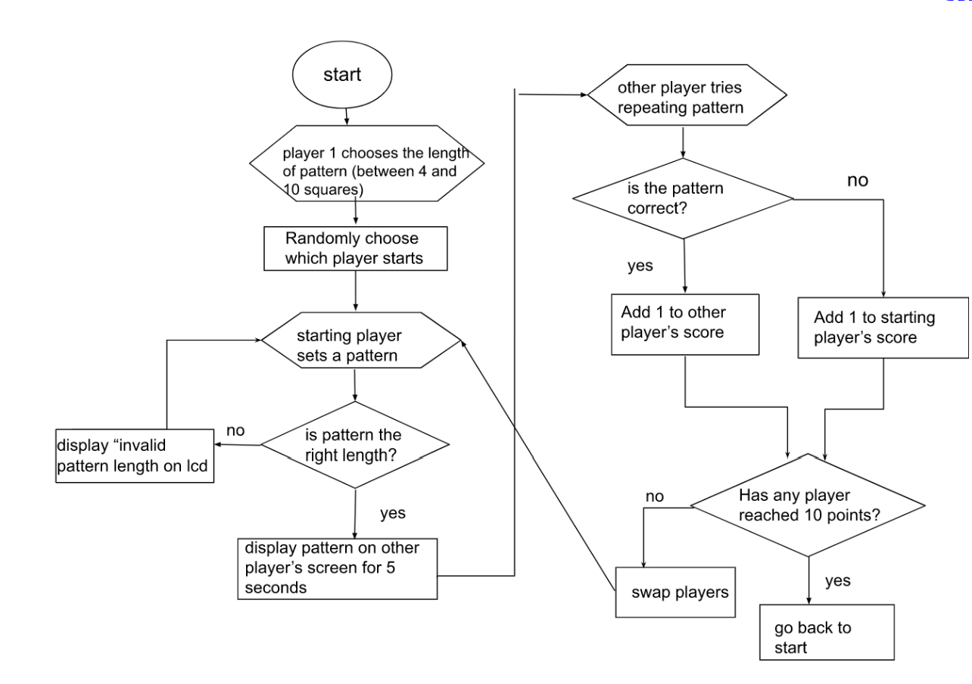
Background Information: Overview of the Game
Figure 1: Game Logic Flowchart

Slide 4
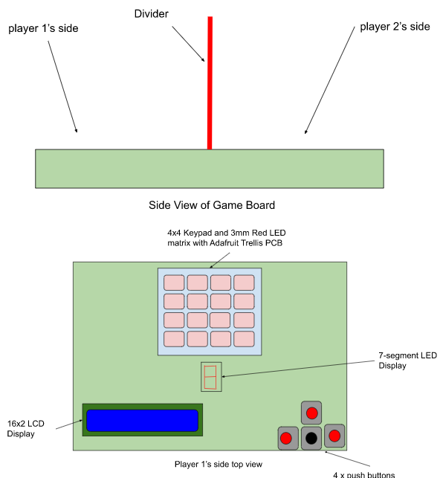
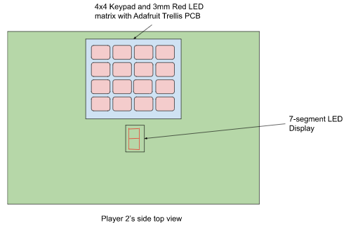
Background Information: The Device
Figure 3: Top view of player 2’s side
Figure 2: Side view of game board (top) and top view of Player 1’s side(bottom)

Slide 5
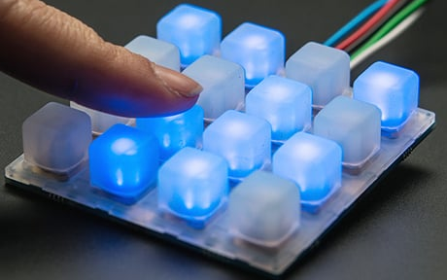
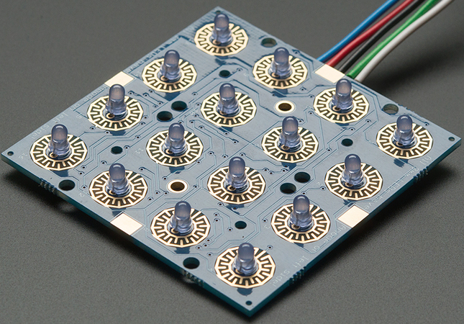
Background Information: The Device
Player 1 interfaces with LCD with the pushbuttons to select the pattern length
Players’ Score is shown on 7-segment LED
Figure 4: Adafruit Trellis PCB with LEDs installed (Rembor) [1]
Figure 5: Adafruit Trellis PCB with LEDs and 4x4 keypad (Rembor) [2]
[1]: Rembor, Kattni “Adding LEDs” Adafruit, 6 Dec. 2013, https://learn.adafruit.com/adafruit-trellis-diy-open-source-led-keypad/adding-leds Accessed 12 Feb. 2023.
[2]: Rembor, Kattni “Overview” Adafruit, 6 Dec. 2013, https://learn.adafruit.com/adafruit-trellis-diy-open-source-led-keypad/overview Accessed 12 Feb. 2023

Slide 6
Background Information: Existing Project and Improvements
My project is based on a Pattern Memory Game with the Tessel 1 Development Board:
https://www.hackster.io/nmoadev/rebloc-099bdd
https://github.com/nmoadev/reBloc/blob/master/rebloc.js
My project adds multiplayer and the option to choose the size of the pattern.
Additional software: code to store patterns, validate patterns, swap players, and count score
Additional hardware: 16x2 LCD display, push buttons, 7-segment LED Display

Slide 7
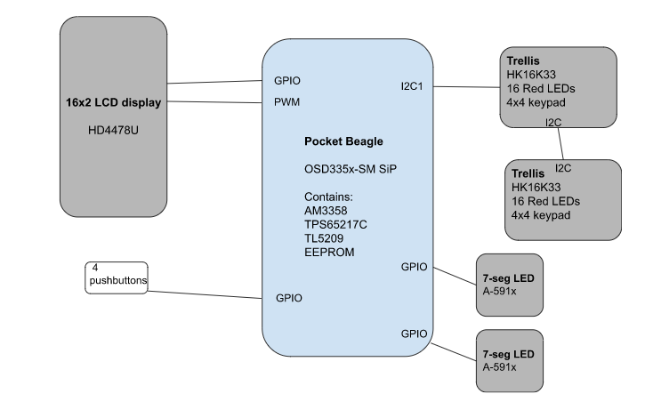
System Block Diagram
Figure 5: System block diagram for the game

Slide 8
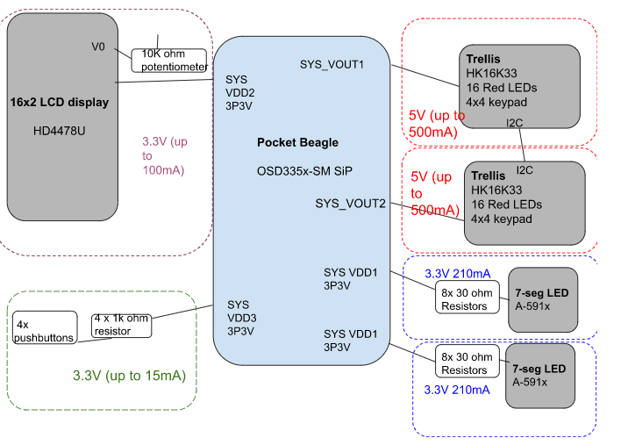
Power Block Diagram
The datasheet for the Trellis does not specify an exact value for the current draw. An additional power source might be needed.
Figure 6: Power Block Diagram of Game

Slide 9
Components / Budget
Component | Need to Buy | Total
Adafruit Trellis Driver PCB | 2 | $19.90
Trellis Elastomer Keypad | 2 | $9.90
Standard LCD 16x2 + extras | 1 | $9.95
I can source the 7-seg LEDs, buttons, and Red LEDs myself and from the parts kit
An additional power source may be needed after the current draw of the Trellis is measured

Slide 10
Components / Budget
Component | Need to Buy | Total
Adafruit Trellis Driver PCB | 2 | $19.90
Trellis Elastomer Keypad | 2 | $9.90
Standard LCD 16x2 + extras | 1 | $9.95
I can source the 7-seg LEDs, buttons, and Red LEDs myself and from the parts kit
An additional power source may be needed after the current draw of the Trellis is measured

