Slide 1
ENGI 301 PCB Project
Deepak Narayan
Due 05/02/2022 @ 11:59pm

Slide 2
Options
Can choose one of two options:
Create a PCB based on your Project #1
Create a PCB based on an example project
See Project #2 assignment for specific details
If choosing Option 1
Replace Background Information and System Block Diagram slides with your slides from the Project #1 proposal
Create a Mechanical Drawing
If choosing Option 2
Used provided Background Information and System Block Diagram slides
Create a Mechanical Drawing

Slide 3
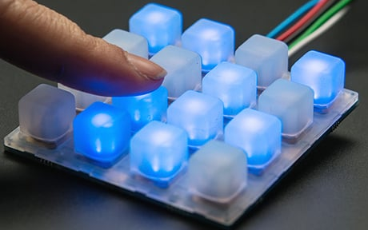
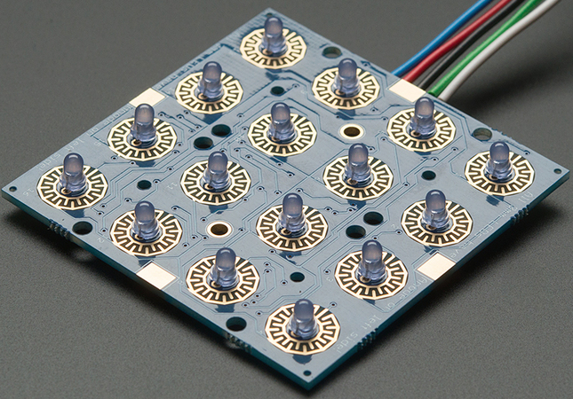
Background Information: The Device
Player 1 interfaces with LCD with the pushbuttons to select the pattern length
Players’ Score is shown on 7-segment LED
Figure 4: Adafruit Trellis PCB with LEDs installed (Rembor) [1]
Figure 5: Adafruit Trellis PCB with LEDs and 4x4 keypad (Rembor) [2]
[1]: Rembor, Kattni “Adding LEDs” Adafruit, 6 Dec. 2013, https://learn.adafruit.com/adafruit-trellis-diy-open-source-led-keypad/adding-leds Accessed 12 Feb. 2023.
[2]: Rembor, Kattni “Overview” Adafruit, 6 Dec. 2013, https://learn.adafruit.com/adafruit-trellis-diy-open-source-led-keypad/overview Accessed 12 Feb. 2023

Slide 4
Background Information: Existing Project and Improvements
My project is based on a Pattern Memory Game with the Tessel 1 Development Board:
https://www.hackster.io/nmoadev/rebloc-099bdd
https://github.com/nmoadev/reBloc/blob/master/rebloc.js
My project adds multiplayer and the option to choose the size of the pattern.
Additional software: code to store patterns, validate patterns, swap players, and count score
Additional hardware: 16x2 LCD display, push buttons, 7-segment LED Display

Slide 5
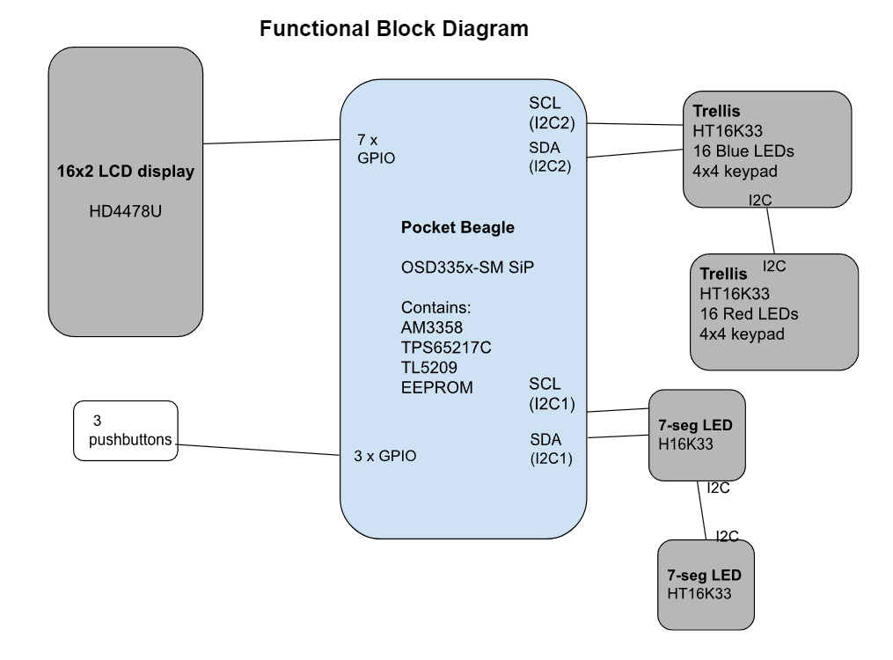
System Block Diagram
Figure 5: System block diagram for the game

Slide 6
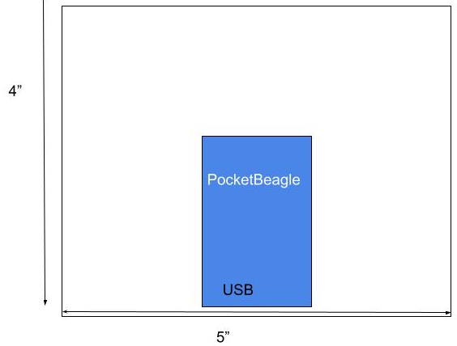
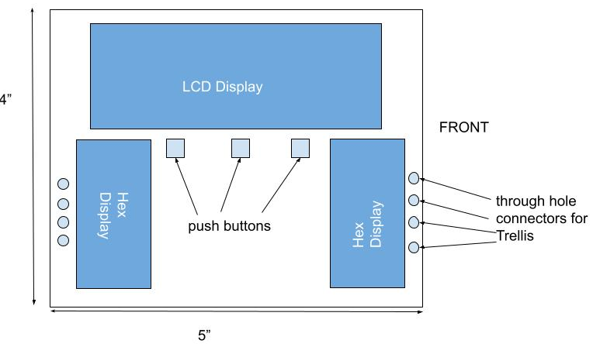
Mechanical Drawing
FRONT
BACK

Slide 7
Example Mechanical Drawing (from Combo Lock)
3”
.25”
Hex Display
Pocket Beagle
.5”
USB
2”
Button
Buzzer
Pot
Servo
1.5”
FRONT
BACK
Remove this slide in your submission

