Slide 1
Redesign of Database Algorithms for Next Generation Non-volatile Memory Technology
Weiwei Hu
Supervisor: Prof. Beng Chin Ooi
School of Computing
National University of Singapore

Slide 2
Acknowledgement
Prof. Beng Chin Ooi
Prof. Kian-Lee Tan
Guoliang Li (Tsinghua University)

Slide 3
Why?
What?
How?

Slide 4
Motivation
Traditional memory technologies
DRAM is volatile
Flash has limited write endurance and high write latency
Emerging next-generation memory technologies
Non-volatile memory (NVM)
Phase change memory (PCM)

Slide 5
Motivation
Phase Change Memory (PCM)
Non-volatile
Byte-addressable
Denser than DRAM
More energy efficient than DRAM
Better read/write latency and endurance than Flash
Can PCM replace DRAM to be in main memory?
“how should database systems be modified to best take advantage of this emerging trend towards PCM?”

Slide 6
Why?
What?
How?

Slide 7
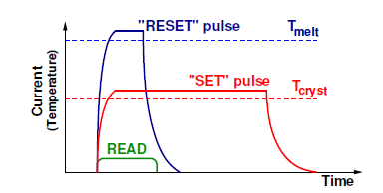
PCM Technology – What is PCM?
A byte addressable non-volatile memory
Phase change material
Large resistance contrast between amorphous and crystalline states
SET and RESET operation

Slide 8
PCM vs. Other Technologies
 | DRAM | PCM | NAND | HDD
Density | 1X | 2-4X | 4X | N/A
Read Latency | 20-50ns | ~50ns | ~25μs | ~5ms
Write Latency | 20-50ns | ~1μs | ~500μs | ~5ms
Read Energy | 0.8J/GB | 1J/GB | 1.5J/GB | 65J/GB
Write Energy | 1.2J/GB | 6J/GB | 17.5J/GB | 65J/GB
Idle power | ∼100mW/GB | ∼1mW/GB | 1∼10mW/GB | ∼10W/TB
Endurance | ∞ | 10⁶ - 10⁸ | 10⁵ - 10⁶ | ∞
Note: The table contents are mainly based on [1, 2, 3]

Slide 9
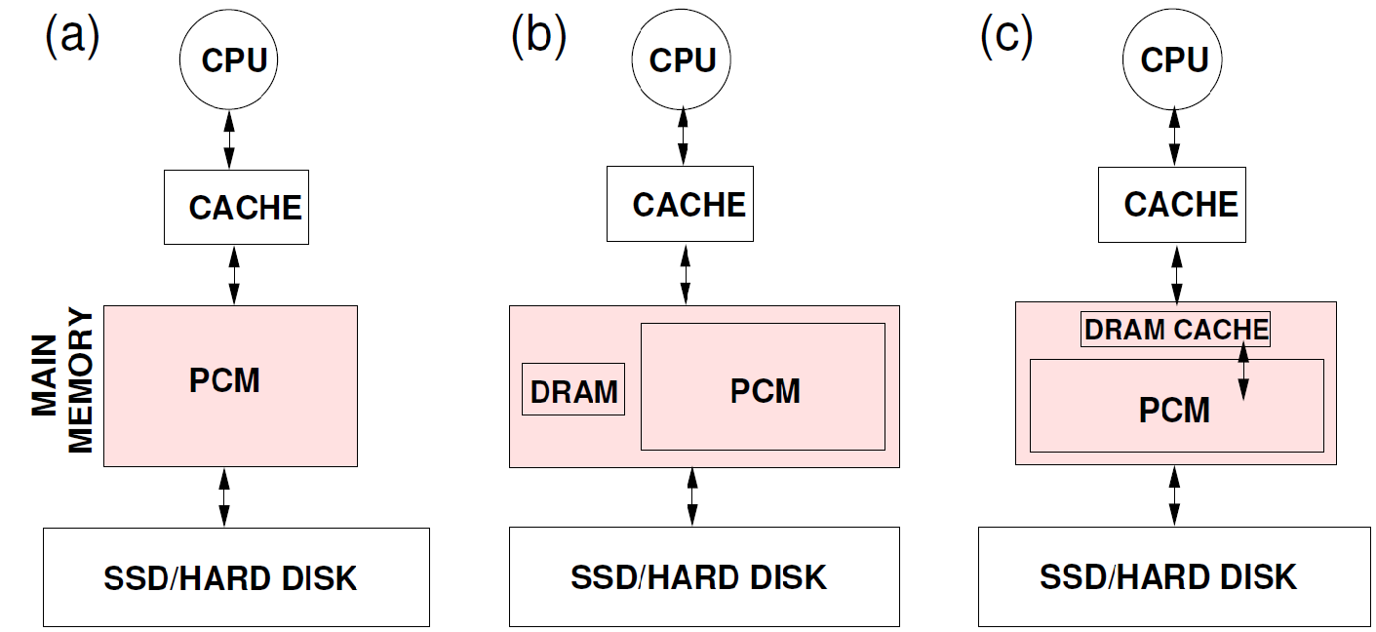
PCM in Main Memory Hierarchy
Replace DRAM with PCM
PCM + software controlled DRAM buffer
PCM + DRAM buffer as hardware level cache
Note: In previous study [3, 4], DRAM buffer is 3% - 8% size of the PCM capacity

Slide 10

Challenges with PCM
Major disadvantage – Writes
High energy consumption
Incur high voltage, high current
High latency and low bandwidth
Longer SET time
Limited number of bits per iteration
Limited endurance
Wear leveling at the memory controller

Slide 11

PCM-Friendly DB Algorithms Design
Design Goals
Minimize PCM writes
Good CPU cache performance
Power efficiency
Analytical Metrics
Total PCM access latency
Energy consumption

Slide 12
PCM-Friendly DB Algorithms Design
Algorithm analysis
Cache lines
Fetch: N1, T1 are the number and latency resp.
Write back: N2, T2 are the number and latency resp.
Bits
E1, E2 are the energy for reading and writing a PCM bit resp.
Model
L is the number of bits in a cache line, λ is the average number of modified bits per written cache line
Total PCM access latency = N1 * T1 + N2 * T2
Energy consumption = T1 * L * E1 + T2 * λ * E2

Slide 13
Literature Review
HDD
Log-Structured Merge Tree (LSM-tree) ^{[5]}
The Buffer Tree ^{[6]}
SSD
B-Tree layer for ﬂash-memory storage systems (BFTL) ^{[7]}
FD-tree ^{[9]}

Slide 14
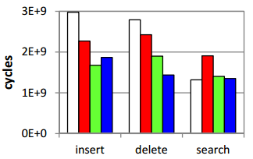
Literature Review
PCM-based Indexing ^{[10]}
Outline new database algorithms design consideration
B⁺-Tree related proposals
Sorted
Unsorted
Unsorted leaf
Unsorted leaf with bitmap
Execution Time

Slide 15

Our Focuses
How to make existing algorithms write-optimized?
Indexing Techniques
Future Work
Query Processing Algorithms
Buffer Management

Slide 16
Why?
What?
How?

Slide 17
Indexing Algorithm – Predictive B⁺-Tree
Design Principle
Reduce the number of writes for data insertions and updates without sacrificing the performance of searches
Methods
Adopt the unsorted leaf strategy
Develop a scheme to minimize data movements by node splitting and merging
Basic Idea
Predict the data distribution based on the previous insertions and pre-allocate space on PCM for accommodating future nodes

Slide 18
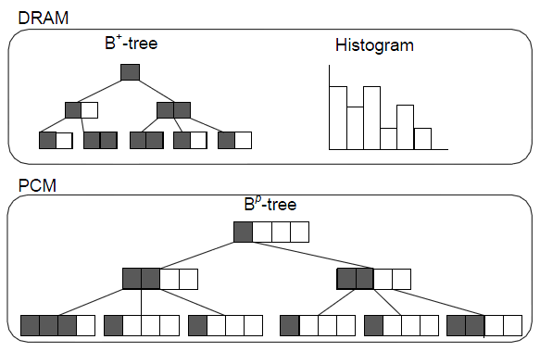
Predictive B⁺-Tree
Main Components
DRAM buffer
B^{p}-tree on PCM
Construction
Warm-up phase
Update phase

Slide 19
DRAM Buffer
Small standard B⁺-tree
New keys inserted into DRAM buffer first
When buffer is full, flush the keys to PCM
Histogram to capture the data distribution

Slide 20
Warm-up phase
For the first time that the DRAM buffer is full, all the keys in the buffer will be moved to the PCM
Construct the skeleton of B^{p}-tree
Enlarge the node size by K
Set by administrator
Estimated based on the distribution
Width of a bucket W = (U-L) / |B|, current number of keys is N, maximum number of keys among all the current buckets is A
Estimate the total number of possible keys is T = N * W / A
Estimate K = log_{h}(T/N) = log_{h}(W/A)
Split the node in an eager manner

Slide 21
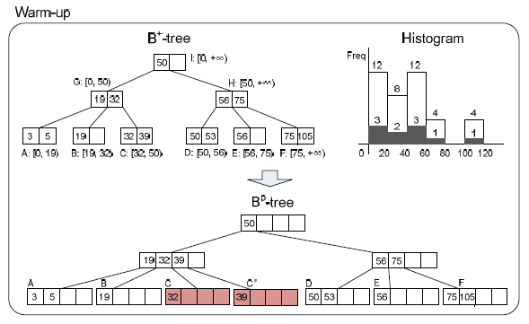
Warm-up phase

Slide 22
Update phase
Keys are first inserted into the buffer
Each time the buffer is full, update the predictive model first
Merge the buffer tree to the main B^{p}-tree according to the predictive model
Main concern: determine whether a node needs to be split even it is not full

Slide 23
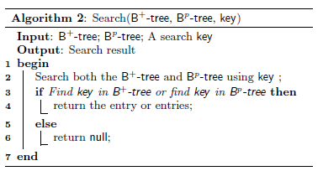
Update phase
Search

Slide 24
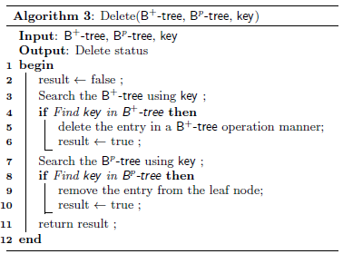
Update phase
Deletion

Slide 25
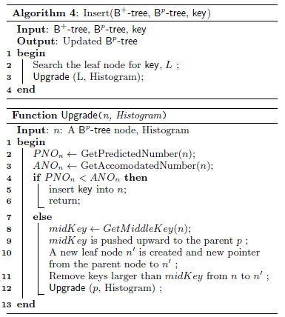
Update phase
Insertion

Slide 26
Predictive Model
Number of keys that can be accommodated in node n: ANO_{n}
Number of possible keys that could fall in node n based on the predictive model: PNO_{n}
For node n, extent is [key_{min}, key_{max}]
If key_{min} and key_{max} are in the same bucket B_{s},
Otherwise, in two different buckets B_{s} and B_{e},

Slide 27
Predictive Model
Get the ``middle’’ key in node n
Suppose the existing keys on node n is key₁, key₂, …, key_{|n|}
A key key_{i} is called a middle key if
where P(key_{i}, key_{j}) denote the number of predicted keys between key_{i} and key_{j}

Slide 28
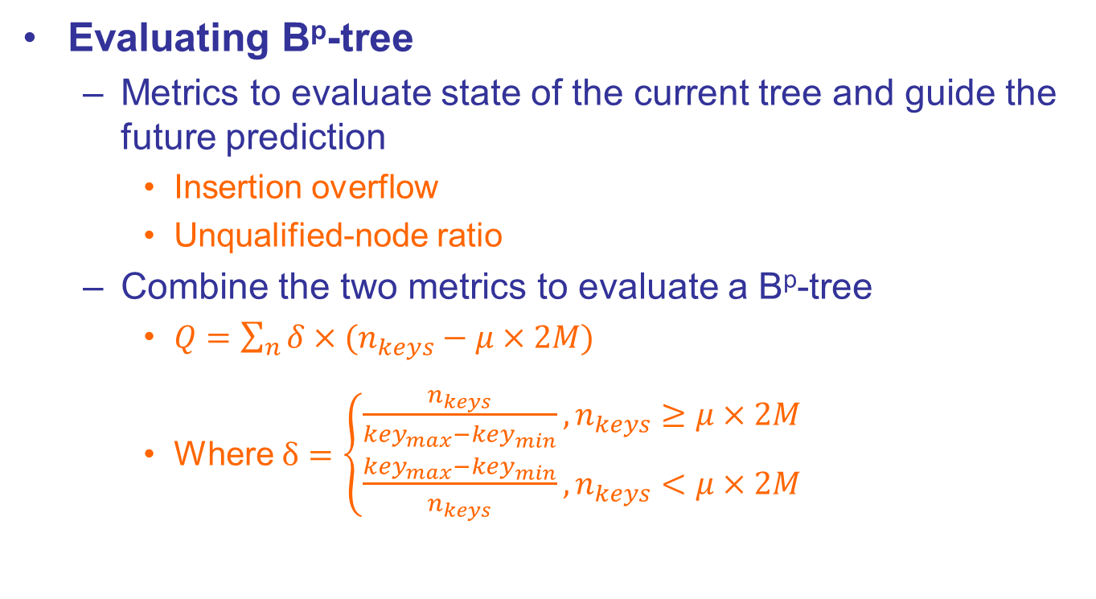
Predictive B⁺-Tree
Evaluating B^{p}-tree
Metrics to evaluate state of the current tree and guide the future prediction
Insertion overflow
Unqualified-node ratio
Combine the two metrics to evaluate a B^{p}-tree
$Q=\sum_{n}{δ×(n_{keys}−μ×2M)}$
Where $δ=\left\{\begin{matrix}\frac{n_{keys}}{{key}_{max}−{key}_{min}}, n_{keys}≥μ×2M \\ \frac{{key}_{max}−{key}_{min}}{n_{keys}}, n_{keys}<μ×2M\end{matrix}\right.$

Slide 29
Experimental Evaluation
Experimental Setup
Simulation – calculate number of writes based on both bits and cache lines
Datasets and workloads – two datasets with uniform and skewed distribution separately, workloads include insertions, updates and searches
Algorithms compared – our B^{p}-tree, standard B⁺-tree, the unsorted leaf tree and our B^{p}-tree with sorted leaf nodes

Slide 30
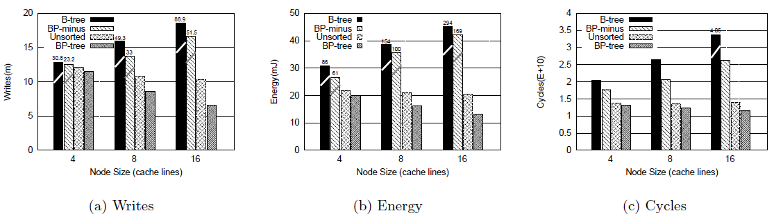
Experimental Evaluation
Insertion performance

Slide 31
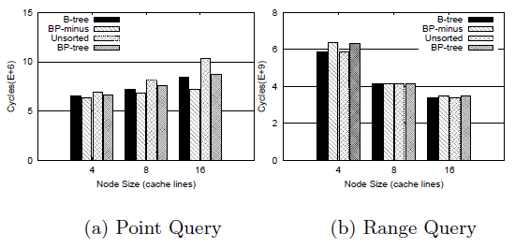
Experimental Evaluation
Search performance

Slide 32
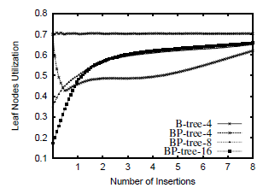
Experimental Evaluation
Leaf node utilization
(m)

Slide 33
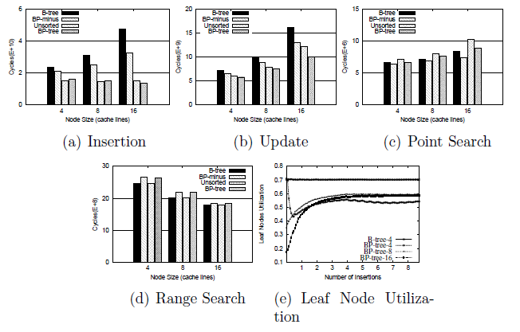
Experimental Evaluation
Sensitivity to data distribution changes
(m)

Slide 34
Conclusion and Future Work
Contributions
Described the characteristics of PCM
Introduced the analytic metrics to design algorithms for PCM-based database systems
Proposed B^{p}-tree indexing technique
Future research directions
Buffer pool designing
Query processing algorithms

Slide 35
Thank You! Q & A

Slide 36
References
[1] F. Bedeschi, R. Fackenthal, C. Resta, E. Donze, M. Jagasivamani, E. Buda, F. Pellizzer, D. Chow, A. Cabrini, G. Calvi, et al. A multi-level-cell bipolar-selected phase-change memory. In Solid-State Circuits Conference, ISSCC 2008.
[2] S. Chen, P. Gibbons, and S. Nath. Rethinking Database Algorithms for Phase Change Memory. CIDR 2011.
[3] M. K. Qureshi, V. Srinivasan, and J. A. Rivers. Scalable high performance main memory system using phase-change memory technology. In Proceedings of the 36th annual international symposium on Computer architecture, ISCA 2009.
[4] L. E. Ramos, E. Gorbatov, and R. Bianchini. Page placement in hybrid memory systems. In Proceedings of the international conference on Supercomputing, ICS 2011.
[5] P. O’Neil, E. Cheng, D. Gawlick, and E. O’Neil. The log-structured merge-tree (lsm-tree). Acta Informatica, 33(4):351–385, 1996.
[6] L. Arge. The buffer tree: A new technique for optimal i/o-algorithms. In WADS, pages 334–345, 1995.
[7] C.-H. Wu, T.-W. Kuo, and L. P. Chang. An efficient b-tree layer implementation for flash-memory storage systems. ACM Transactions on Embedded Computing Systems (TECS), 6(3):19–es, 2007.

Slide 37
References
[8] S. Nath and A. Kansal. Flashdb: dynamic self-tuning database for nand flash. In Proceedings of the 6th international conference on Information processing in sensor networks, IPSN ’07, pages 410–419. ACM, 2007.
[9] Y. Li, B. He, R. J. Yang, Q. Luo, and K. Yi. Tree indexing on solid state drives. PVLDB, 3(1):1195–1206, 2010.
[10] S. Chen, P. Gibbons, and S. Nath. Rethinking Database Algorithms for Phase Change Memory. CIDR, 2011.
[11] D. Tsirogiannis, S. Harizopoulos, M. Shah, J. Wiener, and G. Graefe. Query processing techniques for solid state drives. In SIGMOD, 2009.
[12] M. Shah, S. Harizopoulos, J. Wiener, and G. Graefe. Fast scans and joins using flash drives. In Proceedings of the 4th international workshop on Data management on new hardware, pages 17–24. ACM, 2008.

