Slide 1
Career Pathfinder
Career Pathfinder

Slide 2
Problem
Current career platforms focus on job matching, not career growth
Limited guidance on required skills and training
Users lack personalized career paths and development plans
2

Slide 3
Solution
AI-driven career analysis and recommendation engine
Personalized career paths and development plans
Integration with top course and certification providers
3

Slide 4
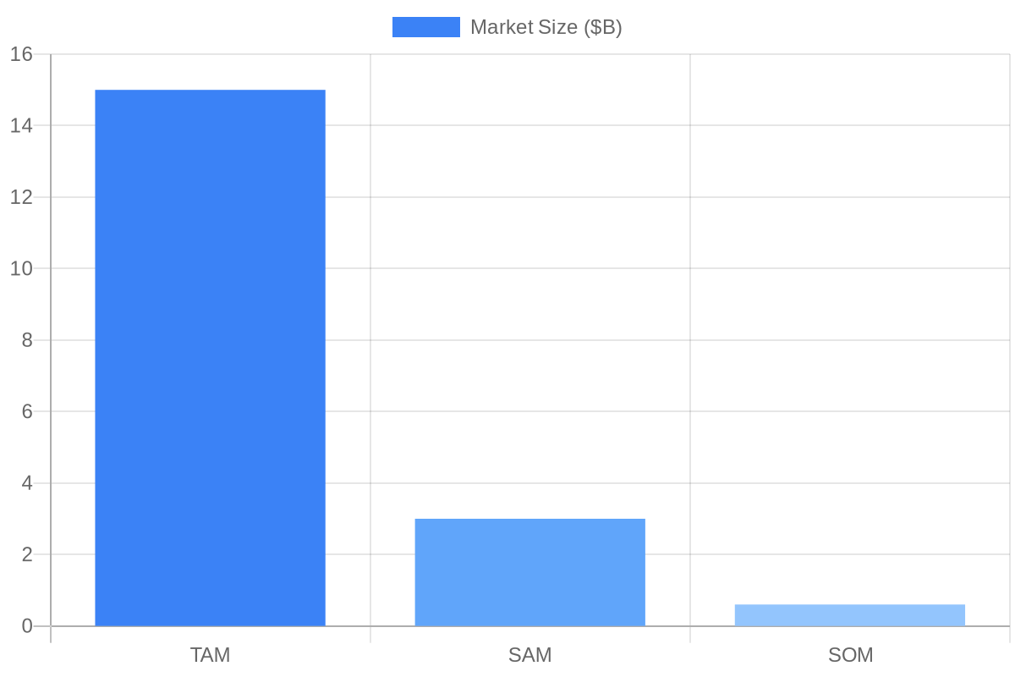
Market Opportunity
TAM: $10B career development market
SAM: $1B AI-powered career platforms
SOM: $200M personalized career development solutions
4

Slide 5
Product
User profiling and skills analysis
AI-driven career recommendations and pathways
Integrated course and certification marketplace
5

Slide 6
Business Model
Freemium model with premium features and services
Partnerships with course and certification providers
B2B offerings for enterprise career development
6

Slide 7
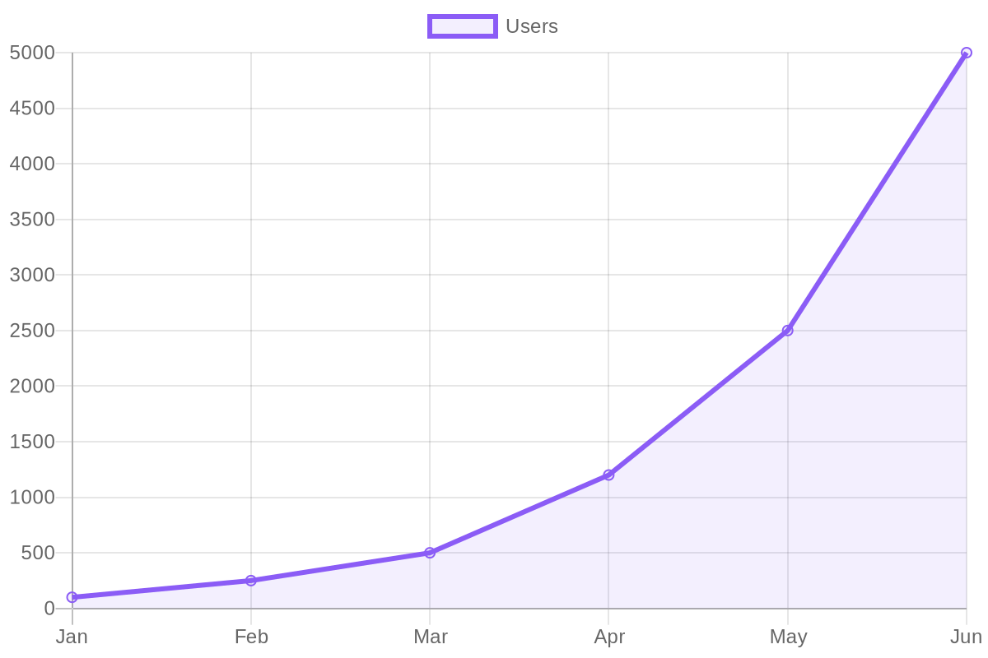
Traction
Prototype developed with 100+ user testers
Partnerships with 5+ course and certification providers
User engagement metrics: 30% monthly retention, 25% weekly active users
7

Slide 8
Competition
LinkedIn: limited career development features
Other career platforms: lack AI-driven recommendations
Career Pathfinder: unique value proposition with AI-powered career analysis
8

Slide 9
Team
Founders: [Your Name], [Co-Founder's Name]
Key team members: AI engineer, career development expert, marketing lead
Advisors: industry experts in AI, education, and career development
9

Slide 10
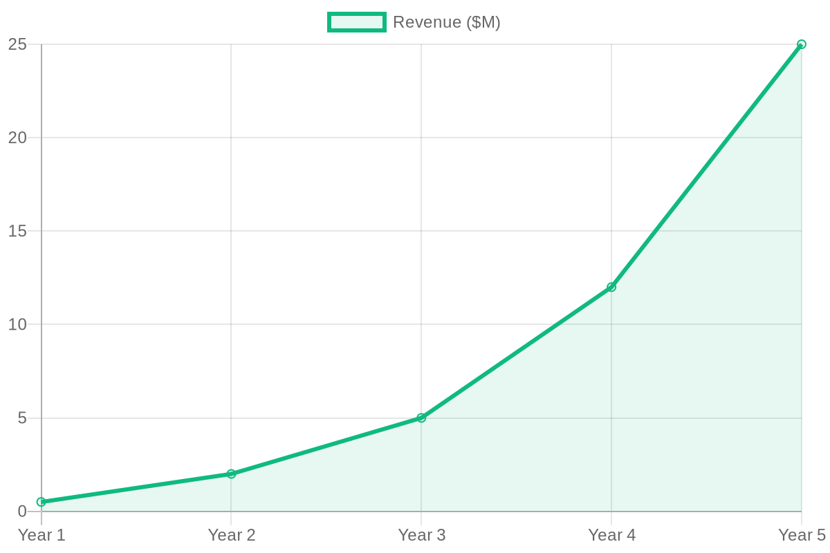
Financials
Revenue projections: $250,000 (year 1), $1M (year 2), $5M (year 3)
User acquisition costs: $50/user
Lifetime value: $200/user
10

Slide 11
The Ask
Funding amount: $100,000
Use of funds: product development, marketing, user acquisition
Milestones: launch premium features, expand partnerships, reach 10,000 users
11

Slide 12
Closing
Join us in revolutionizing career development with AI
Together, let's unlock new career possibilities for millions of users
Invest in Career Pathfinder today
12

