Slide 1

NBA Shot Chart
Git buckets:
Jongwoo Lee
BilL Eveloff
Alan Tsai
Deep Sran

Slide 2
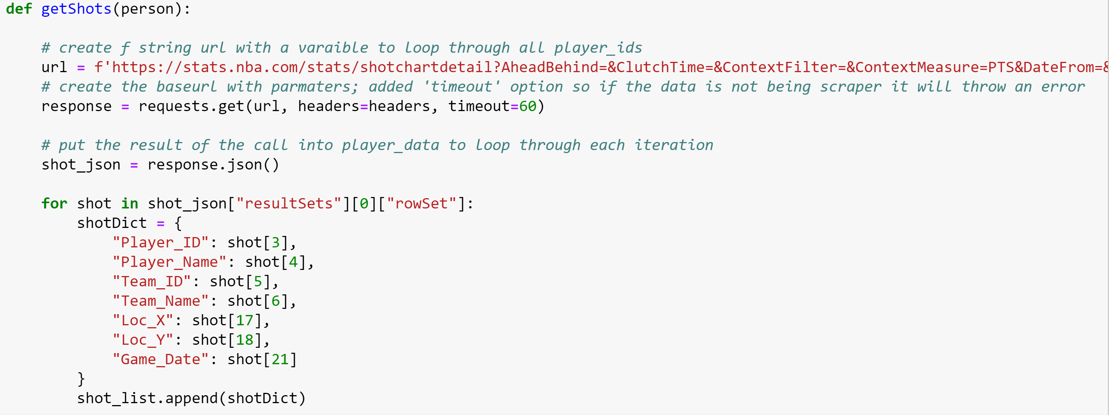

Pulling data from Nba STATS API

Slide 3

Data Cleaning

Slide 4
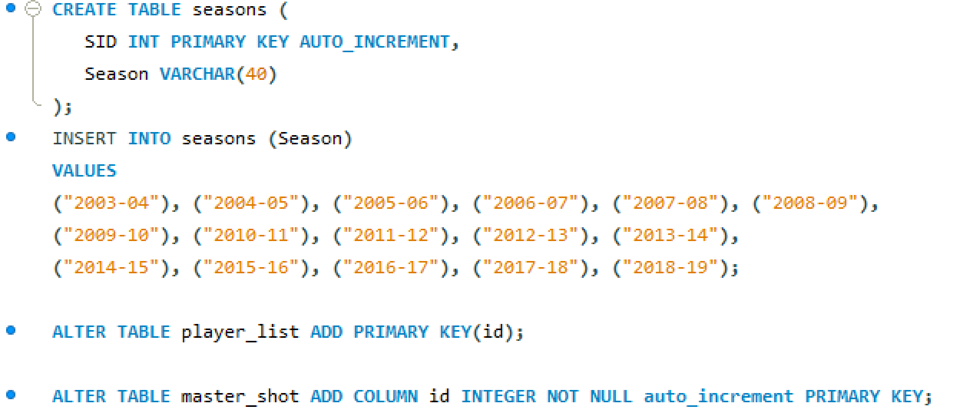
DATA CLEAN AND CREATING SQL Database

Slide 5
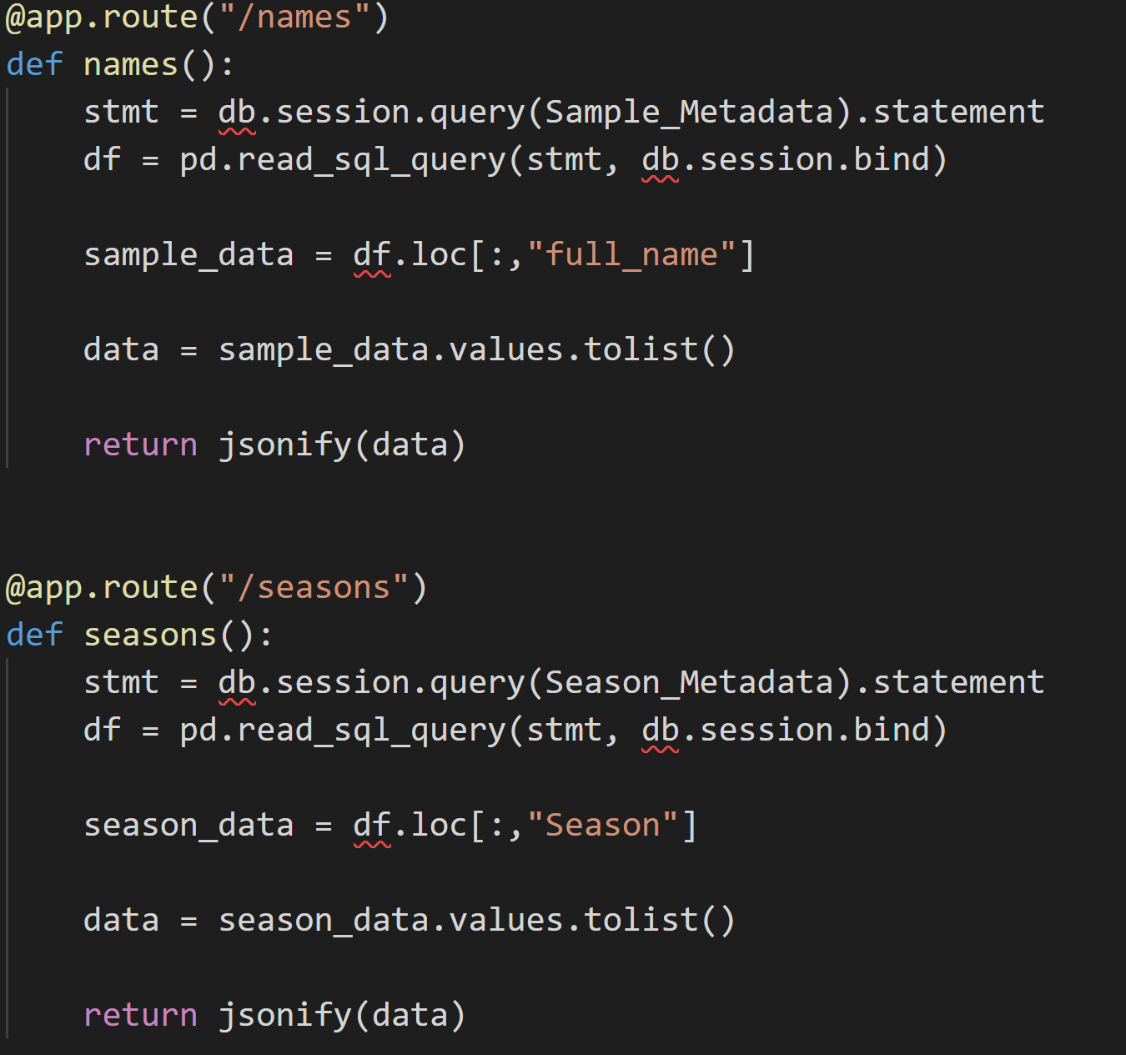
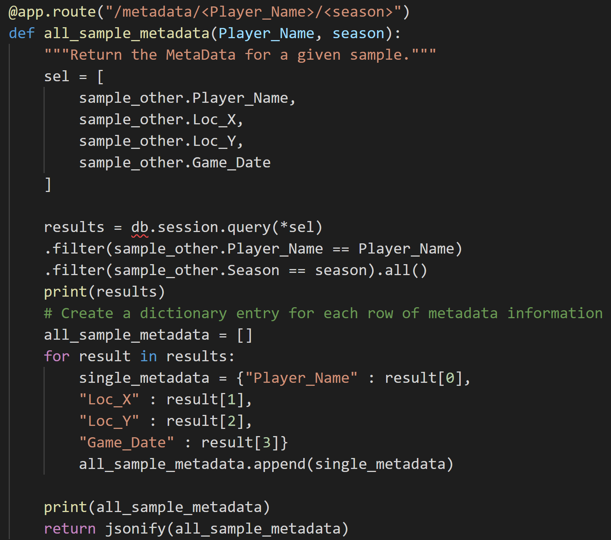
FLask

Slide 6
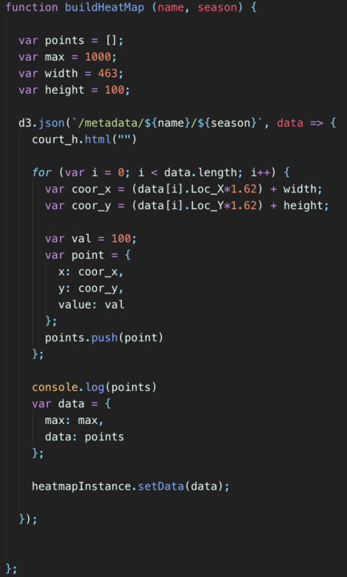
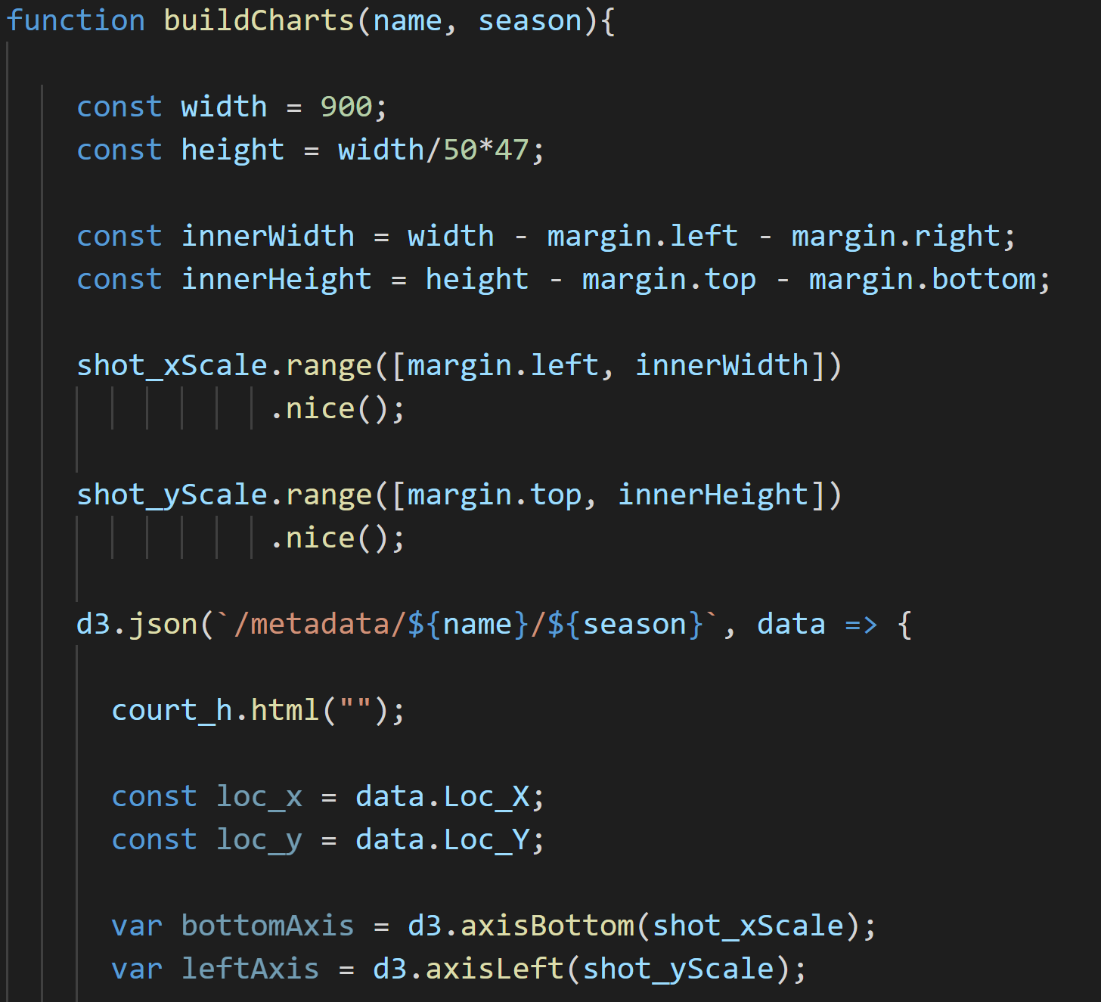
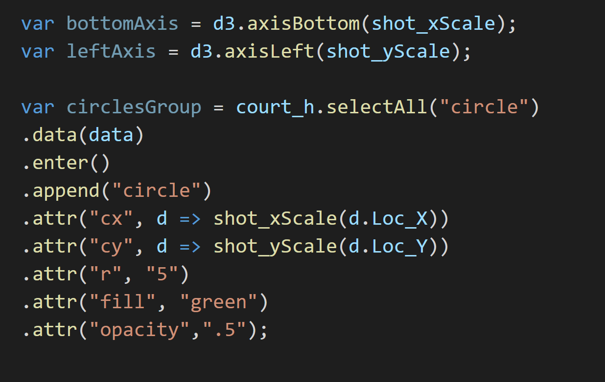
Plotting Data onto Shot chart

Slide 7
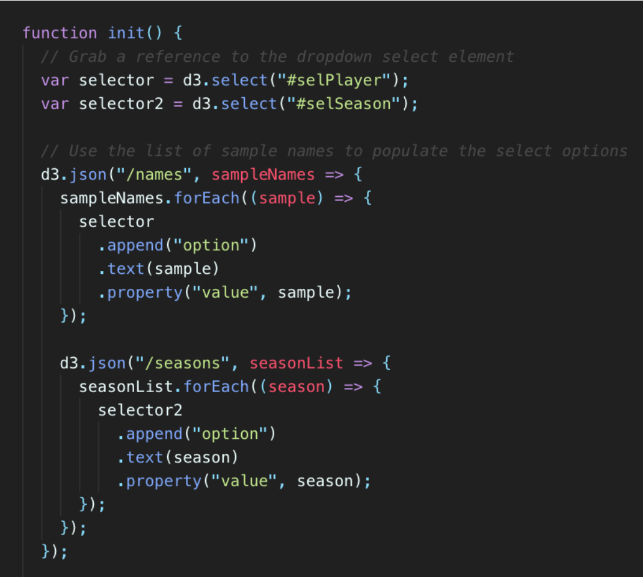
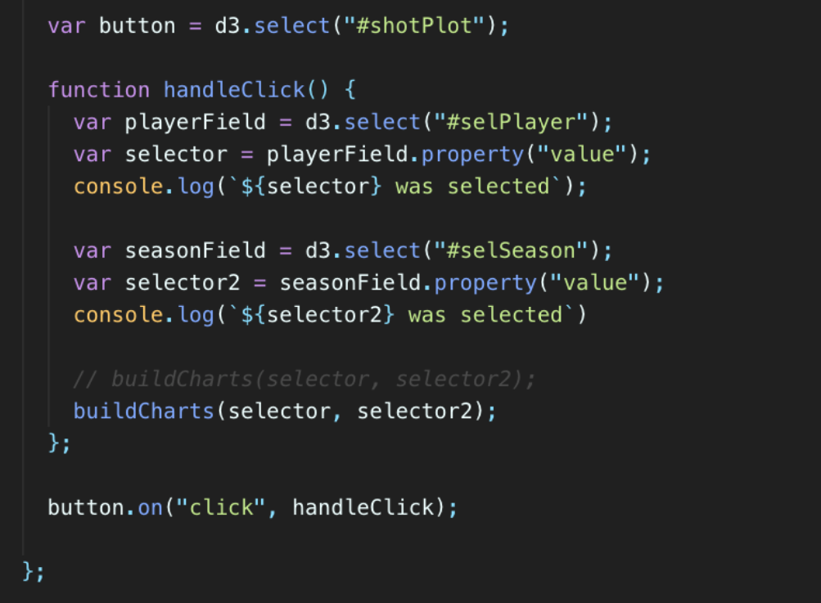
Init

