Slide 1
BI-Modernization and Migration Portal Design presented by : Arghadeep Chaudhury IBM Confidential

Slide 2
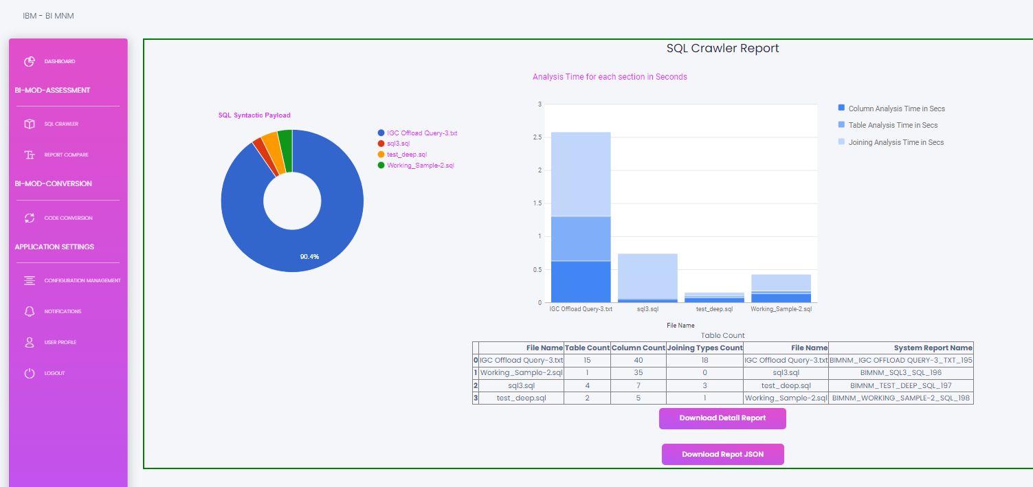



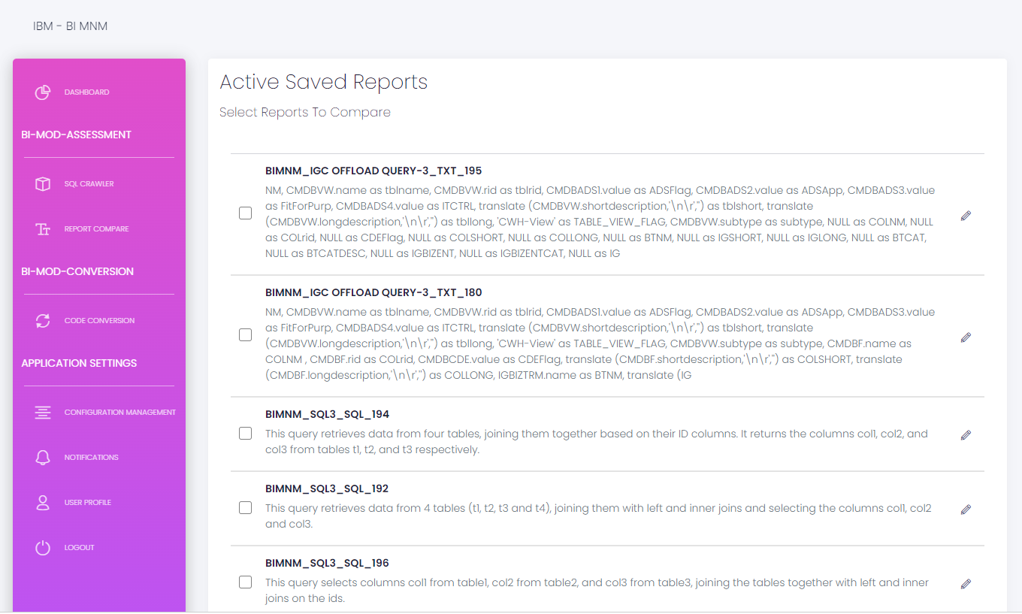


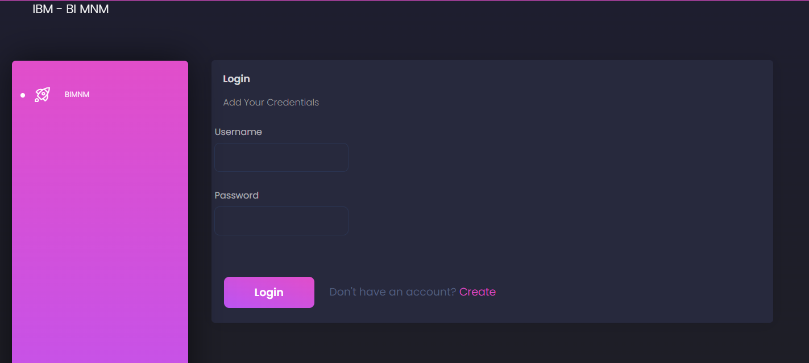
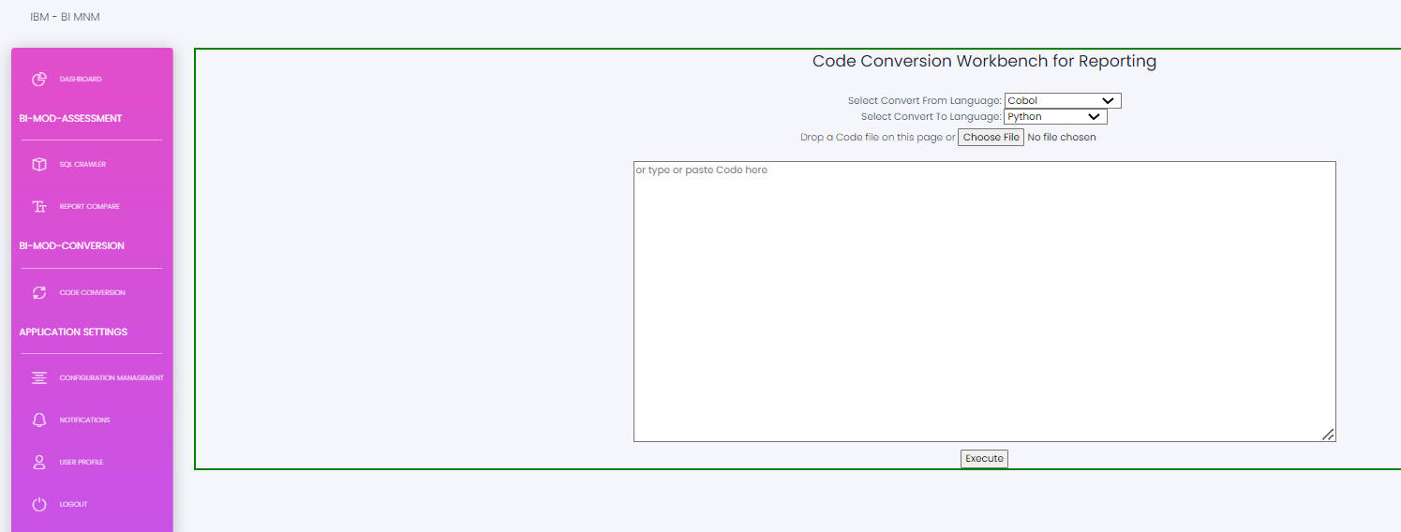
Proof of Technology (POT)

Slide 3
Technology Stack Overview
User Interface
1.HTML5
2.CSS/SCSS
3.JavaScript/Jquery
4.bootstrap.js
5.min.js
6.react.js
7.Google chart API
Middleware
1.Python 3.8/3.9
2.Python Flask 2.0.1
3.GPT3 API
Backend
1.Postgresql
2.SQLite
3.Mongo (document storage)
Hosted on : gunicorn-nginx
Hosted on : AWS
Docker Image
K8

Slide 4
Important Links: BI Modernizaton | Powered by Box
Thank You!

