Slide 1
Cool-Dictionary
Search Cool Words!
By: Sasha Ashtiani,
Deep Patel,
Jeff Henrichs

Slide 2
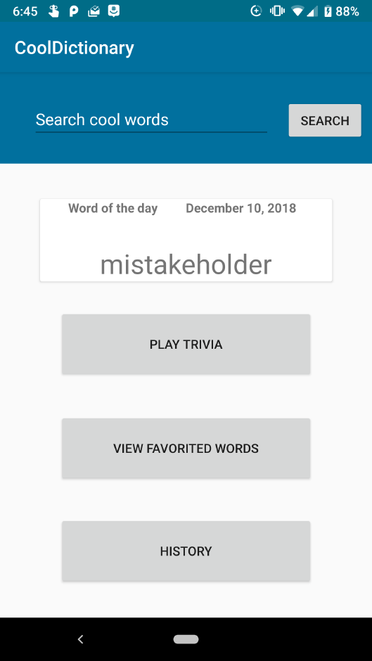
What’s the App?
A Dictionary!
Includes 5 Main Features:
Search
Word of the Day
Trivia
Favorite Words
Search History
Uses custom API made by a third-party
Indirectly using Oxford Dictionary API
Uses Volley for network requests
Volley is a HTTP Library
Includes 4 Android Components:
SQLite database
RecyclerView
Network access
Dialogs

Slide 3
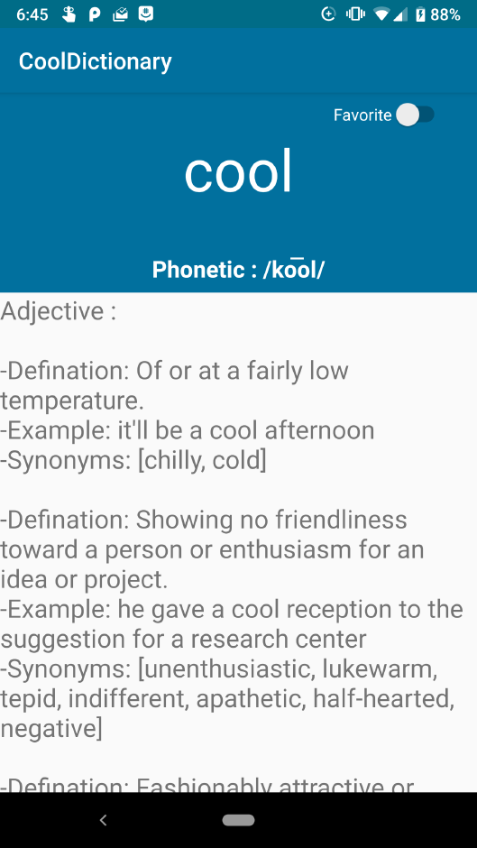
Our Challenges
Attaining the definition from API
API’s JSON is complicated
Displaying the information from API
API returns info in gibberish (unorganized)
We had to parse and analyze the data
Setting up the database
Took too much time

Slide 4
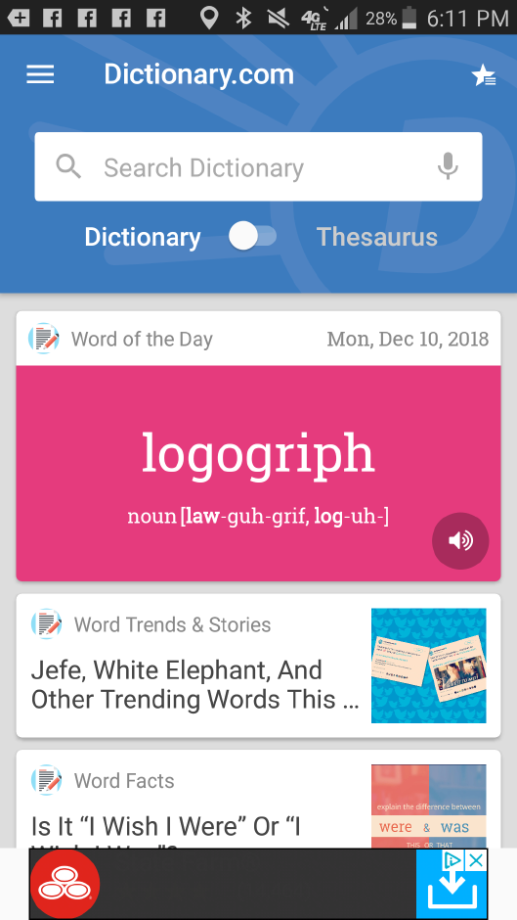
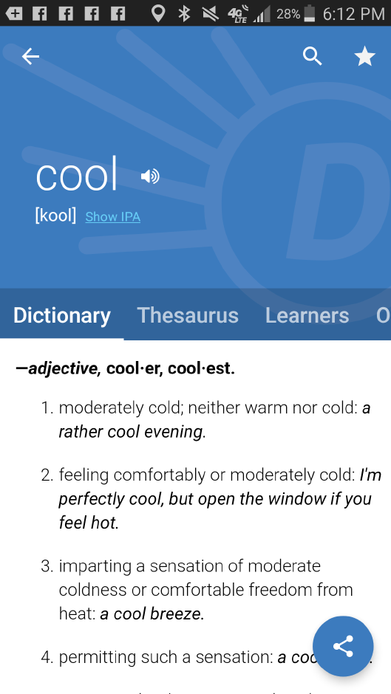
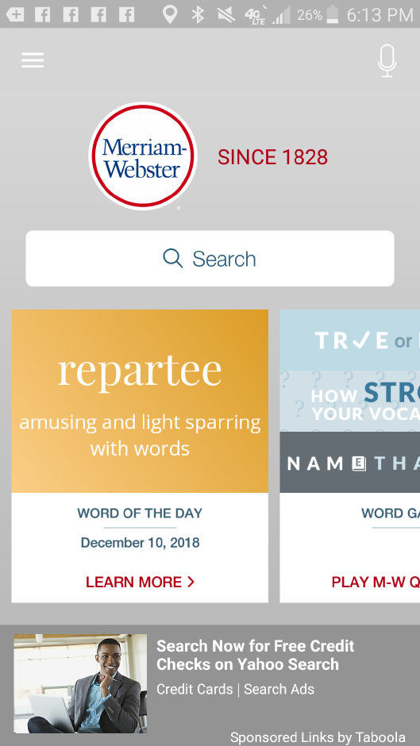
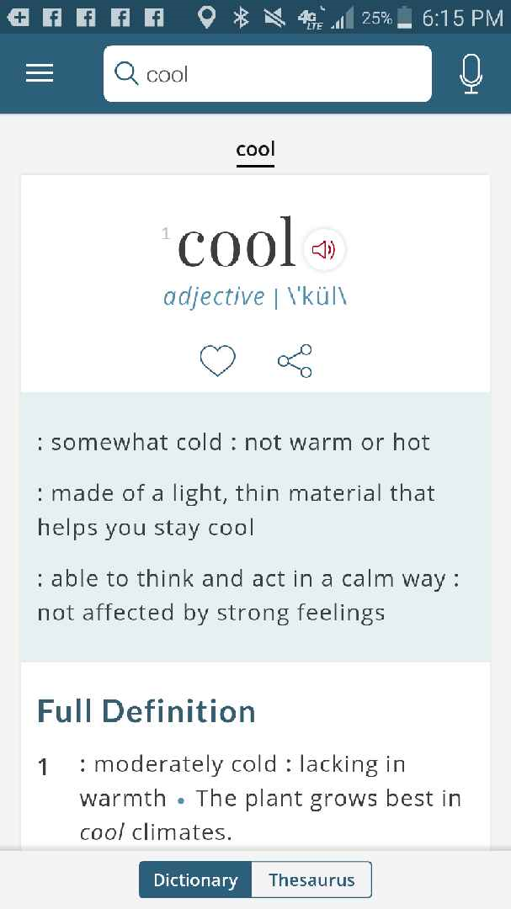
Comparing Cool-Dictionary to Other Apps
Dictionary.com App Merriam-Webster App

Slide 5


