Slide 1
ProduScope 2025
Building a Smarter Financial Tool for College Students
Team Name:deepteshrout2294

Slide 2
Agenda
1. Problem Context
2. Target Personas
3. Pain Points
4. Market Gap & Opportunity
5. Product Vision
6. MVP Features & Prioritization
7. User Journey & Wireframes
8. Go-To-Market Strategy
9. Metrics & Roadmap

Slide 3
Problem Context
• Students struggle with budgeting, saving, and expense management.
• Peer pressure and irregular income create financial stress.
• Existing tools like Splitwise or Jupiter do not address student-specific needs.
• Need for a simple, student-first financial product.

Slide 4
Target Personas
1. Rohan (19): First-year engineering student, hostel resident
• Monthly allowance: ₹5,000
• Pain: Overspending on food & outings
2. Priya (21): Final-year student, part-time tutor
• Works part-time, irregular income
• Pain: Tracking multiple income sources

Slide 5
Pain Points
• Complex banking apps.
• No easy way to split hostel bills.
• Lack of insights on spending patterns.
• Poor financial literacy resources.

Slide 6
Market Gap & Opportunity
• Existing apps lack student-specific solutions.
• Opportunity to integrate UPI, savings goals, and budget alerts.
• Growing student population = scalable market.

Slide 7
Product Vision
"To simplify financial management for students, fostering financial confidence from the first semester."

Slide 8
MVP Features
• Smart Expense Tracking (UPI integrated)
• Auto Bill Splitting (Hostel/Roommates)
• Personalized Budget Alerts
• Savings Goal Tracker
• Financial Literacy Micro-Lessons

Slide 9
Feature Prioritization (MoSCoW)
Must-Have: Expense Tracking, Bill Splitting
Should-Have: Budget Alerts, Savings Goal Tracker
Could-Have: Gamification, Social Spend Challenges
Won’t-Have (Now): Investment Features

Slide 10
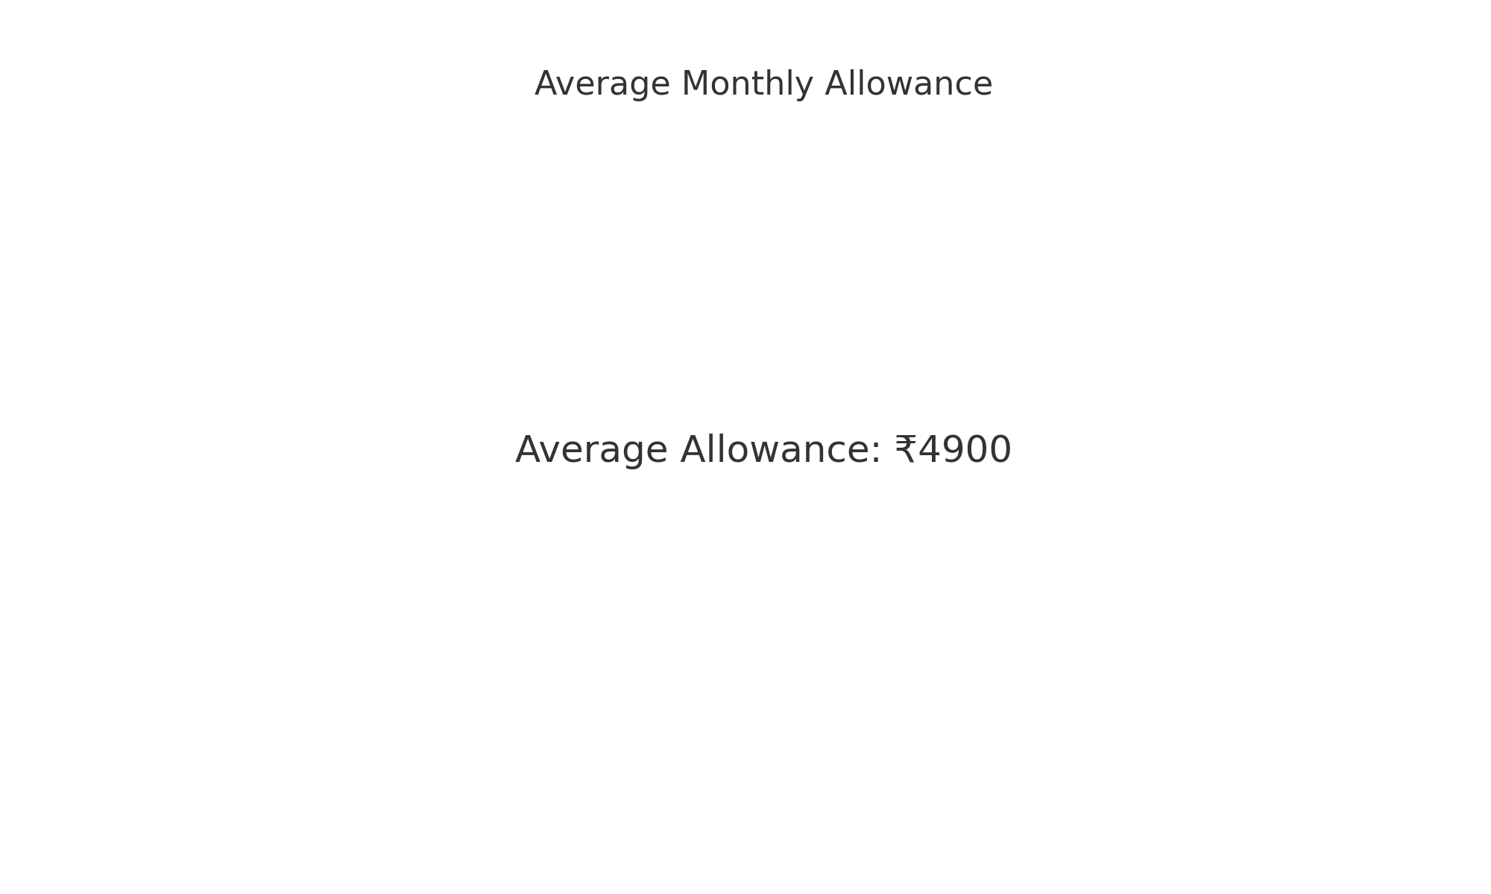
Average Allowance

Slide 11
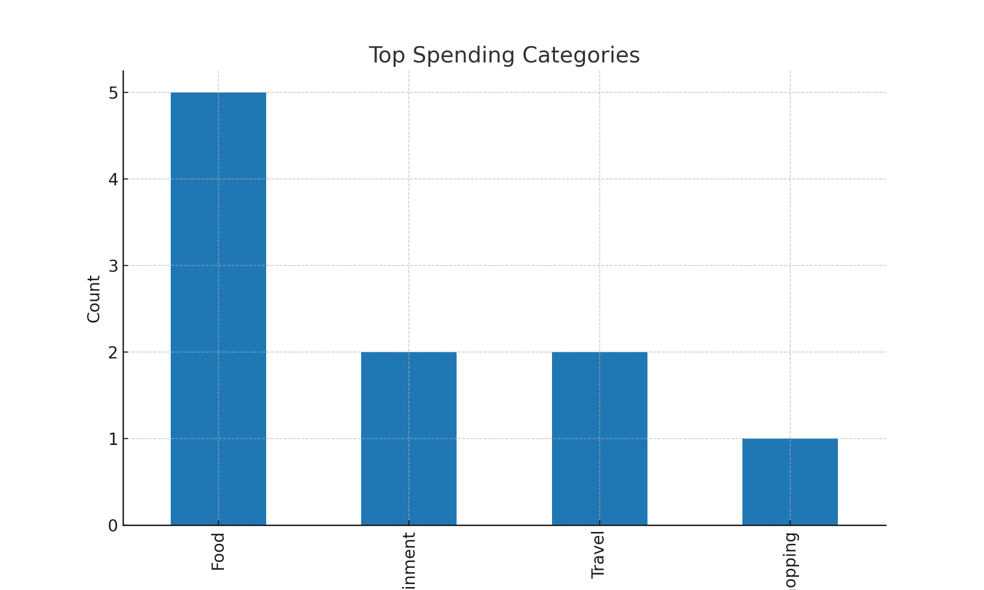
Top Spending Categories

Slide 12
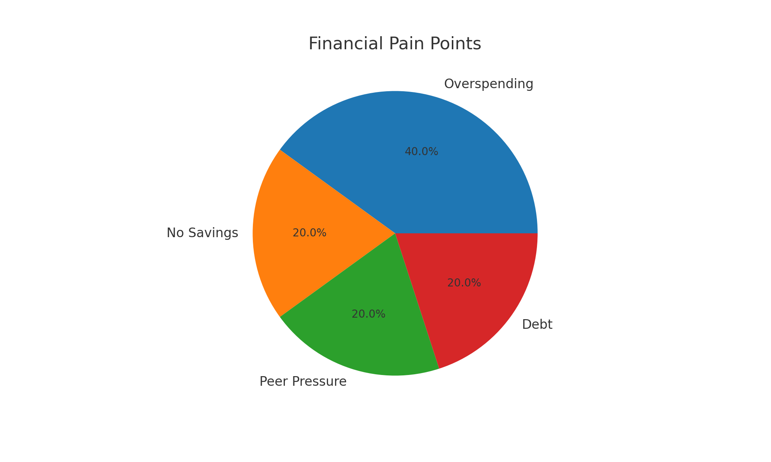
Financial Pain Points

Slide 13
Roadmap
Month 1-2: Research & Wireframes
Month 3-4: MVP Development
Month 5: Beta Testing in Colleges
Month 6: Full Rollout & Feedback

Slide 14
Thank You!
Building financial confidence for students.
Contact: [Mail] | [+91-8260527635]
Let's make money management simple!

