Slide 1
Latent-Based Comparative Analysis: GAN, C-GAN, VAE-GAN for SINVAD on MNIST Dataset

Slide 2
Why SINVAD?
All deep learning models, despite their strengths, are susceptible to adversarial attacks.
SINVAD, by integrating generative models, offers an advanced testing mechanism
Manual creation and validation of adversarial examples are time-consuming and may not cover all possible scenarios. SINVAD automates this process.
It navigates in the space of plausible image, this subspace resembles semantically of specific dataset.
It prefer generative model, VAE for experiment. Optimization over latent space instead of entire image space yield realistic images.

Slide 3
Our Approach(SINVAD_latent)
We've made modifications to the SINVAD code by introducing a new fitness_score.
Use of distinct generative models such as GAN, C-GAN, and VAE to check the validity of test input generation.
We apply perturbations to a single latent vector. Subsequently, the genetic algorithm operates on the latent, mirroring the approach used in the original SINVAD code.
Notably, the perturbation size for generating the perturbed latent is considerably smaller compared to the original SINVAD. This results in minor changes to the images, yielding realistic outputs.

Slide 4
1. SINVAD FOR GAN

Slide 5
INTRODUCTION:
GAN: Generative Adversarial Network
Comprises two neural networks: the Generator and the Discriminator.
Generator creates data, Discriminator evaluates its authenticity until Generator produces realistic data.
It promotes unsupervised learning and synthetic data generation.

Slide 6
Experiment-1: SINVAD_latent with GAN
Firstly, GAN is trained for MNIST dataset.
It’s generator will use to produce output from latent space that is called original latent and its label denoted as original label
Subsequently, induce perturbation inside the latent space called perturbed latent.
Then, Apply genetic algorithm and compute fitness between perturbed latent with original label.

Slide 7
Continue...
Selected min fitness score as a now-best.
It performs new generation of individuals set via GA_algorithm until this score cross the 0.
At this point, image get perturbed.
parameters:
init_perturbed(init_p)=0.01 Pertubation_size(p_s) = 0.02
pop-size = 25 , best_left = 10 , sample-sizes= 1,5

Slide 8
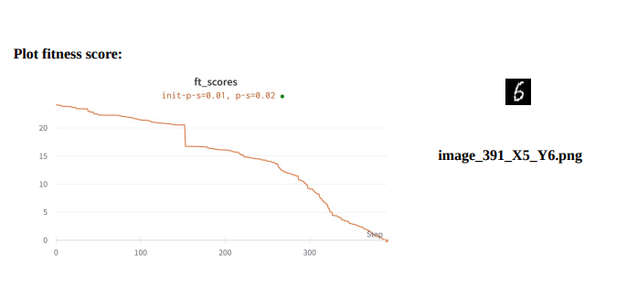
Results:

Slide 9
Results detail
At small perturbation it shows change in inputs , original label was 5, after applying SINVAD_latent it change in to label 6.
This experiments are performed for different init_p =0.02 0.05,0.1: p_s = 0.05,0.07 , 0.7 , for every iteration results compute fitness and slowly cross the label boundary. But, for large perturbation (0.1, 0.7) it jumps without computing small steps of fitness.

Slide 10
2. SINVAD_latent FOR C-GAN

Slide 11
INTRODUCTION:
In this scenario, the C-GAN uses labels as input, rather than relying on merely images in its latent space..
Using labels as input can provide more specific control over the type of output generated.
Using labels as inputs could improve the performance, robustness, or stability of the GAN.
Relying on labels might simplify the architecture.

Slide 12
Experiment 2: SINVAD_latent with c_GAN
Here,Architecture of the C_GAN is changed , it takes images and labels both as an input.
Rest of the steps are performed similarly that I performed for experiment 1.
Parameters:
init_perturbed(init_p)=0.01,0.05,0.1 Pertubation_size(p_s) = 0.02,0.05,0.7
pop-size = 25 , best_left = 10 , sample-sizes= 1,5

Slide 13
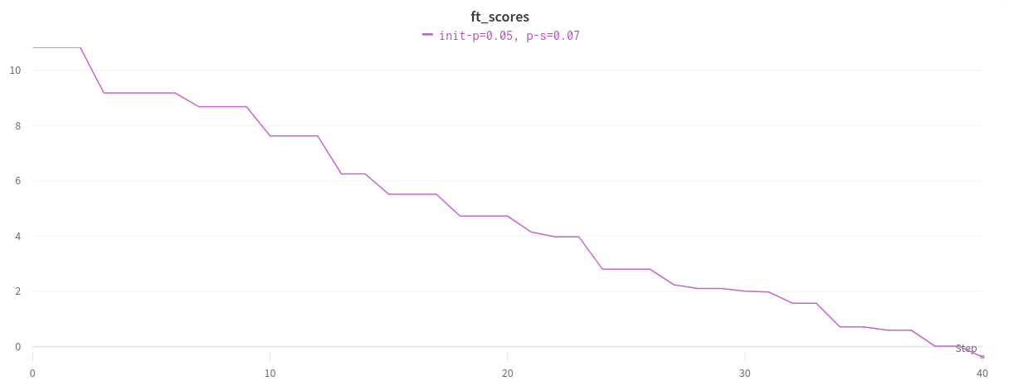
Result-1
X_4,Y_9

Slide 14
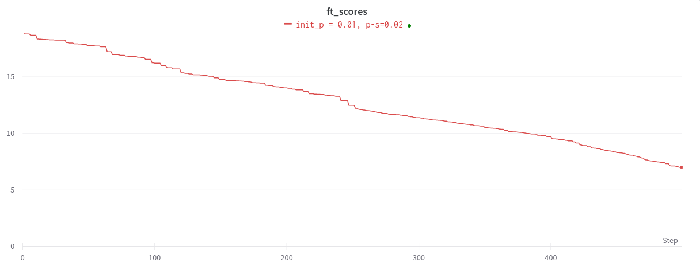
Result-2

Slide 15
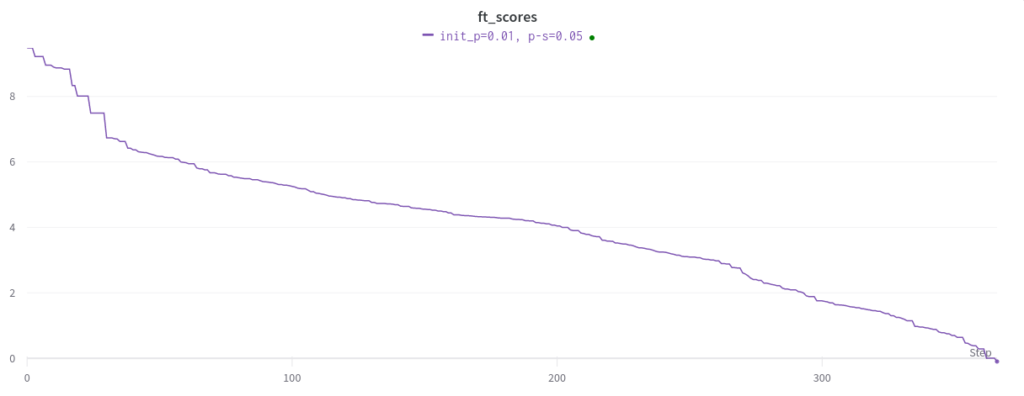
Result-3
X-5,Y_7

Slide 16
Results detail
It works well at small perturbation, similar to GAN fitness score.
In this scenario, with a minimal perturbation size (init_p = 0.01 and p_size = 0.02), the fitness decreases. However, even after 500 iterations (gen_num = 500), it fails to surpass the threshold. This is likely due to the tiny incremental steps taken at this particular score.
Thus, best adjusted init_p= 0.01 and p_s=0.05 to cross the boundary.

Slide 17
Why perturbation size GAN,C_GAN not same?
Reason:
GAN is being unstable during training. Small perturbations can amplify existing instabilities. C_GAN, on the other hand, is often more stable due to their conditioning variables, which provide a clearer signal to the generator about what to produce.
Given the conditional nature of CGANs, they may require more significant perturbations to shift away from producing outputs associated with the specified conditions.

Slide 18
3. SINVAD_latent FOR VAE

Slide 19
INTRODUCTION:
VAEs are a type of generative model that learns to encode and decode data in a probabilistic manner.
Composed of two main parts: an encoder that maps inputs to a latent space and a decoder that reconstructs data from this latent space.
VAEs map inputs to a distribution in the latent space, capturing data uncertainty.
VAE+ SINVAD_latent is used to generate the test inputs.

Slide 20
Experiment-3:SINVAD_latent for VAE
The original SINVAD utilized VAEs to explore plausible image spaces. In this iteration, we've made minor adjustments to the fitness score and reduced the perturbation size compared to the original SINVAD.
Rest of the steps similar that I discussed in previous section.
Parameters:
init_perturbed(init_p)=0.01 Pertubation_size(p_s) = 0.02,
pop-size = 50 , best_left = 20 , sample-sizes= 1, 100

Slide 21
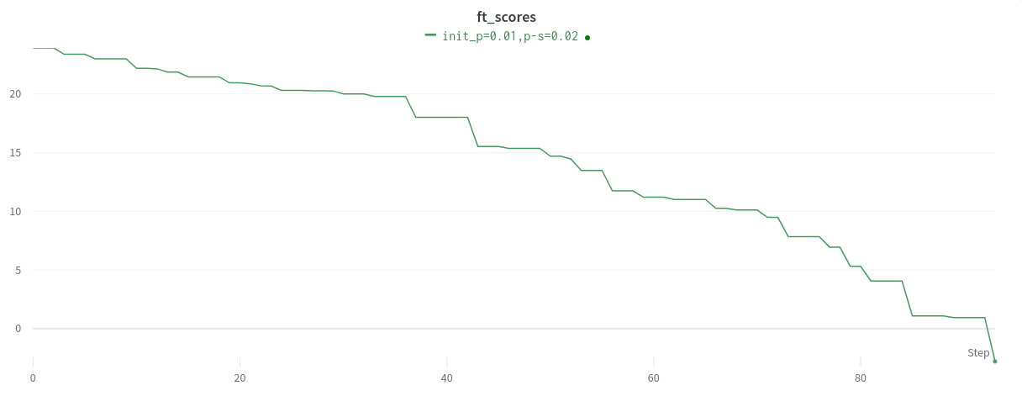
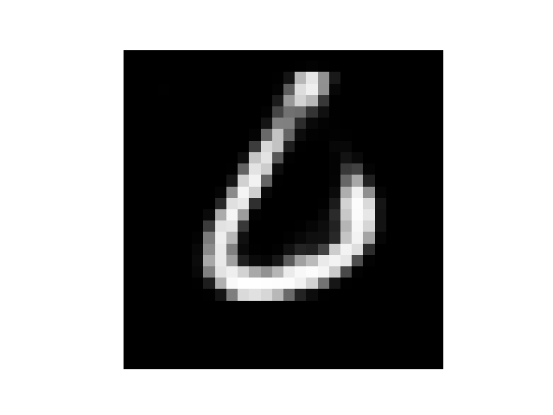
Results-1:
X_0,y_6

Slide 22
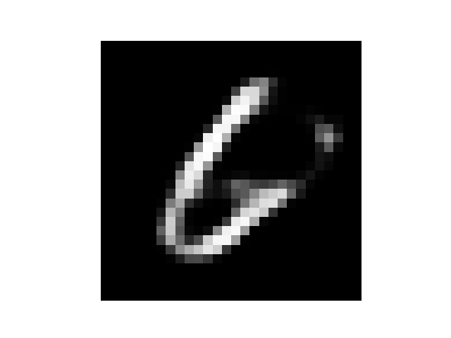
Result_2
Gen-num=0
Init-p=0.7
P-s=0.1
Sample=1
Population=50, best_left =20

Slide 23
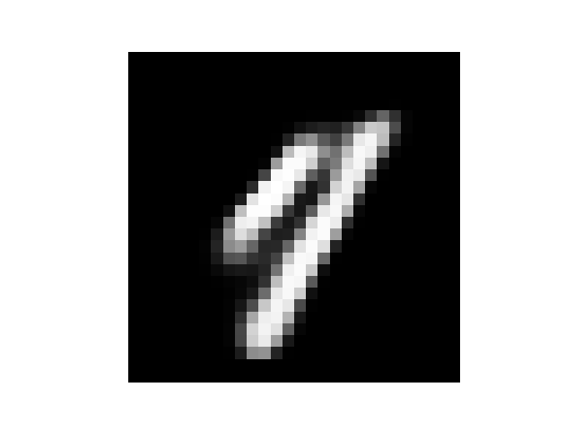
Result-3:

Slide 24
Results_detail
Our approach works for VAE as well with very small perturbation size as compared to original_SINVAD.
If I applied init_p and p-size of SINVAD , it change the image in first iteration and results are not up-to-mark.
It works for minimum perturbation perfectly.
Conclusion:
GAN produces high quality images as compared to VAE. However, GAN latent space not fully structured like VAE. For this reason, small perturbation via small steps make changes and keep its semantically meaningful. On the other hand, C_GAN impose targeting searching in latent space with labels that’s why high perturbation is required as compared to GAN but less than original SINVAD.

