Slide 2

DeepTest 2019
DeepTest 2019

Slide 3
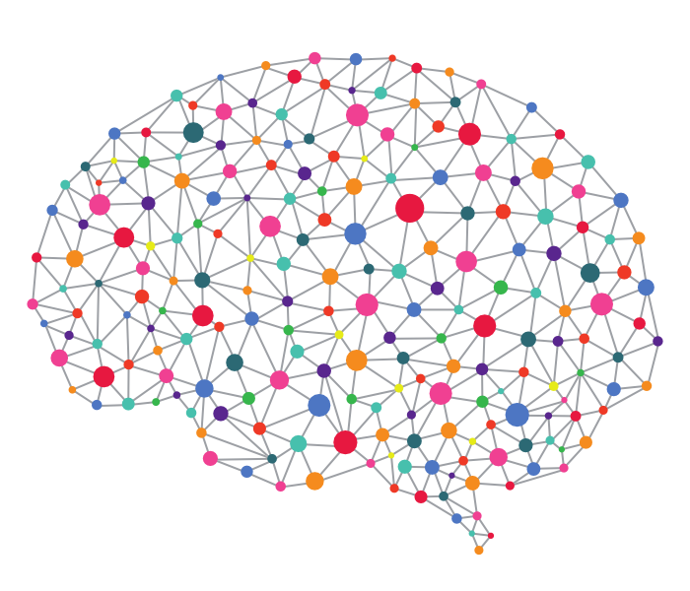
DeepTest 2019
DeepTest 2019

Slide 4
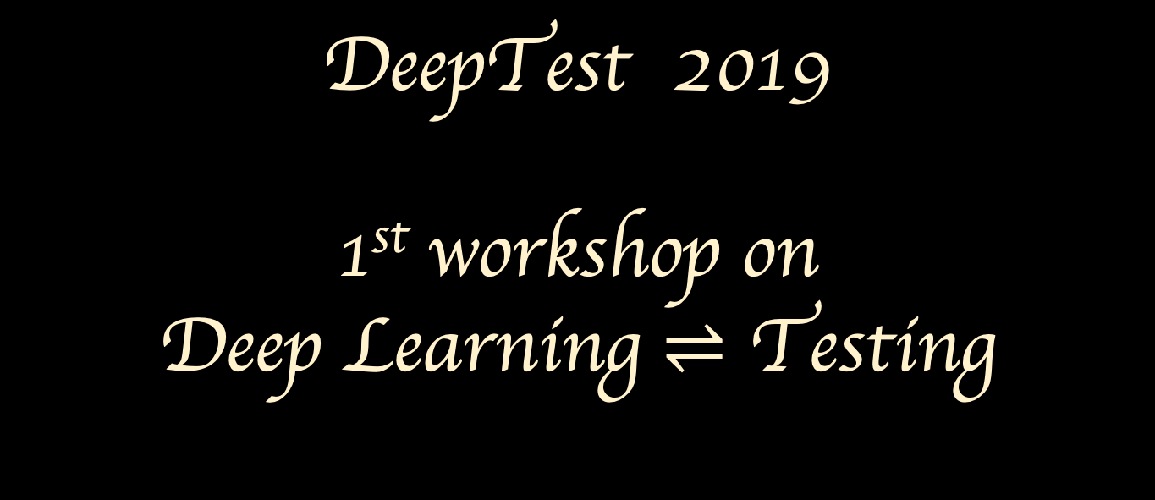
DeepTest 2019
1st workshop on
Deep Learning $⇌$ Testing
An ICSE 2019 workshop on Testing for Deep Learning and Deep Learning for Testing

Slide 5


An ICSE 2019 Workshop on Testing for Deep Learning and Deep Learning for Testing
DeepTest 2019
1st workshop on Deep Learning $⇌$ Testing
May 28th, 2019 @ Montreal, Canada

Slide 6

An ICSE 2019 Workshop on Testing for Deep Learning and Deep Learning for Testing
DeepTest 2019
1st workshop on Deep Learning $⇌$ Testing
May 28th, 2019 @ Montreal, Canada

