Slide 1
Stream Processing
Main References:
“Comparing Reyes and OpenGL on a Stream Architecture”, 2002
“Polygon Rendering on a Stream Architecture”, 2000
Department of Computer Science, University of Virginia
pascal@cs.virginia.edu

Slide 2
The Stream Programming Model
The Main Idea
Stream 4
data
data
data
data
data
Stream 3
data
data
data
data
data
Stream 2
data
data
data
data
data
Stream 1
data
data
data
data
data
Programmable
Kernel

Slide 3
The Stream Programming Model
The Main Idea
Stream 4
data
data
data
data
data
Stream 3
data
data
data
data
data
Stream 2
data
data
data
data
data
Stream 1
transformed data
transformed data
transformed data
transformed data
transformed data
Programmable
Kernel

Slide 4
The Stream Programming Model
The Main Idea
Stream 4
data
data
data
data
data
Stream 3
data
data
data
data
data
Stream 2
data
data
data
data
data
Stream 1
transformed data
transformed data
transformed data
transformed data
transformed data
Programmable
Kernel

Slide 5
The Stream Programming Model
The Main Idea
Stream 4
data
data
data
data
data
Stream 3
data
data
data
data
data
Stream 2
data
data
data
data
data
Stream 1
transformed data
transformed data
transformed data
transformed data
transformed data
Programmable
Kernel

Slide 6
The Stream Programming Model
The Main Idea
Stream 4
data
data
data
data
data
Stream 3
data
data
data
data
data
Stream 2
data
data
data
data
data
Stream 1
transformed data
transformed data
transformed data
transformed data
transformed data
Programmable
Kernel

Slide 7
The Stream Programming Model
Chaining Kernels
  Example: The Geometry Stage of the OpenGL Pipeline
Input
Vertexes
Transform
Shade
Assemble
Toward
Rasterization
Stage
Project
Cull

Slide 8
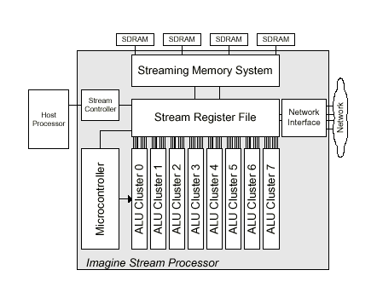
The Stream Programming Model
Hardware Implementation: the Imagine Stream Processor
Communicate
with host and issue
operations.

Slide 9
The Stream Programming Model
Hardware Implementation: the Imagine Stream Processor
Transfer data
between parts of
the chip.

Slide 10
The Stream Programming Model
Hardware Implementation: the Imagine Stream Processor
Local storage and
reuse of intermediate
streams.

Slide 11
The Stream Programming Model
Hardware Implementation: the Imagine Stream Processor
Store kernel code.

Slide 12
The Stream Programming Model
Hardware Implementation: the Imagine Stream Processor
Execute one kernel
at a time.

Slide 13
The Stream Programming Model
Hardware Implementation: the Imagine Stream Processor
Connection with
other Imagine chips.

Slide 14
The Stream Programming Model
Homogeneous Data Type for Efficiency
Stream 6
data type 2
data type 2
data type 2
data type 2
data type 2
Stream 5
data type 1
data type 1
data type 1
data type 1
data type 1
Programmable
Kernel
Code:
if (data type== data type 1)
{...}
if (data type==data type 2)
{...}

Slide 15
The Stream Programming Model
Homogeneous Data Type for Efficiency
Stream 6
data type 2
data type 2
data type 2
data type 2
data type 2
Stream 5
data type 1
data type 1
data type 1
data type 1
data type 1
Programmable
Kernel
Code:
if (data type== data type 1)
{...}
if (data type==data type 2)
{...}

Slide 16
The Stream Programming Model
Homogeneous Data Type for Efficiency
D
A
T
A
S
O
R
T
Stream 5
data type 1
data type 1
data type 1
data type 1
data type 1
Programmable
Kernel 1
Stream 5
data type 1
data type 1
data type 1
data type 1
data type 1
Stream 5
data type 1
data type 1
data type 1
data type 1
data type 1
Stream 7
data type 1
data type 1
data type 1
data type 1
data type 1
Stream 6
data type 2
data type 2
data type 2
data type 2
data type 2
Programmable
Kernel 2

Slide 17
Advantages of a Stream Processor
Programmability
  Efficient Shading
    Example: OpenGL Inefficiency

Slide 18
Advantages of a Stream Processor
Programmability
  Efficient Shading
    Example: OpenGL Inefficiency
1. Draw the plane.

Slide 19
Advantages of a Stream Processor
Programmability
  Efficient Shading
    Example: OpenGL Inefficiency
1. Draw the plane.
2. Draw the cube.

Slide 20
Advantages of a Stream Processor
Programmability
  Efficient Shading
    Example: OpenGL Inefficiency
1. Draw the plane.
2. Draw the cube.
3. Redraw the cube.

Slide 21
Advantages of a Stream Processor
Programmability
  Efficient Shading
    Example: OpenGL Inefficiency
1. Draw the plane.
2. Draw the cube.
3. Redraw the cube.
Redraw the complete scene to obtain correct shadow on one object.

Slide 22
Advantages of a Stream Processor
Programmability
  Efficient Shading
  Hardware Implementation of New API
    API Example:
    Pixar’s Renderman
    (Reyes Image Rendering Architecture)

Slide 23
Advantages of a Stream Processor
Producer - Consumer Locality Capture
  Example: OpenGL Pipeline Inefficiency
Geometry
Stage
Rasterization
Stage
Composite
Stage
Vertexes

Slide 24
Advantages of a Stream Processor
Producer - Consumer Locality Capture
  Example: OpenGL Pipeline Inefficiency
Geometry
Stage
Rasterization
Stage
Composite
Stage
Fragments
Pixels
Assembled
Triangles
Vertexes

Slide 25
Advantages of a Stream Processor
Producer - Consumer Locality Capture
  Example: OpenGL Pipeline Inefficiency
Geometry
Stall
Rasterization
Stage
Composite
Stage
Fragments
Pixels
Vertexes
Assembled
Triangles

Slide 26
Advantages of a Stream Processor
Producer - Consumer Locality Capture
  Example: OpenGL Stream Inplementation
Geometry
Kernels
Rasterization
Kernels
Composite
Kernels
Vertex
Streams
Triangle
Streams
Fragment
Streams
Pixel
Streams

Slide 27
Advantages of a Stream Processor
Producer - Consumer Locality Capture
  Example: OpenGL Stream Inplementation
Geometry
Kernels
Rasterization
Kernels
Composite
Kernels
Vertex
Streams
Triangle
Streams
Fragment
Streams
Pixel
Streams

Slide 28
Advantages of a Stream Processor
Flexible Resource Allocation
  Example: OpenGL Pipeline Inefficiency
Geometry
Stage
Rasterization
Stall
Composite
Stall
Waste of hardware capacity.
Vertexes

Slide 29
Advantages of a Stream Processor
Flexible Resource Allocation
  Example: OpenGL Stream Implementation
Geometry
Kernels
Rasterization
Kernels
Composite
Kernels
No waste: kernels are pieces of code
running on the same hardware!
Vertex
Streams

Slide 30
Advantages of a Stream Processor
Pipeline Reordering
  Example: Blending off in the OpenGL Pipeline
Part of Rasterization - Composite Stage
Texture
Kernel
Blending
Kernel
Depth
Kernel
Fragments

Slide 31
Advantages of a Stream Processor
Pipeline Reordering
  Example: Blending off in the OpenGL Pipeline
Part of Rasterization - Composite Stage
Texture
Kernel
Blending
Kernel
Depth
Kernel
Fragments
Many fragments are needlessly textured

Slide 32
Advantages of a Stream Processor
Pipeline Reordering
  Example: Blending off in the OpenGL Pipeline
Part of the Rasterization/Composite Stage
Depth
Kernel
Texture
Kernel
Fragments
We can reorder the pipeline.

Slide 33
Advantages of a Stream Processor
Obvious Scalability
  Data Level Parallelism
Texture
Kernel
Texture
Kernel
Fragments
Texture
Kernel

Slide 34
Advantages of a Stream Processor
Obvious Scalability
  Functional Parallelism
Texture
Kernel
Blending
Kernel
Depth
Kernel

Slide 35
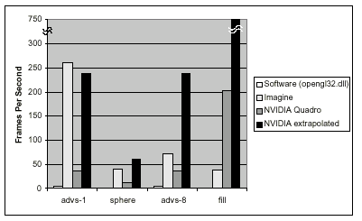
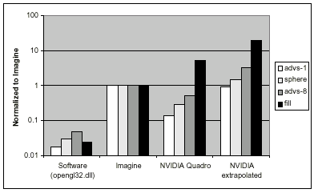
Imagine’s Performance
That looks great!

Slide 36
Imagine’s Performance
“Interaction between host processor and graphics subsystem not modeled” in Imagine.
“Many hardware-accelerated systems are limited by the bus between the processor and the graphics subsystem”.

Slide 37
Imagine’s Performance
“Imagine clocks rate is also significantly higher (500MHz vs. 120 MHz)”.

Slide 38
Imagine’s Performance

Slide 39
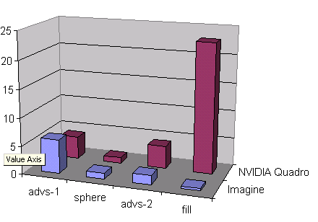
Imagine’s Performance
But the comparison is still “instructive”.
“Running our tests on commercial systems gives a sens of relative complexity”.
Frame Rate
Normalized to the
Sphere Test
NVIDIA Quadro
and Imagine Relative
Performance

Slide 40
Conclusions on Imagine Performance
Year 2000
“Implementing polygon rendering on a stream processor allows performance approaching that of special-purpose graphics hardware while at the same time providing the flexibility traditionally associated with a software-only implementation”

Slide 41
Conclusions on Imagine Performance
Year 2000
“Implementing polygon rendering on a stream processor allows performance approaching that of special-purpose graphics hardware while at the same time providing the flexibility traditionally associated with a software-only implementation”

Slide 42
Conclusions on Imagine Performance
Year 2002
“The lack of specialization hurts Imagine’s performance compared to modern graphics processors”.

Slide 43
Conclusions on Imagine Performance
Year 2002
“The lack of specialization hurts Imagine’s performance compared to modern graphics processors”.
“When comparing graphics algorithms, [the lack of specialization] does make Imagine performance-neutral to the algorithms employed”.

Slide 44
Comparing Reyes and OpenGL on a Stream Architecture
Why?
Frame
Speed
Frame
Complexity/ Quality
OpenGL
Reyes
Speed:
Interactive
(50 frames per second)
Speed:
Allowing to compute the pictures of a 2 hours movie in one year
(1 frame every 3 minutes or
0.006 frames per second)

Slide 45
Comparing Reyes and OpenGL on a Stream Architecture
Why?
Frame
Speed
Frame
Complexity/ Quality
OpenGL
Reyes
Quality/ Complexity:
Variable...
Quality/ Complexity:
Indistinguishable from live action motion picture photography.
As complex as real scenes.

Slide 46


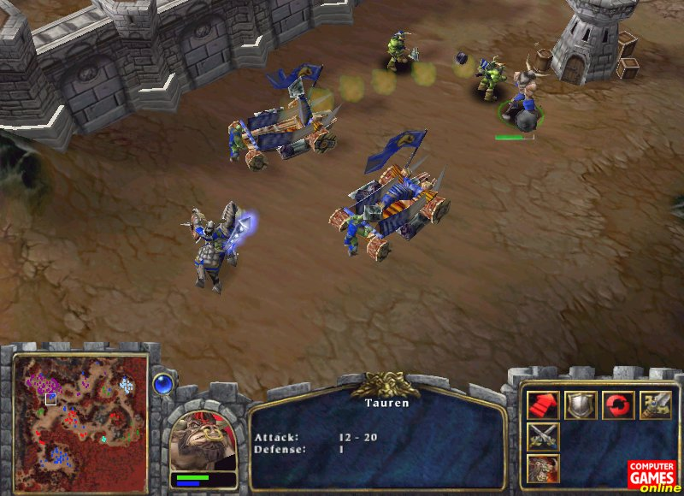


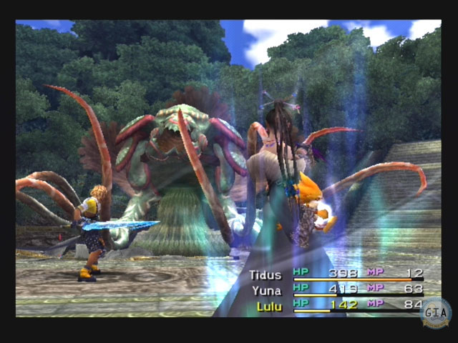


Comparing Reyes and OpenGL on a Stream Architecture
Why?
Frame
Speed
Frame
Complexity/ Quality
OpenGL
Reyes

Slide 47
The OpenGL Pipeline
Command Specification
glBegin(GL_TRIANGLES)
glColor3f(0.5,0.8,0.9);
glVertex3f(5.,0.4,100.);
glVertex3f(0.6,101.,102.);
glVertex3f(2.,5.,6.);
glEnd()
etc...
Object Space

Slide 48
The OpenGL Pipeline
Per Vertex Operation
Eye Space

Slide 49
The OpenGL Pipeline
Programmable
Stage
Per Vertex Operation: Lighting, Shading
Eye Space

Slide 50
The OpenGL Pipeline
Assembly
Eye Space

Slide 51
The OpenGL Pipeline
Per Primitive Operation: Clip and Project
Eye Space

Slide 52
The OpenGL Pipeline
Per Primitive Operation: Clip and Project
Eye Space

Slide 53
The OpenGL Pipeline
Rasterization: Interpolation
Screen Space

Slide 54
The OpenGL Pipeline
Rasterization: Fragment Generation
Screen Space

Slide 55
The OpenGL Pipeline
Rasterization: Fragment Generation
. . .
. . .
. . .
.
.
.
.
.
.
.
.
.
Screen Space

Slide 56
The OpenGL Pipeline
Programmable
Stage
Per Fragment Operation: Texturing and Blending
. . .
. . .
. . .
.
.
.
.
.
.
.
.
.
Screen Space

Slide 57
The OpenGL Pipeline
Composite: visibility filter
Screen Space

Slide 58
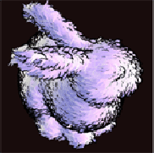
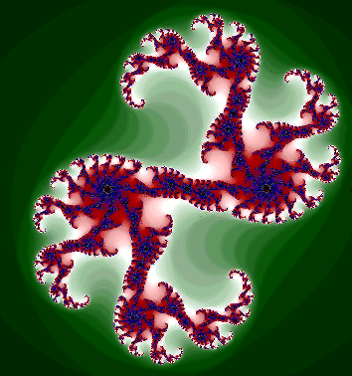
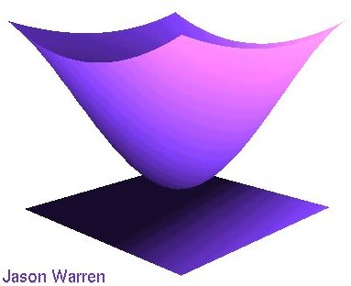
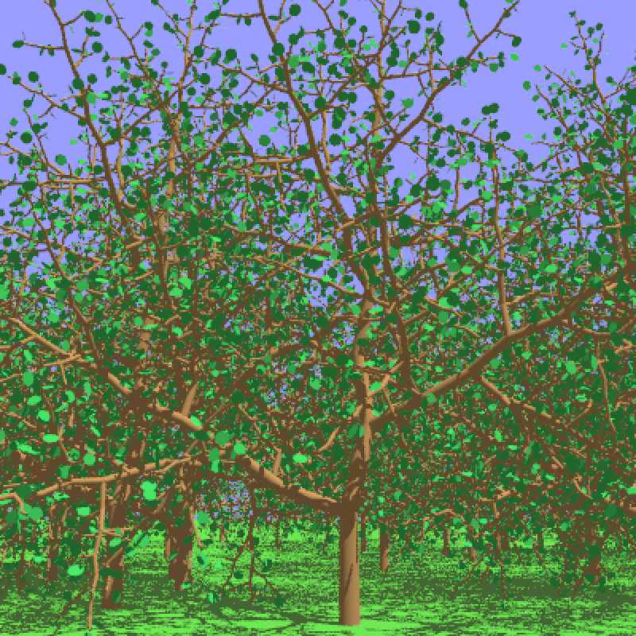
The Reyes Pipeline
Command specification
  Fractals
  Graftals
  Bezier surfaces
  etc...
Object Space

Slide 59

The Reyes Pipeline
Tessellation.
  Splitting of big primitives in smaller ones.
  Dicing in micropolygones.
1/2
pixel
Sphere split into patches.
Patches split into grids of micropolygones.
Eye Space
Knowledge of Screen Space

Slide 60
The Reyes Pipeline
Programmable
Stage
Flat shading, texturing, blending.
1/2
pixel
Eye Space

Slide 61
The Reyes Pipeline
Jittering or stochastic sampling to eliminate any artifact.
16 subpixels
1 Pixel
Screen Space

Slide 62
The Reyes Pipeline
Jittering or stochastic sampling.
Random
displacement
1 Pixel
Screen Space

Slide 63
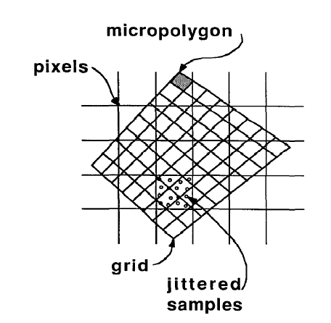
The Reyes Pipeline
Jittering or stochastic sampling.
Screen Space

Slide 64
The Reyes Pipeline
Depth filtering to obtain final image.
Screen Space

Slide 65
Difference between OpenGL and Reyes
OpenGL | Reyes
Two programming stages. | One programming stage.
Coherent access texture. | Mipmapping (non coherent texture access).
Primitives are triangles. | Primitives are micropolygons.
Does not support high order data type. | Support high order data type (e.g.: Bezier surfaces).
Reyes Hardware
Implementation
Easier.

Slide 66
Difference between OpenGL and Reyes
OpenGL | Reyes
Two programming stages. | One programming stage.
Mipmapping (non coherent texture access). | Coherent access texture.
Primitives are triangles. | Primitives are micropolygons.
Does not support high order data type. | Support high order data type (e.g.: Bezier surfaces).
Reyes saves
in computation
and memory
bandwidth.

Slide 67
Difference between OpenGL and Reyes
OpenGL | Reyes
Two programming stages. | One programming stage.
Mipmapping (non coherent texture access). | Coherent access texture.
Primitives are triangles. | Primitives are micropolygons.
Does not support high order data type. | Support high order data type (e.g.: Bezier surfaces).
OpenGL advantages:
Work Factorization
for shading and lighting.
Reyes advantages:
Easy storage of
primitives.
Load balance.
Parallelization.

Slide 68
Difference between OpenGL and Reyes
OpenGL | Reyes
Two programming stages. | One programming stage.
Mipmapping (non coherent texture access). | Coherent access texture.
Primitives are triangles. | Primitives are micropolygons.
Does not support high order data type. | Support high order data type (e.g.: Bezier surfaces).
Triangle size gets
smaller and smaller
in modern graphics
scenes.
Reyes advantages:
Easy storage of
primitives.
Load balance.
Parallelization.

Slide 69
Difference between OpenGL and Reyes
OpenGL | Reyes
Two programming stages. | One programming stage.
Mipmapping (non coherent texture access). | Coherent access texture.
Primitives are triangles. | Primitives are micropolygons.
Does not support high order data type. | Support high order data type (e.g.: Bezier surfaces).
Reyes reduces the necessary bandwidth between host CPU
and graphics card.

Slide 70
Implementation on the Stream Processor
OpenGL modifications:
  Programmable shader added.
  Barycentric rasterizer algorithm instead of scanline algorithm.
Reyes modifications:
  No supersampling.
  Micropolygon size is not half a pixel anymore.

Slide 71
Implementation on the Stream Processor
Frame
Speed
Frame
Complexity/ Quality
OpenGL
Reyes

Slide 72
Implementation on the Stream Processor
Frame
Speed
Frame
Complexity/ Quality
Enhanced
OpenGL
Implementation
Degraded
Reyes
Implementation

Slide 73
Implementation on the Stream Processor
OpenGL
Implementation
Reyes
Implementation
How to compare
the results?
Isim Simulator
Models complete
Imagine architecture.
Idebug Simulator
Do not model kernel stalls
Do not model cluster occupancy effects
Increased size of dynamically addressable memory

Slide 74
Implementation on the Stream Processor
OpenGL
Implementation
Reyes
Implementation
Isim Simulator
Models complete
Imagine architecture.
Idebug Simulator
Do not model kernel stalls
Do not model cluster occupancy effects
Increased size of dynamically addressable memory
Results of Idebug multiplied
by 20%

Slide 75
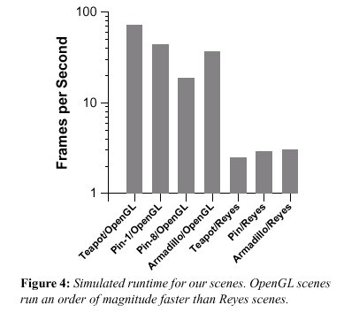
Results

Slide 76
Conclusion
  “When comparing graphics algorithms, [the lack of specialization] does make Imagine performance-neutral to the algorithms employed”.
  “Our Reyes implementation made slight changes to the simulated Imagine hardware [...] Having a larger [size of addressable memory] was vital for kernel efficiency”.

Slide 77
Conclusion
  “Imagine is an appropriate platform for comparing different rendering algorithms toward an eventual goal of high-performance hardware implementation.”

Slide 78
Conclusion
  “Continued work in the area of efficient and powerful subdivision algorithm is necessary to allow a Reyes pipeline to demonstrate comparable performance to its OpenGL counterpart.”

