Slide 1
AI-Based Fake News Detection
Using Machine Learning
FINAL REVIEW
Team Members
Sarayu
Deepthi Priyanka
Varshitha
Roll Nos: 2410080080 | 2410080005 | 2410080060

Slide 2
Presentation Outline
01 Problem Statement
06 Dataset & Model Evaluation
02 Objectives
07 Output Demonstration
03 Proposed Solution
08 Results, Limitations & Future Scope
04 System Architecture
09 Applications & Real-World Impact
05 Technologies Used
10 Conclusion

Slide 3
Problem Statement
📢 Rapid Spread
🔍 Low Verification
Fake news spreads virally through social media platforms before verification can occur.
People often share news without checking authenticity, amplifying misinformation.
⏱ Slow Manual Checks
🤖 Need for Automation
Traditional fact-checking is time-consuming and cannot keep up with viral content.
An AI-powered automated system is required to detect fake news at scale in real time.

Slide 4
Objectives of the Project
1
Build an ML model to classify news as Real or Fake with high accuracy.
2
Apply NLP preprocessing techniques to clean and prepare text data effectively.
3
Use TF-IDF feature extraction to convert text into numerical representations.
4
Train and compare classification models (Logistic Regression, Naive Bayes).
5
Provide users with a credibility score, Real/Fake label, and fact-check links.
6
Achieve ≥ 90% accuracy on the benchmark Kaggle Fake News Dataset.

Slide 5
Proposed Solution
1
User Input
2
NLP Processing
3
TF-IDF Vectorization
User pastes or types news article content into the web-based interface.
Text is cleaned, tokenized, stopwords removed, and lemmatized.
Text is converted into numerical feature vectors for the ML model.
4
ML Classification
5
Credibility Score
6
Fact-Check Links
Logistic Regression / Naive Bayes model predicts Real or Fake.
System outputs a confidence score (e.g., 87% Fake) for the input.
Relevant fact-check references are shown to help users verify.

Slide 6
System Architecture
Step 1
Step 2
Step 3
Step 4
Step 5
Input
Text Preprocessing
Feature Extraction
Classification
Output
News article text from user
Lowercase → Remove Punctuation → Stopword Removal → Lemmatization
TF-IDF Vectorization
Logistic Regression / Naive Bayes
Real or Fake Prediction + Credibility Score

Slide 7
Technologies Used
Python
Language
Pandas
Library
NumPy
Library
Core programming language for ML pipeline & scripting
Data loading, cleaning, and manipulation
Numerical computation and array operations
Scikit-learn
ML
NLTK / spaCy
NLP
Jupyter Notebook
Tool
ML algorithms: Logistic Regression, Naive Bayes, metrics
Text preprocessing: tokenization, stopwords, lemmatization
Interactive development, visualization, and model experimentation

Slide 8
Dataset & Model Evaluation
Dataset Used
Evaluation Metrics & Results
📦 Source: Kaggle Fake News Dataset
📄 Columns: title, text, label
🔢 Classes: REAL / FAKE (binary)
✂️ Split: 80% Train / 20% Test
🧹 Preprocessing: NLTK pipeline
📊 Vectorization: TF-IDF
Metric | Logistic Reg. | Naive Bayes
Accuracy | 92% | 88%
Precision | 91% | 87%
Recall | 93% | 89%
F1-Score | 92% | 88%

Slide 9
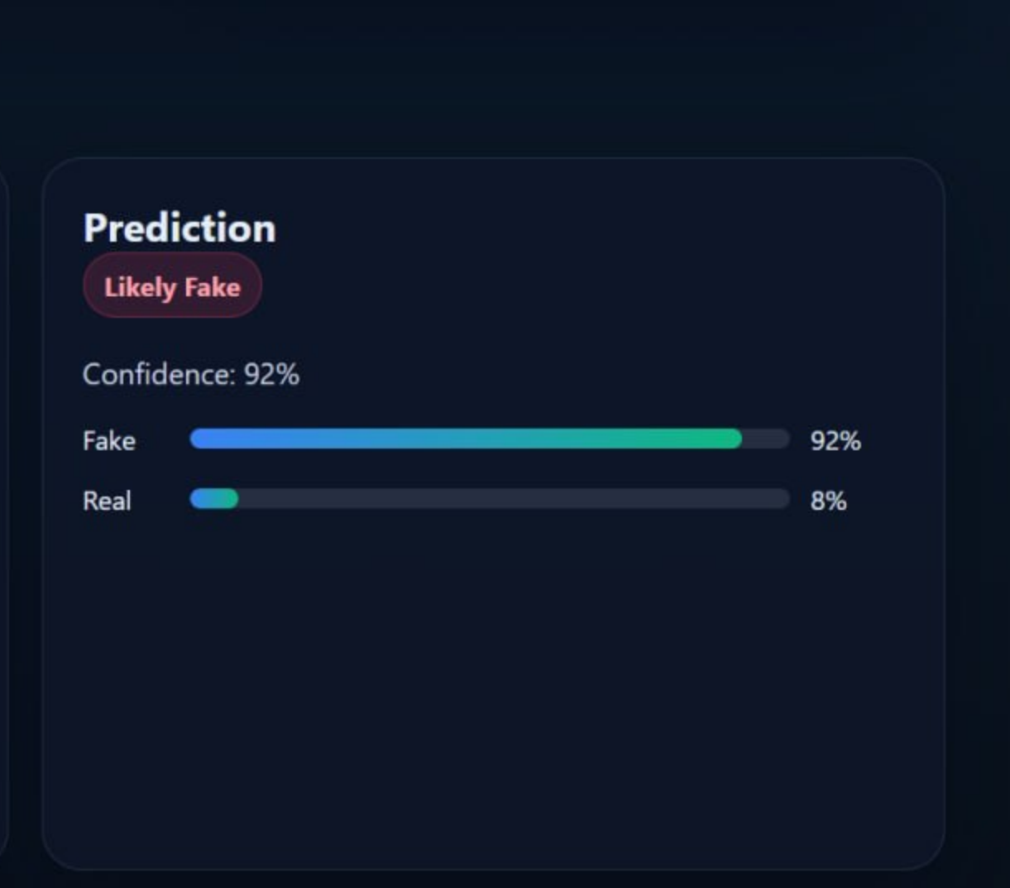
Output Demonstration
System Outputs
🏷️
Real/Fake Label
Binary classification result displayed prominently
📊
Credibility Score
0–100% trustworthiness score for the news content
🔗
Fact-Check Links
Relevant external links for manual verification
⚡
Real-Time Speed
Results delivered in under 2 seconds per article

Slide 10
Results, Limitations & Future Scope
✅ Results
⚠️ Limitations
🚀 Future Scope
Successfully classifies fake & real news
Logistic Regression: 92% accuracy
Good Precision, Recall and F1-Score
Fast inference speed (<2 seconds)
Struggles with sarcasm & satire
Sensitive to dataset quality
English-only support currently
No real-time API integration yet
LSTM / BERT deep learning models
Multilingual news detection
Browser extension integration
Live news API ingestion

Slide 11
Applications & Real-World Impact
📱
Social Media Filtering
📰
Newsroom Verification
🎓
Educational Tools
Auto-flag fake posts before they go viral on platforms like X, Facebook.
Journalists can quickly cross-check sources and articles for authenticity.
Help students and teachers identify misinformation in academic content.
🏛️
Government Monitoring
🌐
Multilingual Extension
📧
Spam & Propaganda
Monitor political misinformation and detect state-sponsored fake news.
Extendable to detect fake news in multiple languages globally.
Same architecture can detect email spam, hate speech, propaganda.

Slide 12
Conclusion
1
Built a complete ML pipeline to classify news as Real or Fake using supervised learning.
2
Applied NLP preprocessing (tokenization, stopword removal, lemmatization) and TF-IDF features.
3
Achieved 92% accuracy with Logistic Regression on the Kaggle Fake News Dataset.
4
Demonstrated how AI can serve as a scalable solution to combat online misinformation.
🏆 Project Ready for Submission

Slide 13
Thank You!
AI-Based Fake News Detection Using Machine Learning
Sarayu | Deepthi Priyanka | Varshitha
Roll: 2410080080 | 2410080005 | 2410080060
Questions & Feedback Welcome

