Slide 1
AI-Based Fake News Detection Using Machine Learning
Presented by
2410080080-Sarayu,
2410080005- Deepthi Priyanka,
2410080060-Varshitha.

Slide 2

Problem Statement
Fake news spreads rapidly through social media platforms.
People often share news without verifying authenticity.
Manual fact-checking takes time.
There is a need for an automated system to detect fake news.

Slide 3
Objectives of the Project
Build a supervised ML model for fake news classification.
Apply NLP techniques for text preprocessing.
Convert text data into numerical form using feature extraction.
Evaluate model performance using standard metrics.
Improve awareness through automated prediction.

Slide 4
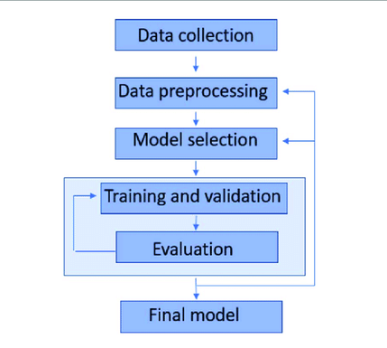
Proposed Solution
User pastes news content into the system.
NLP processes the text.
ML model predicts authenticity.
System provides:
Credibility score
Real/Fake label
Fact-check links

Slide 5
System Architecture
Step 1: Input
News article text
Step 2: Text Preprocessing
Lowercasing
Removing punctuation
Stopword removal
Stemming/Lemmatization
Step 3: Feature Extraction
TF-IDF Vectorization
Step 4: Classification Model
Logistic Regression / Naive Bayes
Step 5: Output
Prediction: Real or Fake

Slide 6
Technologies Used
Programming Language: Python
Libraries:
Pandas (Data handling)
NumPy (Numerical computation)
Scikit-learn (ML algorithms)
NLTK / spaCy (Text preprocessing)
Jupyter Notebook (Model development)

Slide 7
Dataset & Model Evaluation
Dataset Used:
Fake News Dataset (Kaggle)
Evaluation Metrics:
Accuracy
Precision
Recall
F1-Score
Example Result:
Accuracy Achieved: 92% (example)

Slide 8
Results, Limitations & Future Scope
Results:
Successfully classifies fake and real news.
Good accuracy and performance.
Limitations:
May struggle with sarcastic or newly created fake news.
Depends on dataset quality.
Future Scope:
Use Deep Learning models (LSTM, BERT)
Add multilingual support
Real-time news API integration

Slide 9
Delivering with confidence
Applications & Real-World Impact
Applications:
Social media content filtering
News organization verification tools
Educational awareness systems
Government misinformation monitoring
Real-World Impact:
Reduces spread of misinformation
Promotes responsible sharing
Improves digital literacy
Supports decision-making based on verified content
Broader Scope:
Can be extended to detect spam, hate speech, or propaganda.

Slide 10
Conclusion
Developed a Machine Learning model to detect fake news.
Used NLP techniques for text processing and classification.
Achieved good accuracy using supervised learning.
Demonstrates how AI can help reduce misinformation.

Slide 11
Thank you

