Slide 1


Prototype Submission Phase

Slide 2
TEAM NAME and MEMBER DETAILS
Salagalla Deepthi Preethika Thadishetty Kondreddy Manvitha Reddy Mallavarapu Asha Shiny
THEME:
Access to education in the rural areas

Slide 3
PROBLEM STATEMENT
Traditional scholarship systems in rural India face significant barriers, hindering access to education. The lack of transparency leaves students unable to track their application progress, fostering distrust in the process. Fraud and corruption by middlemen often divert funds, preventing deserving students from receiving support. Additionally, manual verification and bureaucratic delays slow down approvals, leaving students waiting for months and sometimes missing educational opportunities. These inefficiencies disproportionately affect rural students, who already face challenges like limited access to resources and documentation. A decentralized, transparent, and efficient system is urgently needed to ensure scholarships reach the right beneficiaries promptly and fairly, empowering rural students to pursue education without systemic obstacles.

Slide 4
SOLUTION
Solution: A blockchain-based scholarship system using Ethereum. A Solidity smart contract automates student registration and fund transfers, eliminating middlemen. Tested in Remix IDE, successfully disbursing 1 ETH.
How It Solves: Ensures transparency, reduces fraud, and speeds up processing for rural students.
Impact Metrics: Percentage of funds reaching students (target: 100%), processing time (target: <1 day), number of rural students supported.
Technologies: Solidity, Ethereum (Remix JavaScript VM), Remix IDE.
Assumptions/Constraints: Assumes internet access; constrained by Ethereum gas fees. Chose Ethereum for its ecosystem, Remix for ease.
Implementation/Effectiveness: Implementable with basic blockchain knowledge; highly effective per testing.
Scalability/Usability: Scalable on Ethereum testnet; usable with training, limited by rural internet access.

Slide 5
METHODOLOGY
The architecture includes Ethereum as the blockchain, a Solidity smart contract for logic, and Remix IDE for deployment. The process flow is:
1 Student submits details,
2 Smart contract verifies eligibility,
3 Admin approves,
4 Funds are disbursed directly.
Architecture:https://drive.google.com/file/d/11lkEWpKp167BDuydg8gqBOYD-lRLzuAB/view?usp=sharing
Flowchart:https://drive.google.com/file/d/1wj9af-Xh8iTCm1A47XYldcY7LQliqBe5/view?usp=sharing
Graphs:https://drive.google.com/file/d/1dR5-LfAME9B2yQfb8t6B05yJk5zeSMun/view?usp=sharing
Wireframe:https://drive.google.com/file/d/1QyaYk829Xd1WKf2oMJ1g8DSo9B3FSFVq/view?usp=sharing

Slide 6
WORKING PROTOTYPE
Demo link -https://drive.google.com/file/d/1tCZqEmlAv8n0_uaD5yiroSrnXsmEiejy/view?usp=sharing

Slide 7
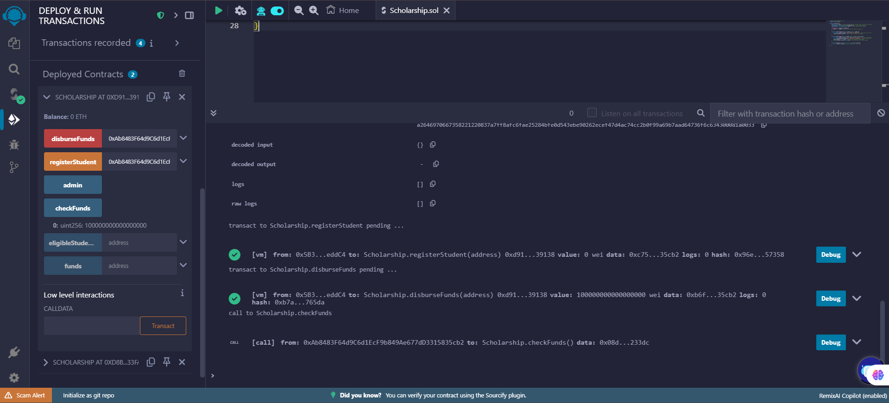
Attachments

