Slide 1

Detection & Classification of Diabetic Retinopathy using Inception V3 and Xception Architectures
Team A17 Project Demo – 21/03/2023
Presented By :
Guided By:
J. Bharghavi - 211419104041
H. Deepthi - 211419104052
B. Mathumita - 2114191040164
Ms.V. Sathiya

Slide 2
Project Objective:
To build and deploy a web app which helps us detect whether a person have diabetic retinopathy or not
If they have diabetic retinopathy it will also identify what type of diabetic retinopathy it is.
How:
By using hybrid models
Inception V3
Xception

Slide 3
Problem Definition:
The main objective of this project is to build a web app which detects whether a person have diabetic retinopathy (DR) or not.
If a patient have diabetic retinopathy, our models will also determine the severity and type of Diabetic retinopathy. Since our app is deployed in the internet, anyone on the internet can easily be able to access the app remotely to check whether they have diabetic retinopathy or not just by uploading their retinal images as an input to the system. Here, Two deep learning models have been used to increase the accuracy by 98%. Inception V3 for detection and Xception for classification.

Slide 4
Before getting into the internal working of the system.
Let us understand,
1. What exactly is Diabetic Retinopathy ?
2. Symptoms of Diabetic Retinopathy
3. What happen if we don’t take proper measures?
4. How to get rid of Diabetic Retinopathy
5.How to prevent ourselves from Diabetic Retinopathy

Slide 5
1. What exactly is Diabetic Retinopathy and what causes Diabetic Retinopathy ?
Diabetic Retinopathy is a eye disease which occurs when the sugar content in the blood increase.
This sugar content will try to block the blood cells which helps in nourishment of the retina.
As a result, the eye attempts to grow new blood vessels.
But these new blood vessels are either developed poorly or weak. So, it can be leaked easily.
As the condition progresses the person with diabetic retinopathy might develop vision loss

Slide 6
2. Symptoms Of Diabetic Retinopathy:
Blurred vision
Seeing spots or floaters
Difficulty seeing well in night
3. What happen if we don’t take proper measures in the earlier stage of Diabetic Retinopathy ?
This fluid which gets leaked from the blood cells gets accumulated in the back of the eye and will the curvature of the lens in the back of the eye.
This causes the retinal tissue to swell
If we don’t take proper measures in the early stage. It will result in permanent blindness

Slide 7
How to get rid of Diabetic retinopathy ?
Good control of your sugar level
Good control of your blood pressure
Exercising regularly
Avoid alcohol and smoking
How to prevent ourselves from Diabetic Retinopathy ?
According to a 2018 American EyeQ Survey nearly more than one-third of Americans 2 didn't know a comprehensive eye exam is the only way to determine if a person have diabetic retinopathy or not.
This incident proves that most of the people are not aware of this disease
Proper eye check up is the only way to prevent ourselves from the disease

Slide 8
Disadvantages of existing system:
The existing system have only used one model (ResNet50)
The accuracy is less(92%) compared our model (98%)
They didn’t found what type of diabetic retinopathy exactly it is
They didn’t built a web app which can be accessed through the internet
Advantages of existing system:
We have used two models for detection and classification to improve the accuracy
The accuracy is more(98%) compared to the existing system(92%)
Our model can able to identify what type of diabetic retinopathy exactly it is
We built and deployed the web app using streamlit which can accessed by anyone with the help of internet

Slide 9
Hardware Requirements :
System | Core i5 Processor
Hard Disk | 500 GB
Monitor | 15’’ LED
Input Devices | Keyboard, Mouse
Ram | 4 GB
Software Requirements :
Operating System | Windows 10
Coding Language | Python 3.11
IDE | Visual Studio Code
Package Manager | PIP
Framework | Streamlit

Slide 10
Distribution of classes in the dataset :
Class Name | Train | Validate | Total
Normal | 34 | 16 | 50
Abnormal | 34 | 16 | 50
Microaneurysm | 28 | 8 | 36
Exudates | 27 | 6 | 33
Haemorrhage | 27 | 13 | 40

Slide 11
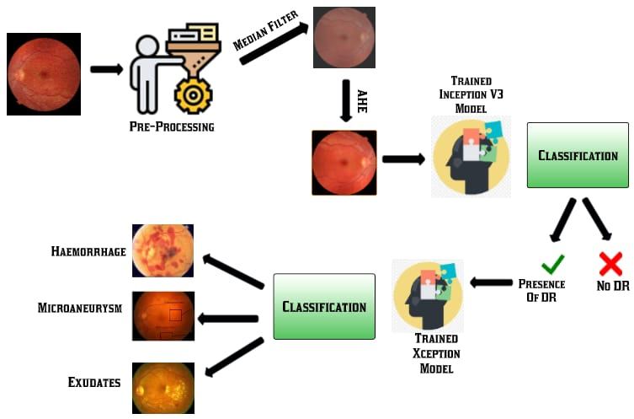
System Architecture :

Slide 12
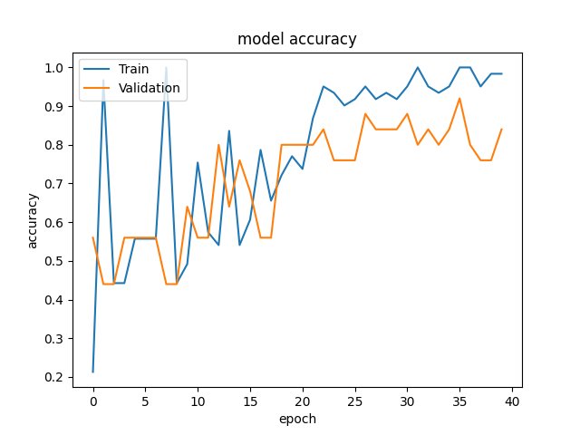
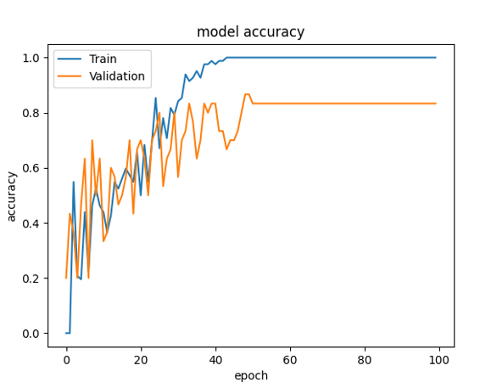
Training and validation accuracy for DR detection
Training and validation accuracy for DR Classification :

Slide 13
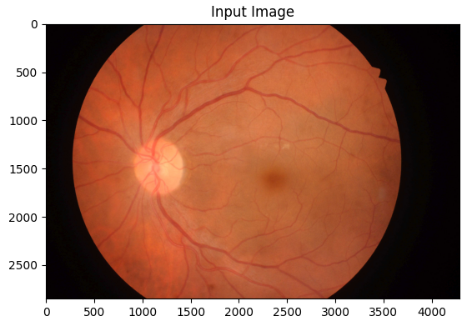
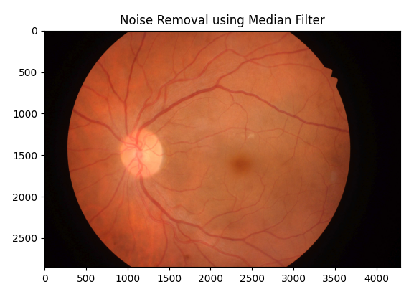
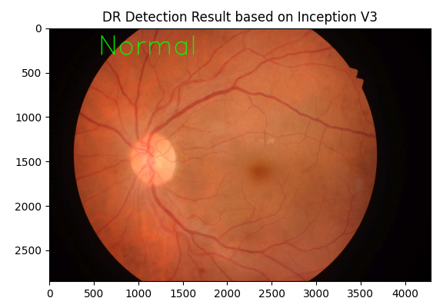
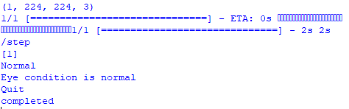
Preprocessing
Retinal Image
Output
Classification

Slide 14
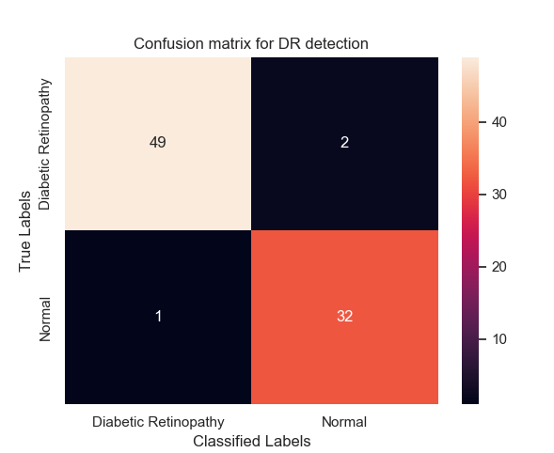
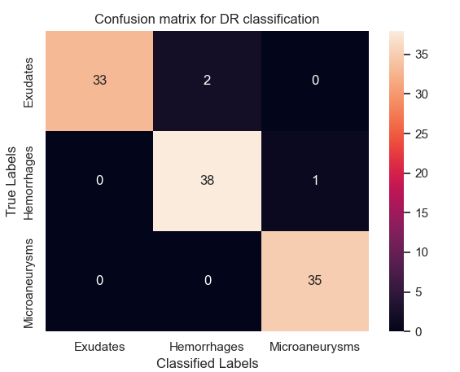
Confusion Matrix
Model1(InceptionV3)
Model2 (Xception)

Slide 15
Test Cases :
Action | Input | Expected Output | Actual Output | Test Result
Launch streamlit app using “streamlit run app.py” | http://localhost:8501/ | DR detection and classification web app | DR detection and classification web app | Pass
Detection of diabetic retinopathy | Upload fundus image that have diabetic retinopathy | Diabetic retinopathy | Diabetic retinopathy | Pass
Classification of diabetic retinopathy | Upload fundus image that have diabetic retinopathy | Exudates | Exudates | Pass
Detection of diabetic retinopathy | Table 7.1. Test Cases Upload fundus image that don’t have diabetic retinopathy | No diabetic retinopathy | No diabetic retinopathy | Pass

