Slide 1
Project Demonstration on E-Commerce(Online Shopping)
Torry Harris Business Solutions

Slide 2
Group Members
Abu Amir Iraqui
Arun Rathod
Deepthi Gangadhara
Kiran Mahatara

Slide 3
Introduction
Commonly known as Electronic Market
It consist of Buying Goods over an electronic System Such as the internet.
Our System is an e-commerce website from where people can buy
Electronic products online .

Slide 4
Spring MVC Flow
Browser
Controller
Service
Repository
DataBase
View
(Thymeleaf template)

Slide 5
Features
Home Page
Login
Register/Signup
Admin
Add Product
Cart
Check Out

Slide 6
Tools
Html
CSS
Bootstrap
Java
Spring MVC
MySql

Slide 7
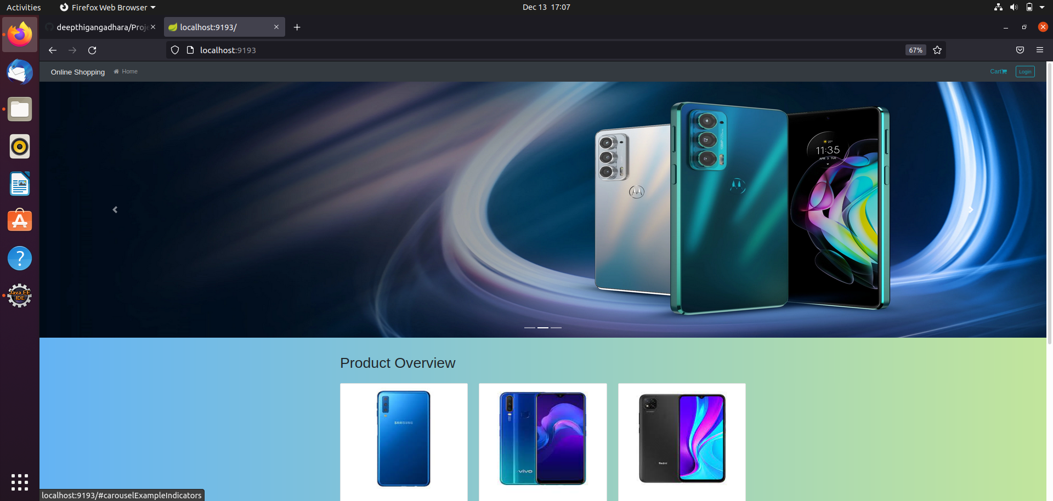
Home Page

Slide 8
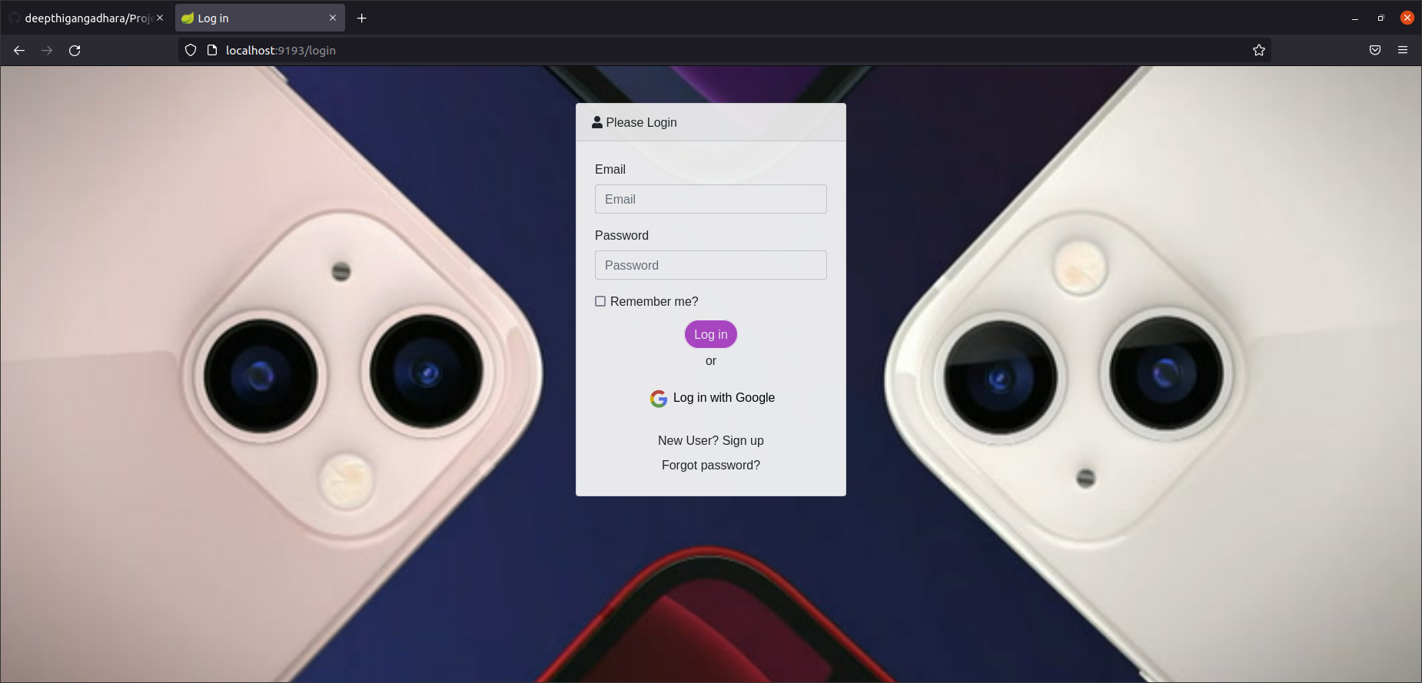
Login

Slide 9
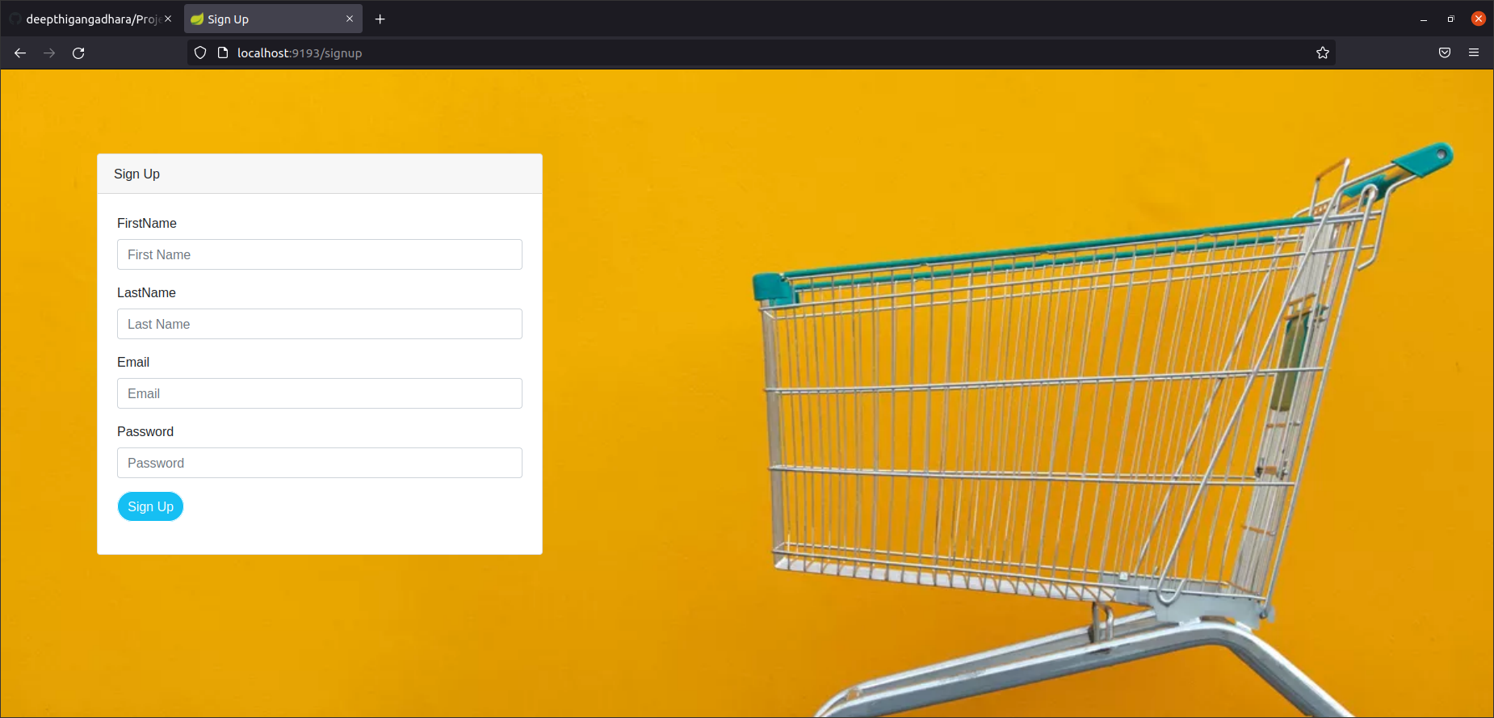
Sign up

Slide 10
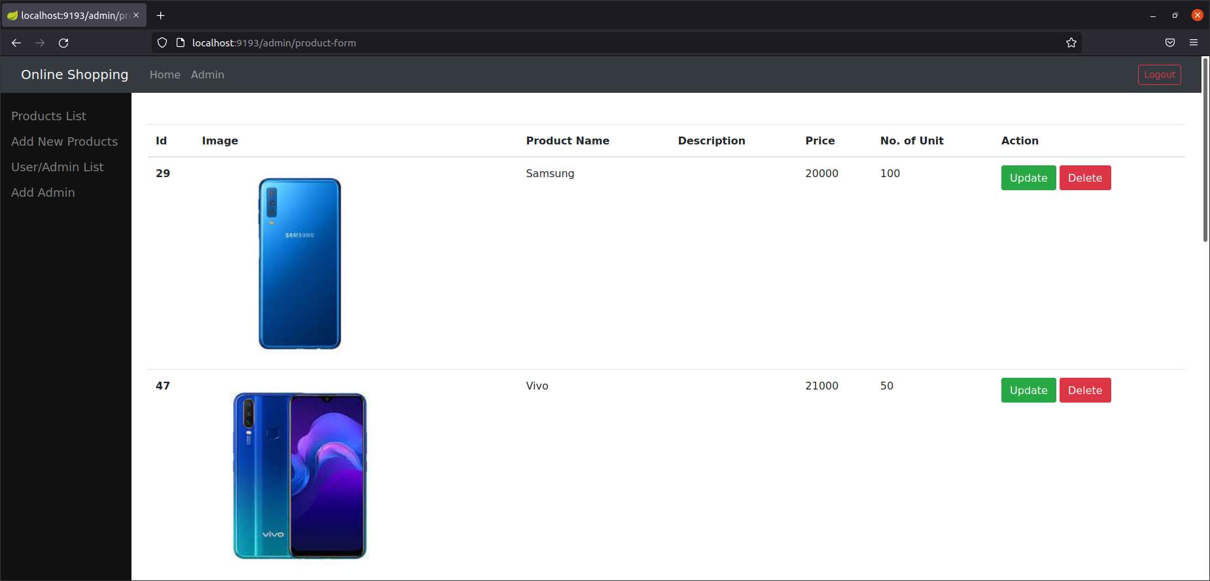
Admin Page

Slide 11
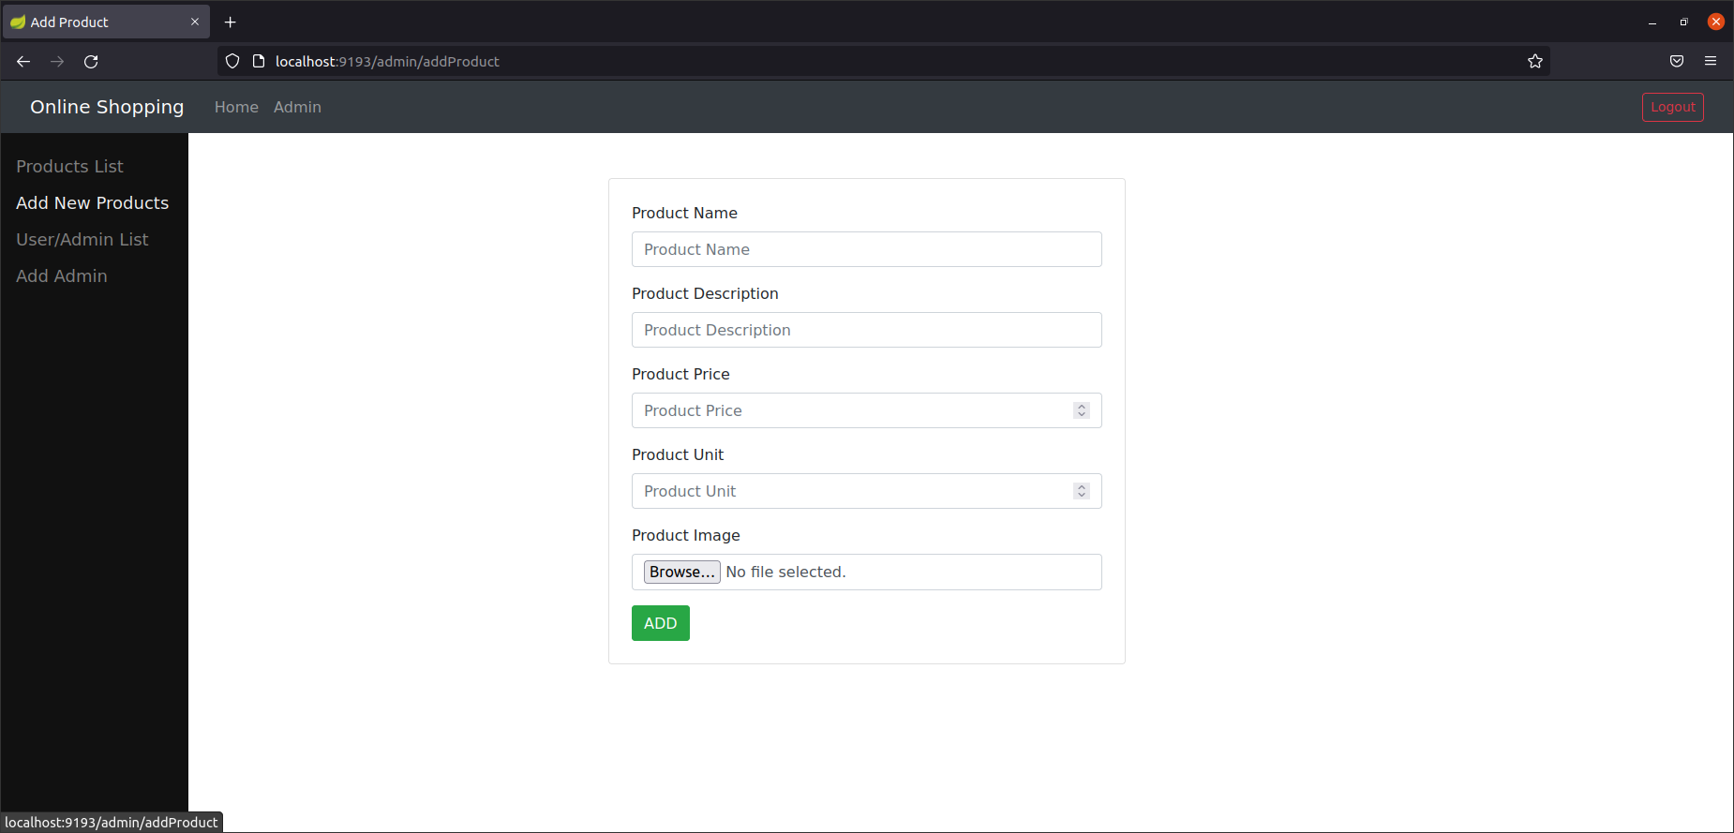
Add Product

Slide 12
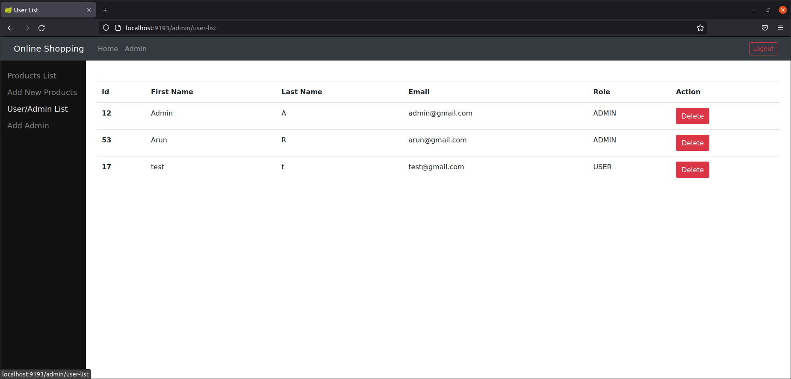
User/Admin List

Slide 13
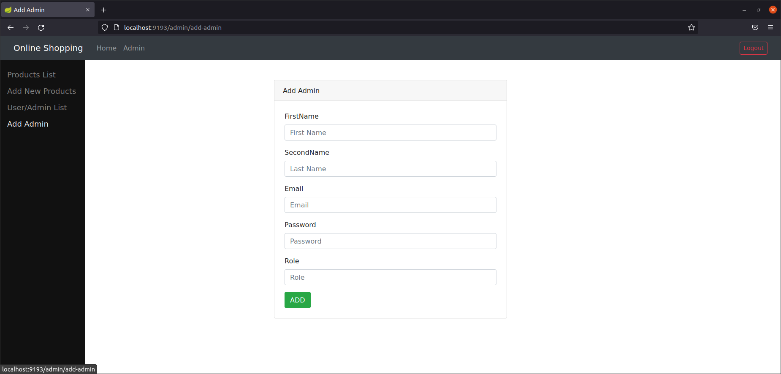
Add Admin

Slide 14
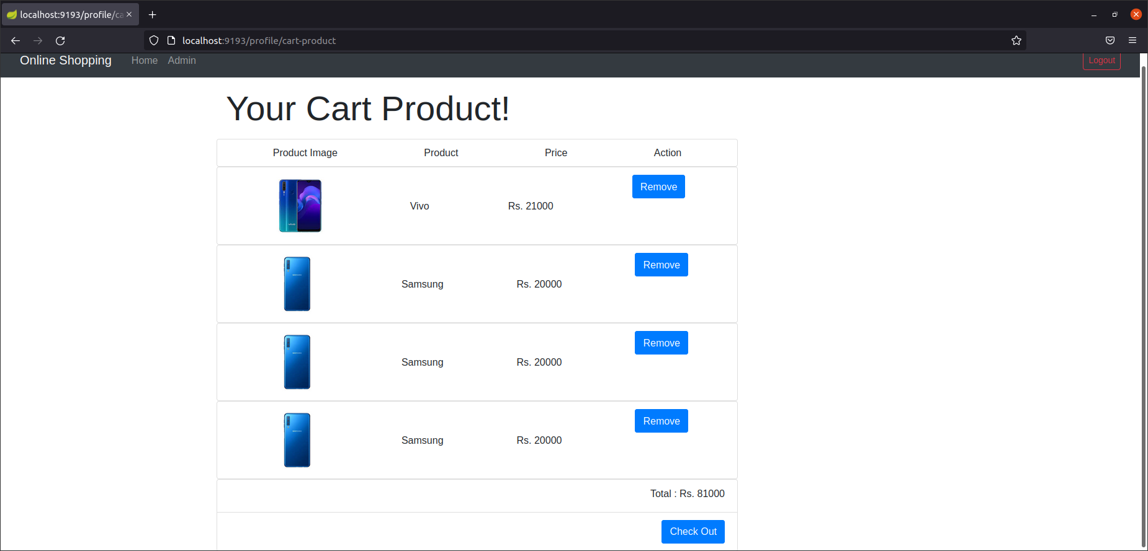
Cart

Slide 15
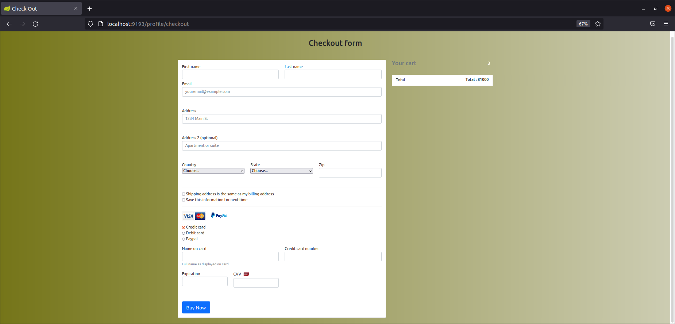
Checkout

Slide 16
Thank You

