Slide 1

AI-Based Financial News Sentiment Analysis for Stock Market Prediction
By
Roopesh 2420030359
Deepthi Anusha 2420030448
Vyshnavi 2420030449
Team Number: 11
Section : 7
Cluster 3
Under the guidance of
Dr. K. SWANTHANA
Department of Computer Science and Engineering

Slide 2
Outline of the Presentation
Abstract
Problem Statement
Project Flow Diagram
Objectives with Justification
Literature Survey
Research Gap Identification
Innovation
Creativity
Novelty
Feasibility
Project Plan

Slide 3
Abstract
Financial news has a major impact on stock market movements.
The project uses AI and Natural Language Processing (NLP) to analyse news sentiment.
News is classified as Positive, Negative, or Neutral to predict market trends.
The system helps investors make faster and more informed decisions.

Slide 4
Problem Statement
Stock prices are influenced by financial news and public sentiment. Manually analyzing large volumes of news is difficult and time-consuming, making investment decisions less effective.

Slide 5
Objectives
To overcome the limitations of historical-data-only stock prediction systems.
To automatically analyse financial news using AI and NLP.
To identify the sentiment of financial news as positive, negative, or neutral.
To combine news sentiment with historical market data.
To generate more relevant and informed stock trend predictions.

Slide 6
Literature Survey
No. | Paper Name & Year | Model | Limitations
1 | Tetlock (2007) | Media Sentiment | No end-to-end prediction model
2 | AZFin (2009) | SVM | Traditional text representation
3 | Bollen et al. (2011) | Twitter Mood Analysis | General social-media sentiment
4 | Ding et al. (2015) | NTT + CNN | Complex architecture
5 | Moore & Rayson (2017) | Financial Sentiment Classification | Sentiment only, not stock prediction

Slide 7
Literature Survey
No. | Paper Name & Year | Model | Limitations
6 | Xu & Cohen (2018) | Deep Generative Model | Twitter-focused, complex model
7 | Araci (2019) | FinBERT | Sentiment classification, not prediction
8 | Li et al. (2020) | LSTM + Technical + Sentiment | Market-specific; complex
9 | News Sentiment Investment Strategy (2020) | Sentiment + Investment Strategy | Short-lived sentiment effect
10 | Kaeley et al. (2023) | Transformer + Sentiment | Computationally complex

Slide 8
Research Gap Identification
Most existing models primarily depend on historical stock price data.
Real-time financial news is not effectively utilized in many prediction systems.
Prediction accuracy remains a challenge due to dynamic market conditions.
There is a need for an integrated system that combines sentiment analysis with market trend prediction.

Slide 9
Innovation
Integrates AI and NLP techniques for automated financial news analysis.
Utilizes sentiment information to enhance stock market trend prediction.
Enables rapid processing of financial news for timely insights.
Supports data-driven decision-making through intelligent analysis.

Slide 10
Creativity
Presents sentiment analysis through an intuitive and interactive dashboard.
Visualizes financial news and predicted market trends in a simplified format.
Enhances accessibility of financial insights for users with varying expertise.
Promotes efficient interpretation of market sentiment using graphical representations.

Slide 11
Novelty
Combines financial-news sentiment analysis with market-trend prediction.
Uses real-time news sentiment along with market data.
Provides automated market insights through AI.
Presents results in a single, user-friendly dashboard.
Feasibility
Technically feasible using existing AI/ML tools and libraries.
Cost-effective using open-source tools and datasets.
Easy to implement and use through an interactive dashboard.

Slide 12
Project plan
Phase 1: Data collection and preprocessing of financial news articles.
Phase 2: Sentiment analysis using NLP and Machine Learning techniques.
Phase 3: Development and evaluation of the stock market prediction model.
Phase 4: Dashboard implementation, system testing, and project validation.

Slide 13
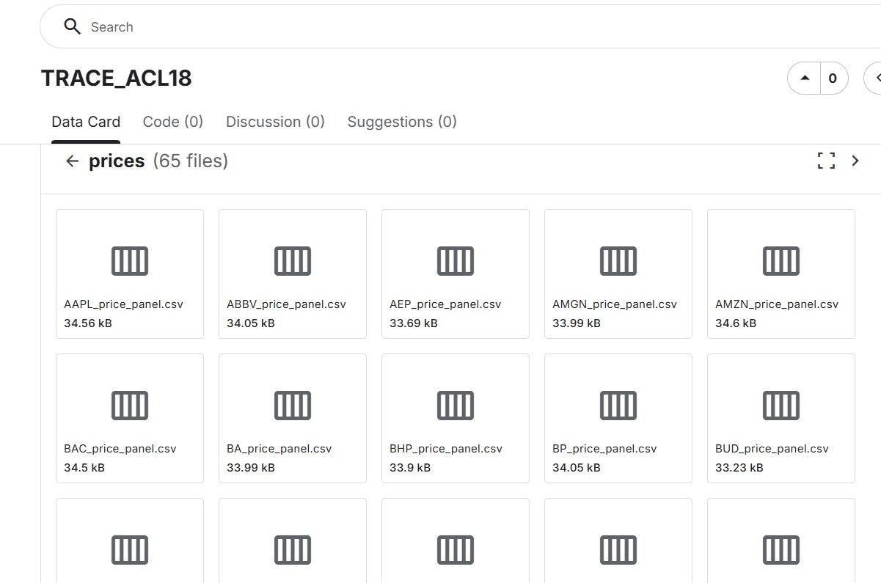
dataset
https://www.kaggle.com/datasets/williamtage/trace-acl18?utm_source=chatgpt.com&select=TRACE_ACL18_joint_prediction_model_set

Slide 14
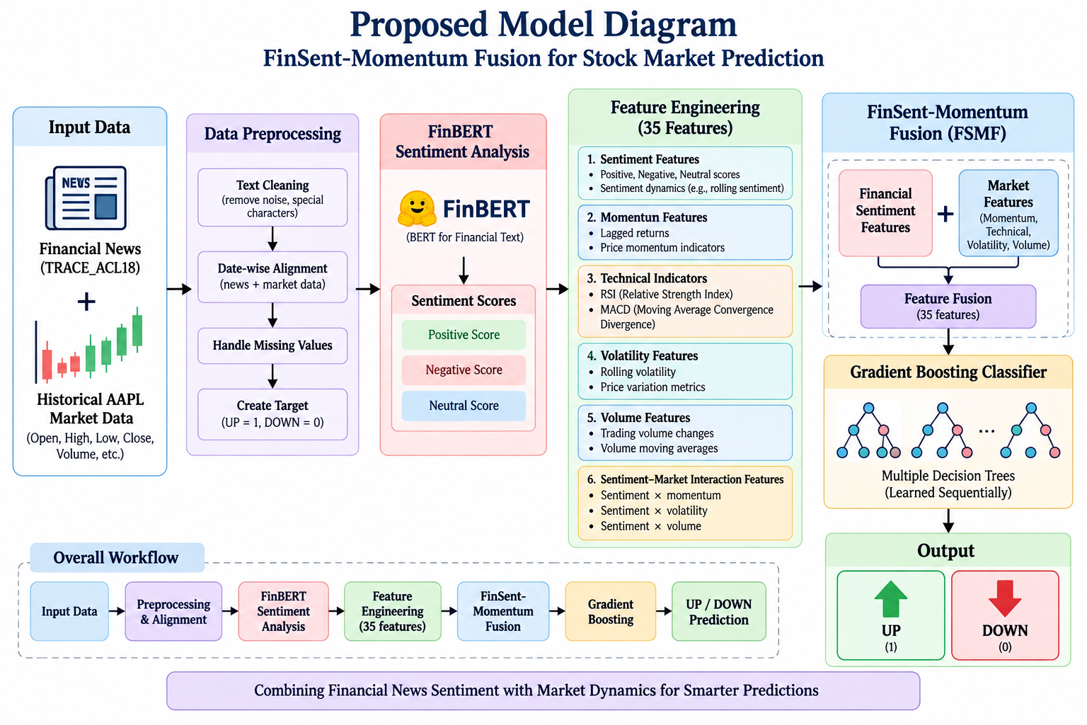

Slide 15
Algorithms
# | Algorithm / Model | Purpose
1 | FinBERT | Analyzes financial news and generates Positive, Negative, Neutral sentiment scores
2 | RSI (Relative Strength Index) | Captures price momentum / overbought–oversold behavior
3 | MACD (Moving Average Convergence Divergence) | Captures market momentum and trend changes
4 | Gradient Boosting Classifier | Main stock-direction prediction algorithm
5 | StandardScaler | Normalizes the numerical features before classification
6 | Chronological Data Split | Separates data into training/validation/testing while preserving time order

Slide 16
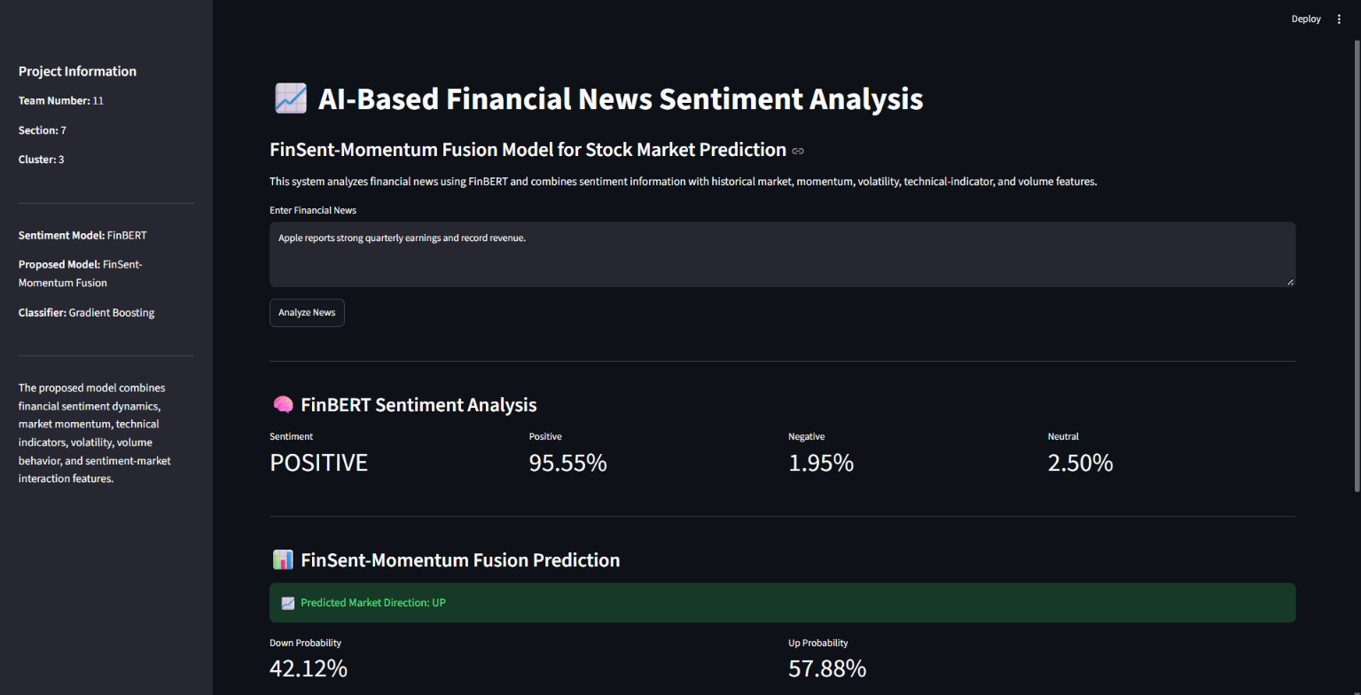
result

Slide 17
Thank you

