Slide 1

SALES/DEMAND FORECASTING SYSTEM
Final Project Review | Department of CSE | KLH
TEAM MEMBERS
2420030359 – Roopesh Chalasani
24200303448 – Turlapati Deepthi Anusha
24200303449 – Avula Vasantha Vyshnavi
Guide: Dr. N. Sunanda | Academic Year: 2026–27
Notes:
Title slide. Replace all bracketed text. Use the full project title, list every team member with registration number, and name your guide. Insert the institution logo in the dashed box.

Slide 2



Introduction & Problem Statement
Background
Businesses generate large volumes of sales data every day. Historical sales analysis helps reveal trends, seasonality and demand fluctuations. Forecasting supports better planning.
Problem Statement
Businesses have historical sales data but may lack an efficient way to use it to predict future demand. Manual pattern identification is difficult, and inaccurate estimates can cause overstocking or understocking.
Motivation / Need
A forecasting system can help businesses improve inventory management, resource allocation and demand planning. An understandable dashboard helps users interpret predictions and make better business decisions.
Notes:
State the domain, the exact problem and why it matters. Keep it to about 2 minutes. Add one real-world statistic if you can, with a citation.

Slide 3


Objectives & Scope
Objectives
1
Collect and preprocess historical sales data, handling missing values, inconsistencies and irrelevant information.
2
Perform EDA to identify sales trends, seasonality and demand fluctuations.
3
Apply ARIMA and Prophet time-series models to forecast future sales.
4
Compare model performance and visualize actual versus predicted sales to support inventory planning.
Notes:
Objectives should be measurable and start with action verbs. The scope slide tells the panel what you did and did not attempt.

Slide 4

Literature Survey
S.No | Author(s) & Year | Method / Technique | Key Findings | Limitation / Gap
1 | Taylor & Letham (2018) | Prophet; trend, seasonality, holidays | Flexible forecasting at scale | Accuracy depends on data and model settings
2 | Hyndman & Khandakar (2008) | Automatic ARIMA and exponential smoothing | Automated statistical forecasting | No integrated interactive sales dashboard
3 | Retail sales study (2015) | State-space and ARIMA models | Compared retail footwear forecasts | Selected footwear categories only
4 | Alon, Qi & Sadowski (2001) | Neural networks, ARIMA, Winters, regression | Compared aggregate retail methods | Aggregate US retail data may not generalize
Research Gap
Existing studies provide forecasting methods such as ARIMA and Prophet, but the project identifies a need to combine preprocessing, exploratory analysis, model comparison and clear visualization in one understandable sales-forecasting platform.
Notes:
Summarise four to six relevant papers or existing systems. End with the research gap, because that gap justifies your project.

Slide 5





Proposed System & Methodology
STEP 1
STEP 2
STEP 3
STEP 4
STEP 5
Define Problem
Collect Data
Design
Implement
Test & Evaluate
Identify demand forecasting needs and define the sales-planning problem.
Historical sales data in CSV/Excel format, containing dates and sales or demand values.
Prepare time-series workflow using EDA, ARIMA and Prophet; plan model evaluation and dashboard.
Build preprocessing, forecasting, evaluation and Streamlit visualization components.
Compare forecasts with actual sales using MAE, RMSE and MAPE; test the dashboard workflow.
Key Novelty / Contribution
The system integrates historical-data analysis, two forecasting approaches, model comparison and interactive visualization in one workflow.
Notes:
Walk through the five steps left to right. Rename the steps to match your project (for example, Requirement Analysis, Design, Coding, Testing, Deployment). End with your novelty.

Slide 6
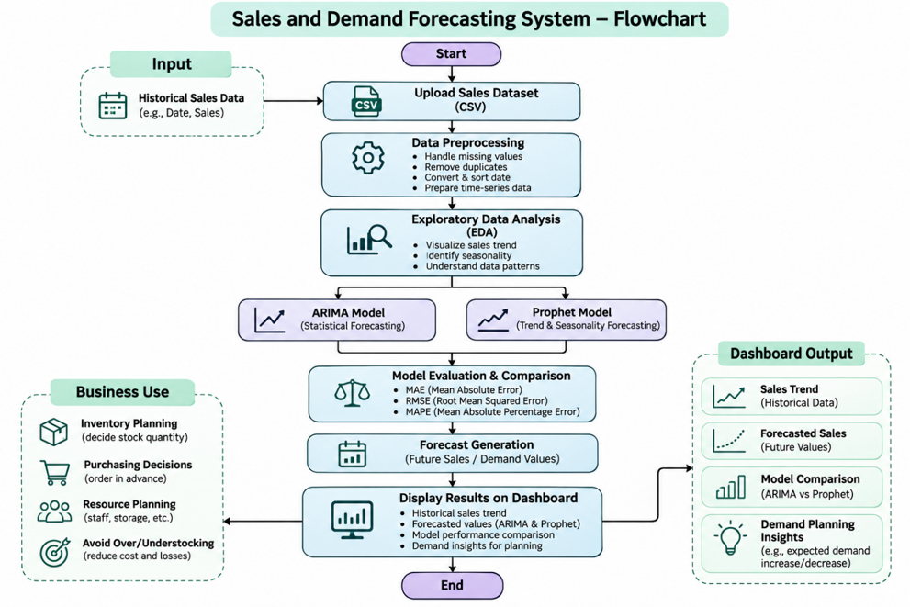
System Architecture
Components
1
1. Data Collection
Loads historical sales records from CSV/Excel files.
2
2. Preprocessing & EDA
Formats dates, handles missing/duplicate records and identifies trends and seasonality.
3
3. Forecasting Models
ARIMA uses past values and errors; Prophet models trend and seasonality.
4
4. Evaluation & Dashboard
Compares predictions using MAE, RMSE and MAPE; displays trends and forecasts.
Notes:
Insert a clear block diagram: input, processing, storage, output. Number each block and explain them on the right. Redraw the figure yourself rather than copying it.

Slide 7


Hardware & Software Requirements
Hardware
Software & Tools
Libraries / Frameworks
Hardware requirements are not specified in the source presentation.
A computer capable of running Python and the dashboard is required.
Python
Development environment: not specified
Version control: not specified
Pandas and NumPy
Matplotlib and Seaborn
Statsmodels (ARIMA)
Prophet, Scikit-learn, Streamlit
Deployment / Platform: Streamlit dashboard
Notes:
List only what you actually used, with versions. For a pure software project, shorten the hardware list and add cloud or deployment resources.

Slide 8

Algorithms & Technologies Used
ARIMA
Prophet
Evaluation Metrics
Why chosen
Statistical time-series forecasting using past values and forecast errors.
Key parameters
Specific parameter values are not stated.
Why chosen
Models trend and seasonality; designed for business time-series data.
Key parameters
Specific parameter values are not stated.
MAE, RMSE and MAPE measure forecast error from different perspectives.
Key parameters
MAE: absolute error; RMSE: larger-error penalty; MAPE: percentage error.
Selection criteria: Compare ARIMA and Prophet predictions against actual sales using MAE, RMSE and MAPE.
Notes:
Name each model, algorithm or technology, say why you chose it, and list the key settings. Then explain how you picked the final one.

Slide 9
Implementation / Model Building
Feature Selection
app.add_middleware(
CORSMiddleware,
allow_origins=[
"http://127.0.0.1:5173", "http://localhost:5173",
"http://127.0.0.1:5174", "http://localhost:5174",
],
allow_credentials=True,
allow_methods=["*"],
allow_headers=["*"],
)
Code snippet / pseudocode
Date and sales/demand values from historical records are used for time-series forecasting.
Preprocessing Pipeline
Convert dates; handle missing values; remove duplicates; resample if needed; ensure consistent time intervals.
Data Splitting
Chronological train/test split. Exact ratio and sample counts are not stated.
Configuration
ARIMA and Prophet are the forecasting models. Exact hyperparameter settings are not stated.
Notes:
Describe the build in the order you did it. Paste only the most important code or pseudocode, not entire files. For hardware projects, show the circuit or wiring summary instead.

Slide 10
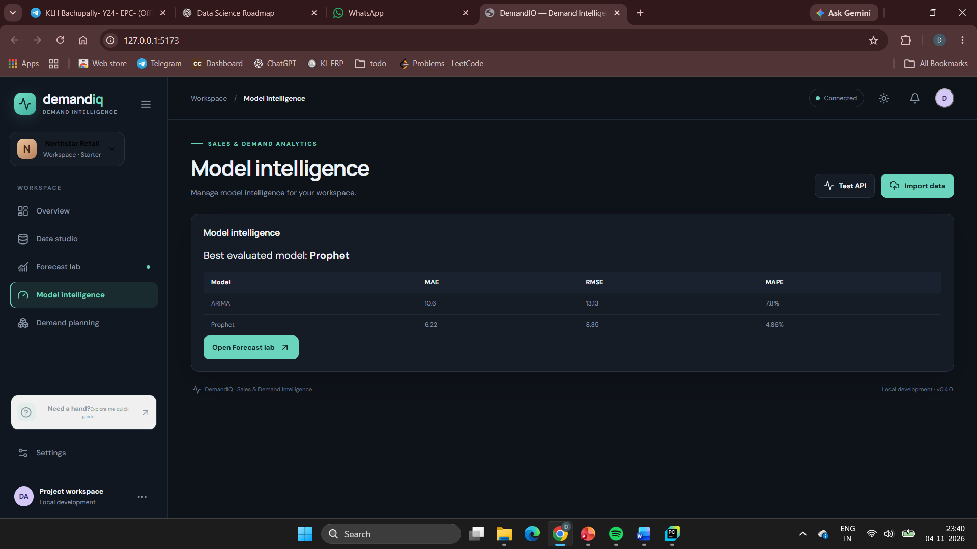
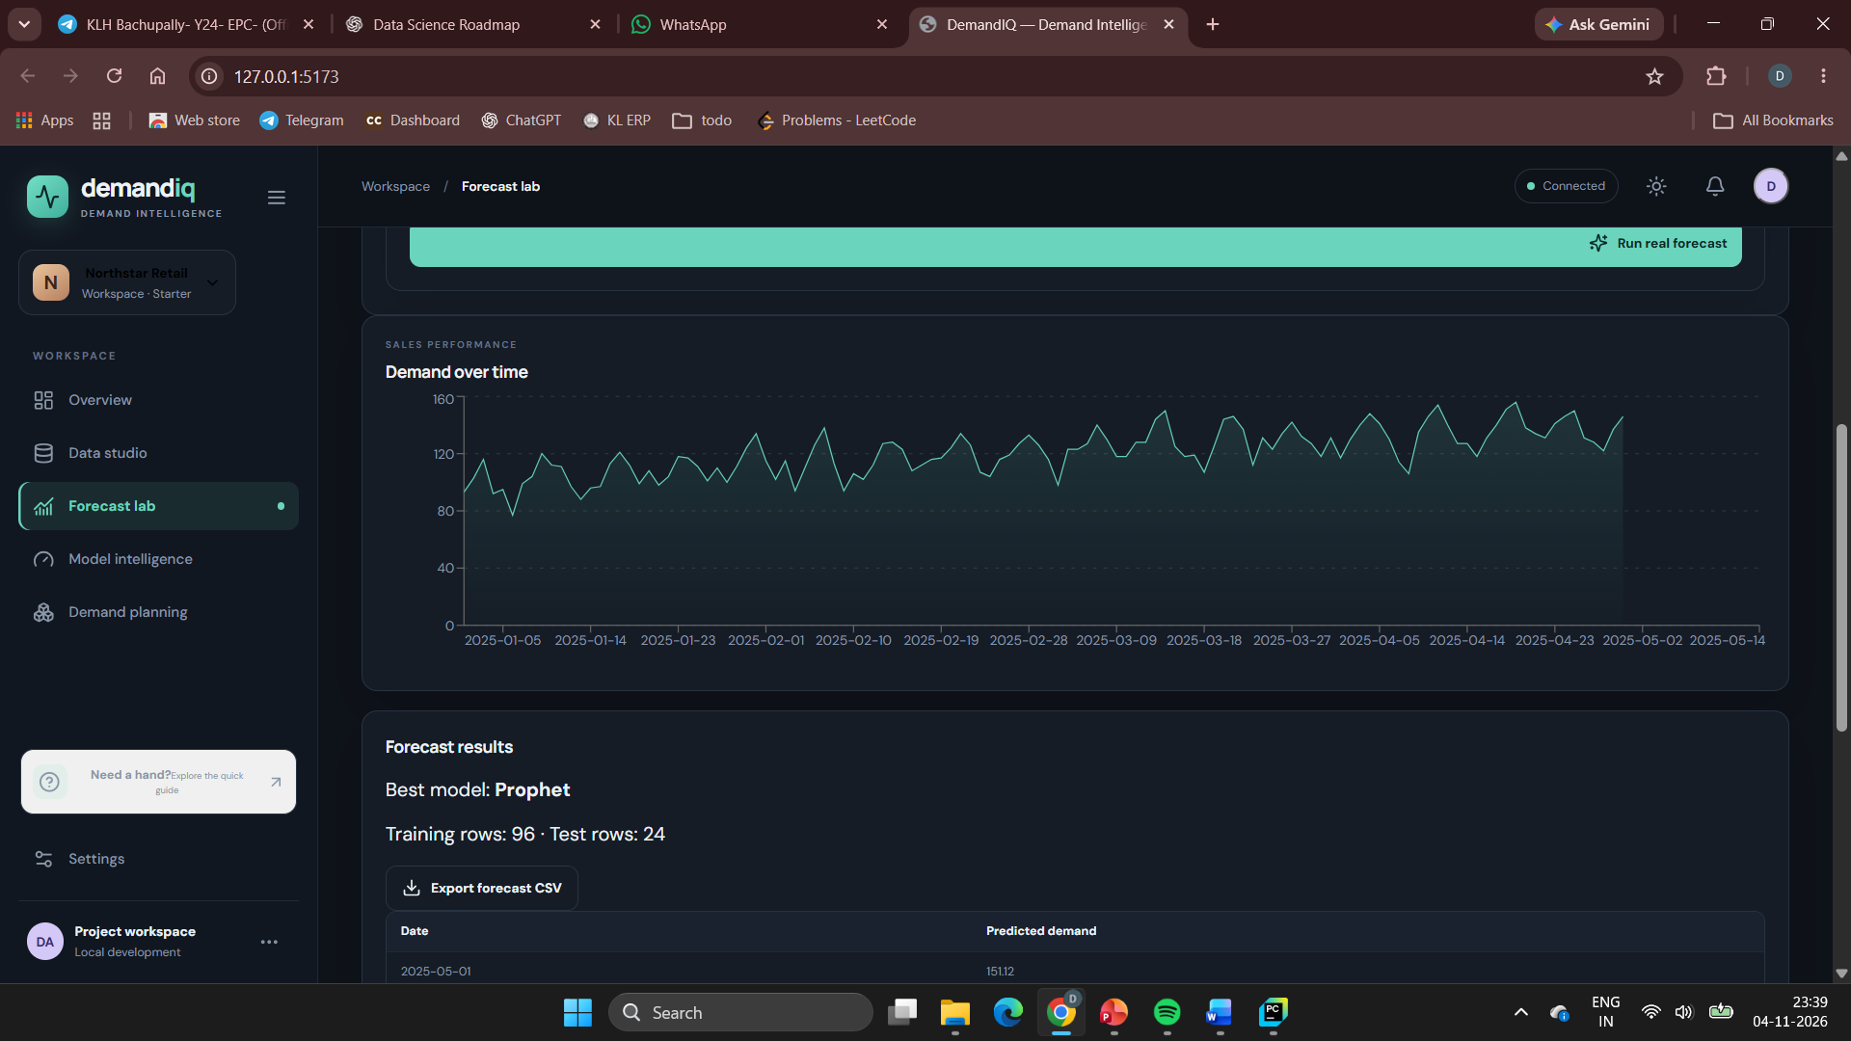
Working Prototype / Output Screens
Forecasting workflow
The project presentation includes sample output visuals.
Model evaluation
The review includes an evaluation section; numeric results are not legible/provided in text.
Dashboard outputs
Sample output images are present in the source deck; detailed screen labels are not specified.
Notes:
Show real screenshots, photos of the hardware or a short demo video link. Caption each one with what the viewer should notice.

Slide 11
Results & Performance Comparison
Metric | ARIMA | Prophet | Metric
MAE | 19.81 | 16.99 | MAE
RMSE | 24.14 | 19.49 | RMSE
MAPE (%) | 13.09 | 11.45 | MAPE (%)
Metric | ARIMA | Prophet | Metric
Best model: Not reported in the supplied review
The source lists MAE, RMSE and MAPE as evaluation metrics, but does not provide numerical scores or a confirmed winning model.
Notes:
Right-click the chart and choose Edit Data to enter your real numbers. Replace the metrics with the ones that fit your project (accuracy, latency, power, throughput, user rating). State clearly which option performed best.

Slide 12


Testing & Validation
Test ID | Test Description | Expected Result | Actual Result | Status
TC-01 | CSV Dataset Upload | Dataset should upload successfully | Dataset uploaded and displayed | Pass*
TC-02 | Data Preprocessing | Data should be cleaned and prepared | Data prepared for forecasting | Pass*
TC-03 | Forecast Generation | ARIMA and Prophet should generate predictions | Forecast values generated | Pass*
TC-04 | Model Evaluation | MAE, RMSE and MAPE should be calculated | Both models evaluated successfully | Pass*
Functional Testing
Validation Method
Performance Testing
Planned checks include date conversion, missing-value handling, duplicate removal, consistent time intervals and forecast output generation.
Chronological train/test split is identified for evaluating predictions on later observations.
Compare ARIMA and Prophet with MAE, RMSE and MAPE. Actual test outcomes and timing/load measurements are not provided.
Notes:
List representative test cases with expected and actual outcomes. Name the validation methods you used. Delete rows you do not need.

Slide 13


Challenges & Limitations
Challenges Faced
Limitations
Historical data needs cleaning → convert dates and handle missing values.
Duplicate or inconsistent records → remove duplicates and ensure consistent intervals.
Demand patterns vary → compare ARIMA and Prophet rather than relying on one model.
Dataset size and exact feature details are not stated.
Model parameter values and measured performance are not reported.
The supplied review does not describe completed deployment or detailed test outcomes.
Notes:
Be candid. Pair every challenge with how you solved it, and list limitations that the panel would otherwise spot themselves.

Slide 14

Conclusion
The project presents a sales/demand forecasting workflow using historical sales data, Python-based processing and a Streamlit dashboard.
1
Final Outcome
ARIMA and Prophet are selected for comparison. MAE, RMSE and MAPE are the stated metrics; numerical results are not included in the supplied deck.
—
2
Forecasting pipeline defined
Objectives listed: 8
The planned workflow addresses data preparation, trend and seasonality analysis, forecasting and visualization to support inventory and demand planning.
3
Notes:
Revisit each objective and say whether you met it. Quote your headline result with numbers. Do not introduce new material here.

Slide 15



Future Scope & Applications
Improve Forecasting
Compare ARIMA and Prophet using MAE, RMSE and MAPE; further tuning is not detailed in the source.
Applications
Inventory management
Resource allocation
Demand planning
Potential users: businesses using historical sales data.
Expand Data / Features
The current description uses date and sales/demand values. Additional data sources are not specified.
Deploy & Build an Interface
A Streamlit dashboard is included to visualize trends, compare models and present forecasts.
Scale & Secure
Cloud scaling and security plans are not described in the supplied presentation.
Notes:
Give concrete next steps, ideally tied to the limitations. Then name two or three real-world uses.

Slide 16
Team Contribution
Team Member | Registration Number | Contribution
Roopesh Chalasani | 2420030359 | Dataset collection, data preprocessing, data cleaning, exploratory data analysis, and visualization of historical sales trends.
Turlapati Deepthi Anusha | 24200303448 | React frontend development, FastAPI backend integration, dashboard design, API integration, and overall system integration.
Avula Vasantha Vyshnavi | 24200303449 | ARIMA and Prophet implementation, model training, forecasting, performance evaluation, and comparison using MAE, RMSE, and MAPE.
Notes:
Show that work was planned and shared. Every member should be able to explain their own module.

Slide 17

References
[1] S. J. Taylor and B. Letham, “Forecasting at Scale,” 2018.
[2] R. J. Hyndman and Y. Khandakar, “Automatic Time Series Forecasting: The forecast Package for R,” 2008.
[3] “Performance of State Space and ARIMA Models for Consumer Retail Sales Forecasting,” 2015.
[4] I. Alon, M. Qi, and R. J. Sadowski, “Forecasting Aggregate Retail Sales: A Comparison of Artificial Neural Networks and Traditional Methods,” 2001.
[5] S. Ma and R. Fildes, “Retail Sales Forecasting with Meta-Learning,” 2021.
[6] “Retail Demand Forecasting: A Comparison between Deep Neural Network and Gradient Boosting Method for Univariate Time Series,” 2019.
[7] M. R. Hasan et al., “A Comparative Study on Forecasting of Retail Sales,” 2022.
[8] M. S. Haque, M. S. Amin, and J. Miah, “Retail Demand Forecasting: A Comparative Study for Multivariate Time Series,” 2023.
[9] S. Makridakis, E. Spiliotis, and V. Assimakopoulos, “M5 Accuracy Competition: Results, Findings, and Conclusions,” 2022.
[10] R. Fildes, S. Kolassa, and S. Ma, “Post-script—Retail Forecasting: Research and Practice,” 2022.
Project Links
Project Links
GitHub: Not provided
Dataset: Historical sales dataset (CSV/Excel); URL not provided
Demo video: Not provided
Notes:
Use IEEE style, numbered in order of first citation in the deck. Include datasets, documentation and code repositories.

Slide 18
THANK YOU
Questions & Discussion
Guide: Dr. N. Sunanda
Department of Computer Science and Engineering
KLH CSE Bowrampet Campus
Notes:
Leave this slide up during questions. Make sure every team member can answer questions about their own module.

