Slide 1
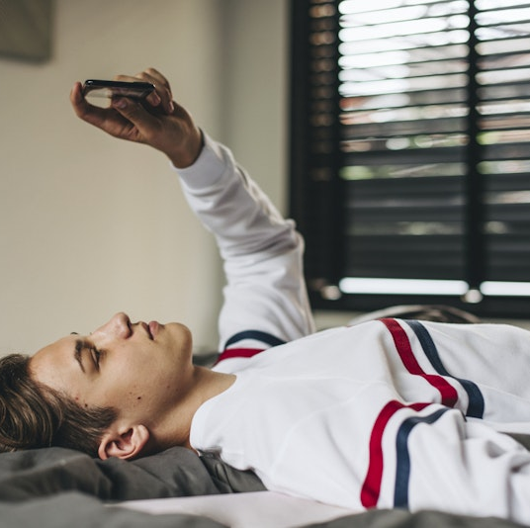
Why should we not use smartphone 10mins before bed?

Slide 2
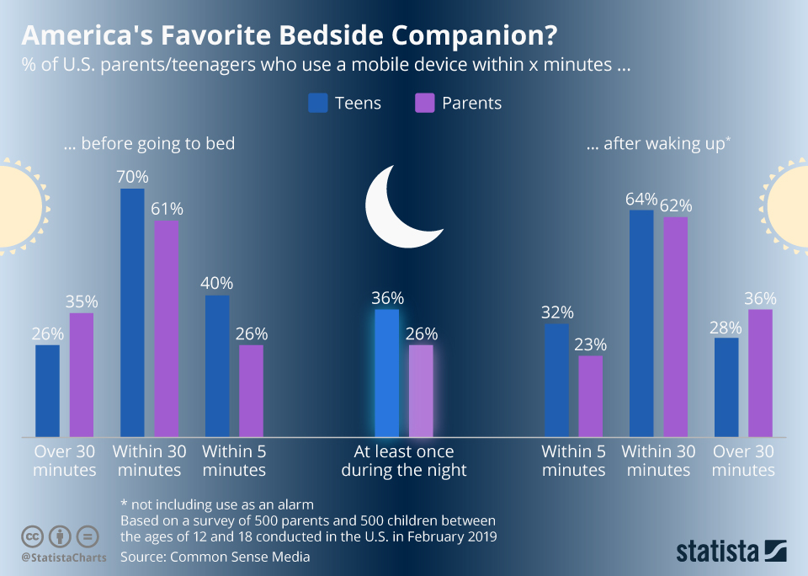
The Prevalence of Smartphone Use Before Bed

Slide 3
Is it too important?
Checking emails
Social media
Photos or videos from the day
Messaging apps
Ordering groceries/ food
Planning for the next day
Gaming

Slide 4
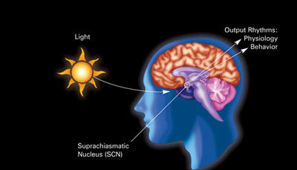
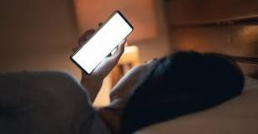
Circadian Rhythm
The blue light emitted by your cell phone screen restrains the production of melatonin, the hormone that controls your sleep-wake cycle

Slide 5
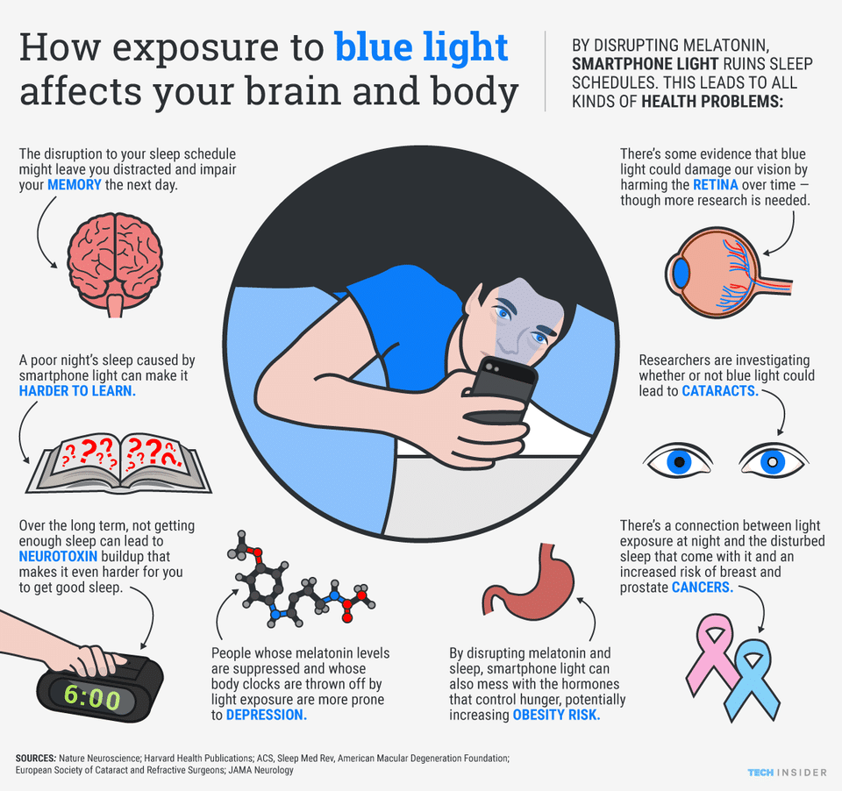
Smartphone use and sleep problems.

Slide 6

Delayed Sleep Onset
“Using the mobile for at least 30 minutes (without blue light filter) after the lights have been turned off” results in :
poor sleep quality,
daytime sleepiness,
sleep disturbances,
increased sleep latency.

Slide 7

Information Overload and Stress
Mental activity before bed like reading books, gaming, social media scrolling can keep your mind active and alert, making it difficult for you to relax and transition into a state conducive to sleep.
This Photo by Unknown Author is licensed under CC BY-SA-NC

Slide 8

Establishing Healthy Bedtime Routines
Create a relaxing pre-sleep routine.
Set a specific "screen curfew" time.
Replace smartphone use with alternative activities like reading or meditation.

Slide 9
Conclusion
Quality sleep is essential for physical health, mental well-being, and cognitive function.
By disconnecting from your smartphone at least 10 minutes before bed, you can improve your sleep hygiene and increase the chances of a restful night's sleep.
Establishing a relaxing bedtime routine that doesn't involve screens can lead to better overall health and productivity during the day.
Remember, small changes in your nightly routine can have a significant impact on your sleep quality and overall quality of life.

Slide 10
tHANK YOU
Q&A

