Slide 1

Institute of Aeronautical Engineering
(Autonomous)
Department of Electronics and Communication Engineering
THYROID ULTRASOUND IMAGE CLASSIFICATION
USING DEEP LEARNING APPROACH
Supervisor
Mr. J. Siva Rama Krishna
Assistant Professor
K Saai Deepthi Reddy - 19951A04B8
Mohammed Riazuddin – 20955A0408
Jangam Ruchitha - 19951A04B6

Slide 2

OUTLINE
KEY POINTS
INTRODUCTION
PROBLEM IDENTIFICATION
PROPOSED METHOD
METHODOLOGY
IMPLEMENTATION
SYSTEM REQUIREMENTS
ALGORITHMS
RESULTS
CONCLUSION

Slide 3
KEY POINTS
Today, the majority of thyroid nodule diagnoses are made through clinical techniques, which demand a significant amount of personnel & medical equipment. In order to diagnose thyroid ultrasonography nodules automatically, this project presents a method that combines image texture information & convolutional neural networks.
We are employing Feature Fusion VGG16, MobileNet V2, ResNet50 approaches for comparision.We examine the accuracy-efficiency trade-off by taking into account both the accuracy costs necessary to attain the various accuracies for a more fair comparison.
We will compare the accuracy of our model with various algorithms. Our findings suggest that reservoir computing can be a promising tool for classification of thyroid ultrasound, potentially allowing efficient analysis and improved outcomes on diesease patterns.

Slide 4
INTRODUCTION
Doctors can only judge the thyroid as benign and malignant based on clinical experience, which are highly subjective and easily affected. Therefore, the ability to accurately and quickly identify and diagnose the pathology of ultrasound thyroid nodules has become an increasingly urgent need.
In recent years, application of artificial intelligence technology in the medicine has gradually increased, especially in imaging and signal.
Scholars are actively exploring the application of convolutional neural networks (CNNs) in diagnosing hypothyroidism using deep learning techniques. While CNNs offer the advantage of streamlined and simplified processes without extensive pre-processing requirements, their effectiveness heavily relies on the completeness of features in the training data. Since there is limited theoretical support, the exact direction and details of feature training are often unknown.

Slide 5
PROBLEM IDENTIFICATION
Scholars are actively exploring the application of convolutional neural networks (CNNs) in diagnosing hypothyroidism using deep learning techniques. While CNNs offer the advantage of streamlined and simplified processes without extensive pre-processing requirements, their effectiveness heavily relies on the completeness of features in the training data.
Since there is limited theoretical support, the exact direction and details of feature training are often unknown. The effectiveness of the model heavily relies on complete training data and lacks theoretical support. In this scenario, the precise specifics of feature training are often uncertain. Further improvement in diagnosis accuracy is urgently required
Therefore, there is a pressing need to further enhance the accuracy of diagnosis using CNNs and explore strategies to improve feature training methods.

Slide 6
PROPOSED METHOD
This research suggests a machine controlled hypothyroid ultrasonography examination of a lesion that incorporates picture texture data and convolutional neural networks.
The key actions consist of: By gathering both positive and negative samples, normalizing the pictures, and segmenting the nodule area, the ultrasonography thyroid nodule dataset is first created.
Second, a texture features model is created through the extraction of The dimensionality of information elimination, choosing attributes, as well as characteristics of textures
Thirdly, a artificial neural network is employed for assessing an attribute representation for a lesion in photos by transfer learning
Then, a unique feature modal is created by fusing the texture and convolutional neural network feature models; an artificial neural network analysis system which adapts as required and voting classifier network are used to train and increase efficiency over unit networks.

Slide 7
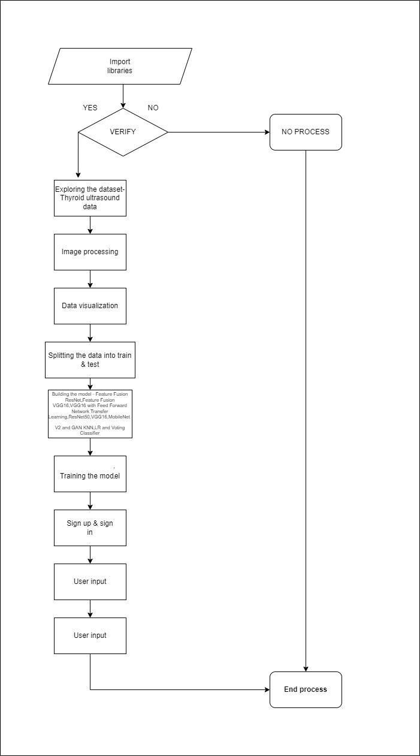
METHODOLOGY

Slide 8
IMPLEMENTATION
Data exploration: We will use a module to load data into the system.
Processing: The module will be used to read data for processing.
Data splitting: The data will be split into sets for training and testing using a different module.
Model generation: We will build different ML models such as Feature Fusion ResNet, VGG16, ResNet50, Mobile Net V2, GAN, KNN, LR and Voting Classifier, and calculate their accuracy.
User registration and login: A segment is be used to enable user signup and login.
User input: Another module will allow users to provide input for the prediction.
Prediction: Finally, the predicted output will be displayedUser input: Using this module will give input for prediction

Slide 9
SYSTEM REQUIREMENTS
SOFTWARE REQUIREMENTS
Operating System : Windows Only
Processor : i5 and above
Ram : 4gb and above
Hard Disk : 50 GB
HARDWARE REQUIREMENTS
RAM : 4GB and Higher
Processor : i3 processor and above
Hard Disk : 500GB

Slide 10
ALGORITHMS
Feature Fusion ResNet
Feature Fusion VGG16
ResNet50
Mobile Net V2
GAN
KNN
Logistic Regression
Voting Classifier

Slide 11
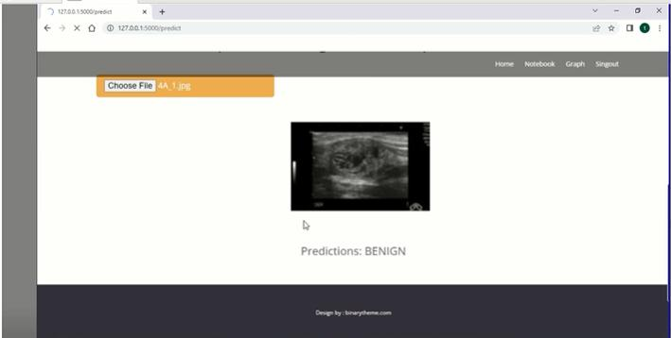
RESULTS

Slide 12
CONCLUSION
The research presented a novel approach to assist doctors in the clinical diagnosis of thyroid nodules using feature fusion and deep neural networks. The results demonstrated improved accuracy and efficiency compared to traditional methods, offering potential benefits to both patients and healthcare professionals. The preprocessing techniques employed, including cropping, enhancement, and extraction of regions of interest, helped to refine the collected data and focus on relevant features.
By leveraging feature engineering and dimensionality reduction, the study successfully extracted texture features and reduced the complexity of the data, enabling a more effective analysis. The integration of a deep neural network model further enhanced the performance, taking advantage of the combined texture features from the previous steps.The evaluation of the proposed approach on a large dataset of thyroid nodule patients showcased its superior performance compared to existing methods.

Slide 13
THANK YOU

