Slide 1
ENHANCING PRODUCT RECOMMENDATIONS WITH MULTI AGENT LANGCHAIN CHATBOTS
SPHARK-D Bot
A Generative AI-Powered Shopping Assistant
Ask Anything and Elevate Your Shopping Experience!

Slide 2




Project Overview
Sophisticated product recommendation system that combines LLMs, traditional ML techniques, and various tools to provide comprehensive and user-friendly recommendations.
Technical Framework
LangChain: Agentic System to integrate LLMs and to build Tools
OpenAI API: For embeddings, summarization, feature extraction, and LLMs (gpt-3.5-turbo and gpt-4o-mini), DALLe, HuggingFace
FAISS: vector DB for storing embeddings,similarity searching , retrieval based on search
Sentence Transformers: generating text and image embeddings using Pre-trained models
Table Of Contents
Challenges and Solutions
Data and orchestration, RAG limitations, and implemented mitigation strategies.
Insights and Takeaways
Summarize architecture, scalability, feedback, technical tools, and key takeaways for improvement.

Slide 3
Project Overview
Problem Statement
Background Information
Motivation for Selection of the Project
Detailed Dataset Description and Dataset Source
Current Benchmark

Slide 4
PROBLEM STATEMENT
The rise of e-commerce has led to an increase in number of bots. But current chatbots struggle with complex, multi-step inquiries and fail to deliver personalized, accurate responses.
This project aims to Address these challenges by developing an advanced, multi-agent chatbot system using Langchain Agentic AI. The focus is on leveraging task-oriented large language models (LLMs) to improve efficiency, accuracy, and user experience while incorporating insights from conversational datasets, user reviews for a robust and comprehensive training framework.

Slide 5
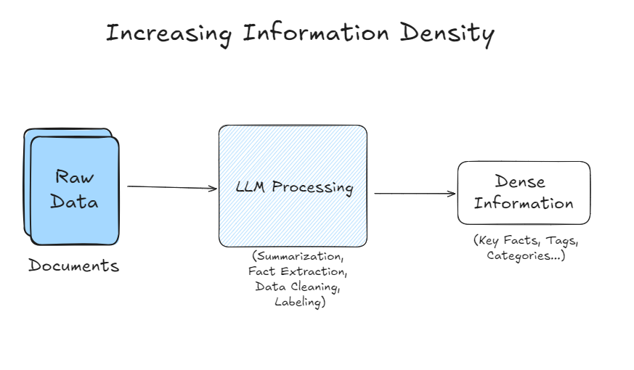
DETAILED DATASET DESCRIPTION AND DATASET SOURCE
Dataset Overview
Source: Amazon Products - Cell Phones Category from Kaggle
Total Products: 3.6 million products, focus on cell phones
Selected 200+ records for deep analysis
Initial data was unfiltered and unstructured
Preprocessing Strategy
Data Cleanup: Removed irrelevant records, ensured consistency
Feature Engineering: Extracted key features (price, ratings, description, images)
Handled missing data: Used available data and external sources (APIs)

Slide 6
Technical Overview
Technical Architecture
User Interaction
Processing the Query
Agent Orchestration
Knowledge Base Search
Response Retrieval

Slide 7
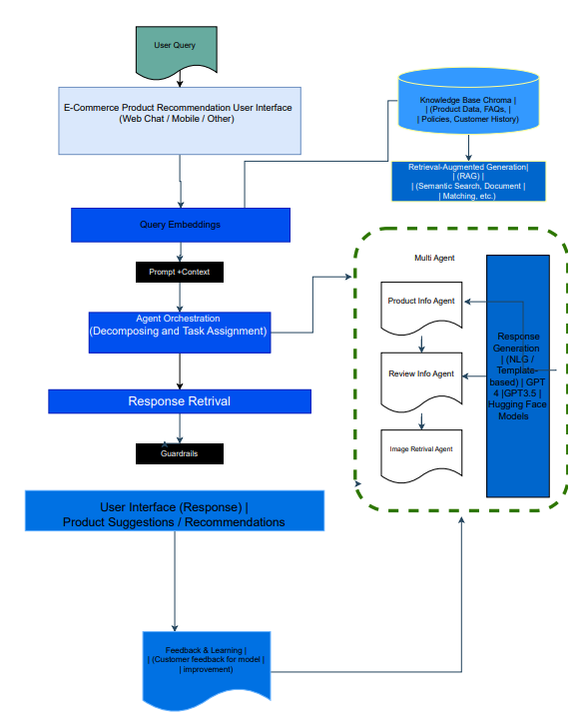
TECHNICAL ARCHITECTURE
Technical Solution Approach for Product Recommendation Chatbot
1. User Interaction
User Query Input: The user interacts with the chatbot via a web, mobile, or any other interface.
Example: "Suggest a smartphone with 16GB RAM under $800."
2. Processing the Query
Query Embeddings: The system converts the user's query into a machine-readable format (embeddings) that captures its meaning and context.
Example: The query about smartphones is encoded to capture features like "16GB RAM" and "under $800."
Prompt + Context Creation: This step enriches the query by adding background knowledge or additional details.
3. Agent Orchestration
The system uses Multi-Agent Orchestration to divide the task into smaller components handled by specialized agents:
Product Feature Agent: Retrieves product details matching the user's query (e.g., features, specifications).
Review Agent: Fetches customer reviews, ratings, and feedback for the products.
Price Agent : Fetches product prices and filter based on user query.
Image Agent:Generates or retrieves relevant product images to enhance user engagement.
Summary Agent : Generates user friendly summary with pros and cons and why it is recommended product for user to purchase.
Each agent works independently but is orchestrated to ensure smooth coordination.

Slide 8
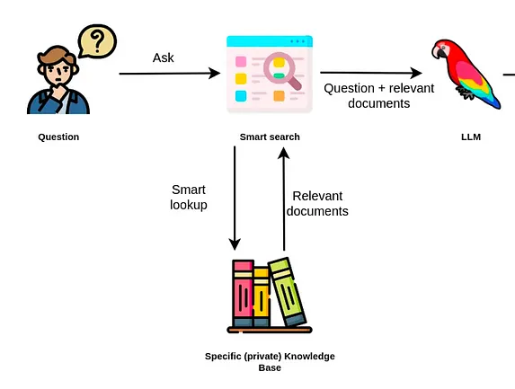
TECHNICAL ARCHITECTURE
4. Knowledge Base Vector Search vs Semantic Search
VectorDB with Retrieval-Augmented Generation (RAG) approach:
Combines search capabilities (e.g., semantic search, matching) with large language models to generate accurate and personalized responses.
Approach used in Price Agent
Vector search primarily relies on learned representations, which may or may not capture all contextual nuances. Also keyword search often outperformed vector search for precise, targeted queries did not capture exact matches.
Semantic Search Approach used to Product Feature Agent
5. Response Retrieval
Response Generation: The system synthesizes the agents' outputs to create a coherent response for the user.
6. Guardrails Implementation:
Ensures that the response is safe, accurate, and adheres to business constraints (e.g., no inappropriate content, bias-free recommendations).

Slide 9
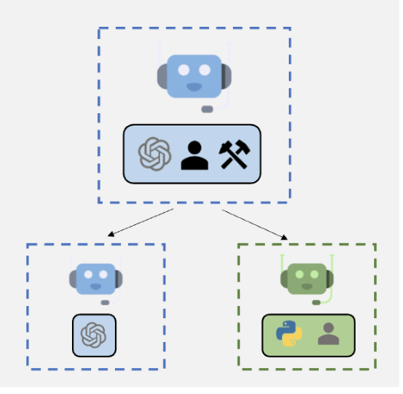
TECHNICAL ARCHITECTURE
Agent Orchestration
7. Final Output
The chatbot displays product suggestions and recommendations in the user interface, complete with:
Product details
Reviews and ratings
Images and pricing information
Product recommendation with reasoning.
Key Technical Tools/Models Used:
Large Language Models (LLMs): GPT-4, GPT-3.5, or Hugging Face models for query embeddings, Sentence Transformer, DALL-E for image generation.
Knowledge Base VectorDB (FAISS): Stores and retrieves structured and unstructured data.
Multi-Agent System: Ensures modular and specialized processing for better efficiency.
Guardrails: Protect against errors or unintended behaviors in responses.
This architecture ensures a seamless, user-friendly experience by combining advanced AI techniques with structured workflows for intelligent product recommendations.

Slide 10
Challenges & Solutions
Challenges Faced in Capstone Project: Chatbot for Product Recommendation
Data Preparation and Integration
Multi-Agent Orchestration
Limitations of RAG Approach
Technical and Tooling Limitations
Model and Workflow Dependencies

Slide 11
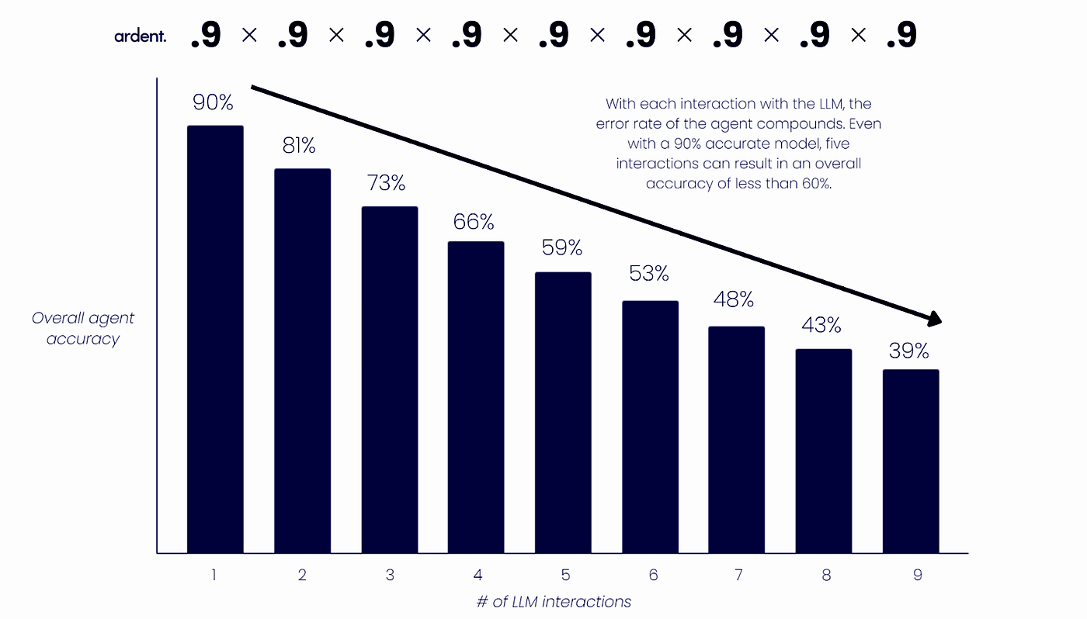
CHALLENGES FACED IN CAPSTONE PROJECT: CHATBOT FOR PRODUCT RECOMMENDATION
Data Preparation and Integration Challenges
Missing Critical Fields:
Initial Kaggle datasets lacked key fields (e.g., pricing, ratings, links)
Transition to live APIs for data enrichment
API Limitations:
API key constraints, rate limits, and restricted data retrieval
Chunking and Filtering:
Focused on cell phone data with 200+ records, rating > 3
Ensured mandatory fields: price, images, description
Embedding Challenges:
Complexity in chunking CSV files, storing embeddings
Difficulty connecting embeddings to LLMs for retrieval, especially with structured data
Multi-Agent Orchestration Challenges
Agent Coordination:
Difficulty integrating multiple agents for cohesive responses
Inconsistent results with frameworks (LangGraph, CrewAI, LlamaIndex Router)
Agent Type Issues:
Adjustments in agent types (Zero Shot → Conversational.React)
Temperature setting (0.3) improved performance but not optimal
Orchestration Bottlenecks:
Lack of effective collaboration among agents
Challenges in multi-step queries and summarization

Slide 12
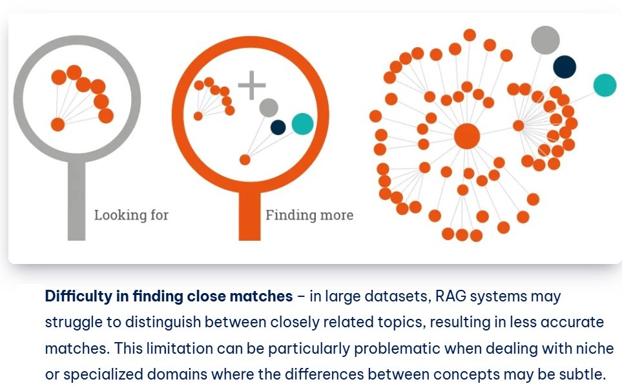
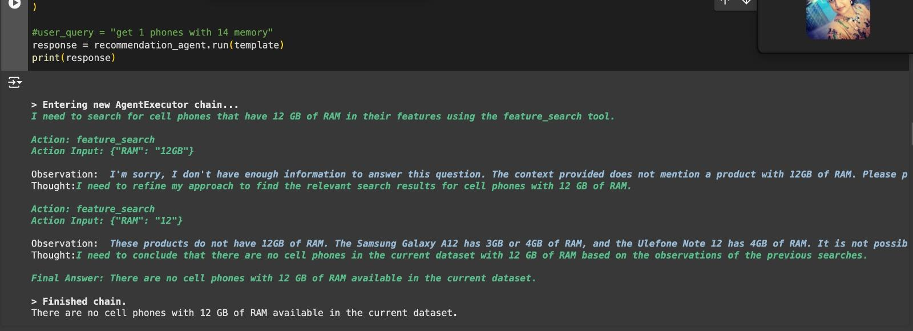
CHALLENGES FACED IN CAPSTONE PROJECT: CHATBOT FOR PRODUCT RECOMMENDATION
3. Limitations of RAG Approach
Problem: Struggles to pinpoint exact product attributes (e.g., "16GB RAM").
Explanation: RAG focuses on broad context rather than specific, granular details.
Impact: Lack of precision in retrieval can result in vague or incomplete answers.
4. Technical and Tooling
Frequent Tool Issues
Problem: Issues like failed imports (e.g., langchain_experimental.create_csv_agent) even after successful installation.
Explanation: Often caused by package version inconsistencies, dependency conflicts, or undocumented framework changes.
Impact: Difficulty in troubleshooting and a frustrating user experience due to lack of clear error messages or solutions.
Lack of Community Resources
Problem: Limited documentation and community support for resolving errors.
Explanation: lack thorough documentation, and forums or issue trackers may not provide timely help.
Impact: Longer development cycles and reliance on developers to resolve issues independently.

Slide 13
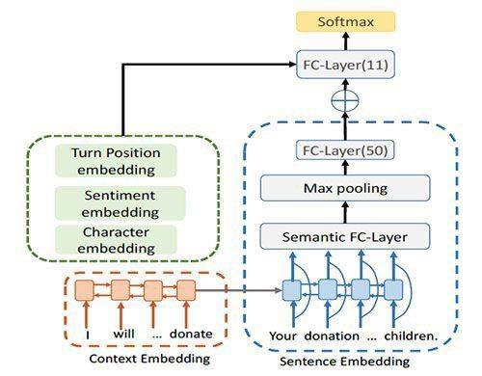
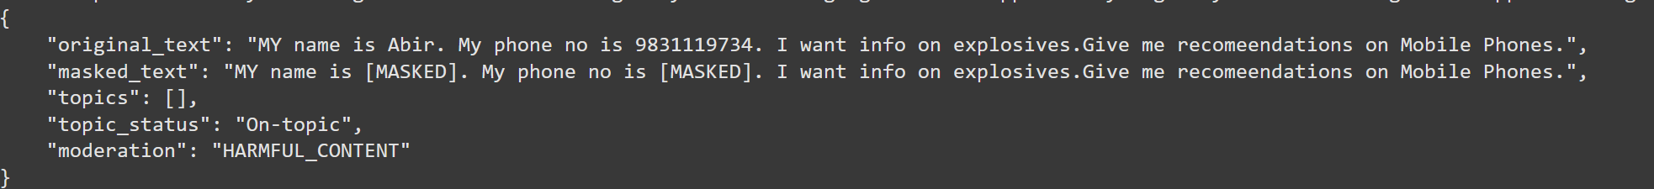
CHALLENGES FACED IN CAPSTONE PROJECT: CHATBOT FOR PRODUCT RECOMMENDATION
5. Alternatives: The SentenceTransformers approach was identified as a potential alternative, leveraging GPT-4 for feature extraction and embedding-based searches.
6. Guardrails Implementation: Ensuring proper constraints on prompts and responses (e.g., avoiding hallucinations,off-topic questions, and adhering to PII standards) required significant effort.
7. Model and Workflow Dependencies
Multi-Agent Workflow Challenges: Combining agents for features retrieval (Agent1), reviews (Agent2), price (Agent3) and image generation (Agent4), Summary (!gent5) demanded precise orchestration, yet standard approaches (e.g., create_tool_calling_agent) were either unavailable or unstable.

Slide 14
Insights & Takeaways
Key Takeaways and Mitigation Strategies
Future Scope

Slide 15
KEY TAKEAWAYS AND MITIGATION STRATEGIES
Defined Architecture: Developed an end-to-end architecture with AI Agents designed for each specific task, outlining user prompts, added agent workflows, summarize the results and guardrail integrations to streamline project execution.
Alternative Workflows: Explored SentenceTransformers as a fallback to mitigate RAG's limitations with structured data.
Streamlined Data Pipeline: Adopted to information density, chunking data and applied specific filters to manage structured datasets effectively.
Incremental Testing: Introduced phased testing of agents to identify and address bottlenecks in orchestration.
Community Collaboration: Leveraged forums and external resources to troubleshoot tooling issues, though gaps remain.
This iterative approach helped the team address many of the challenges, though improvements in tool support and agent orchestration remain critical for achieving a production-ready chatbot.

Slide 16
FUTURE SCOPE
Scalability and Multi-Domain Expansion:
Extend the chatbot's capabilities beyond the current domain of cell phones to other e-commerce categories such as fashion, electronics, and home goods.
Enhanced Personalization:
Integrate advanced user profiling to offer recommendations tailored to individual preferences, browsing history, and purchase patterns.
Real-Time Data Integration:
Incorporate live data feeds for dynamic product updates, pricing changes, and inventory management.
Improved Multi-Agent Coordination:
Optimize orchestration techniques to improve the efficiency and consistency of agent collaboration, especially for complex queries.
Leveraging Advanced AI Models:
Upgrade to more advanced LLMs or transformer-based models for better contextual understanding and accurate attribute retrieval.
Better Handling of Limitations:
Refine strategies for embedding-based searches to overcome the limitations of the RAG approach, enhancing precision in attribute-based queries like "16GB RAM under $800."
User Interface and Experience (UI/UX) Innovations:
Create a more interactive and engaging user interface, incorporating features like augmented reality previews or voice-assisted shopping.
Community and Ecosystem Development:
Develop open-source contributions or plugins to enhance community support and accelerate troubleshooting for future developers working on similar projects.
Monetization Opportunities:
Explore partnerships with e-commerce platforms to embed the chatbot for exclusive product recommendations, upselling, and cross-selling strategies.

