Slide 1
MedCentral: Hospital Management system
- Deepthi, Adria, Lokesh

Slide 2
Project Synopsis
This hospital management project is created for the internal use of employees at a hospital. Its goal is to handle and retrieve vital information regarding hospital staff, patient details, and billing records.

Slide 3
OBJECTIVES
Efficient Doctor Management: Add, update, and maintain employee information such as unique identifiers (ID), specialties, and names within the MedCentral system.
Patient Assignment Tracking: Track and manage patient assignments to each doctor and nurse, providing visibility into workload distribution.
Optimized Patient Care: MedCentral system supports optimized patient care by allowing Hospital Administrators to assign patients to doctors based on specialties, ensuring that patients receive appropriate and specialized medical attention.

Slide 4
Workload Balancing: Balance doctor workloads by monitoring patient assignments to ensure efficient use of doctor resources.
User-Friendly Interface: user-friendly interface for Hospital Administrators within MedCentral, allowing for easy navigation and efficient management.

Slide 5
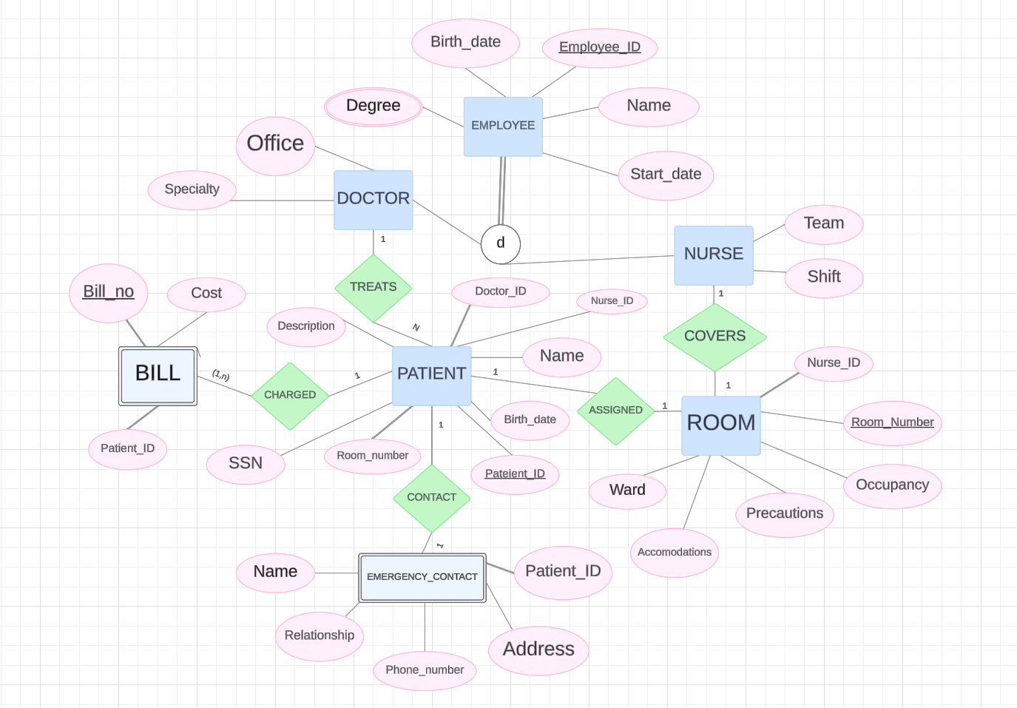
ER Diagram

Slide 6
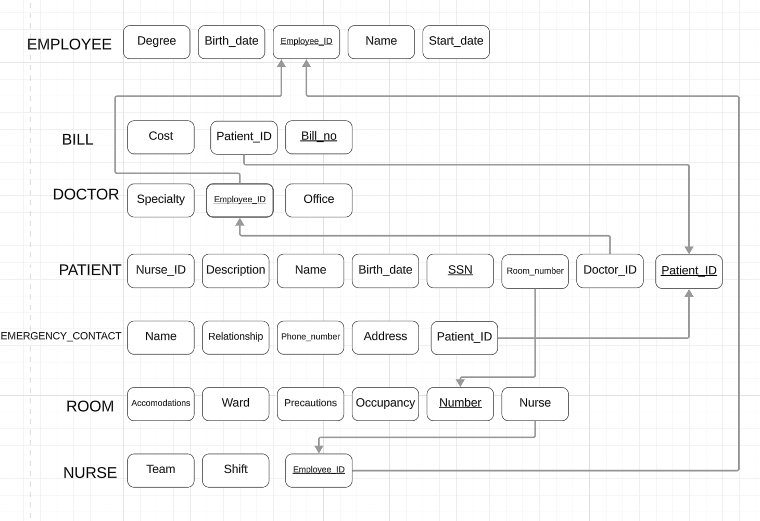
Relational Schema

Slide 7
Data Dictionary:
Employee Table
Employee_ID: Unique identifier for each employee. Primary key.
Name: Name of the employee.
Start_Date: Start date of employment.
Degree: Degree qualification of the employee.
Birth_Date: Birth date of the employee.
Doctor Table
Employee_ID: Unique identifier for each doctor. Primary key and foreign key referencing the Employee table.
Specialty: Specialization of the doctor.
Office: Office location of the doctor.
Nurse Table
Employee_ID: Unique identifier for each nurse. Primary key and foreign key referencing the Employee table.
Team: Team or department the nurse belongs to.
Shift: Shift schedule of the nurse.

Slide 8
Data Dictionary:
Room Table
Room_Number: Unique identifier for each room. Primary key.
Nurse_ID: Foreign key referencing the Nurse table, indicating the nurse assigned to the room.
Occupancy: Current occupancy status of the room.
Precautions: Precautionary measures associated with the room.
Ward: Ward or department the room belongs to.
Accommodations: Additional accommodations provided in the room.
Emergency_Contact Table
Name: Name of the emergency contact person.
Patient_ID: Foreign key referencing the Patient table, indicating the patient for whom the emergency contact is registered.
Address: Address of the emergency contact.
Phone_Number: Phone number of the emergency contact.
Relationship: Relationship of the emergency contact with the patient.
Patient Table
Patient_ID: Unique identifier for each patient. Primary key.
SSN: Social Security Number of the patient.
Name: Name of the patient.
Birth_Date: Birth date of the patient.
Room_Number: Foreign key referencing the Room table, indicating the room where the patient is accommodated.
Nurse_ID: Foreign key referencing the Nurse table, indicating the nurse assigned to the patient.
Doctor_ID: Foreign key referencing the Doctor table, indicating the doctor responsible for the patient.
Description: Additional description or notes about the patient.
Bill Table
Bill_No: Unique identifier for each bill. Primary key.
Cost: Cost associated with the bill.
Patient_ID: Foreign key referencing the Patient table, indicating the patient to whom the bill is related.

Slide 9
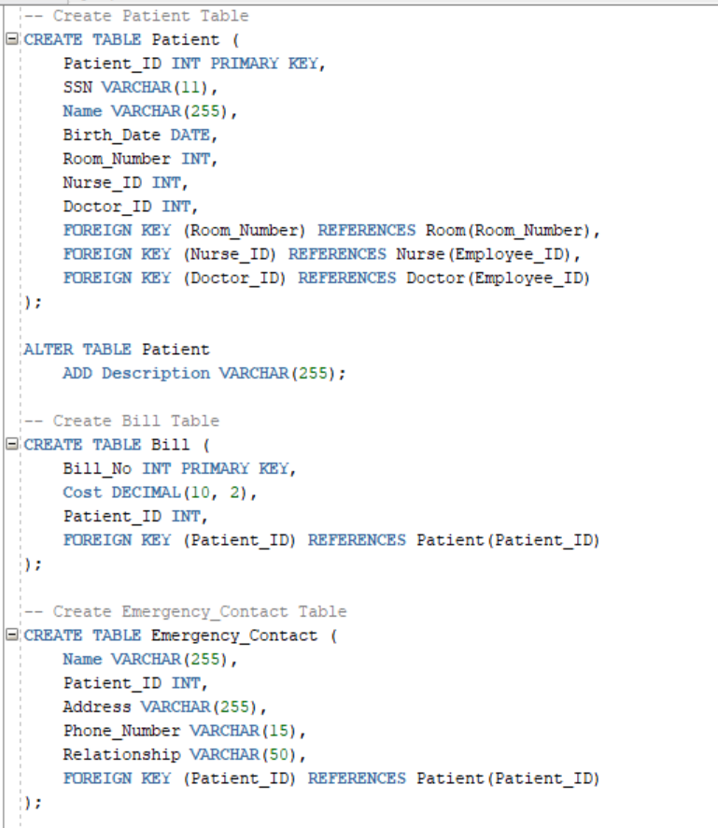
DDL: TABLES

Slide 10
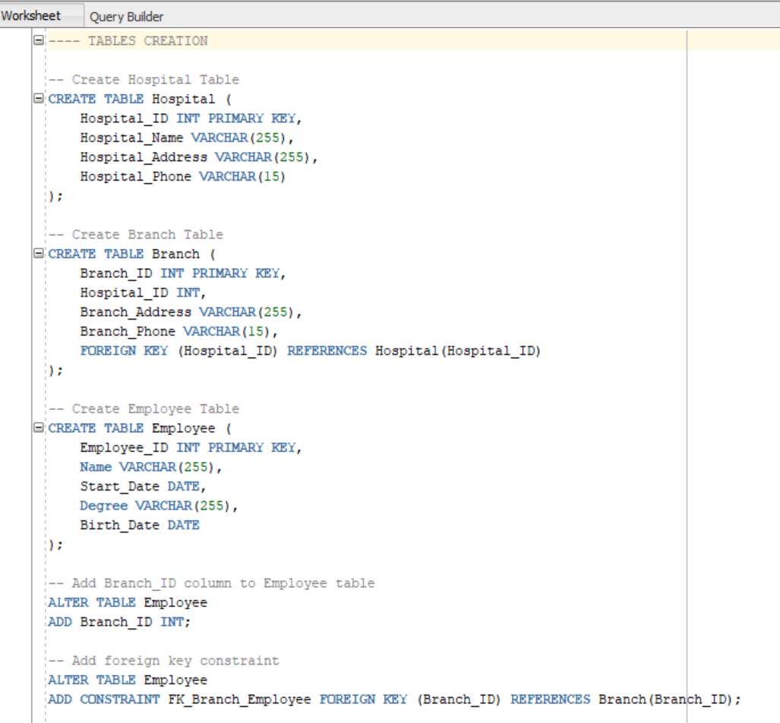
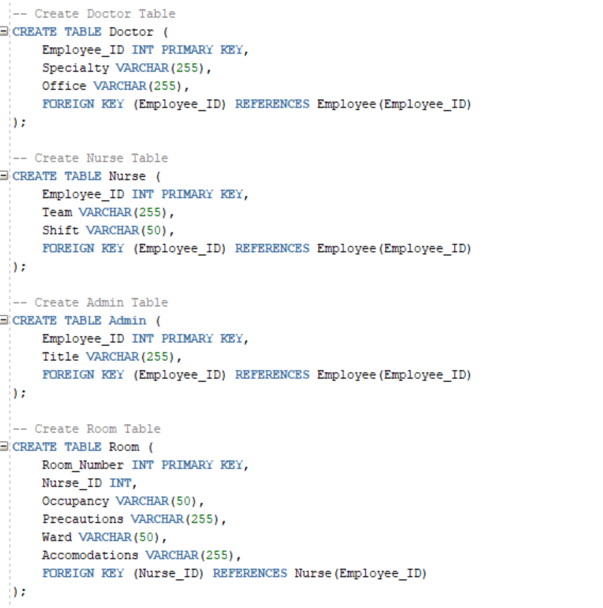
DDL: TABLES

Slide 11
DDL: TABLES

Slide 12
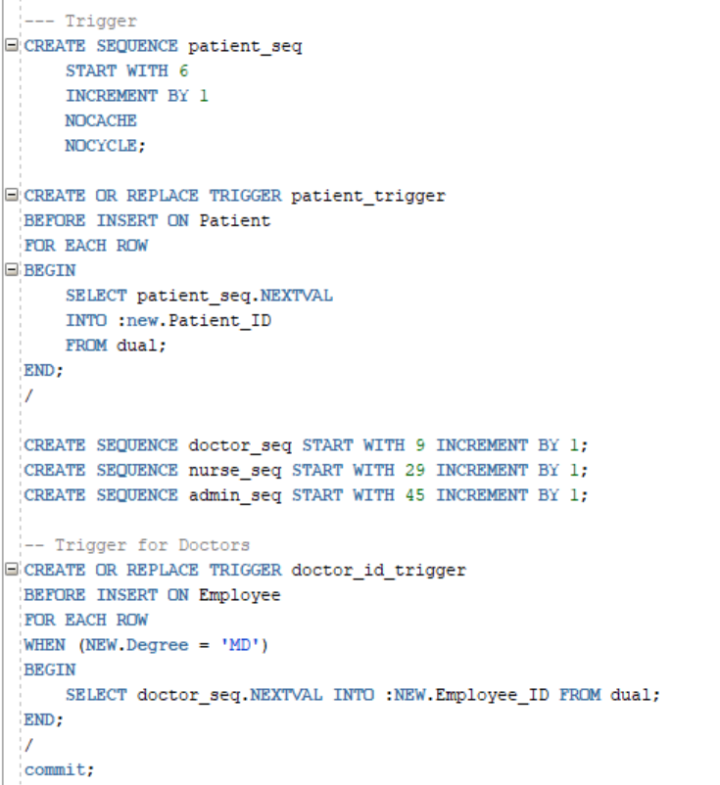
Triggers
Triggers to automate ID assignment

Slide 13
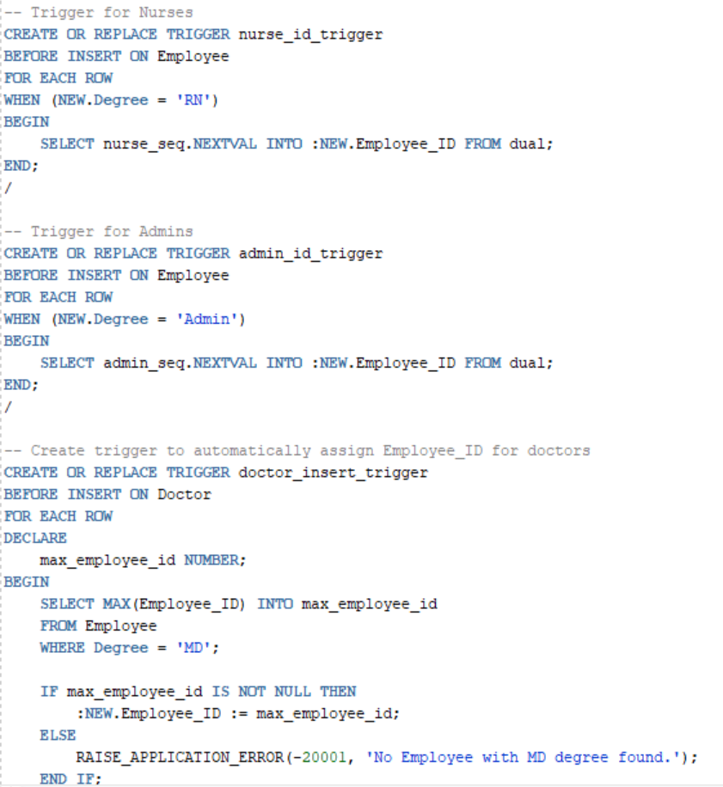
Triggers

Slide 14
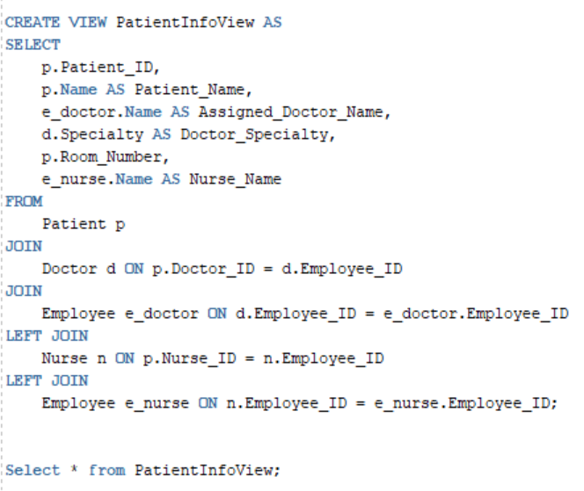
Views
Patient info
Name, ID, doctor (specialty), room assignment, nurse

Slide 15
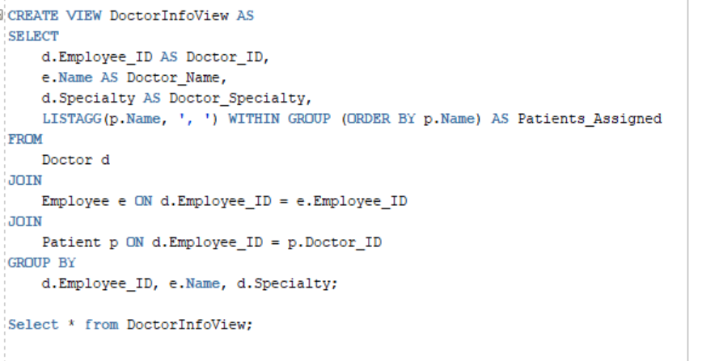
Views
Doctor info
Name, ID, specialty, assigned patients

Slide 16
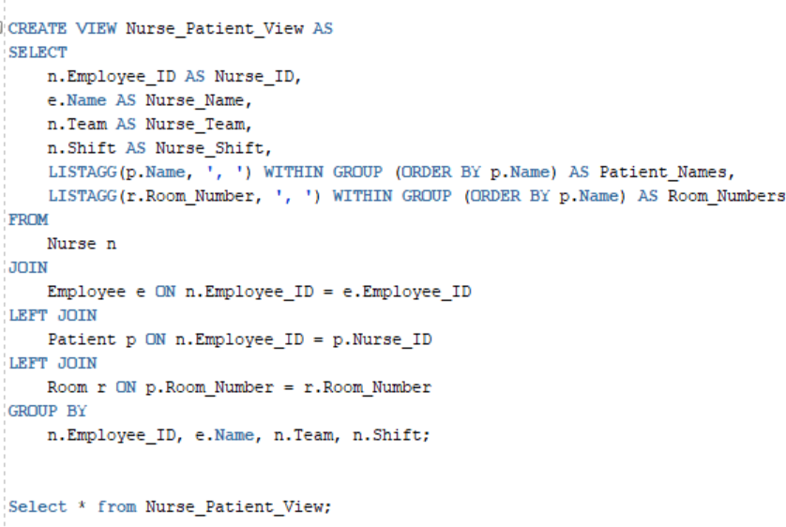
Views
Nurse info
Name, ID, team, shift, assigned patients, assigned rooms

Slide 17
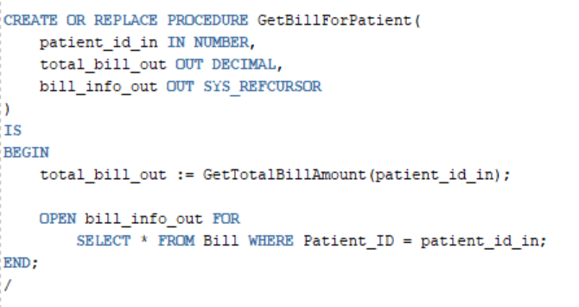
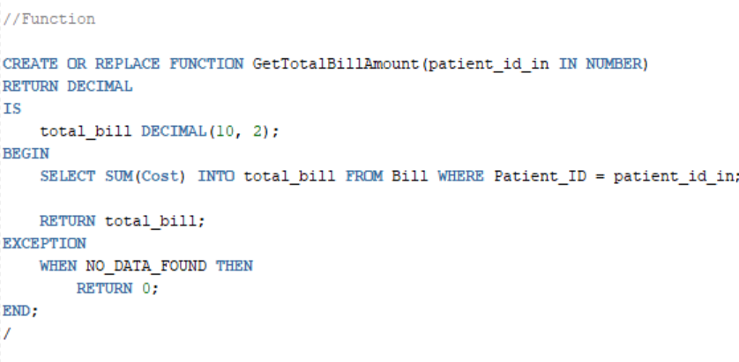
Stored Procedures-- Billing
Stored procedure Function

Slide 18
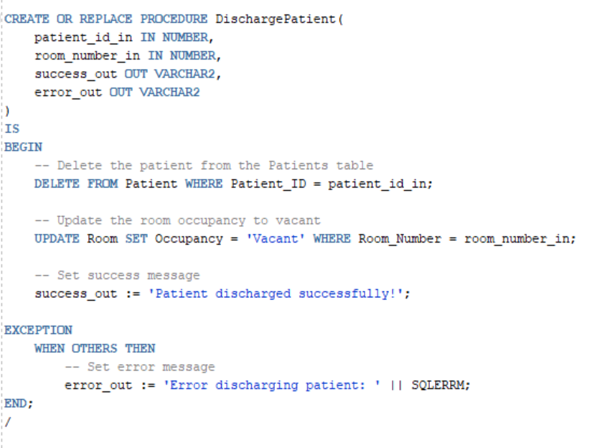
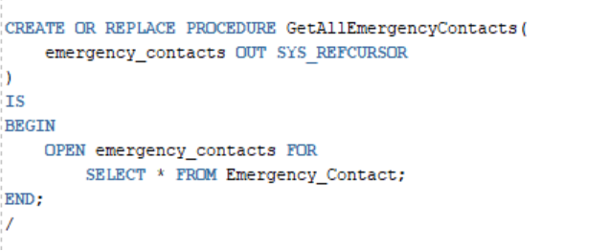
Stored Procedures
Discharge Patient Emergency contacts

Slide 19
User Stories
As a patient I need to…
View my current balance and the cost of individual bills.
Upload my emergency contact information and identifying information like my SSN and date of birth.
View my room assignment, doctor assignment, and nurse assignment.
Look up information about my care team, like their specialties and degrees.
As a nurse I need to…
View my current patients and assigned rooms.
As a doctor I need to…
View my current patients and nurses for collaboration.
As an administrator, I need to…
Discharge patients from the hospital, vacate their rooms and remove them from the lists of their doctors and nurses.
Retrieve/update information about employees including their start date, degrees, and role-specific features like specialties and offices.

Slide 20
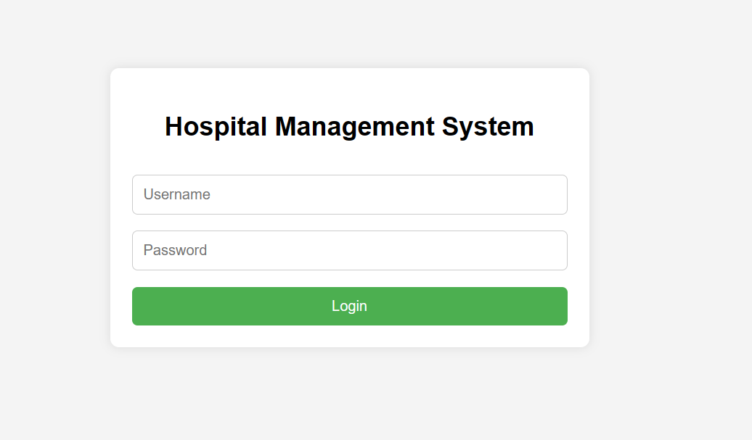
Login
The Hospital Administrator can log in to the Hospital Management System using the provided credentials, ensuring secure access to efficiently manage patient records, staff information, room allocation, and billing.

Slide 21

Hospital Dashboard
Upon logging in, the complete hospital dashboard becomes accessible, showcasing all modules related to patients, doctors, and nurses for comprehensive management and oversight.

Slide 22
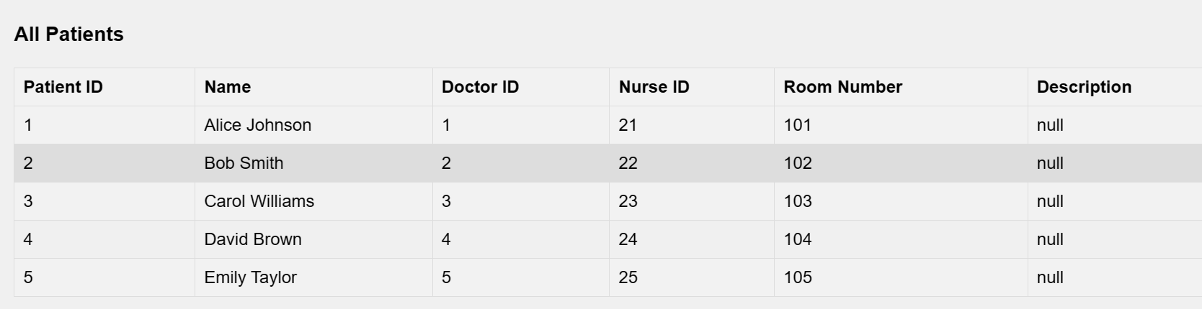
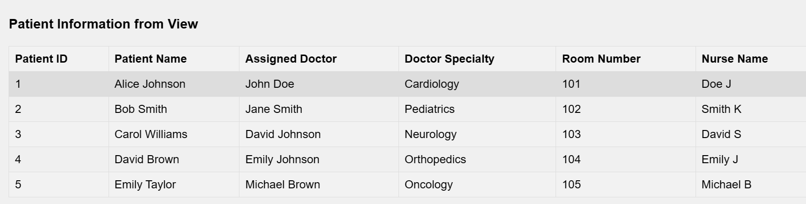
Patients Module
Within the patient module, users can access patient details, view the patient-doctor info, add new patient entries, assign patients to specific healthcare providers, and discharge patients when necessary.
Patient details: Patient-doctor info:

Slide 23
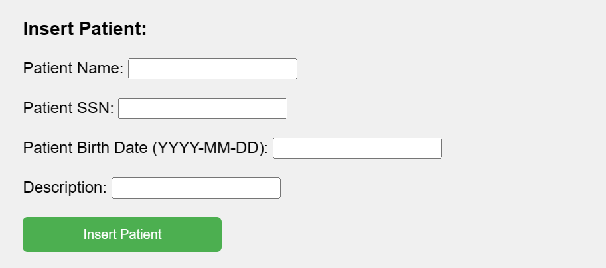
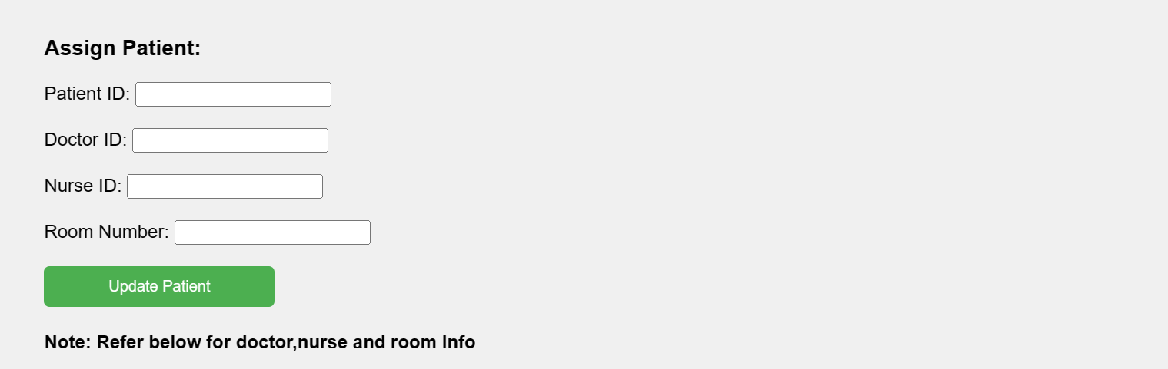
Insert Patient:
We have the capability to add new patients along with descriptions of their medical issues for comprehensive record-keeping and treatment planning.
Assign Patient:
After completing the patient insertion process, we can assign a doctor, nurse, and room to the patient for appropriate care and accommodation.

Slide 24
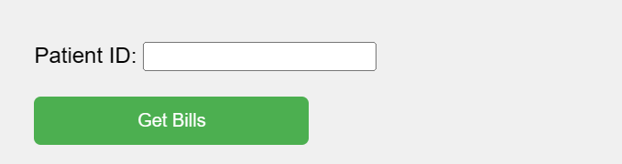
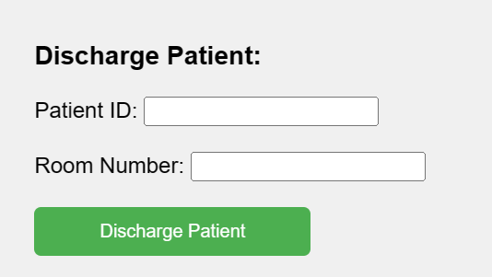
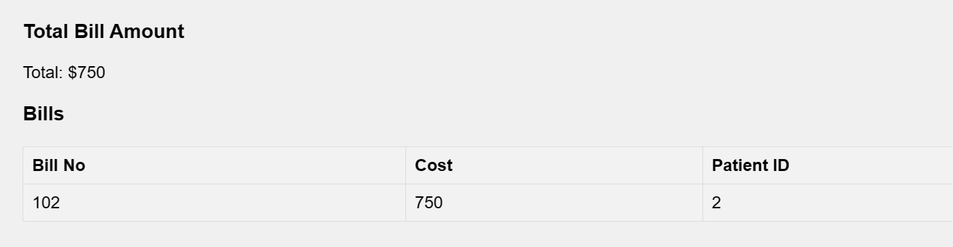
Discharge Patient:
-Upon completion of treatments, you have the option to discharge the patient, which will remove them from the system and deallocate their assigned room, streamlining the hospital's resources for future use. This would internally call the discharge patient stored procedure .
Bills:
-Billing information is accessible by providing the patient ID. Upon submission, the system calculates the total sum of all bills associated with the provided patient ID

Slide 25
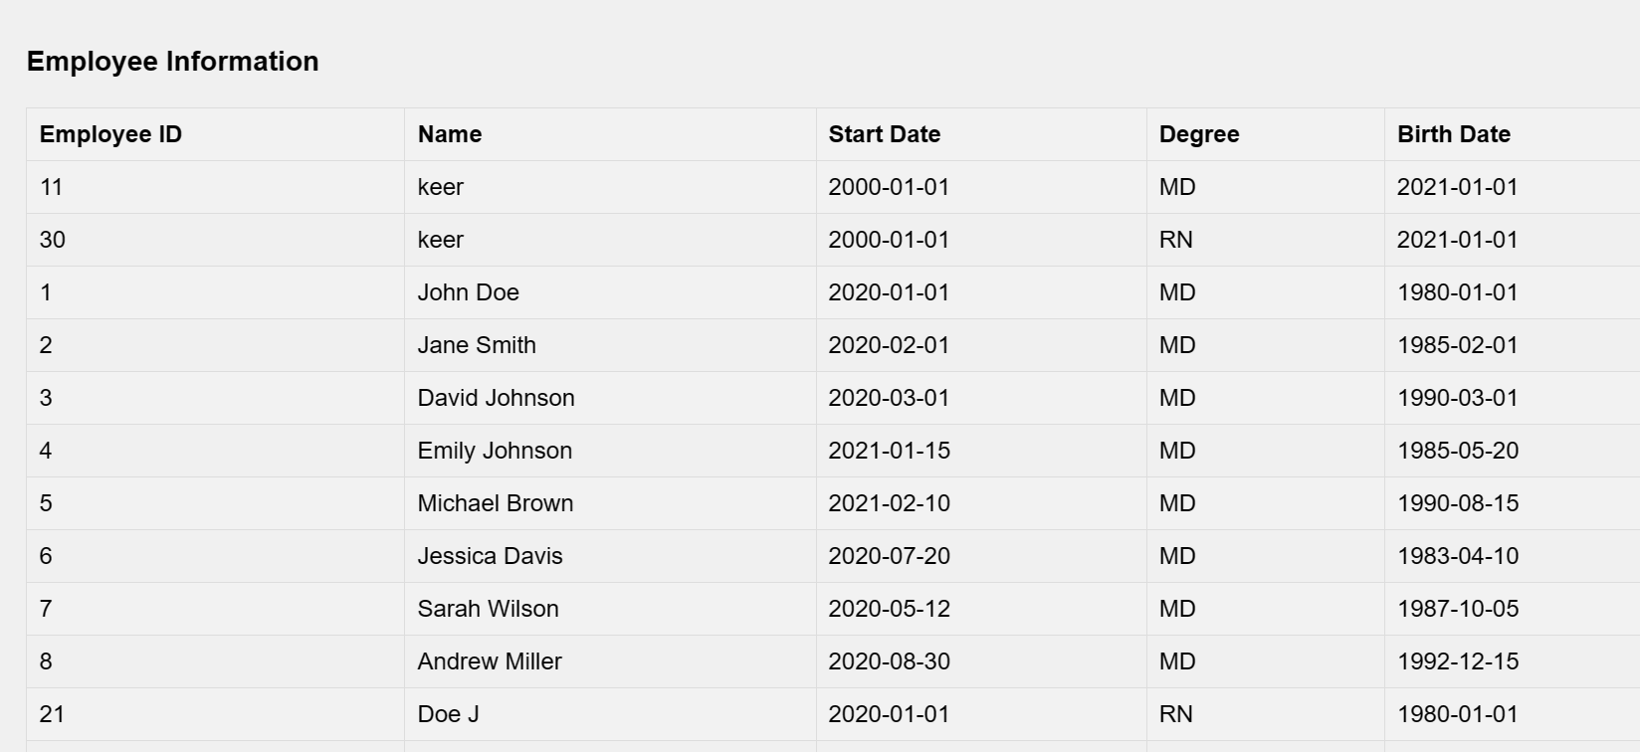
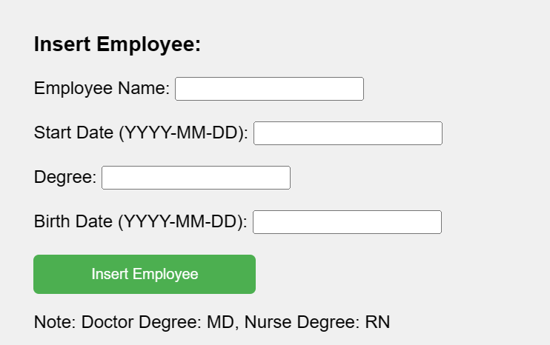
Employee Module
The Employee class serves as the superclass encompassing Doctor and Nurse subclasses. All doctors and nurses fall under the Employee superclass, sharing common information such as demographics. When inserting a doctor or nurse, it's necessary to input the common information in the Employee superclass first, as it forms the foundation for specific role-related details.
Employee info: Insert Employee:

Slide 26
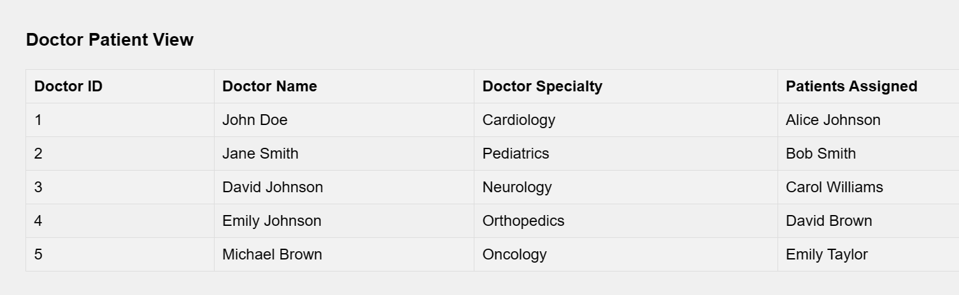
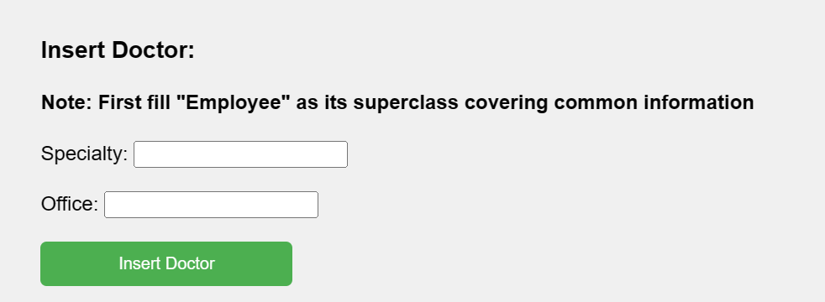
Doctor Module
Within the doctor module, we can see doctor info, patients assigned to doctor, and we can also insert new doctors.
Doctor-patient view: insert doctor:

Slide 27
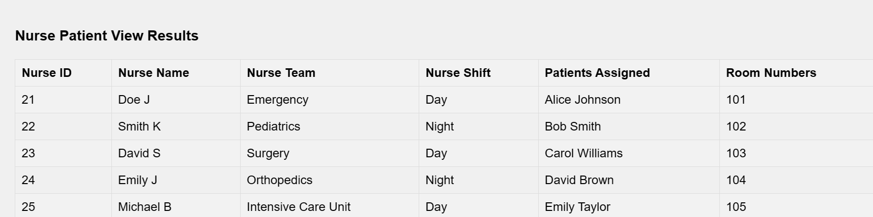
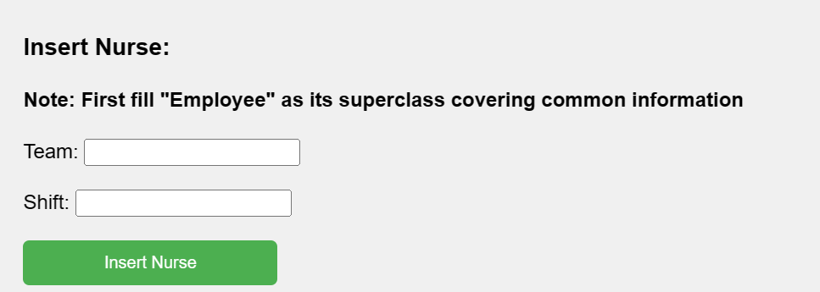
Nurse Module
Within the nurse module, we can see nurse info, patients assigned to nurse, and we can also insert new nurses.
Nurse-patient view: insert Nurse:

Slide 28
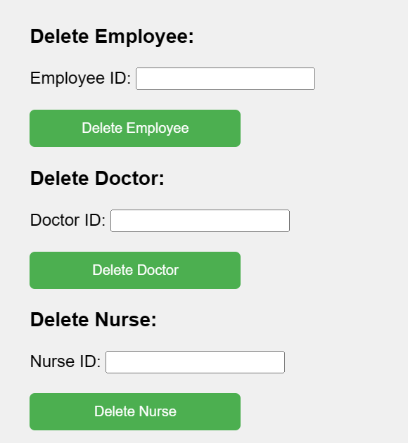
When a doctor or nurse departs from the hospital, we can remove them from the database by utilizing their employee ID.

Slide 29
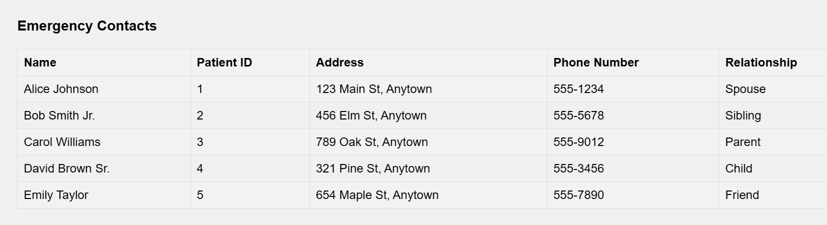
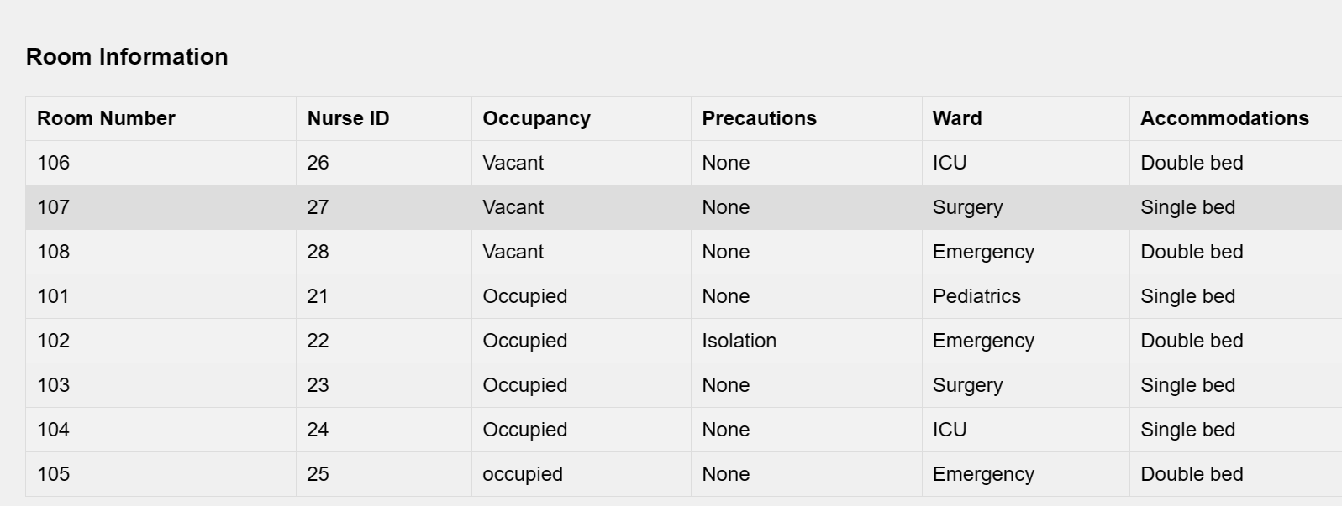
Other:
Apart from above, you can also see Emergency contacts of patients, current status of rooms and we also have logout feature, where we can logout of session.
Emergency contacts: Rooms:

Slide 30
DEMO
https://github.com/deepthisamhithaedara/Database-Project

Slide 31
Thank you!

