Slide 1

What it’s like working at

Slide 2
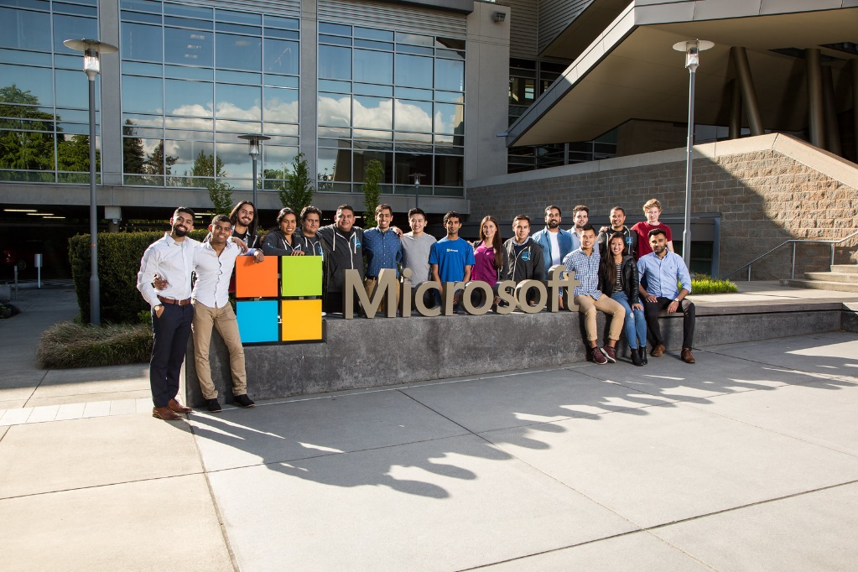
Atmosphere
Good work/life balance; lots of flexibility
Company/team events & employee benefits
Can change disciplines/teams fairly easily
Smart & passionate coworkers
Atmosphere can vary from team to team
Some middle management problems
Hard to stand out in a big company
Better opportunities if willing to relocate

Slide 3

Types of Jobs
Many teams looking for software engineers
Azure, Bing, AI, Office, Gaming, etc.
$94K - $150K
Senior software engineers earn $120K - $160K
Program Manager
$106K - $171K
Data & Applied Scientist
$74K - $147K
UI/UX Design
$85K - $125K

Slide 4
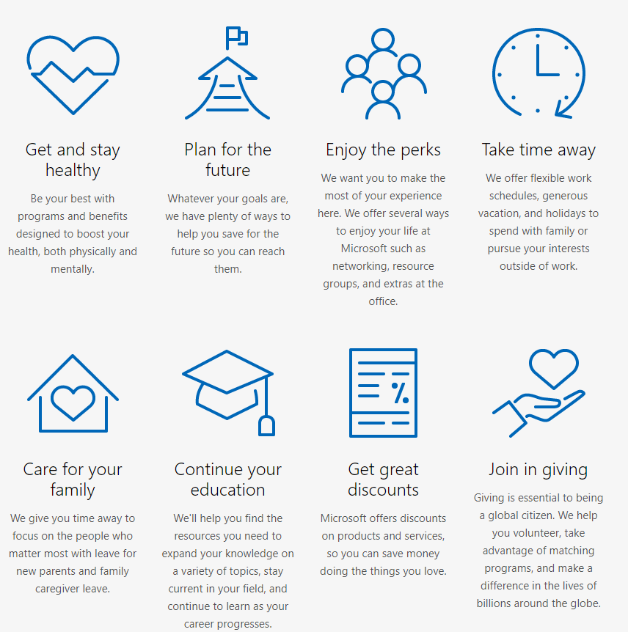
Would I Work There?
Pros
Good income & benefits
Interesting work
Cons
Hard to stand out & grow
Job-hopping

Slide 5
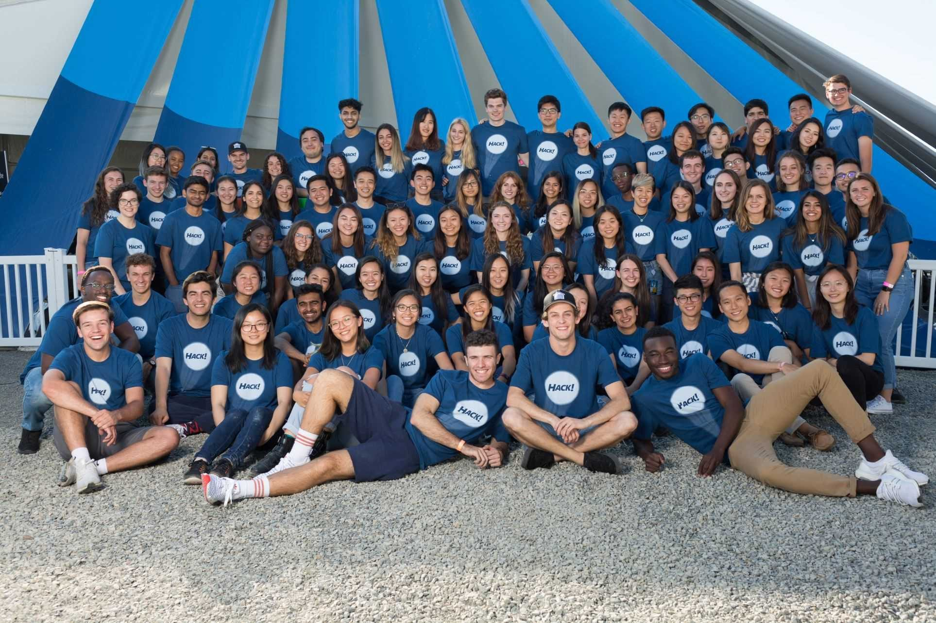
What Made Me Interested
Internship @ Minecraft
First introduction to company values
Some experience working in a large company
Talked to managers about their opinions
Hackathon

Slide 6
Thanks For Listening!
Any questions?

Slide 7
Works Cited
https://careers.microsoft.com/us/en/culture
https://www.glassdoor.com/Reviews/Microsoft-Reviews-E1651.htm
https://www.indeed.com/cmp/Microsoft/reviews

