Slide 1


Airline Flight Delay Analysis & Prediction
Insights, Trends & Recommendations
Presentation by: Deepti Joshi
Mentor: Maimuneesa Kasi
Date: 05.Jul.2025

Slide 2
Project Introduction
Issue at hand: Flight delays have been a significant challenge for the aviation industry, passengers, airlines, and airports. With increasing air traffic, managing delays effectively has become even more critical.
Can Data Be the Solution? : Can we use existing data to predict delays and take proactive measures to reduce them?
Goal : The goal is to explore and analyze flight delay data in-depth, revealing the key factors contributing to delays. Making more informed decisions by identifying patterns and trends improve flight efficiency.

Slide 3
Steps
Data Gathering & Cleaning: Collecting, cleaning, and preparing 10 years’ worth of flight data.
Exploratory Data Analysis (EDA): Uncovering trends, patterns, and relationships in the data.
Predictive Modelling: Building a model to forecast delays.
Visualization & Dashboard: Creating a live dashboard for decision-makers.

Slide 4
Understanding the Data & Preprocessing
It's from the U.S. Department of Transportation , spanning 2013–2023.
This dataset provides a comprehensive idea of the U.S. airline industry, enabling us to analyze flight performance in detail by: carrier, airport, month , year , delay causes.
Key Data Points: flight arrivals, delays, cancellations, and the reasons behind them (weather, security, airline performance, late aircrafts, NAS delays)
Handling missing and duplicate values.
After pre-processing the data from .CSV file, storing the cleaned data into MySQL database.

Slide 5
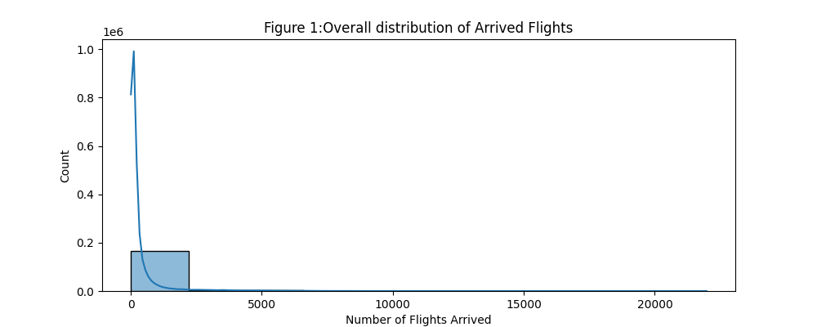

Exploratory Data Analysis (EDA) Discovering patterns and gain insights: 1. Univariate Analysis Examining individual variables
The x-axis represents the number of arrived flights, while the y-axis shows the counts. The distribution is highly skewed, with most airports having between 0 and 2,500 arrivals. The long tail indicates that a few airports have significantly higher arrival counts, suggesting the presence of outliers.

Slide 6
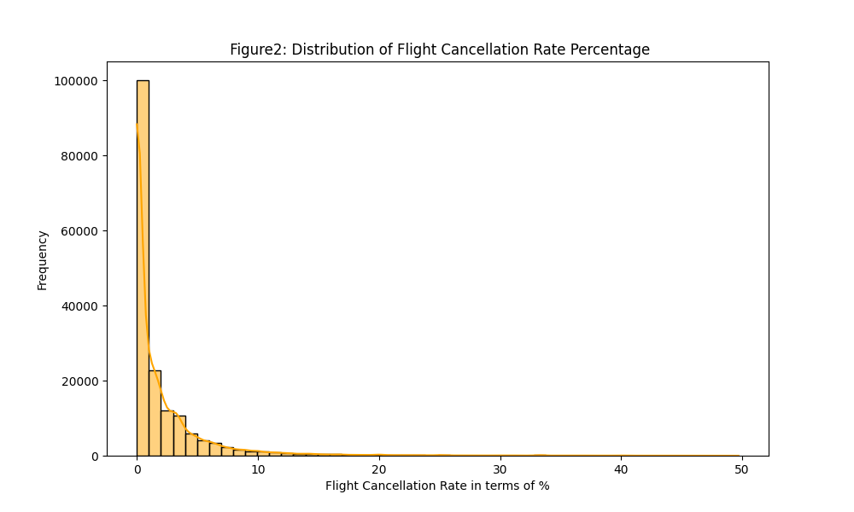
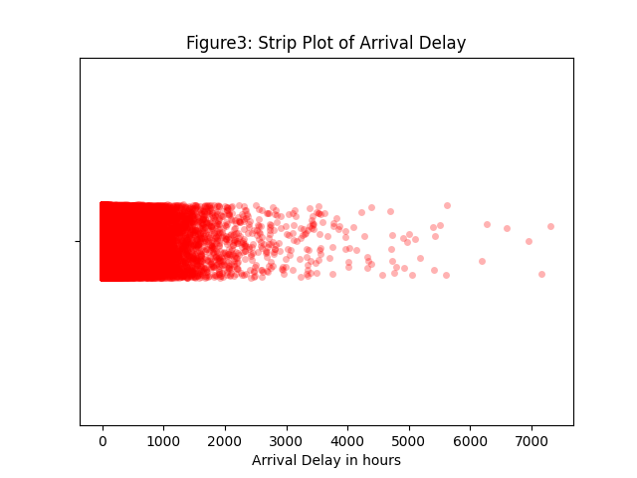
The distribution of canceled flights (Figure 2) is tightly skewed, with most airports having cancellation rates between 0% and 10%. However, the long tail indicates that some airports experienced cancellations of up to 50% in certain months. Similarly, Figure 3 shows that most arrival delays are concentrated between 0 and 1,000 minutes, with data becoming more scattered thereafter, suggesting the presence of outliers.

Slide 7
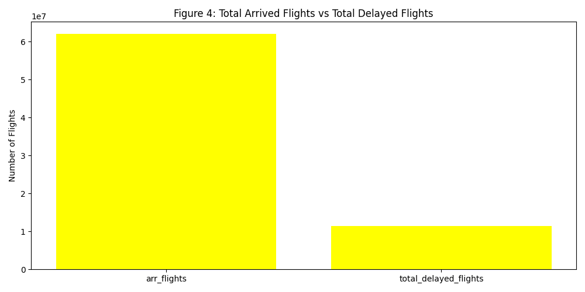
2. Bivariate Analysis Analyzing relationship between 2 variables
The bar for total arrived flights is taller because it includes every flight that landed, while the bar for delayed flights represents only those that were delayed. Since delays affect only a subset of flights, the count of delayed flights is naturally lower, confirming the data’s consistency and reflecting real-world flight operations.

Slide 8
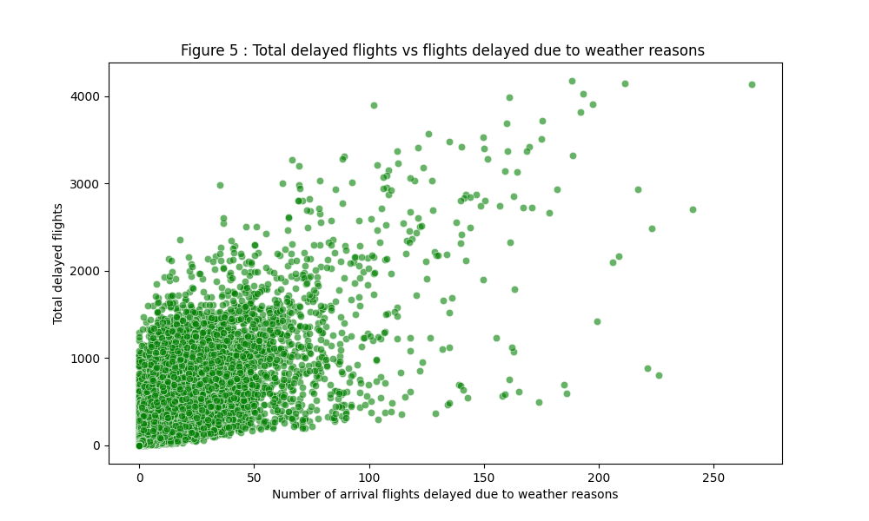
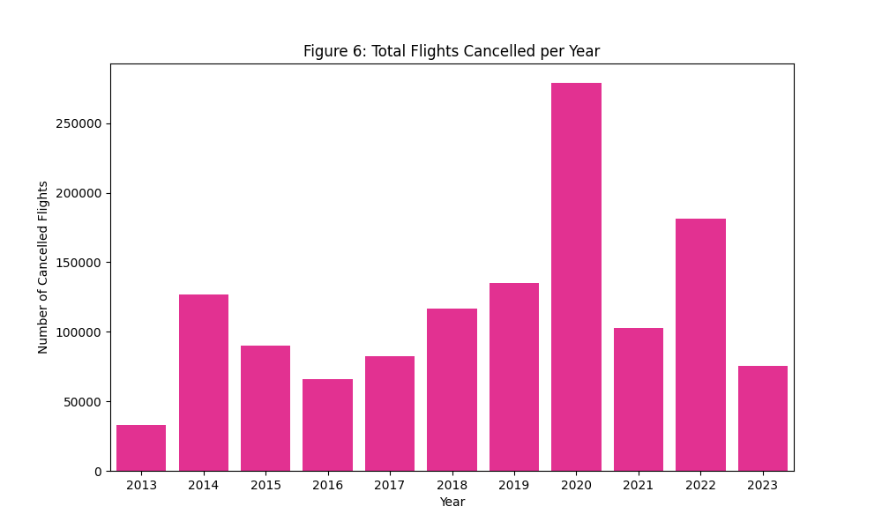
Figure 5 shows that most weather-related delays are concentrated between 0 and 50 flights on the x-axis and 0-1,000 flights on the y-axis, indicating that while weather delays are present, they are relatively low in most cases. Figure 6 highlights that the highest flight cancellations occurred in 2020, coinciding with the COVID-19 pandemic, which led to widespread travel restrictions, reduced demand, and heightened health concerns, resulting in a significant number of cancellations.

Slide 9
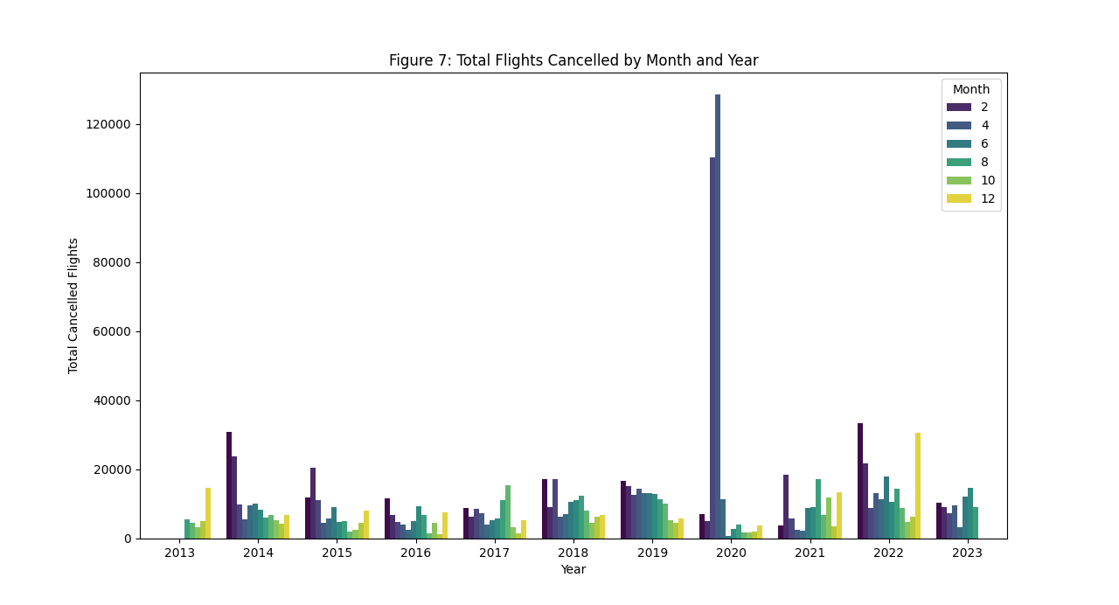
3. Multivariate Analysis Examining 3 or more variables to understand complex relationships
Figure 7 further confirms that the highest flight cancellations occurred in 2020, with a sharp peak in April, reflecting the severe impact of the early pandemic on flight operations. This aligns with the trends observed in Figure 6.

Slide 10
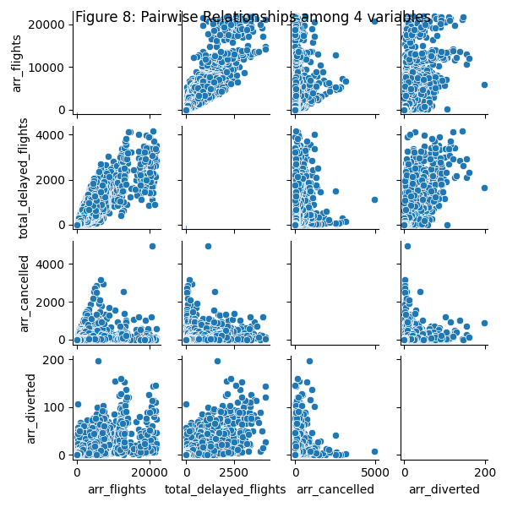
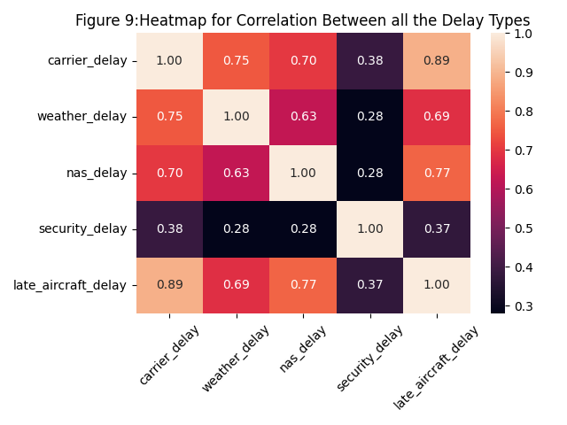
The pair plot provides a visual of the relationships between variables like total flights, delayed flights, cancellations, and diversions. It reveals general trends and weak to moderate correlations, such as a slight rise in cancellations and diversions as flight arrivals increase. The heatmap further explores the correlations among various delay types, with late aircraft delay showing a strong positive correlation with carrier delay, suggesting a link between delays from late arrivals and operational issues. Conversely, security delays have minimal correlation with the other delay types.

Slide 11
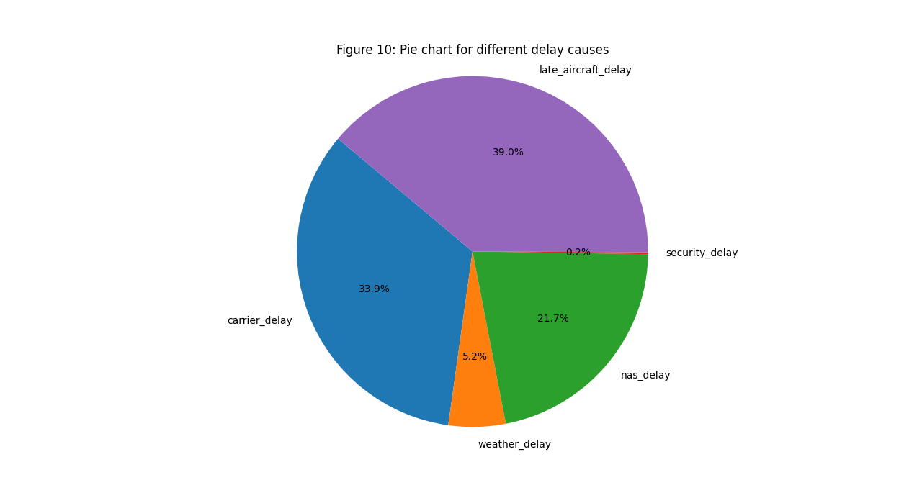
Meaningful insights from analysis
Figure 10 shows a pie chart that breaks down the causes of flight delays, with each slice representing a different factor: Carrier, Weather, NAS, Security, or Late Aircraft. The chart reveals that late aircraft arrivals are the primary cause of delays, taking up the largest portion, while security-related delays contribute the least, occupying the smallest slice.

Slide 12
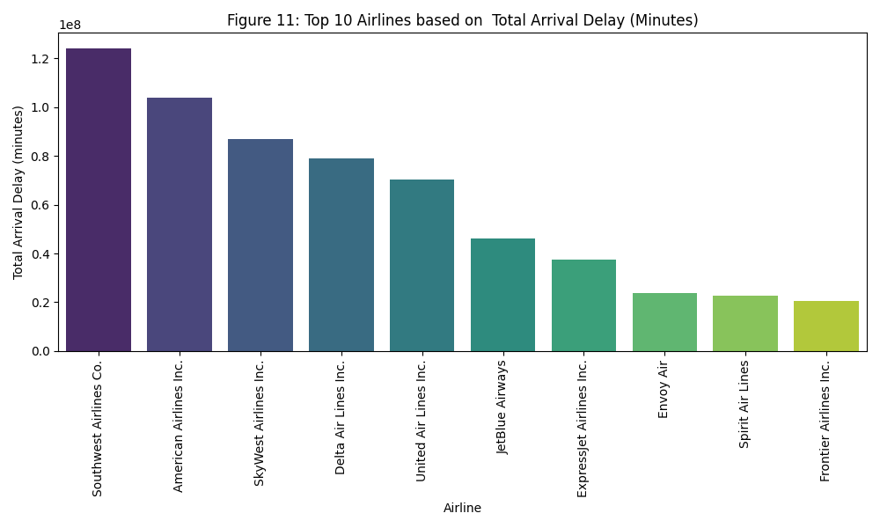
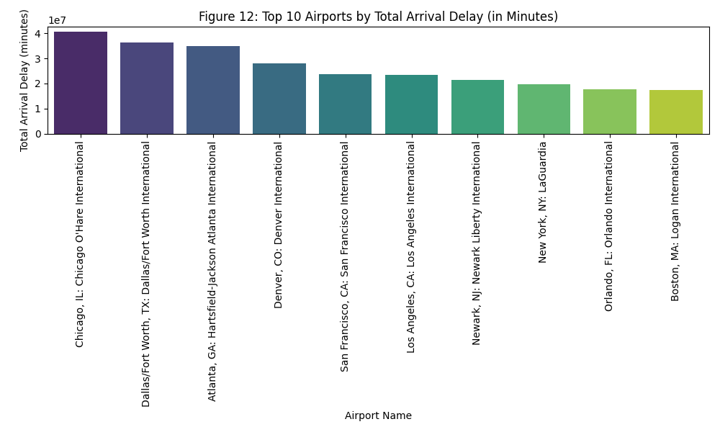
Figures 11 and 12 compare the top 10 airlines and airports with the highest total arrival delays in minutes. Figure 11 reveals that Southwest Airlines experiences the highest delays, suggesting areas for operational improvement. Meanwhile, Figure 12 highlights Chicago IL as the airport with the most significant arrival delays, helping identify key locations contributing to overall flight disruptions.

Slide 13
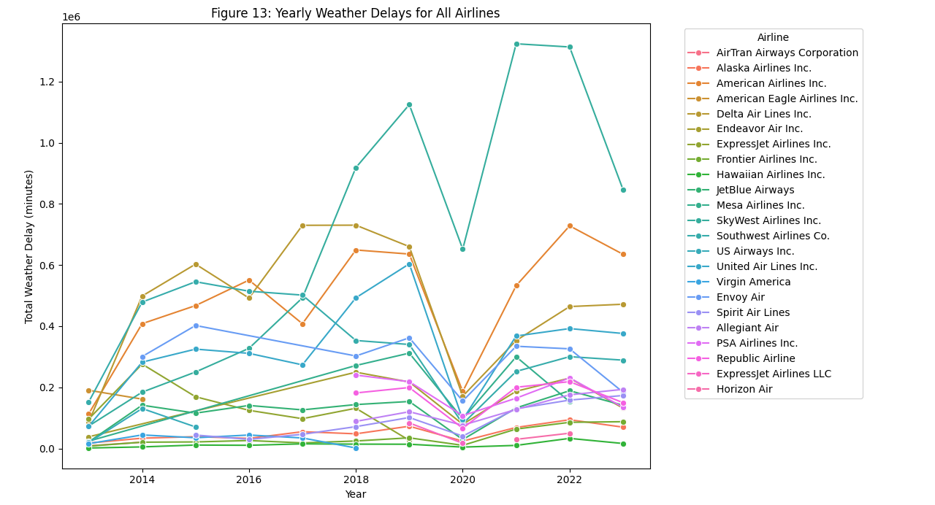
Yearly Weather Delays for All Airlines
Figure 13 displays a line graph showing the total weather-related delays for each airline over different years. Each colored line represents a specific airline, illustrating the variation in weather delay minutes over time.

Slide 14
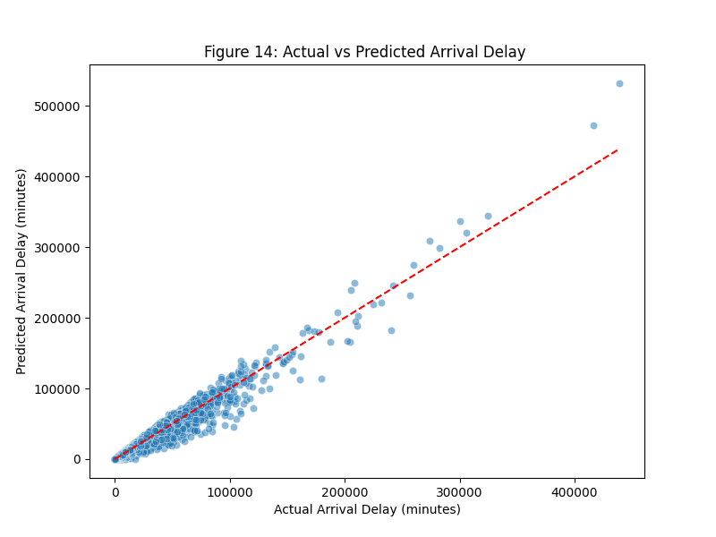
Predictive Modelling
Figure 14 shows a scatter plot where the points are close to the red dotted diagonal line, indicating that the predicted arrival delays align closely with the actual delays. This suggests that the model is accurately estimating flight delays for most of the data.

Slide 15
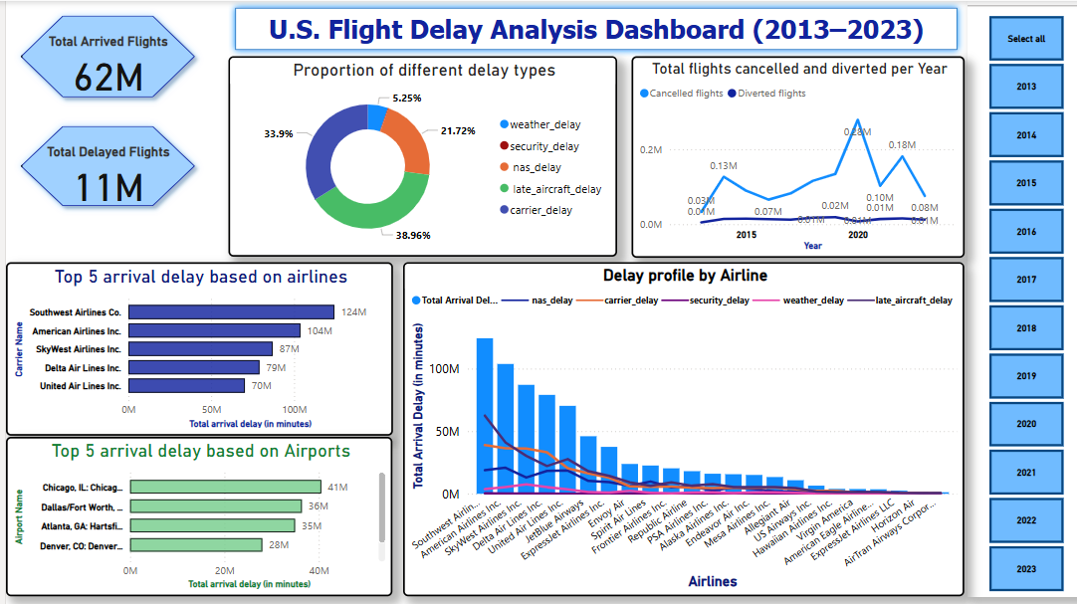
Visualization and Dashboard Development using Power BI

Slide 16
Dashboard Analysis
The dashboard features two key performance indicators (KPIs):Total Arrived Flights & Total Delayed Flights.
The pie chart shows the distribution of delay types, with Late Aircraft Delay contributing 39% and Carrier Delay accounting for 34% of total delay minutes. To improve punctuality, addressing late arrivals and enhancing internal airline operations is essential.
The bar charts reveal that Southwest Airlines and Chicago O'Hare International Airport had the highest arrival delays, primarily due to late aircraft and carrier-related issues.
The line chart shows a sharp increase in flight cancellations in 2020, mainly due to the COVID-19 pandemic, with occasional spikes from weather or technical issues. Flight diversions remained relatively consistent throughout the period.
The Line and Clustered Column Chart compares total arrival delays and their causes across airlines, showing that Late Aircraft Delay and Carrier Delay are the main contributors. Southwest Airlines had the highest delays, suggesting areas for targeted improvements in punctuality and service quality.
The Year Slicer helps to filter and analyze the data across a specific time frame, from 2013 to 2023

Slide 17
Improvement Strategies
Enhancing Efficiency: Streamlining processes and using real-time data can reduce delays caused by late aircraft and carrier issues, improving punctuality.
Collaboration: Collaboration between airlines, airports, and air traffic control can mitigate disruptions and improve overall operations.
Weather Forecasting: Better weather predictions help airlines anticipate and manage weather-related delays more effectively.
Crew Management: Automating crew scheduling and resource allocation reduces human error and enhances operational efficiency.
Customer Communication: Real-time updates via apps and SMS can reduce passenger frustration during delays and improve customer experience.

Slide 18


