Slide 1


Data Insights and Trends:-
By : Deepti Chaudhary

Slide 2

Introduction -Purpose of the data set .
Data cleaning process -step taken .
Data set overview -key attributes and distribution .
Weather and time trends.
Final summary .

Slide 3


Intro-Cleaned data overset…
This presentation summarizes a dataset related to time-based weather conditions.
The data set originally contained rental data ,which has been removed .
Key attributes include date , season ,weather conditions , and temperature trends .
Understand trend and influencing factors in the dataset.

Slide 4
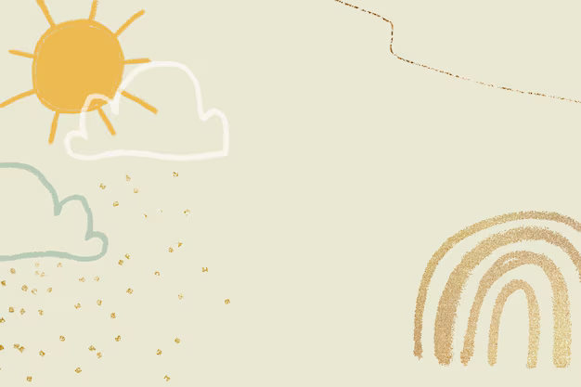
Cleaning Process :-
Standardized date format for consistency .
Merged two dataset into one .
Removed columns (season, yr,instant , unnamed= 0)
Handled missing values in the “atemp” column by filling with ‘Mean’.
Ensured there is no duplicate records.

Slide 5

Feature description
dteday:- Date of observation
mnth: -Month of the year (1-12)
hr:- Hour of the day (0-23)
holiday: -Boolean flag for holidays
weekday: -Day of the week (0-6)
weathersit:- Categorical weather condition (1-4)
temp: Normalized temperature
atemp: Normalized feeling temperature
hum: Normalized humidity
windspeed: Normalized wind speed

Slide 6

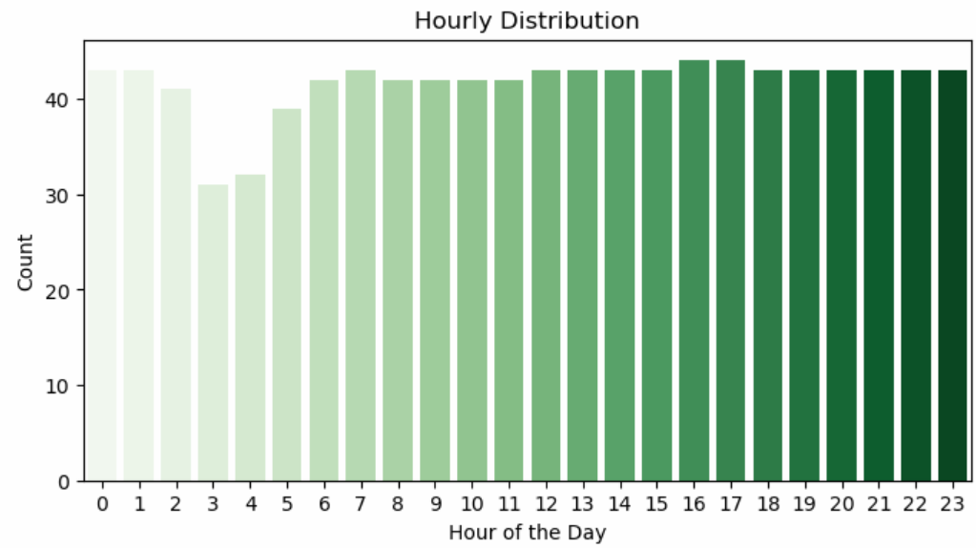
Hourly Distribution
The hourly distribution graph shows the count of recorded data points for each hour of the day (0–23). This helps in understanding how different factors (such as weather, holidays, and time) vary across different hours.
Holidays and weekends might show different hourly trends compared to weekdays.

Slide 7
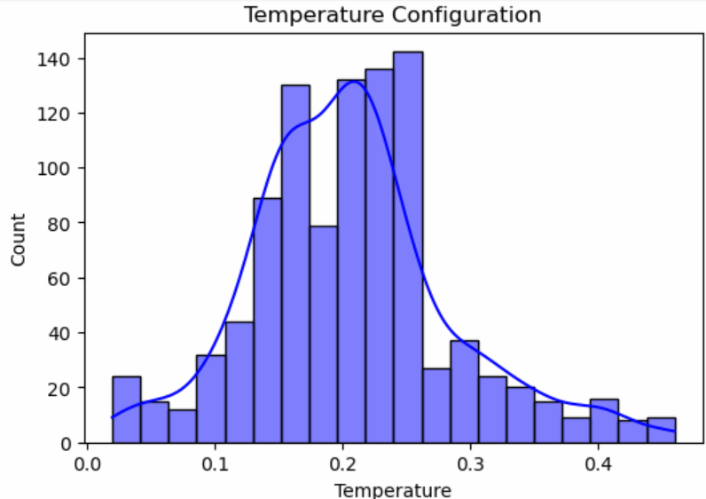
Temperature Config.
The dataset includes a normalized temperature (temp) column, which represents temperature on a scale from 0 to 1. This value corresponds to actual temperatures but has been scaled for easier analysis. There is also a feels-like temperature (atemp) column, which accounts for perceived warmth based on humidity and wind.

Slide 8
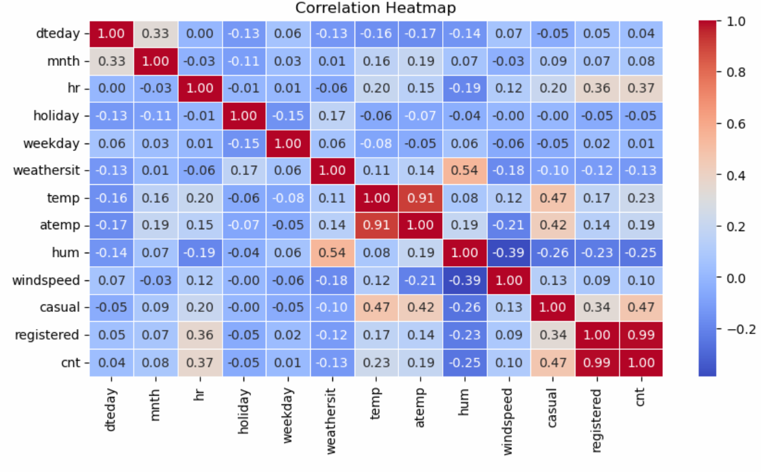
Correlation Heatmap
A correlation heatmap visually represents the relationships between different numerical variables in the dataset. It uses color intensity to show the strength and direction of correlations.
Darker shades (red/blue) indicate stronger correlations.
Lighter shades (closer to white) indicate weaker or no correlation.

Slide 9

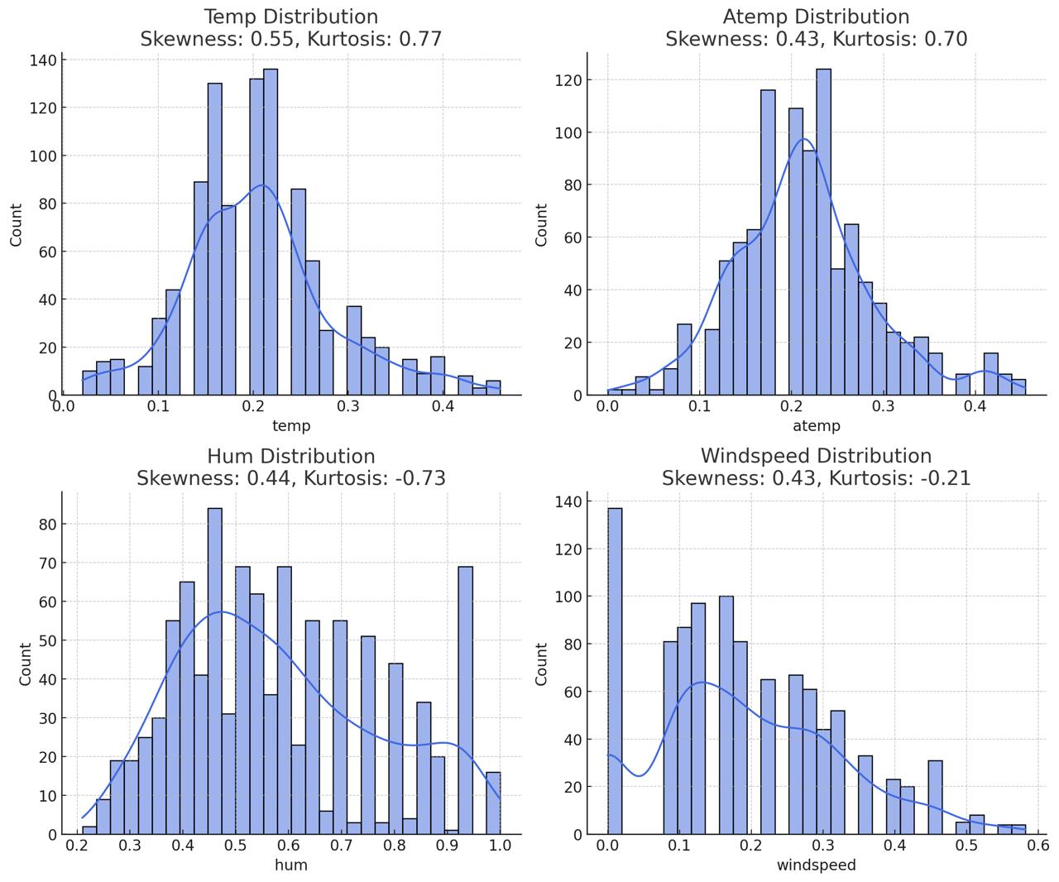
Skewness and kurtosis for numerical attributes :-
Temperature (temp):- skewness = 0.55 , kurtosis = 0.77.
Apparent temp :-skewness=0.43 , kurtosis = 0.70.
Humidity :- skewness =0.44,
kurtosis = -0.73.
Windspeed :- skewness= 0.43, kurtosis = -0.41.

Slide 10
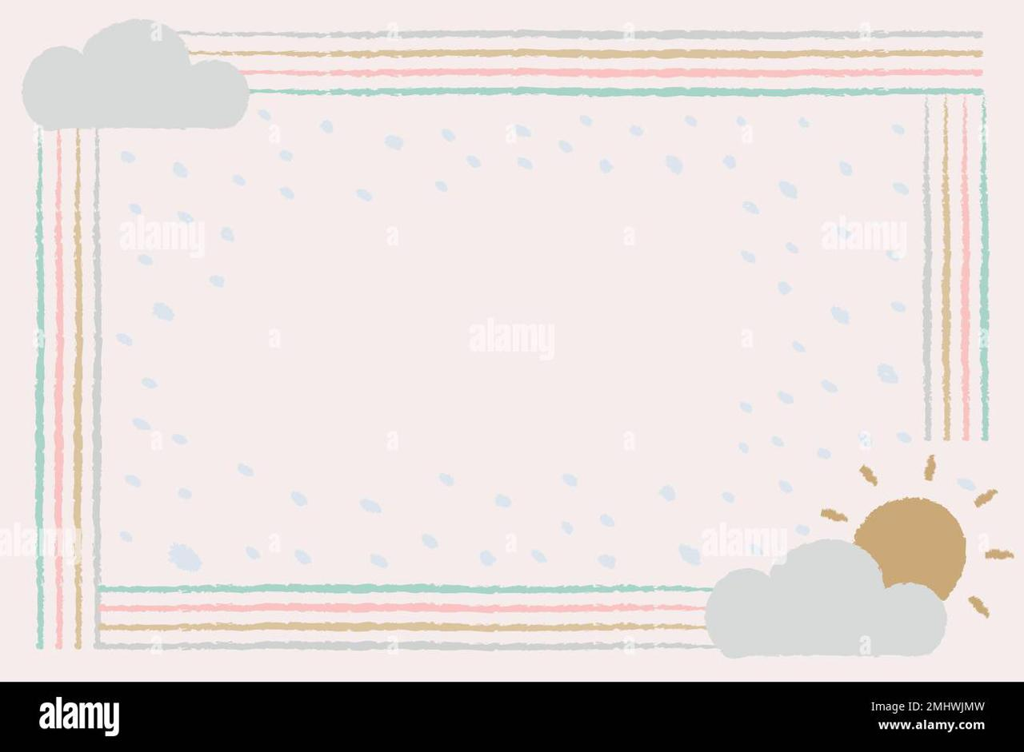
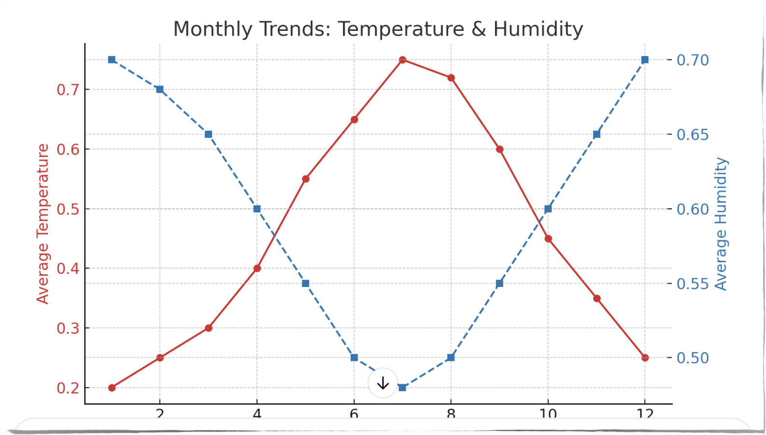
IQR
Temperature (temp):
Q1: 0.16
Q2 (Median): 0.20
Q3: 0.24
Apparent Temperature (atemp):
Q1: 0.1667
Q2 (Median): 0.2121
Q3: 0.2576
Humidity (hum):
Q1: 0.44
Q2 (Median): 0.55
Q3: 0.70
Windspeed (windspeed):
Q1: 0.1045
Q2 (Median): 0.1642
Q3: 0.2836

Slide 11

Weather and time trends:-
Temperature trend :- varies by season and higher in summer.
Humidity and windspeed:-Show moderate fluctuation.
Weather shift’s :-some hour’s have different weather pattern’s.
Line chart showing variations in enviornmental condition over time
Breakdown plots shows relationships btw them, hum and windspeed.

Slide 12
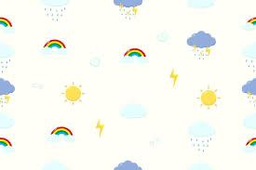
My Understanding
Dataset cleaning & merging.
Graphical Representation on different scenarios.
Dropping extra and null values.
Correlation and visualization of the dataset.
How to make predictive modeling.

Slide 13
Knowledge Hub :
Geeksforgeeks for data merge/concatenation and cleaning.
Online Tutorial about graphical representation and heatmaps.
Python documentation and Libraries.

Slide 14


