Slide 1

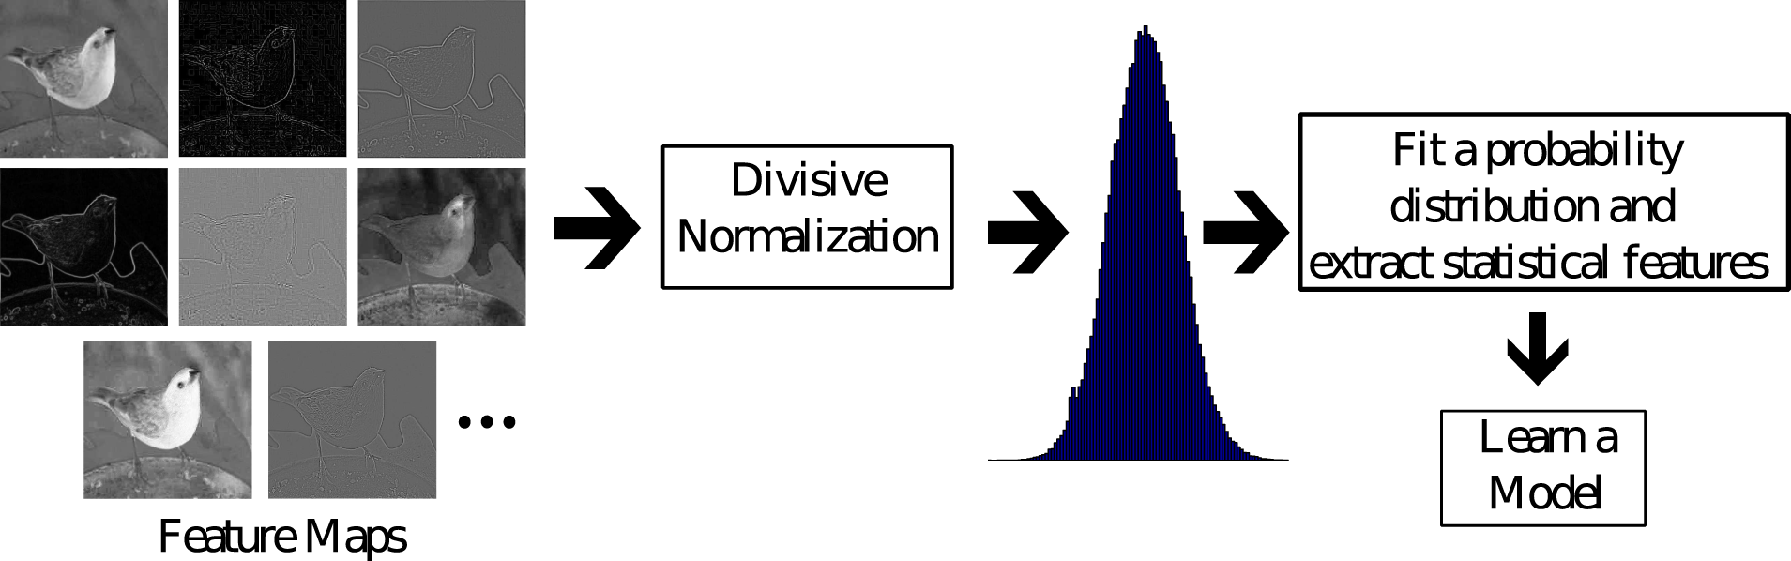
From: Perceptual quality prediction on authentically distorted images using a bag of features approach
Journal of Vision. 2017;17(1):32. doi:10.1167/17.1.32
Figure Legend:
Our proposed model processes a variety of perceptually relevant feature maps by modeling the distribution of their coefficients (divisively normalized in some cases) using GGD (in real or complex domain), AGGD, or wrapped Cauchy distribution and by extracting perceptually relevant statistical features that are used to train a quality predictor.
Date of download: 9/5/2020
The Association for Research in Vision and Ophthalmology Copyright © 2020. All rights reserved.

