Slide 1
Customer segmentation analysis
INSIGHTS and RECOMMENDATIONS

Slide 2
Introduction
RFM analysis, or Recency, Frequency, Monetary Value, is a data-driven method for segmenting customers and targeting them based on their behavior. RFM analysis scores customers based on three factors:
Recency: How recently a customer made a purchase
Frequency: How often a customer shops during a specific period
Monetary value: How much a customer spends
We will be analyzing online retail data from a superstore dataset to understand purchasing behavior and optimize marketing strategies.

Slide 3
Data Overview and Cleaning
There are 541909 entries and 8 columns. The columns Description and CustomerID have missing values
Due to the size of the dataset, I removed the rows with null values using dropna() to ensure data integrity.
Outliers were identified and removed using IQR method to maintain data reliability.
After cleaning, the dataset reduced to 541909 records ready to start the RFM calculations.

Slide 4
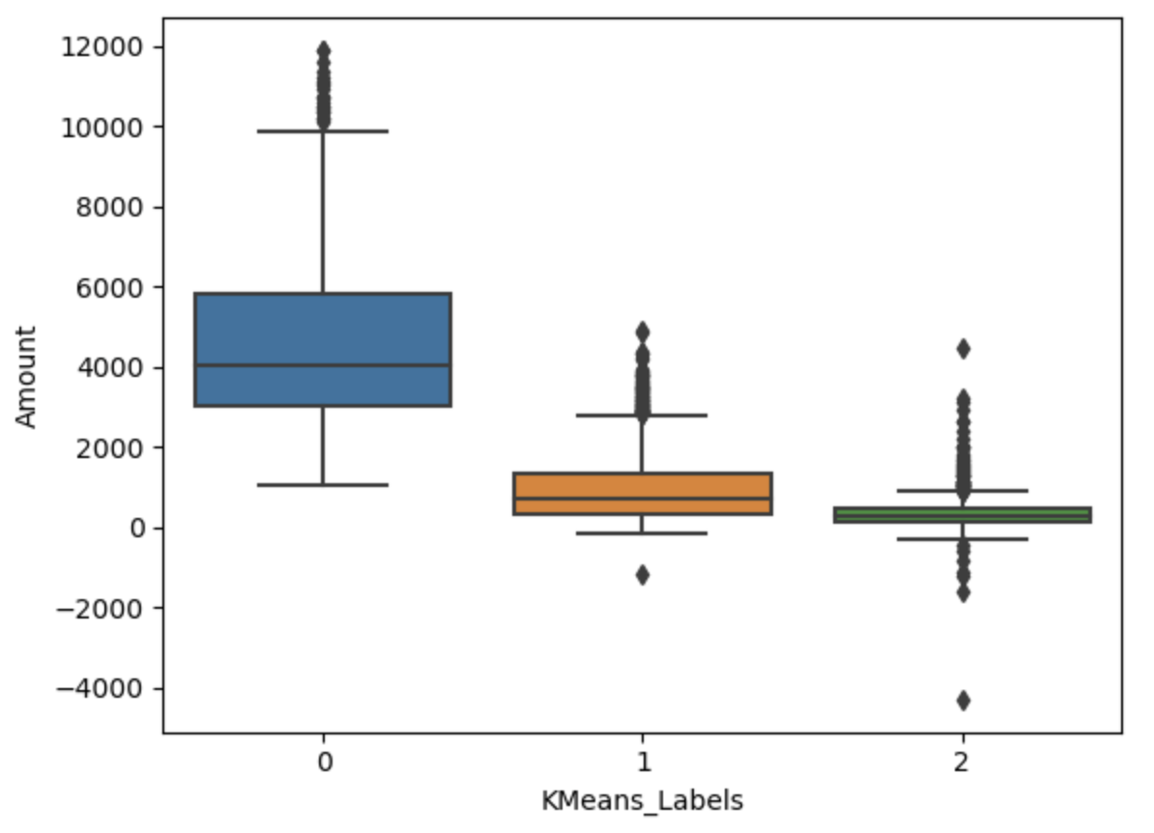
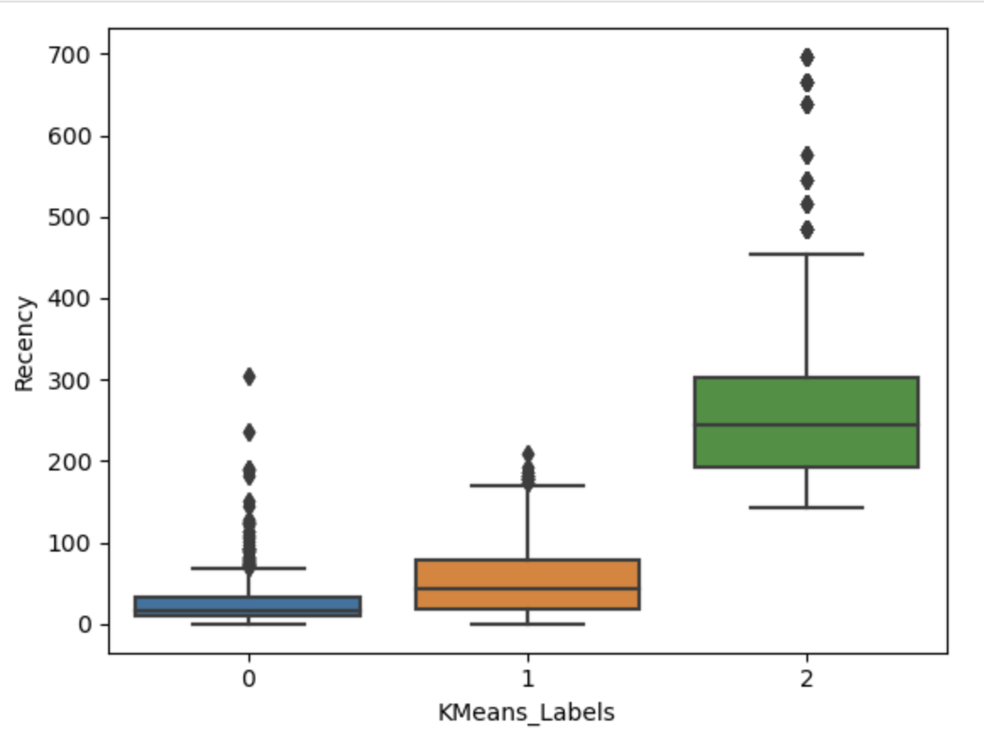
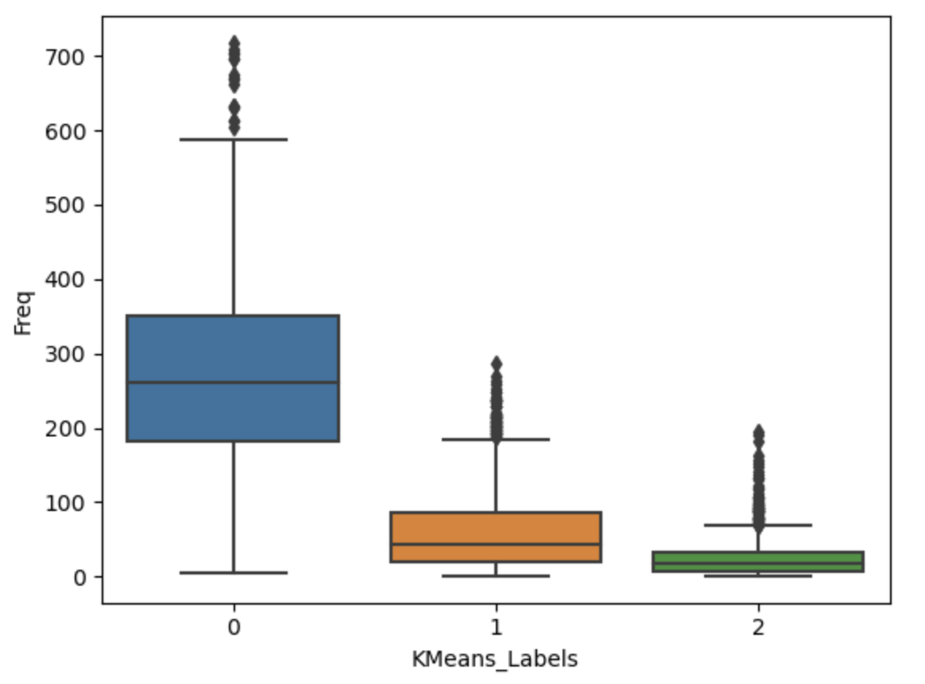
RFM Analysis and Clustering
Segmented customers based on Recency, Frequency and Monetary Value (RFM) to identify behavior patterns.
Utilized K-means clustering on scaled RFM scores to categorize customers into distinct groups.
Cluster 0: Customers who spent the most and frequently visited the store.
Cluster 1: Customers who also didn’t visit recently and don’t visit often and spend less.
Cluster 2: Customers who rarely visited the store but have visited recently but didn’t spend any money.

Slide 5

Recommendations
Based on findings, it can be recommended to implement personalized marketing for high-value segments and enhancing loyalty programs for occasional buyers.
To increase the revenue, we can focus more on people in Cluster 0.

