Slide 1
BAN 612 DATA ANALYTICS PROJECT : DATA JOBS WEB SCRAPING AND ANALYSIS
-DEEPTI KULKARNI

Slide 2
Agenda
Problem Statement
Data Source
Methods Used to Scrape Data
DataFrame Formation
Results: DataFrame Excel Output
Analysis: Individual
Conclusion

Slide 3
Problem Statement
Web Scraping for the jobs in Data Analytics field
Clean and organize the data
Define your own skills and get a Data Frame of the jobs that matches to your skills.
Notes:
Updated by Neha

Slide 4
Data Source
Source – Indeed API Python Client Library.

Slide 5
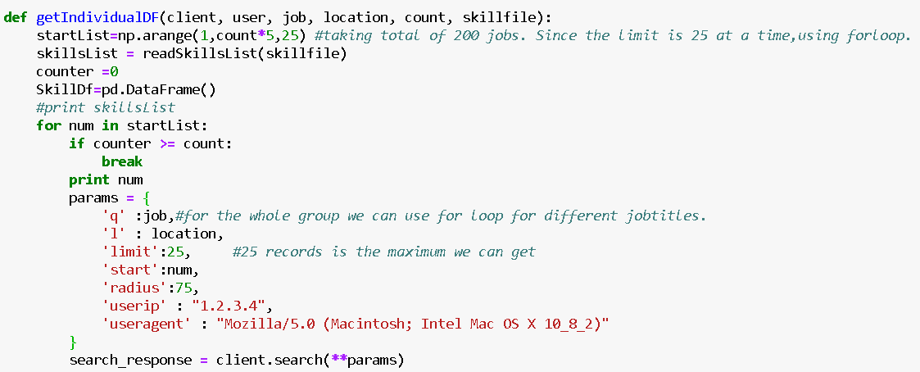
Methods Used to Scrape Data
Notes:
Updated by Neha

Slide 6
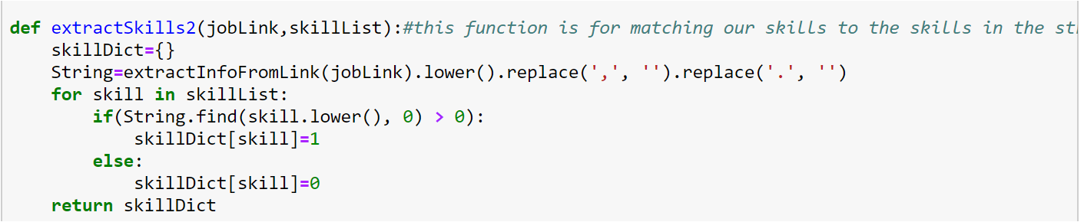
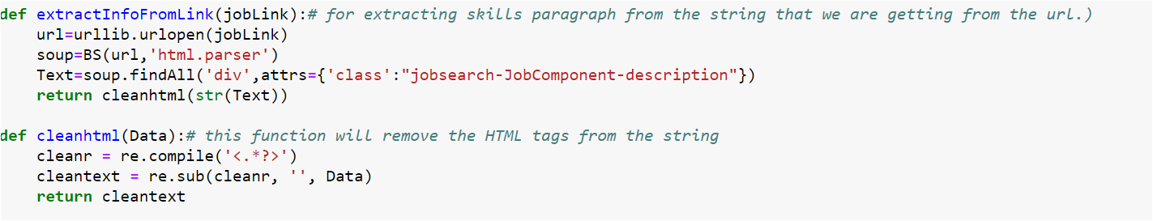
Methods Used to Scrape Data
Notes:
Updated by Neha

Slide 7
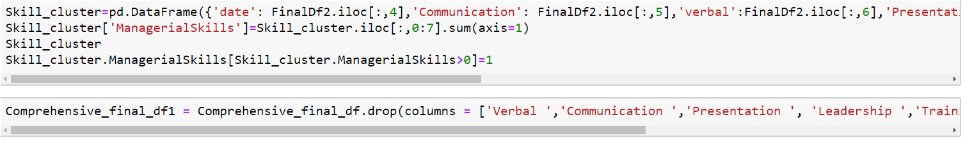
Cleaning Data
Notes:
Updated by Neha

Slide 8
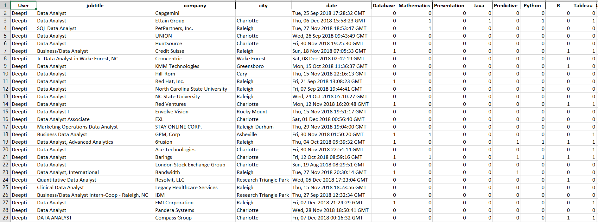
DataFrame Excel Output

Slide 9
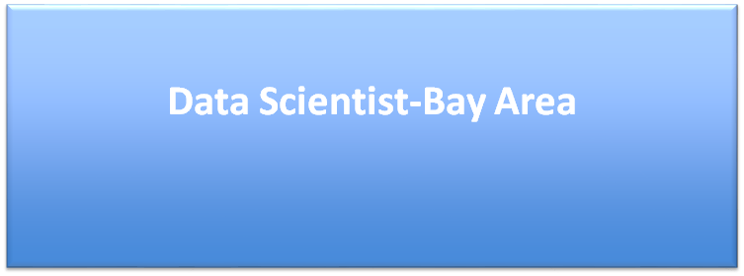

Slide 10
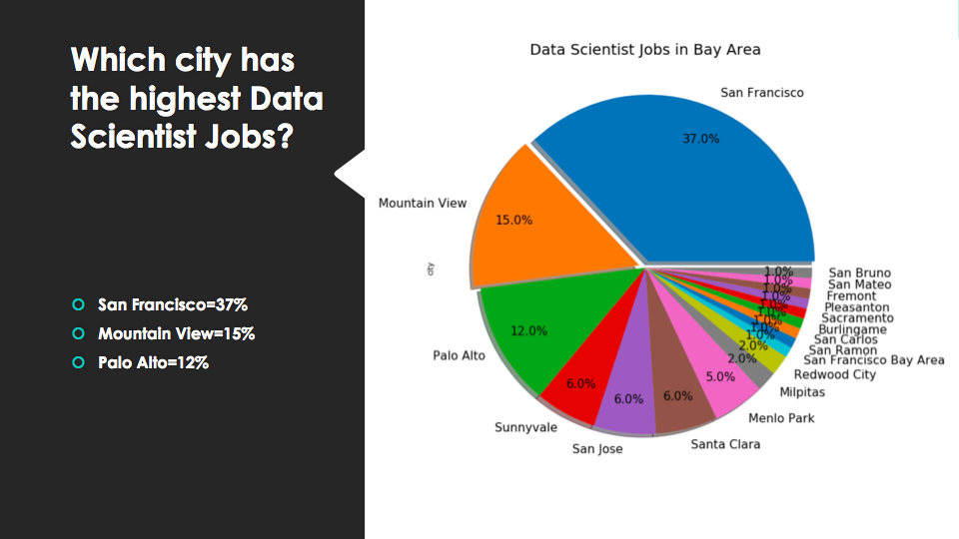

Slide 11
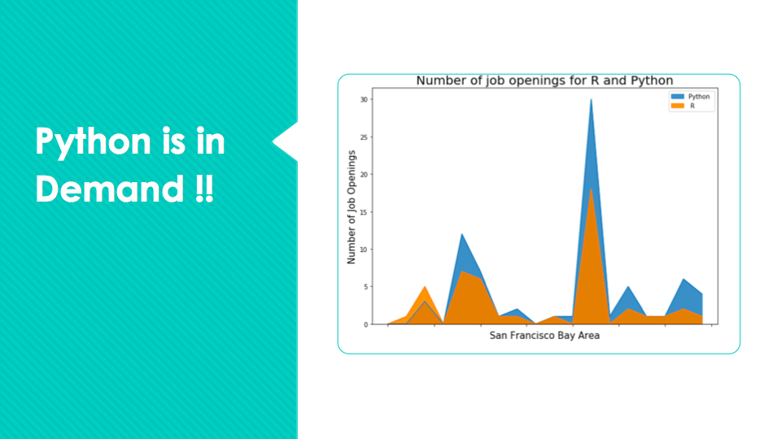

Slide 12
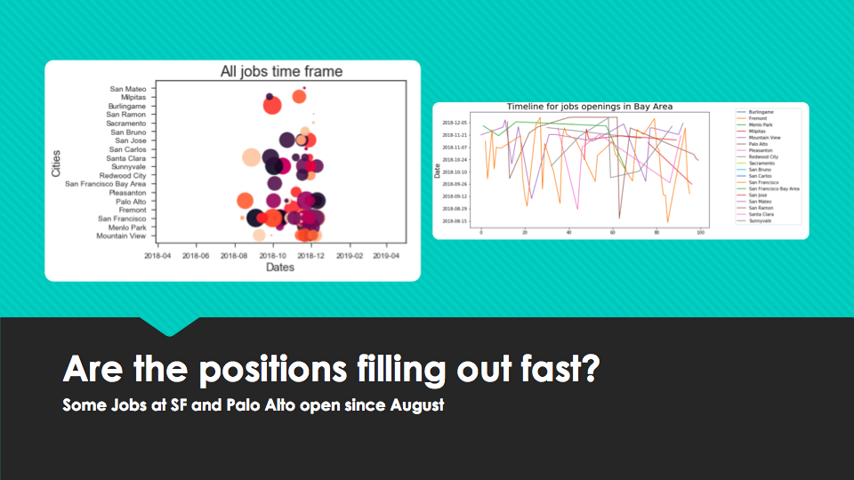

Slide 13
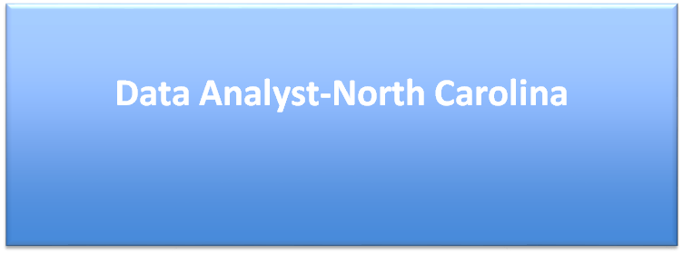

Slide 14
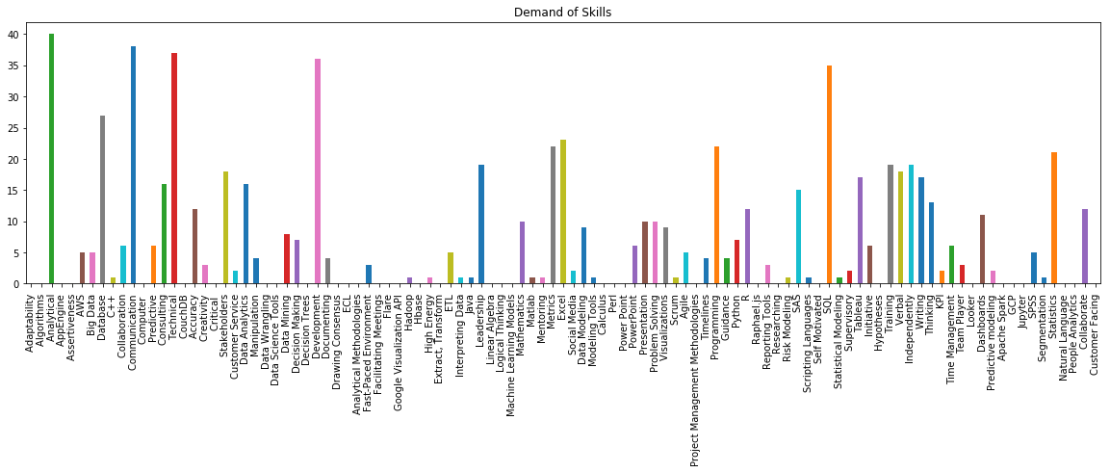
Most demanding skills in North Carolina

Slide 15
From previous chart we can say that, Top 4 demanding skills for data analyst jobs in North Carolina are :
Analytical
Communication
Technical
SQL

Slide 16
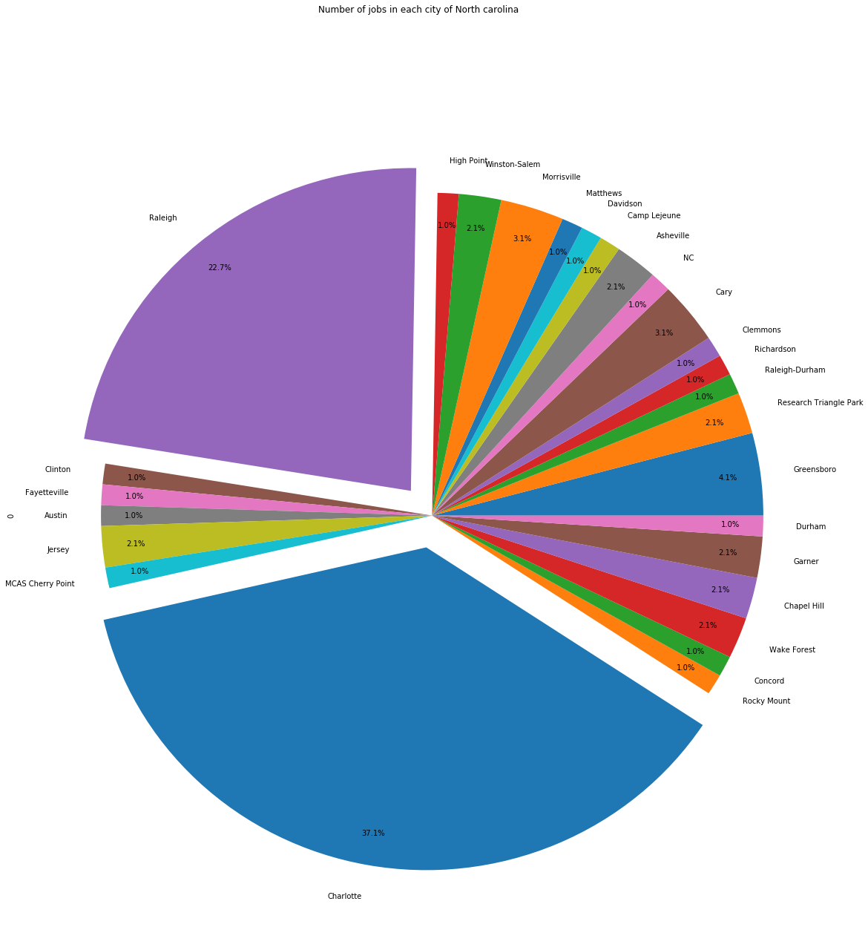
Number of jobs in each city of NC
Top 2 cities in NC with more Data Analyst Jobs are:
Charlotte- 37.1 %
Raleigh – 22.7 %

Slide 17
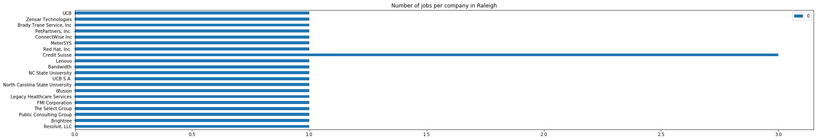
Number of jobs per company in Raleigh, NC
More job openings for Data Analyst in Raleigh are in Credit Suisse

Slide 18
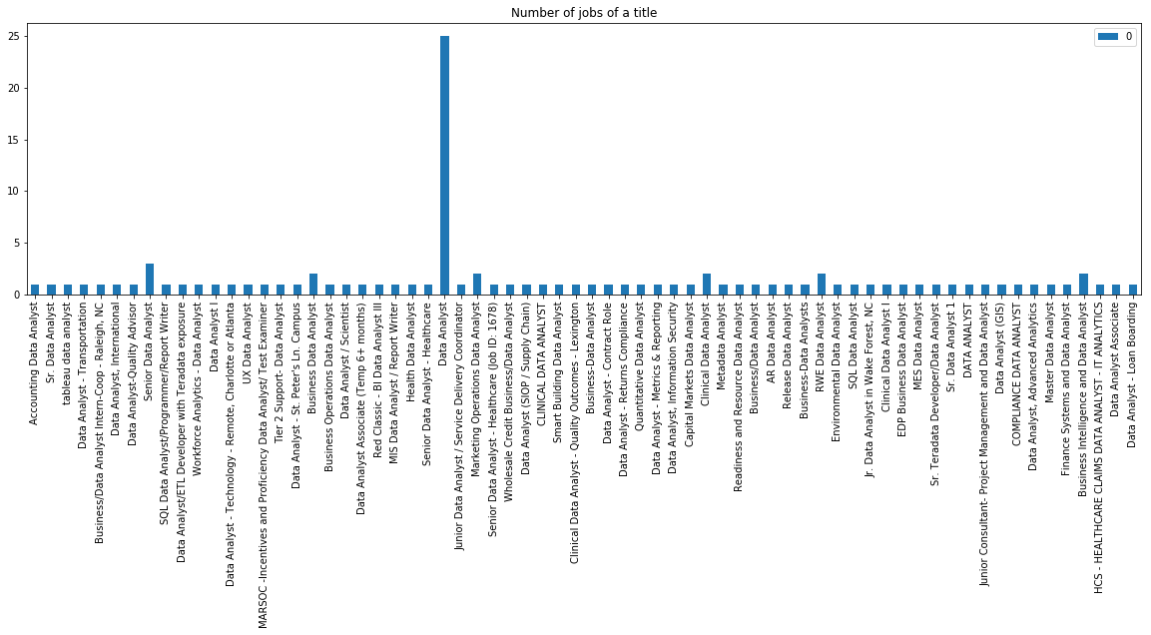
Most Popular Job Title in NC
Most popular keyword for job opening is Data Analyst

Slide 19
Conclusion
Most sought after skills are Analytical, SQL in North Carolina.
Analytical skill is the most searched word for finding resumes and jobs & Most popular keyword of Job Title is Data Analyst.
Top 2 cities to search Data Analyst jobs in North Carolina are Charlotte and Raleigh

Slide 20
Thank You
Questions and Feedback!

